Slide 1
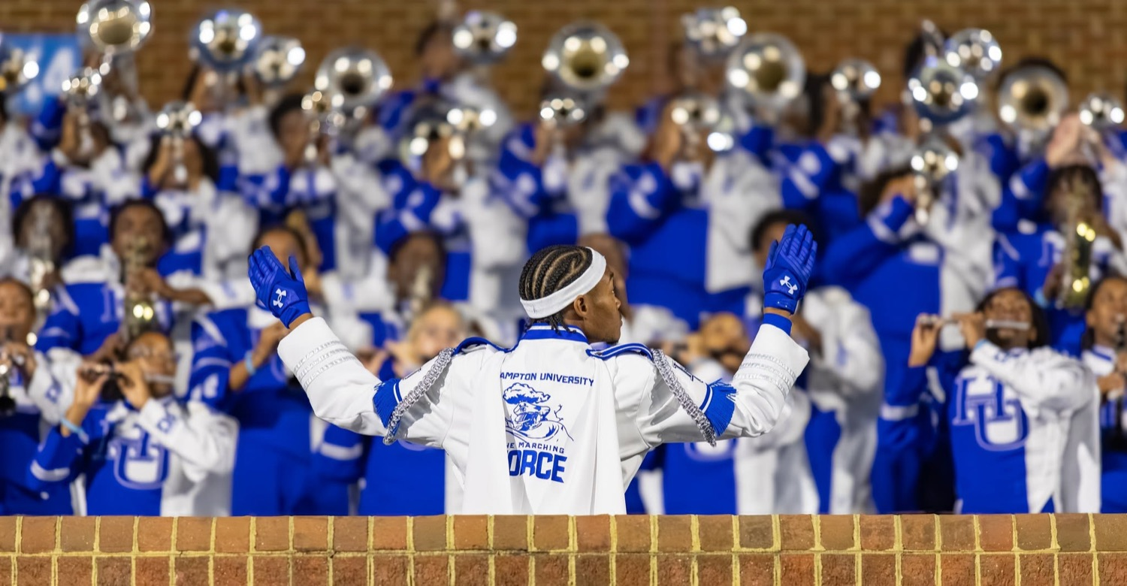
PRE-DRILL CAMP 2026 · LEADERSHIP SEMINARS · DAY 2
Day 2 Close
"Last Out."
Dr. Thomas L. Jones, Jr. and the Captains
All Leaders · Sunday, August 2, 2026
The Hampton University Marching Force
Hampton's Heartbeat
Notes:
SLIDE 1 — TITLE: Day 2 Close, "Last Out"
THE FINAL SESSION OF ALL 22. Dr. Jones and the Captains.
Hold the room. Nobody packs up.
SAY: "Yesterday we took First In. Tonight we finish the creed."

Slide 2
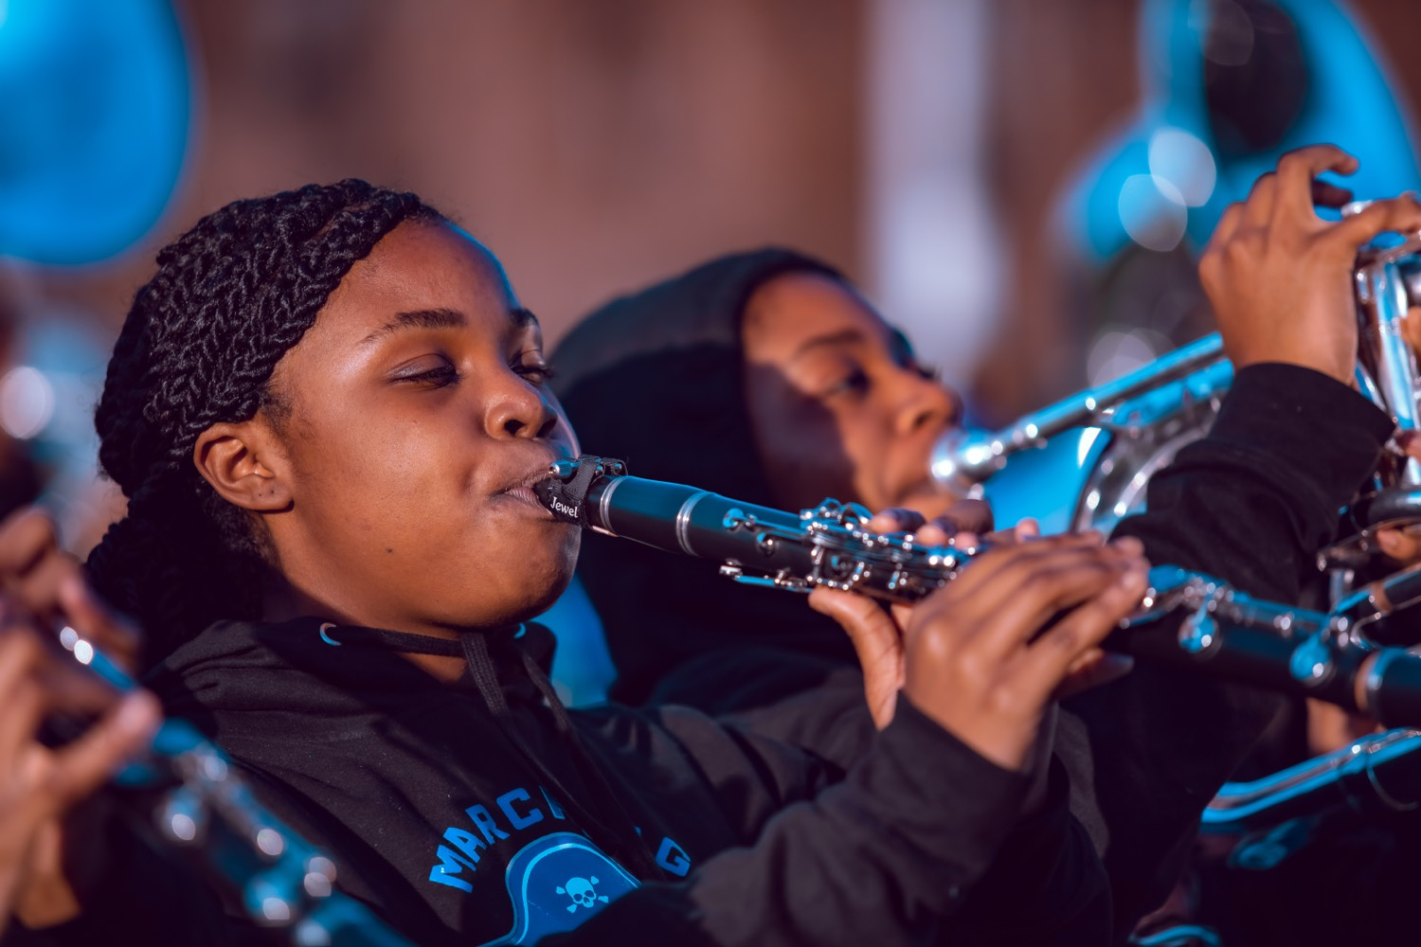
— DAY 2 CLOSE
THE HAMPTON UNIVERSITY MARCHING FORCE
Icebreaker
Carl Brashear lost a leg, and the Navy moved to retire him. To stay a diver he had to walk twelve steps in a 290-pound rig, in front of a room that expected him to fall. Watch a man finish something after he has been handed every reason to quit. That is what Last Out looks like.
▶
Men of Honor — “12 Steps”
youtu.be/QhCISxbO7rg
WATCH · 2:42
Pre-Drill Camp 2026 · Leadership Seminars
02
Notes:
SLIDE 2 — ICEBREAKER: Men of Honor, "12 Steps" (2:42)
SET UP: "Carl Brashear lost a leg. The Navy moved to retire him. To stay a diver he had to walk twelve steps in a 290-pound rig, in front of a room that expected him to fall."
Play it. Do not talk over it.
AFTER: "He finished after he'd been handed every reason to quit. That is Last Out."

Slide 3

01
THE PREMISE
Yesterday we said First In: you arrive before your people, ready, and you set the tone before anyone else walks in. Tonight we finish it. Last Out is the harder half, because nobody claps for it. It is the equipment you put away when the crowd is gone, the member you wait on in a dark parking lot, and the standard you hold at the end of a long day when it would be easy to let it slide. Anybody can start well. Leaders finish.
FIRST IN. LAST OUT.
Notes:
SLIDE 3 — THE PREMISE (statement slide)
Read it.
THE LINE: "Last Out is the harder half, because nobody claps for it."
Takeaway: "First In. Last Out."

Slide 4
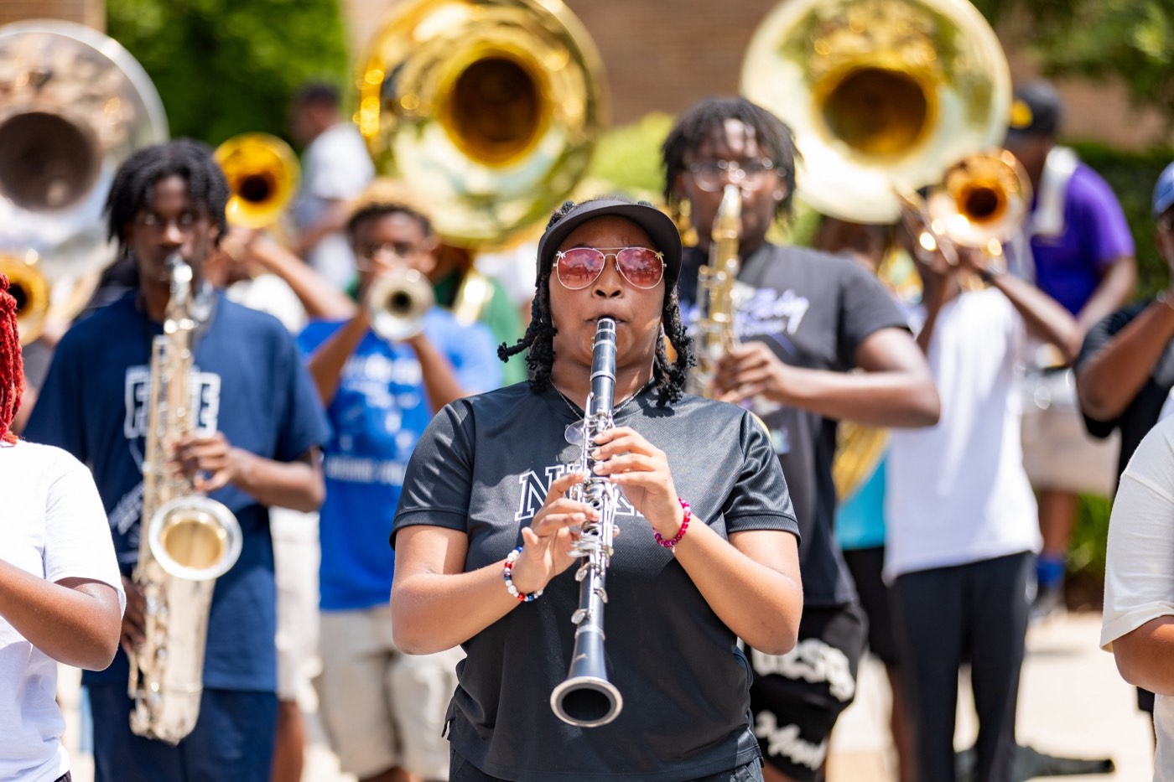
— DAY 2 CLOSE
THE HAMPTON UNIVERSITY MARCHING FORCE
The Creed, Complete
Two halves of one standard—and you do not get to pick just one.
Being first in is about readiness. Being last out is about responsibility. Together they are the whole job.
Pre-Drill Camp 2026 · Leadership Seminars
04
Notes:
SLIDE 4 — THE CREED, COMPLETE
Both halves side by side. Point to Day 1 on the left, Day 2 on the right.
"First in is about READINESS. Last out is about RESPONSIBILITY. Together they're the whole job."
Have the room say the creed out loud together. Twice.

Slide 5
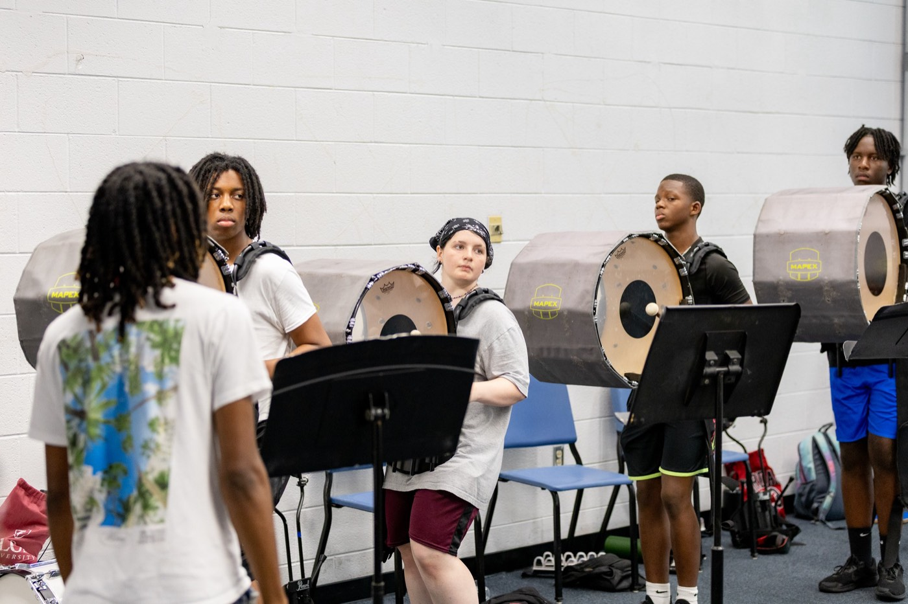
— DAY 2 CLOSE
THE HAMPTON UNIVERSITY MARCHING FORCE
Last Out: The Space
Leave every place better than the Force found it.
◆ beforements secured, equipment accounted for, uniforms handled, trash picked up—before you think about leaving.
◆ The band room, the practice field, the bus, the hotel, and the stadium all carry our name after we walk away.
◆ Do the sweep yourself. A leader who supervises the cleanup from the doorway is not last out; he is just last to leave.
◆ You decide which.ere not there can tell we were, that is either a compliment or an indictment. You decide which.
Pre-Drill Camp 2026 · Leadership Seminars
05
Notes:
SLIDE 5 — LAST OUT: THE SPACE
"Leave every place better than the Force found it."
Band room, practice field, bus, hotel, stadium.
THE DISTINCTION: "A leader who supervises the cleanup from the doorway is not last out. He's just last to leave."
"When people who weren't there can tell we were, that's either a compliment or an indictment. You decide which."

Slide 6
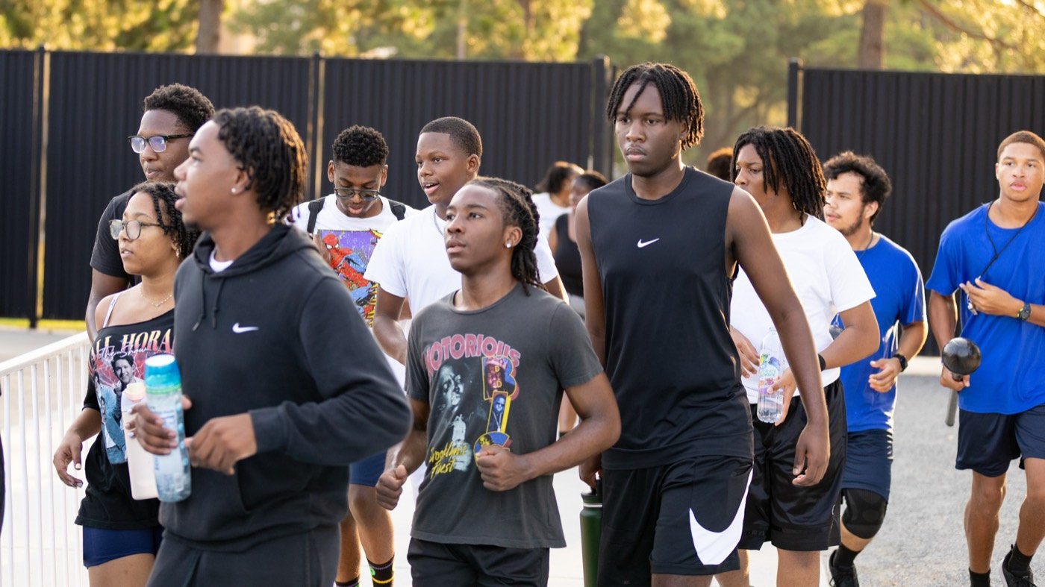
— DAY 2 CLOSE
THE HAMPTON UNIVERSITY MARCHING FORCE
Last Out: The People
Nobody in your line walks out alone.
◆ Account for every member before you go. Know who is still on the field, who is waiting on a ride, and who left upset.
◆ those are the ones you stay for.ep, the member who got corrected hard, the one who went quiet—those are the ones you stay for.
◆ Walk out together. Nobody crosses a dark campus by themselves, and nobody sits alone in a parking lot waiting.
◆ somebody was looking out for them.g your people feel from you is that somebody was looking out for them.
Pre-Drill Camp 2026 · Leadership Seminars
06
Notes:
SLIDE 6 — LAST OUT: THE PEOPLE
The one that matters most. Slow down.
"Account for every member before you go. Who's still on the field, who's waiting on a ride, who left upset."
"The freshman struggling, the member who got corrected hard, the one who went quiet — those are the ones you stay for."
"Nobody crosses a dark campus alone. Nobody sits in a parking lot waiting by themselves."

Slide 7
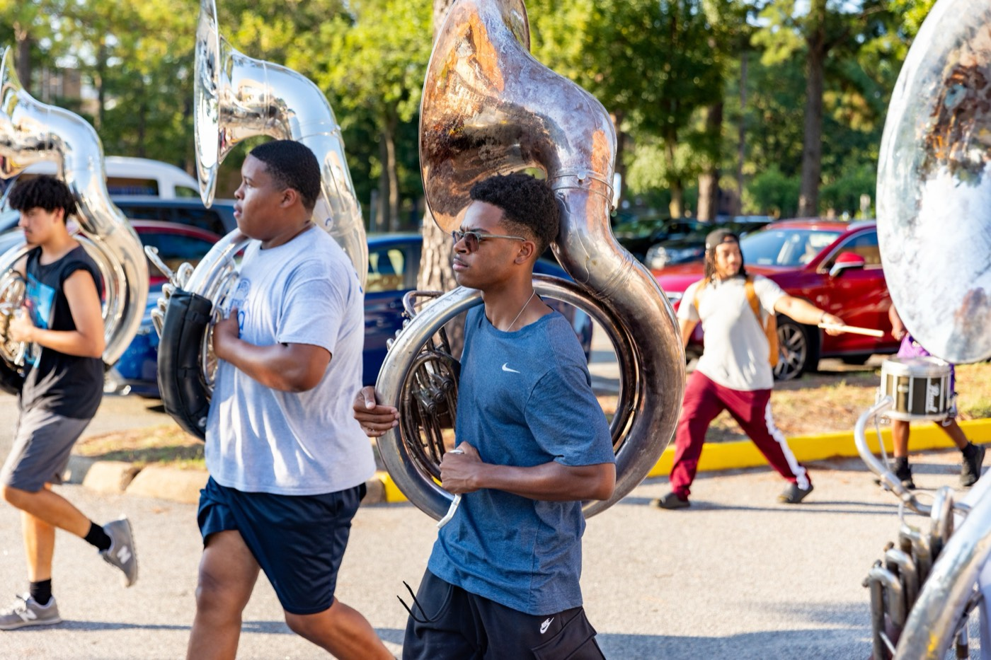
— DAY 2 CLOSE
THE HAMPTON UNIVERSITY MARCHING FORCE
Last Out: The Standard
It holds when nobody is watching, or it never held at all.
◆ what you allow at the end of itnounce at the start of rehearsal. It is what you allow at the end of it, when everyone is tired.
◆ Finish clean.of a long day is where programs are actually built or quietly lost. Finish clean.
◆ Hold the line on the small things late: the uniform detail, the phone in the rehearsal, the corner nobody would notice.
◆ You are the standard when he is not in the room.ly why you exist. You are the standard when he is not in the room.
Pre-Drill Camp 2026 · Leadership Seminars
07
Notes:
SLIDE 7 — LAST OUT: THE STANDARD
"The standard isn't what you announce at the start of rehearsal. It's what you ALLOW at the end of it, when everybody's tired."
"The last rep of a long day is where programs get built or quietly lost."
LAND IT ON THEM: "The director can't be everywhere. That's exactly why you exist. You are the standard when he's not in the room."

Slide 8
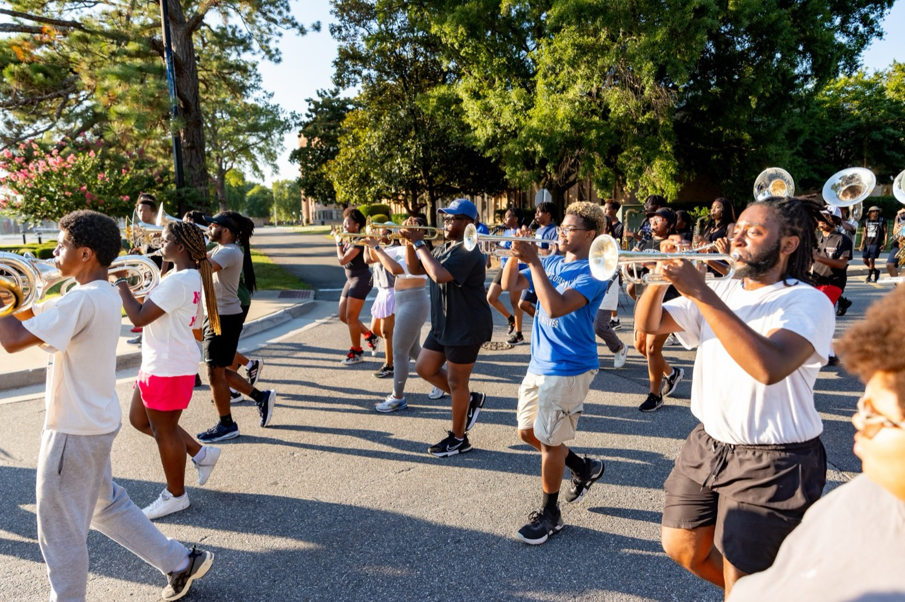
— DAY 2 CLOSE
THE HAMPTON UNIVERSITY MARCHING FORCE
The Whole Weekend, Session by Session
Twenty-two sessions. Here is every one of them, and the line to carry out of it.
Two days do not make you a leader. They give you the vocabulary. What follows is the
short version—one page per session, one line worth remembering. Take the ones that convict you.
Pre-Drill Camp 2026 · Leadership Seminars
08
Notes:
SLIDE 8 — RECAP SECTION DIVIDER
Set up what's coming so nobody thinks you're re-teaching.
SAY: "Twenty-two sessions, one page each, one line worth remembering. Move fast. Take the ones that convict you."
PACING: about twenty seconds a slide. Do not let this become a second lecture.

Slide 9
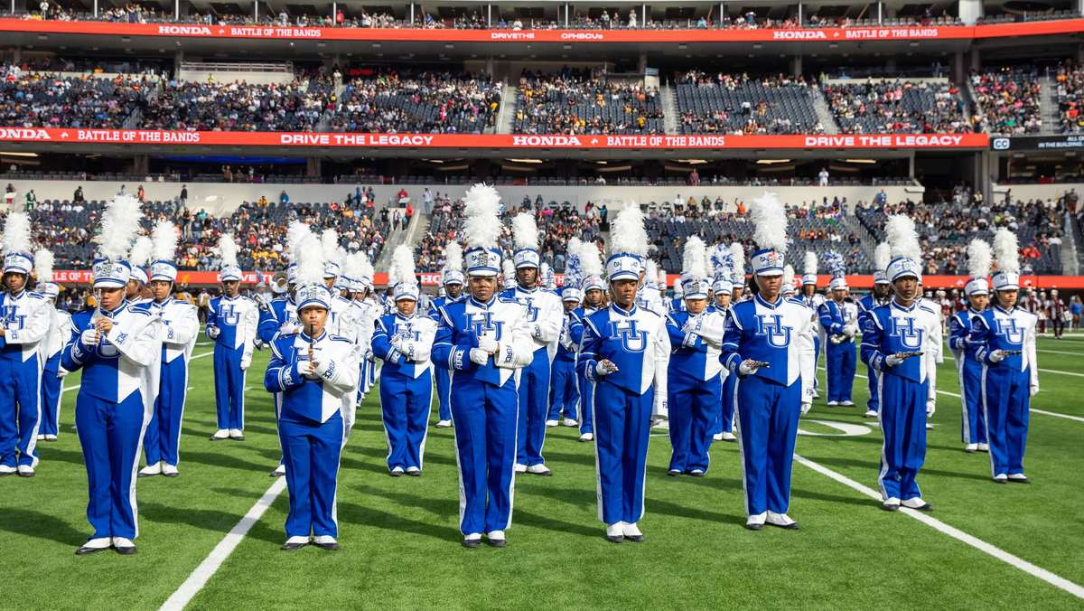
— DAY 2 CLOSE
THE HAMPTON UNIVERSITY MARCHING FORCE
Welcome and Vision
Who we are, our purpose and mission, the 2026 schedule, and this year's watchword: OPTIMIZE.
“We’ve spent so much time learning how to do more with so little that we can do a lot with just a little more.”
Pre-Drill Camp 2026 · Leadership Seminars
09
Notes:
RECAP — Session 1: Welcome and Vision
Read the quote out loud. That's the whole slide.
One sentence of connection at most, then advance.
If a session belonged to a guest or a student presenter, name them as you pass it — the credit matters.
(Quote hook: do more with so little)

Slide 10
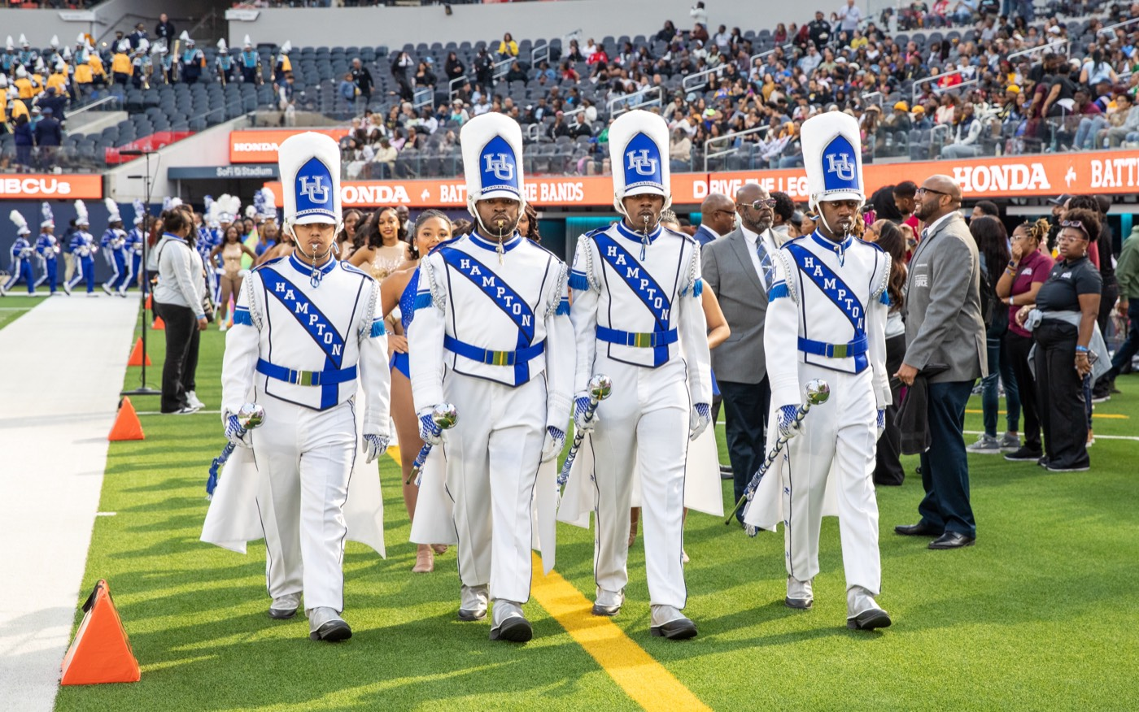
— DAY 2 CLOSE
THE HAMPTON UNIVERSITY MARCHING FORCE
Know Yourself First
Your personality type, your strengths, and the blind spots you lead people through.
“Learn your way out of your problems.”
Pre-Drill Camp 2026 · Leadership Seminars
10
Notes:
RECAP — Session 2: Know Yourself First
Read the quote out loud. That's the whole slide.
One sentence of connection at most, then advance.
If a session belonged to a guest or a student presenter, name them as you pass it — the credit matters.
(Quote hook: learn your way out)

Slide 11
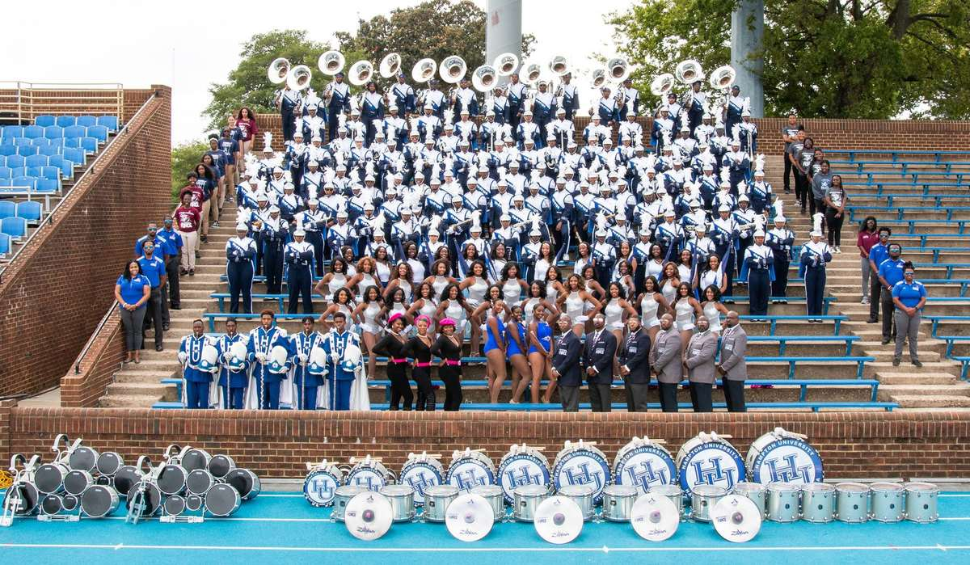
— DAY 2 CLOSE
THE HAMPTON UNIVERSITY MARCHING FORCE
Emotional Intelligence
Managing your own emotions and reading the room—responding instead of reacting.
“Kindness is paying attention out loud.”
Pre-Drill Camp 2026 · Leadership Seminars
11
Notes:
RECAP — Session 3: Emotional Intelligence
Read the quote out loud. That's the whole slide.
One sentence of connection at most, then advance.
If a session belonged to a guest or a student presenter, name them as you pass it — the credit matters.
(Quote hook: kindness is paying attention out loud)

Slide 12
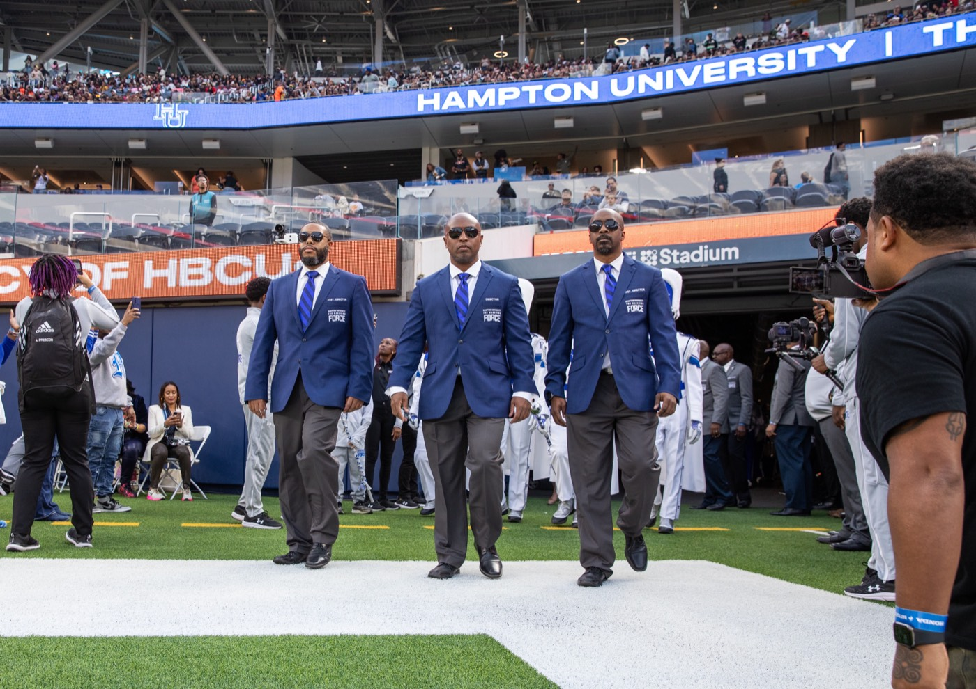
— DAY 2 CLOSE
THE HAMPTON UNIVERSITY MARCHING FORCE
Servant-Leadership
Serve first. Meet your people’s needs, and understand why it is the documented antidote to hazing.
“Power can either be wielded, or it can be shared.”
Pre-Drill Camp 2026 · Leadership Seminars
12
Notes:
RECAP — Session 4: Servant-Leadership
Read the quote out loud. That's the whole slide.
One sentence of connection at most, then advance.
If a session belonged to a guest or a student presenter, name them as you pass it — the credit matters.
(Quote hook: power wielded or shared)

Slide 13
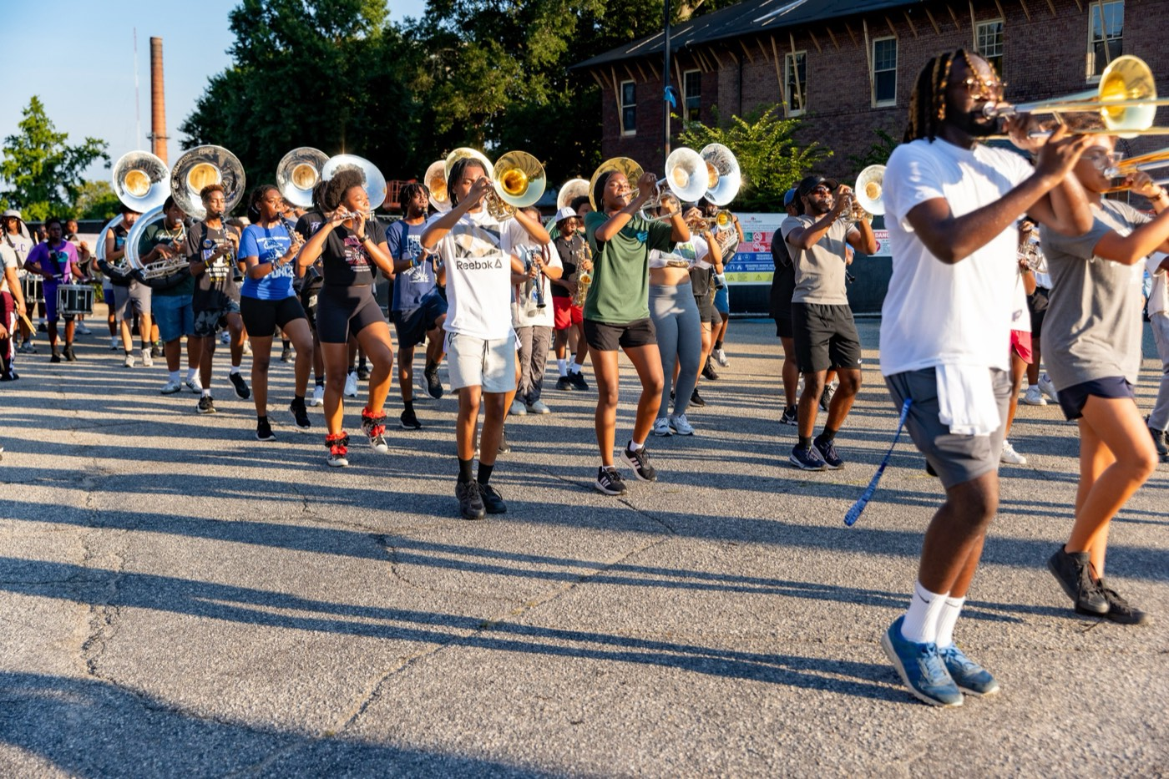
— DAY 2 CLOSE
THE HAMPTON UNIVERSITY MARCHING FORCE
Command Respect
Respect is earned through competence, character, and consistency—never demanded by rank.
“You have the most to lose and the most to prove.”
Pre-Drill Camp 2026 · Leadership Seminars
13
Notes:
RECAP — Session 5: Command Respect
Read the quote out loud. That's the whole slide.
One sentence of connection at most, then advance.
If a session belonged to a guest or a student presenter, name them as you pass it — the credit matters.
(Quote hook: most to lose, most to prove)

Slide 14
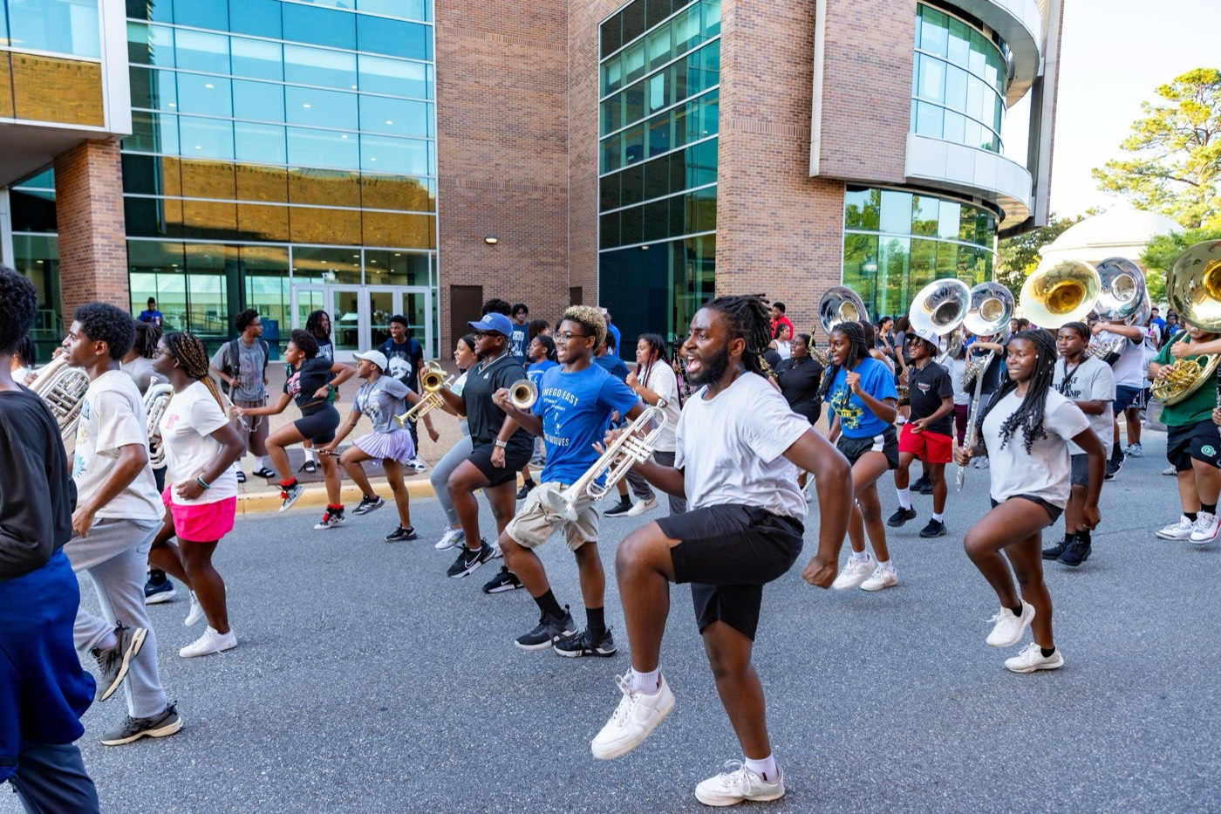
— DAY 2 CLOSE
THE HAMPTON UNIVERSITY MARCHING FORCE
Bonds, Not Fear
Fear buys compliance; bonds build loyalty. Where healthy bonding ends and hazing begins.
“You can go fast alone, but you can go further together.”
Pre-Drill Camp 2026 · Leadership Seminars
14
Notes:
RECAP — Session 6: Bonds, Not Fear
Read the quote out loud. That's the whole slide.
One sentence of connection at most, then advance.
If a session belonged to a guest or a student presenter, name them as you pass it — the credit matters.
(Quote hook: fast alone, further together)

Slide 15
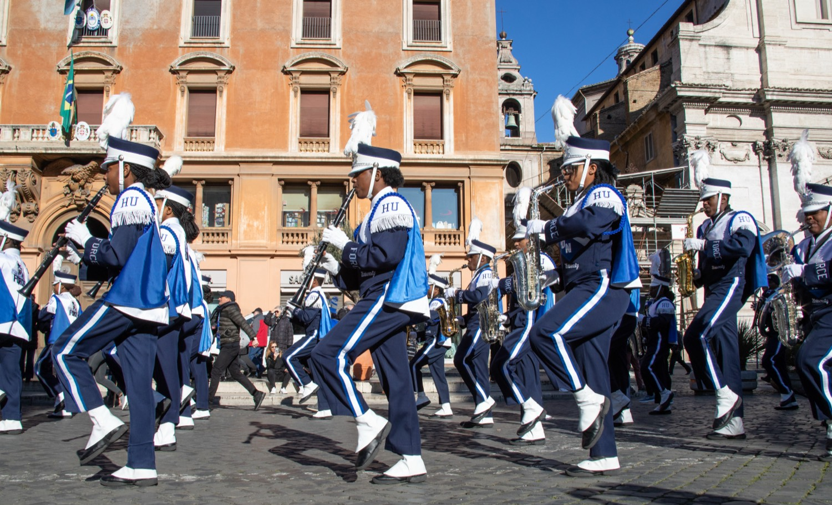
— DAY 2 CLOSE
THE HAMPTON UNIVERSITY MARCHING FORCE
Why Hazing Happens
The need to belong turned cruel, the mind’s traps, and the power of the group—and our non-negotiables.
“People raised on love will do anything for you; people raised on survival will do anything to you.”
Pre-Drill Camp 2026 · Leadership Seminars
15
Notes:
RECAP — Session 7: Why Hazing Happens
Read the quote out loud. That's the whole slide.
One sentence of connection at most, then advance.
If a session belonged to a guest or a student presenter, name them as you pass it — the credit matters.
(Quote hook: raised on love / raised on survival)

Slide 16
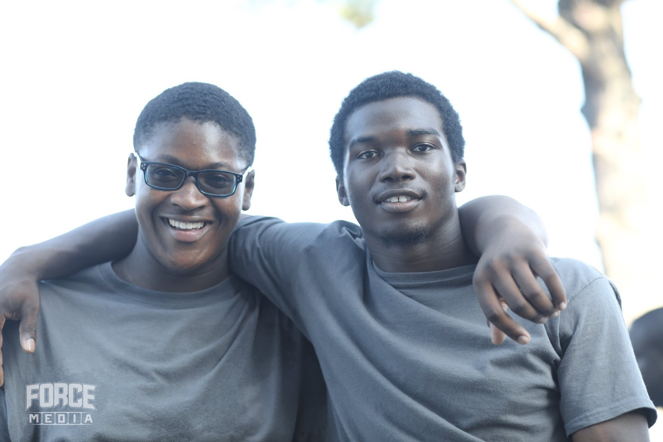
— DAY 2 CLOSE
THE HAMPTON UNIVERSITY MARCHING FORCE
Line Leader Tier
Where the Line Leader fits, and how carrying the basic tasks makes the whole section work.
“A million dollars is made of a million single dollar bills.”
Pre-Drill Camp 2026 · Leadership Seminars
16
Notes:
RECAP — Session 8: Line Leader Tier
Read the quote out loud. That's the whole slide.
One sentence of connection at most, then advance.
If a session belonged to a guest or a student presenter, name them as you pass it — the credit matters.
(Quote hook: a million single dollar bills)

Slide 17
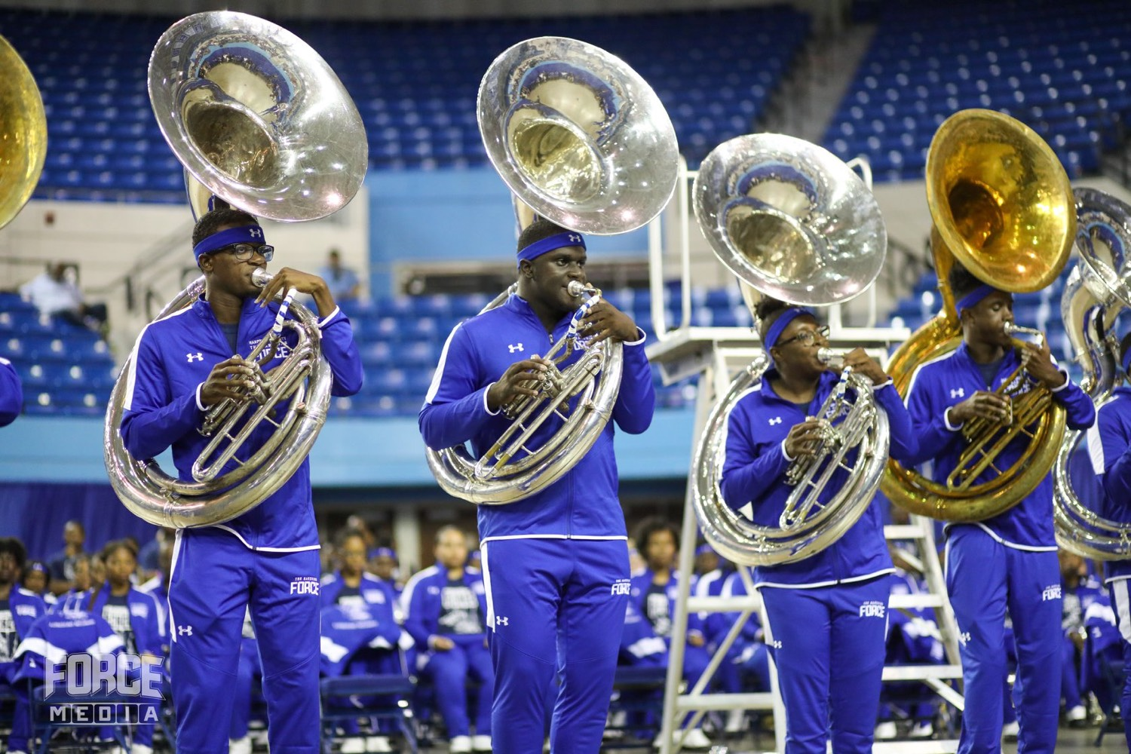
— DAY 2 CLOSE
THE HAMPTON UNIVERSITY MARCHING FORCE
SOP and MSA Standard
The Minimum Skills Audition and how to run a sectional—attack the tough spots, repeat for proficiency.
“If you don’t have the time to do it right, what makes you think you have the time to do it twice?”
Pre-Drill Camp 2026 · Leadership Seminars
17
Notes:
RECAP — Session 9: SOP and MSA
Read the quote out loud. That's the whole slide.
One sentence of connection at most, then advance.
If a session belonged to a guest or a student presenter, name them as you pass it — the credit matters.
(Quote hook: time to do it twice)

Slide 18
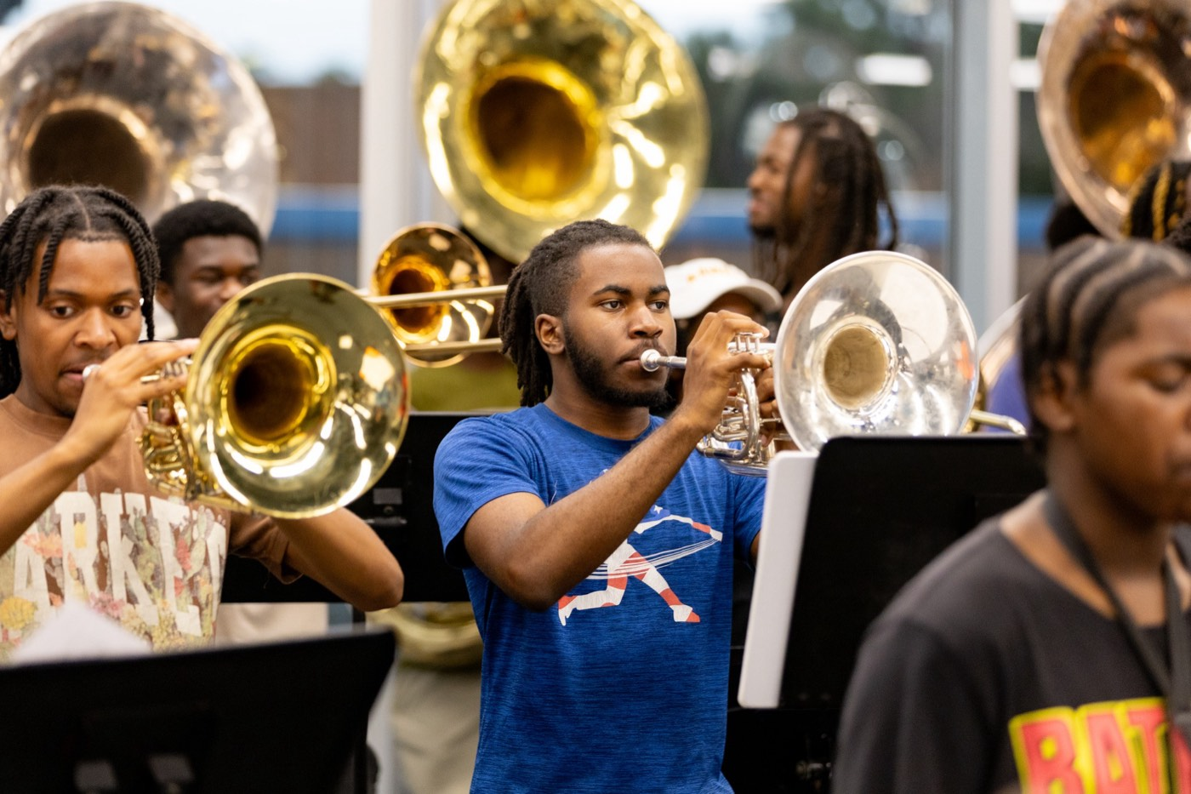
— DAY 2 CLOSE
THE HAMPTON UNIVERSITY MARCHING FORCE
The Hampton Sound
Power and precision. Dark, resonant, and balanced—colors that complement instead of compete.
“Music is my first language.”
Pre-Drill Camp 2026 · Leadership Seminars
18
Notes:
RECAP — Session 10: The Hampton Sound
Read the quote out loud. That's the whole slide.
One sentence of connection at most, then advance.
If a session belonged to a guest or a student presenter, name them as you pass it — the credit matters.
(Quote hook: music is my first language)

Slide 19
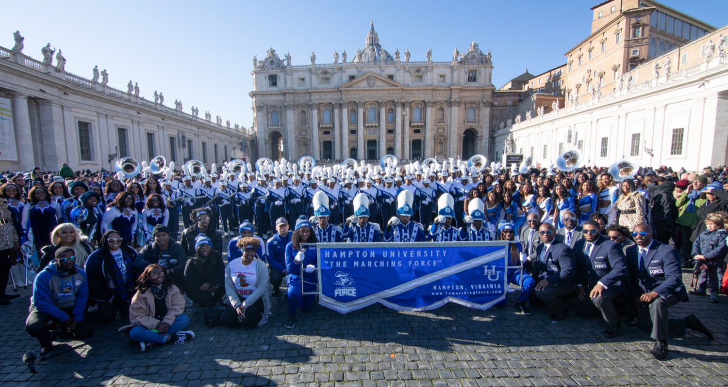
— DAY 2 CLOSE
THE HAMPTON UNIVERSITY MARCHING FORCE
Day 1 Close · First In
Readiness is the standard. Leaders thirty minutes early, sections fifteen, ready by the downbeat.
“The most exciting lives are supported by extremely boring things.”
Pre-Drill Camp 2026 · Leadership Seminars
19
Notes:
RECAP — Session 11: Day 1 Close · First In
Read the quote out loud. That's the whole slide.
One sentence of connection at most, then advance.
If a session belonged to a guest or a student presenter, name them as you pass it — the credit matters.
(Quote hook: exciting lives, boring things)

Slide 20
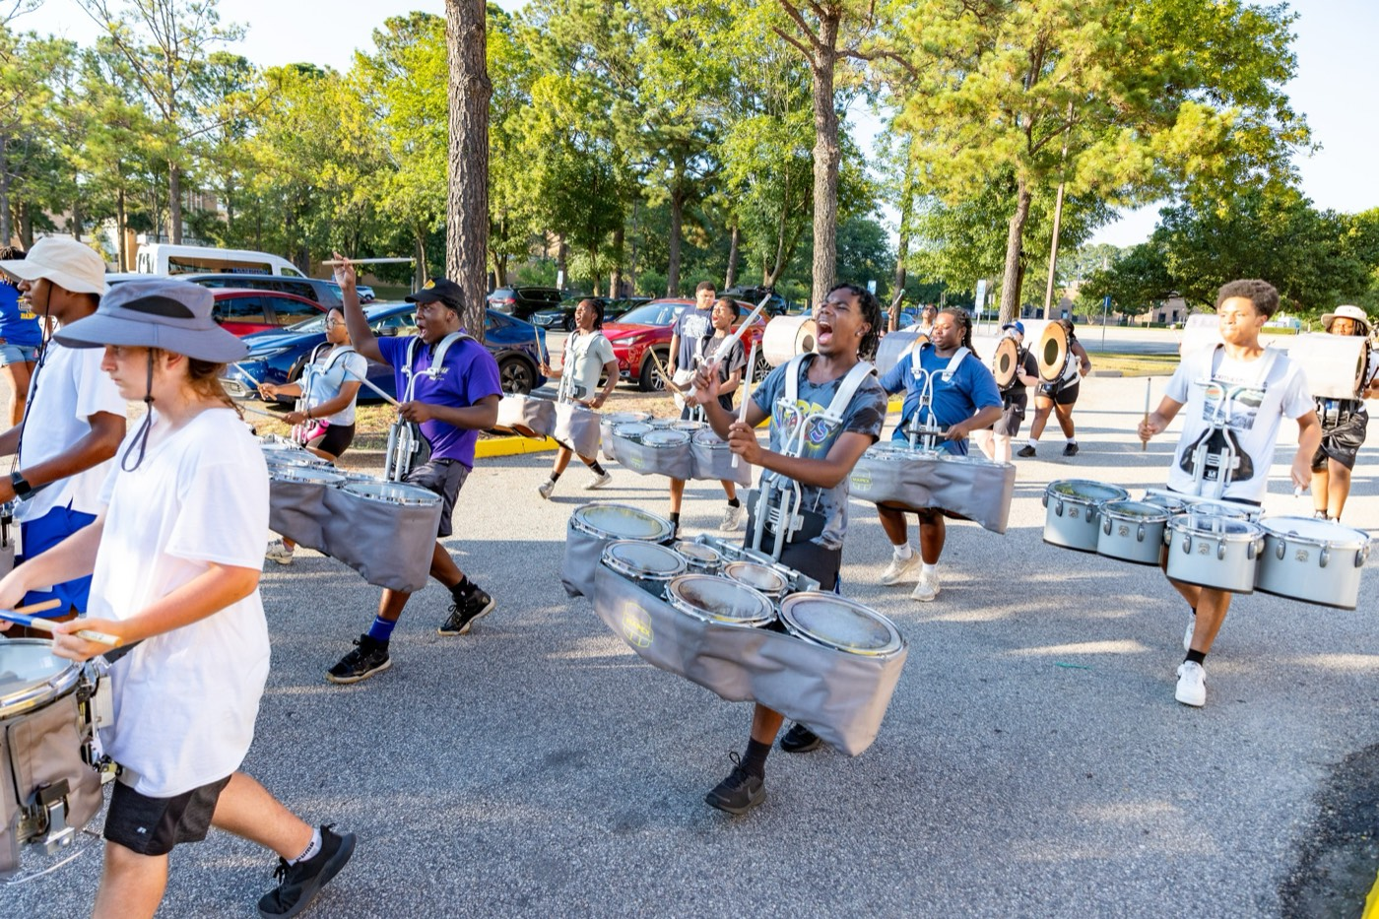
— DAY 2 CLOSE
THE HAMPTON UNIVERSITY MARCHING FORCE
Teach How to Teach
Break it down, model it, check for understanding, and drill it to mastery.
“The acquisition of knowledge is expensive; the application of knowledge is lucrative.”
Pre-Drill Camp 2026 · Leadership Seminars
20
Notes:
RECAP — Session 12: Teach How to Teach
Read the quote out loud. That's the whole slide.
One sentence of connection at most, then advance.
If a session belonged to a guest or a student presenter, name them as you pass it — the credit matters.
(Quote hook: application is lucrative)

Slide 21
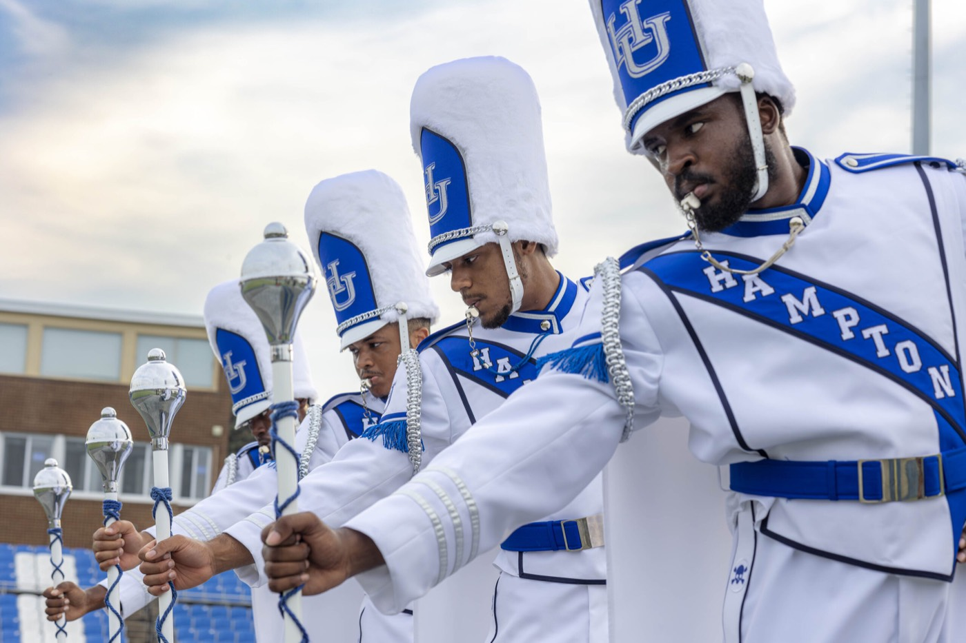
— DAY 2 CLOSE
THE HAMPTON UNIVERSITY MARCHING FORCE
Drum Majors
Two sides of one job: the craft of conducting, and the showmanship that is HBCU DNA.
“Discipline looks like obsession to someone who doesn’t have any.”
Pre-Drill Camp 2026 · Leadership Seminars
21
Notes:
RECAP — Session 13: Drum Majors
Read the quote out loud. That's the whole slide.
One sentence of connection at most, then advance.
If a session belonged to a guest or a student presenter, name them as you pass it — the credit matters.
(Quote hook: discipline looks like obsession)

Slide 22
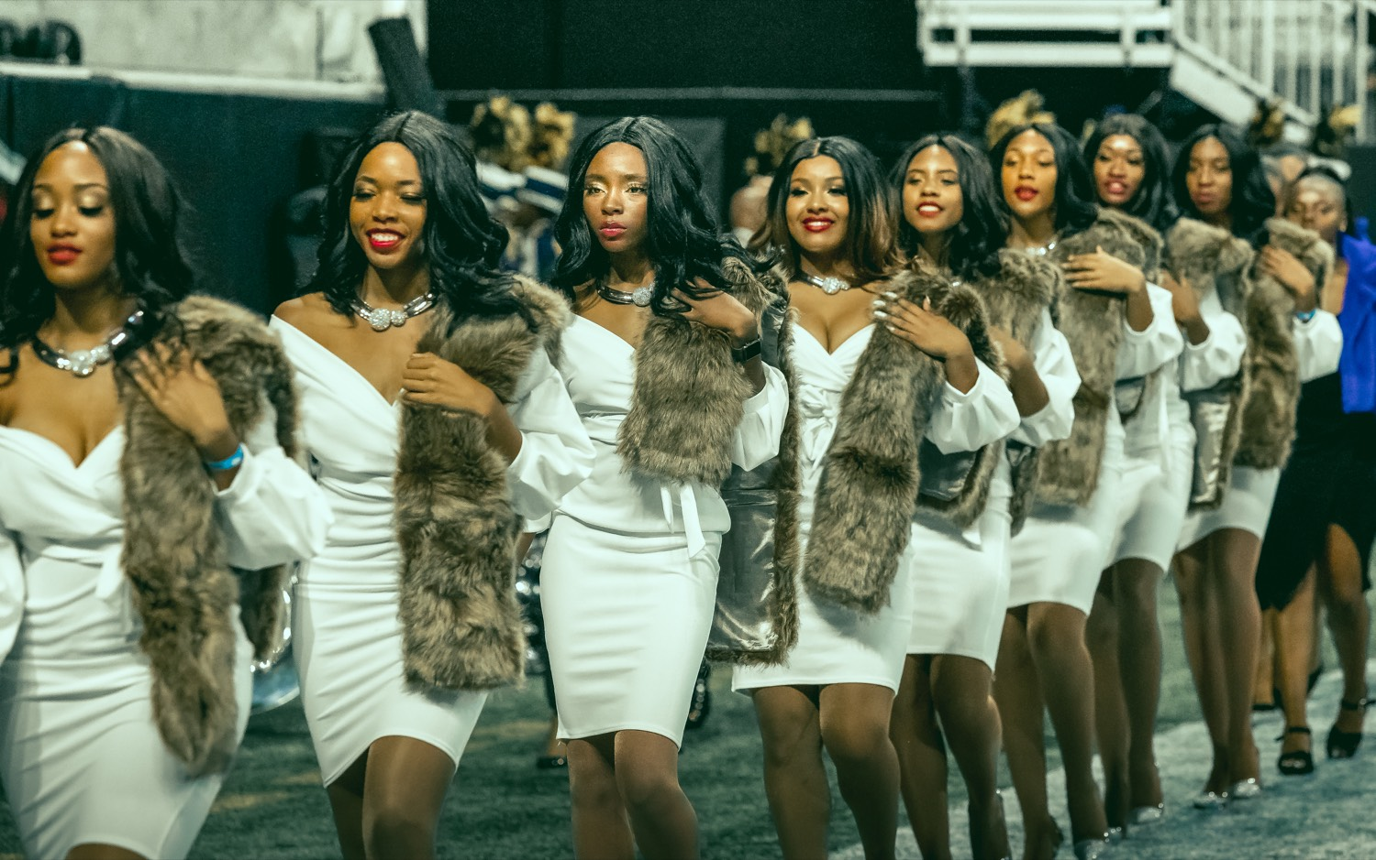
— DAY 2 CLOSE
THE HAMPTON UNIVERSITY MARCHING FORCE
Interpreting the Music
Choreograph to the feel and the lyrics—and play music worth interpreting.
“Art should comfort the uncomfortable, and make the comfortable uncomfortable.”
Pre-Drill Camp 2026 · Leadership Seminars
22
Notes:
RECAP — Session 14: Interpreting the Music
Read the quote out loud. That's the whole slide.
One sentence of connection at most, then advance.
If a session belonged to a guest or a student presenter, name them as you pass it — the credit matters.
(Quote hook: comfort the uncomfortable)

Slide 23
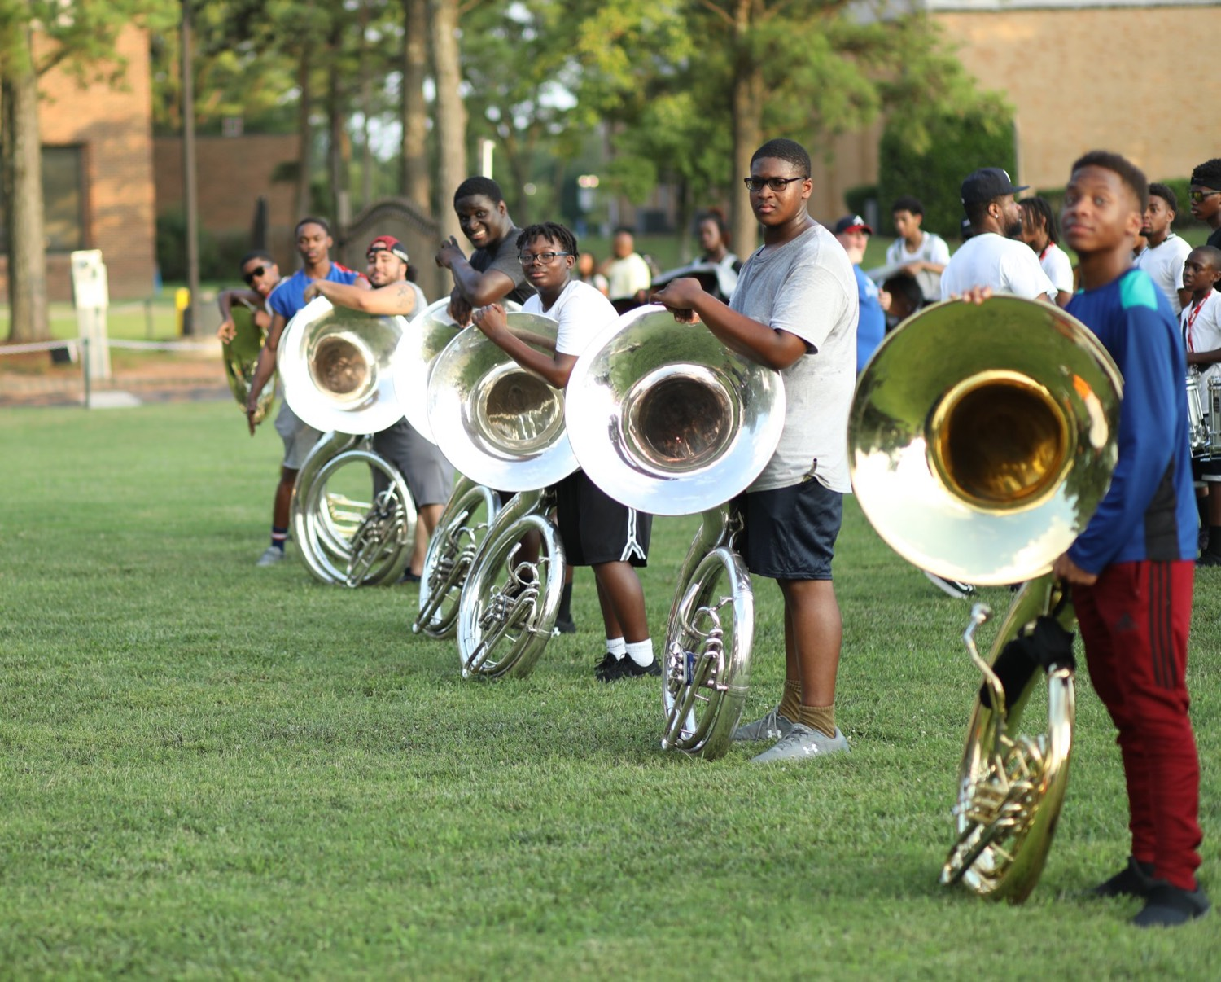
— DAY 2 CLOSE
THE HAMPTON UNIVERSITY MARCHING FORCE
Leading Under Pressure
Breathe, read pressure as a challenge, decide, and slow down to move faster.
“In a stressful situation, you will fall to the level of your training.”
Pre-Drill Camp 2026 · Leadership Seminars
23
Notes:
RECAP — Session 15: Leading Under Pressure
Read the quote out loud. That's the whole slide.
One sentence of connection at most, then advance.
If a session belonged to a guest or a student presenter, name them as you pass it — the credit matters.
(Quote hook: fall to the level of your training)

Slide 24
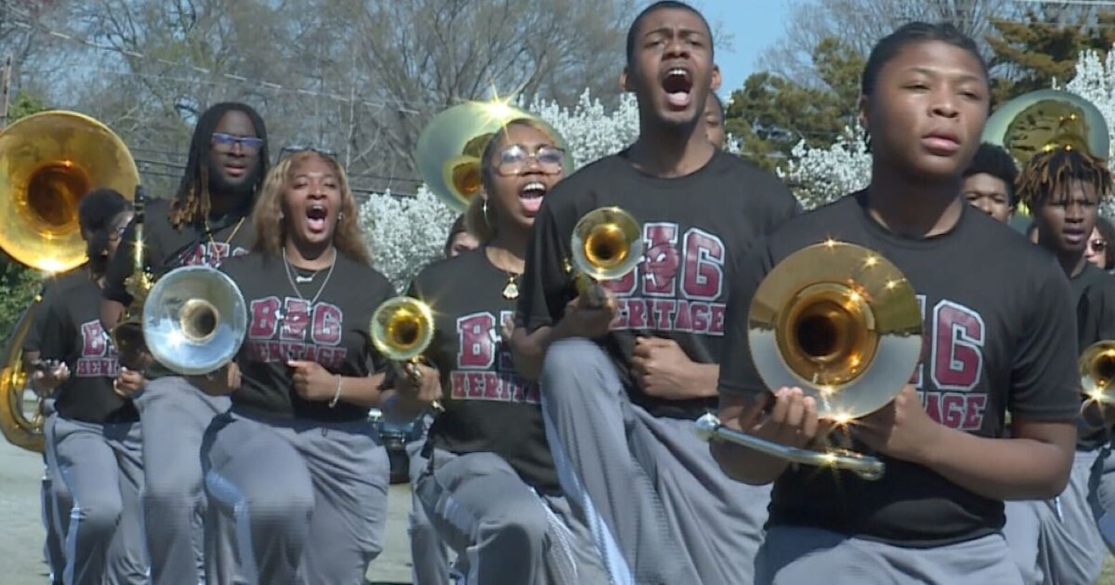
— DAY 2 CLOSE
THE HAMPTON UNIVERSITY MARCHING FORCE
Know Your People
Read the headspace of those you lead and your own. Meet people where they are.
“Consideration is the highest form of love, because consideration is what someone does when they are thinking of you in your absence.”
Pre-Drill Camp 2026 · Leadership Seminars
24
Notes:
RECAP — Session 16: Know Your People
Read the quote out loud. That's the whole slide.
One sentence of connection at most, then advance.
If a session belonged to a guest or a student presenter, name them as you pass it — the credit matters.
(Quote hook: consideration in your absence)

Slide 25
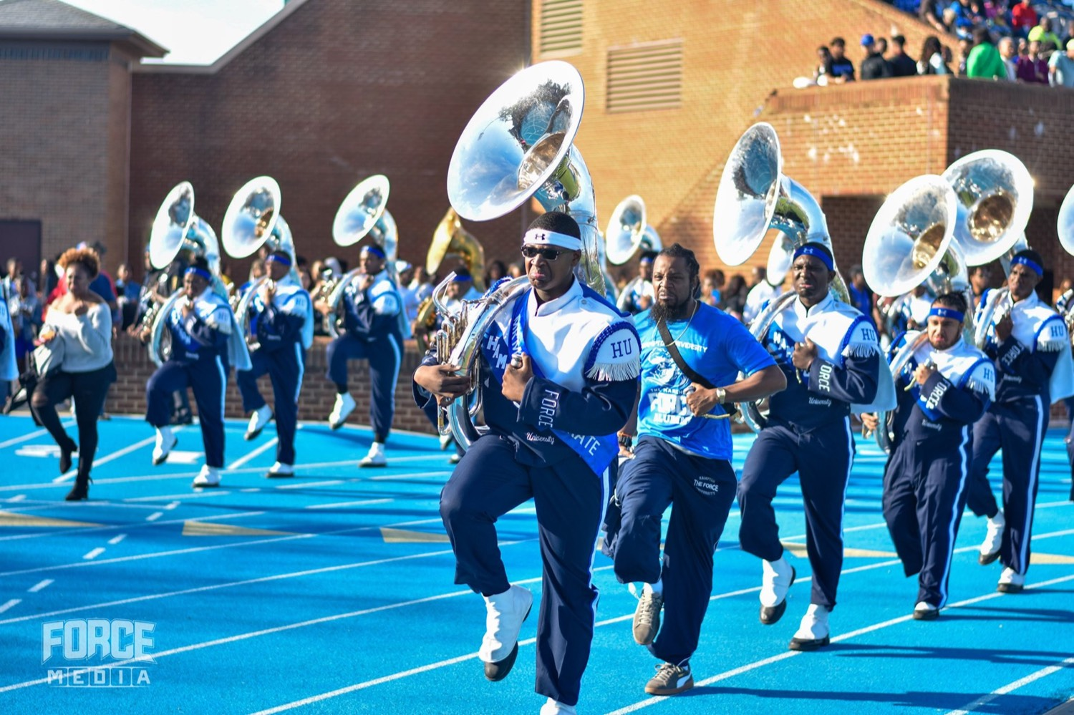
— DAY 2 CLOSE
THE HAMPTON UNIVERSITY MARCHING FORCE
Conflict Resolution
Handle it early, fairly, and directly. Find the interest under the position.
“Never attribute to malice that which is adequately explained by stupidity.”
Pre-Drill Camp 2026 · Leadership Seminars
25
Notes:
RECAP — Session 17: Conflict Resolution
Read the quote out loud. That's the whole slide.
One sentence of connection at most, then advance.
If a session belonged to a guest or a student presenter, name them as you pass it — the credit matters.
(Quote hook: never attribute to malice)

Slide 26
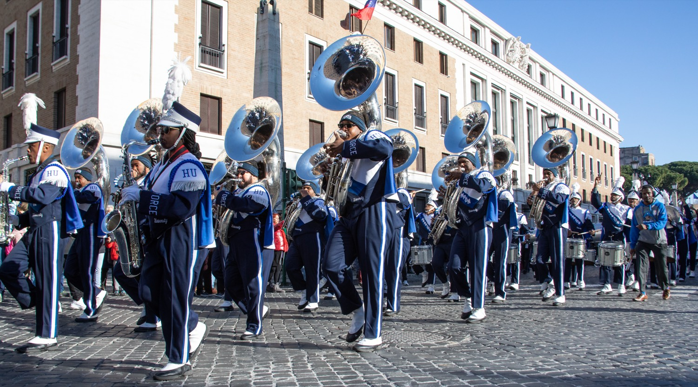
— DAY 2 CLOSE
THE HAMPTON UNIVERSITY MARCHING FORCE
Difficult Conversations
Care personally and challenge directly. On hazing, silence is complicity.
“If you ever think about doing something you feel might be stupid, remind yourself that you are an adult and will be charged as one.”
Pre-Drill Camp 2026 · Leadership Seminars
26
Notes:
RECAP — Session 18: Difficult Conversations
Read the quote out loud. That's the whole slide.
One sentence of connection at most, then advance.
If a session belonged to a guest or a student presenter, name them as you pass it — the credit matters.
(Quote hook: charged as an adult)

Slide 27
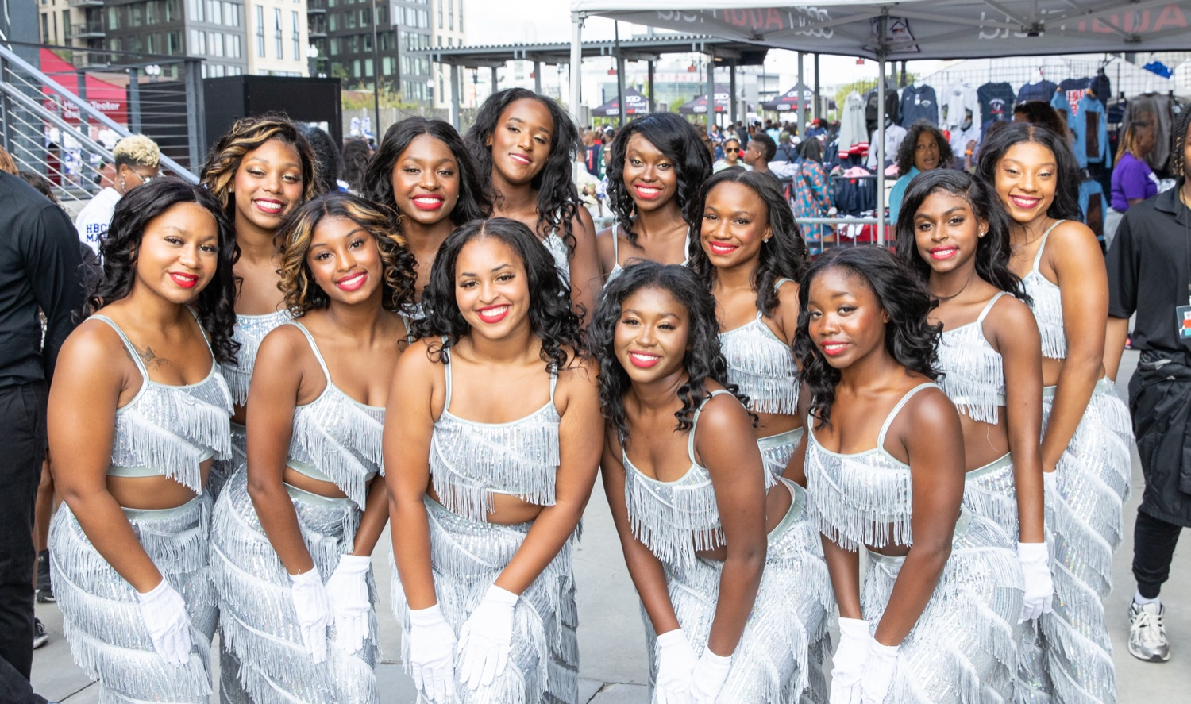
— DAY 2 CLOSE
THE HAMPTON UNIVERSITY MARCHING FORCE
Supporting the Auxiliary
You are their floor. Hold the tempo, give them room, and hype their moment.
“When you help someone, you help everyone.”
Pre-Drill Camp 2026 · Leadership Seminars
27
Notes:
RECAP — Session 19: Supporting the Auxiliary
Read the quote out loud. That's the whole slide.
One sentence of connection at most, then advance.
If a session belonged to a guest or a student presenter, name them as you pass it — the credit matters.
(Quote hook: help someone, help everyone)

Slide 28

— DAY 2 CLOSE
THE HAMPTON UNIVERSITY MARCHING FORCE
Twirler Recruitment
Scout where twirlers actually are, travel to them, and make the pitch in person.
“A half-assed plan executed well is better than a perfect plan executed poorly.”
Pre-Drill Camp 2026 · Leadership Seminars
28
Notes:
RECAP — Session 20: Twirler Recruitment
Read the quote out loud. That's the whole slide.
One sentence of connection at most, then advance.
If a session belonged to a guest or a student presenter, name them as you pass it — the credit matters.
(Quote hook: half a plan executed well)

Slide 29
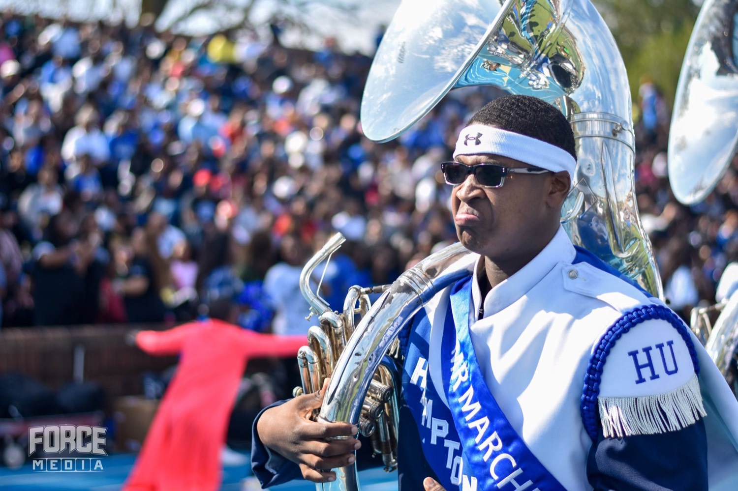
— DAY 2 CLOSE
THE HAMPTON UNIVERSITY MARCHING FORCE
Communication and Ambassadors
Move it up the chain, move it down to your line, and represent us out in the world.
“Good habits come with a price. Bad habits come with a cost.”
Pre-Drill Camp 2026 · Leadership Seminars
29
Notes:
RECAP — Session 21: Communication and Ambassadors
Read the quote out loud. That's the whole slide.
One sentence of connection at most, then advance.
If a session belonged to a guest or a student presenter, name them as you pass it — the credit matters.
(Quote hook: habits: price vs cost)

Slide 30
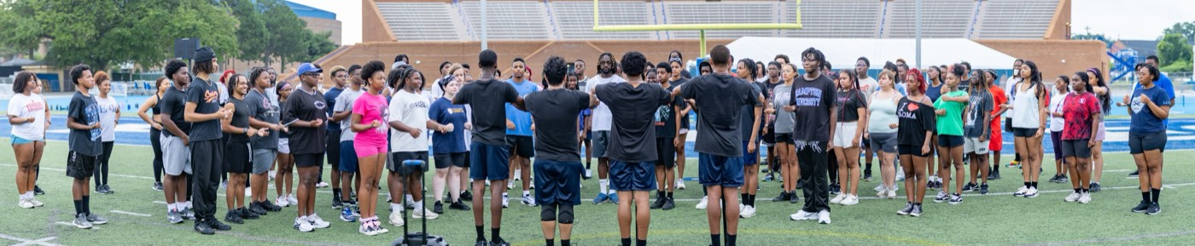
— DAY 2 CLOSE
THE HAMPTON UNIVERSITY MARCHING FORCE
Day 2 Close · Last Out
Accountable for the space, the people, and the standard long after the whistle.
“I will die FOR you. Not BECAUSE of you.”
Pre-Drill Camp 2026 · Leadership Seminars
30
Notes:
RECAP — Session 22: Day 2 Close · Last Out
Read the quote out loud. That's the whole slide.
One sentence of connection at most, then advance.
If a session belonged to a guest or a student presenter, name them as you pass it — the credit matters.
(Quote hook: die FOR you, not BECAUSE of you)

Slide 31
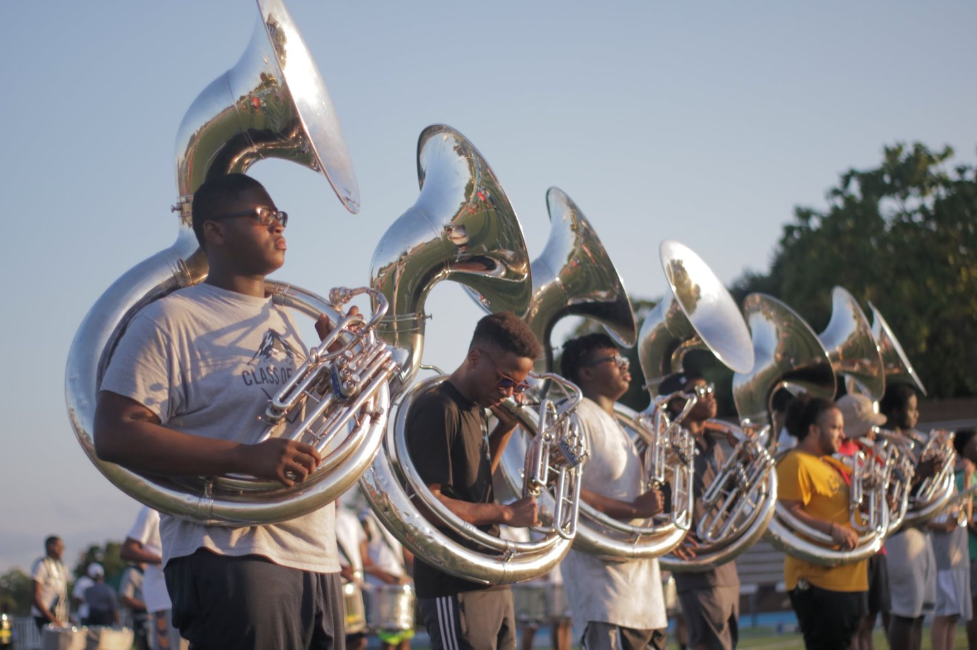
02
THE CHARGE
None of this counts until it survives contact with a hard Tuesday. The members are already here, and tomorrow they will watch what you do far more closely than they listened to anything said this weekend. Every seminar in these two days was theory until you walk back onto that field and live it in front of them. The standard does not stop when the seminar ends. It does not stop when camp ends. It does not stop.
NEVER.
Notes:
IT DOES NOT STOP HERE (statement slide)
The pivot back to weight. Slow the room down again after the recap run.
Read it as written.
THE LINE: "None of this counts until it survives contact with a hard Tuesday."
Takeaway: "Never." Say it and stop.

Slide 32
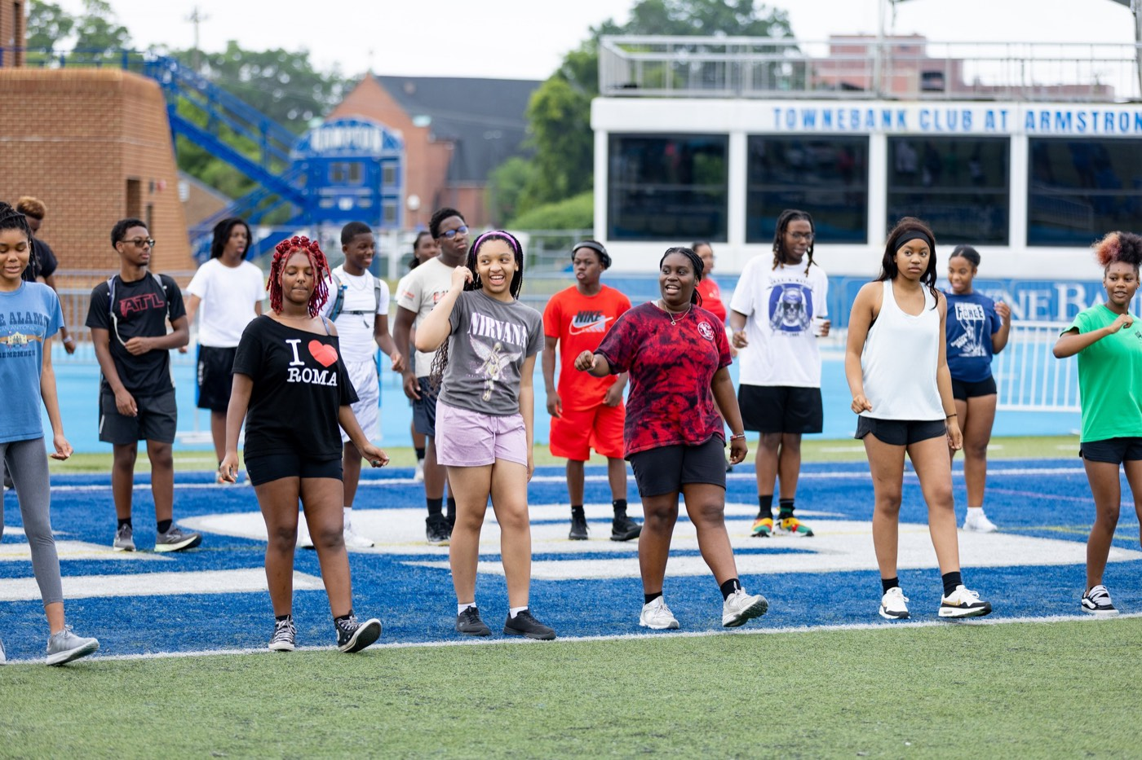
— DAY 2 CLOSE
THE HAMPTON UNIVERSITY MARCHING FORCE
Your Commitments
Before you leave this room tonight, name them out loud.
◆ One thing you will start. A habit, a check-in, a rep you will run with your line beginning tomorrow.
◆ One thing you will stop. Be honest about the behavior that does not belong in a leader on this staff.
◆ One person you will pour into. Pick the member who needs you most and decide to be their reason for staying.
◆ One standard you will not let slip—especially at the end of a long day, when it costs you something to hold it.
Say it to the leader next to you. A commitment spoken out loud to a peer is the one that survives the week.
Pre-Drill Camp 2026 · Leadership Seminars
32
Notes:
YOUR COMMITMENTS
The ask. Give it real air.
One thing you'll START. One thing you'll STOP. One person you'll POUR INTO. One standard you won't let slip.
Have them say it OUT LOUD to the leader next to them. Wait for the room to actually do it — don't narrate over it.
Captains: model it first so nobody's embarrassed to go first.

Slide 33
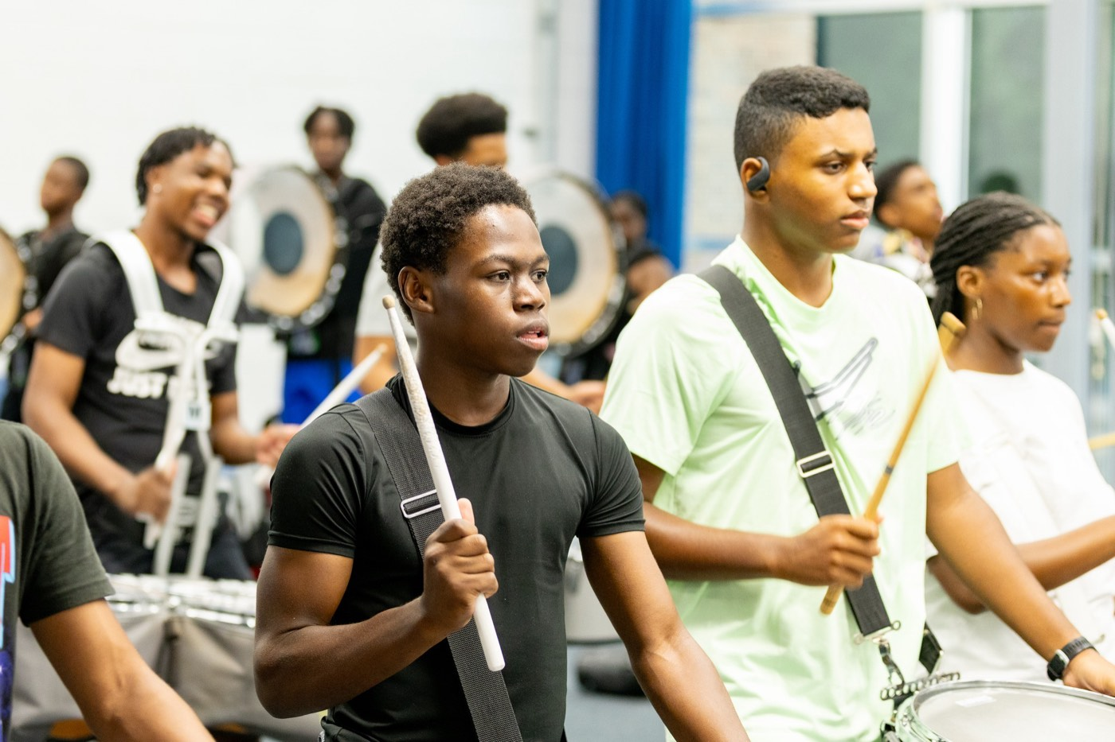
— DAY 2 CLOSE
THE HAMPTON UNIVERSITY MARCHING FORCE
The Creed in Practice
What First In, Last Out looks like every single day.
1
Arrive Ready
Thirty minutes for leaders, fifteen for your section. Warm, prepared, and set before the downbeat.
Pre-Drill Camp 2026 · Leadership Seminars
33
Notes:
THE CREED IN PRACTICE
Arrive Ready, Hold the Room, Account for Everyone, Close It Out.
The daily version of the creed. Photograph slide.

Slide 34

THE FINAL CHARGE
First In.
Last Out.
That is the whole creed, and starting tomorrow it is the whole job. Be the first one ready and the last one to let go. Take care of the space, take care of your people, and hold the standard hardest at the moment it would be easiest to drop. Every member of this band is about to find out what kind of leaders they have, and they will learn it from what you do, not from what any of us said this weekend. You have the training. You have each other. Now go show them.
Serve First. Lead Always. — Drive the Legacy.
The Hampton University Marching Force
Hampton's Heartbeat
Notes:
CLOSE — First In. Last Out.
Standing. No notes. Captains beside you.
"Be the first one ready and the last one to let go."
"Every member of this band is about to find out what kind of leaders they have — and they'll learn it from what you do, not what any of us said this weekend."
End on: "You have the training. You have each other. Now go show them."
Let the Captains dismiss. Add nothing after it.

