Slide 1
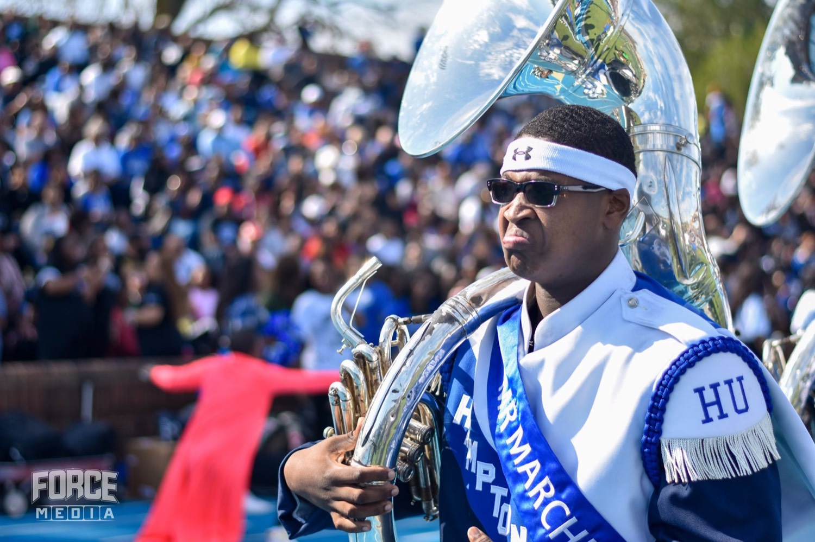
PRE-DRILL CAMP 2026 · LEADERSHIP SEMINARS · DAY 2
Communication
and Ambassadors
"Up, Down, and Out."
Joshua Gibbons and Jay Jones
All Leaders · Sunday, August 2, 2026
The Hampton University Marching Force
Hampton's Heartbeat
Notes:
SLIDE 1 — TITLE: Communication and Ambassadors
PRESENTERS: Joshua Gibbons and Jay Jones. Split it — one of you takes the chain of command, the other takes the ambassador half.
OPEN: "Almost everything a leader does is communication. Up, down, and out."

Slide 2
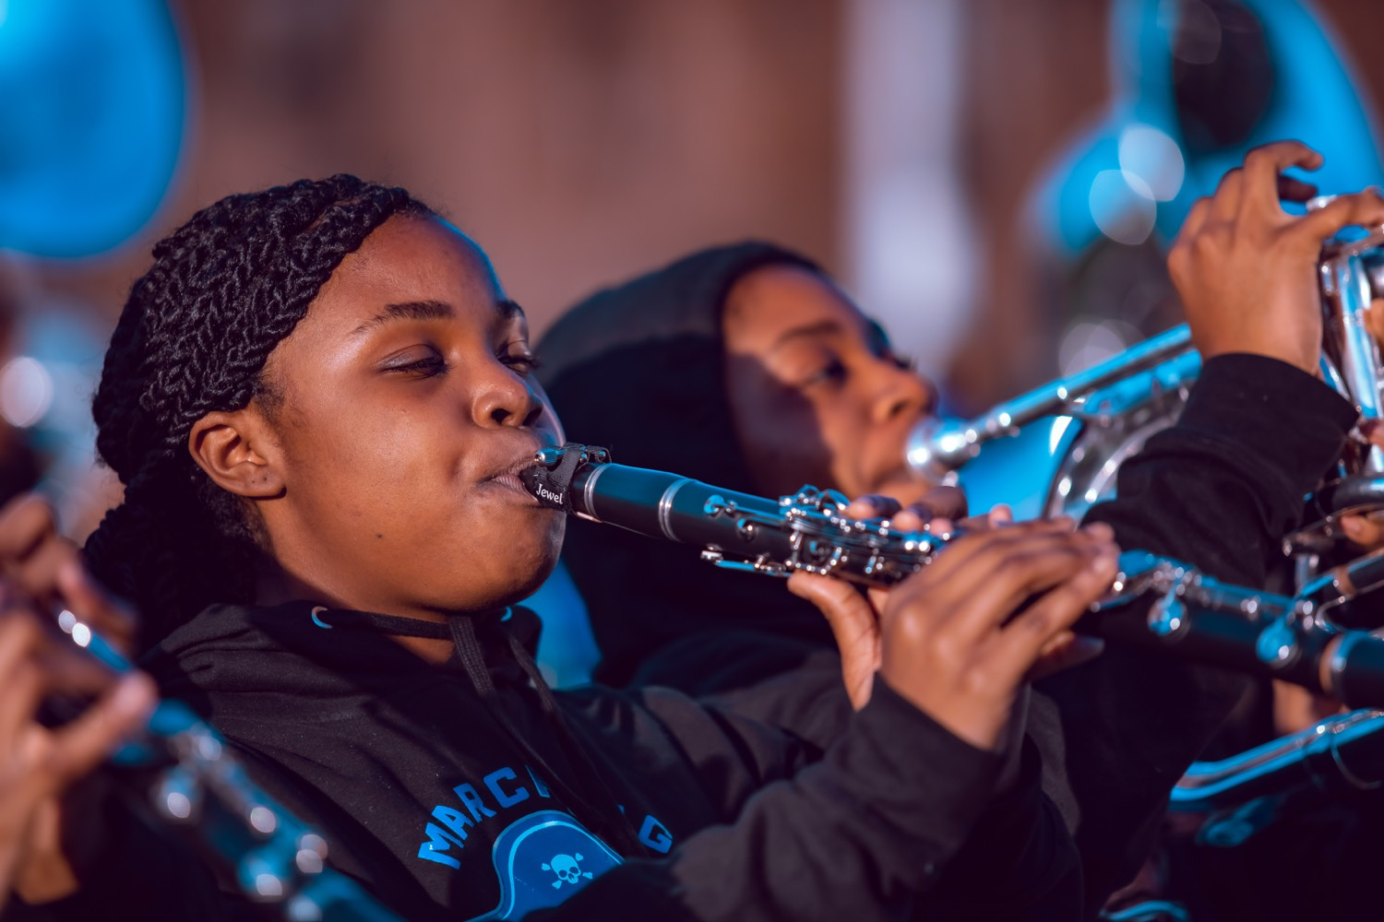
— COMMUNICATION AND AMBASSADORS
THE HAMPTON UNIVERSITY MARCHING FORCE
Icebreaker
Ernie Davis was the first Black player to win the Heisman. In this scene a young Floyd Little meets him and says he wants to be "the best Negro running back"—and Ernie corrects him: no label, just the best there is. Little went on to Syracuse and wore Ernie's number. One conversation, one example. That is what an ambassador does.
▶
The Express — Ernie Davis Meets Floyd Little
youtu.be/sWEl9ou-2lg
WATCH · 2:59
Pre-Drill Camp 2026 · Leadership Seminars
02
Notes:
SLIDE 2 — ICEBREAKER: The Express, Ernie Davis Meets Floyd Little (2:59)
SET UP: "Ernie Davis was the first Black player to win the Heisman. A young Floyd Little meets him and says he wants to be the best Negro running back. Listen to how Ernie corrects him."
Play it.
AFTER: "No label. Just the best there is." Then the fact that lands it: "Floyd Little went to Syracuse and wore Ernie's number. One conversation. That's an ambassador."

Slide 3

01
THE PREMISE
Almost everything a leader does is communication. You pass along a time change, you correct a rank, you answer a parent in the parking lot, you post a video at one in the morning. Every one of those is the band talking. Information has to move up the chain and down the chain without getting lost or twisted, and everything that goes out carries Hampton's name on it. You do not get to step out of the uniform when the whistle stops.
YOU ARE ALWAYS SPEAKING FOR THE FORCE.
Notes:
SLIDE 3 — THE PREMISE (statement slide)
Read it.
"A time change, a correction, a parent in the parking lot, a video posted at one in the morning — every one of those is the band talking."
Takeaway: "You are always speaking for the Force."

Slide 4
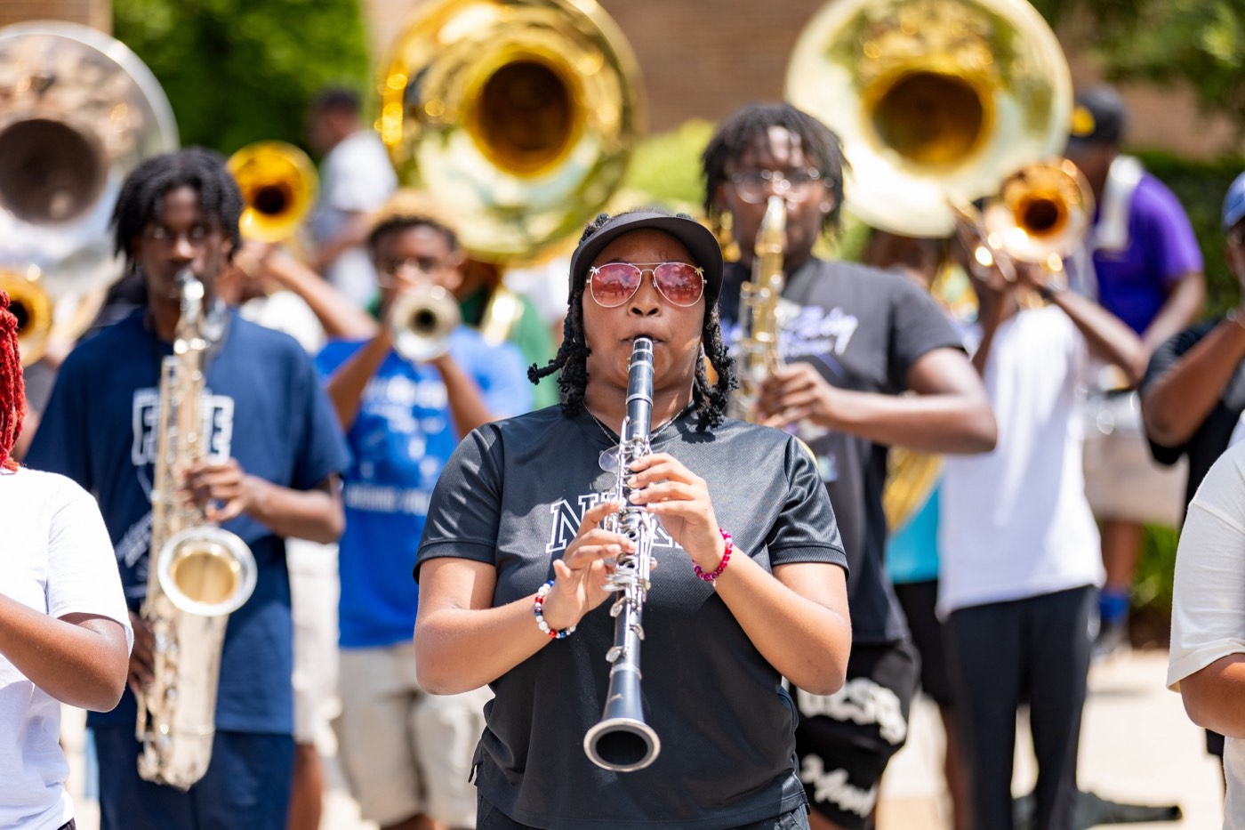
— COMMUNICATION AND AMBASSADORS
THE HAMPTON UNIVERSITY MARCHING FORCE
The Chain of Command
Know exactly where you sit, and exactly who you go to. You start at the bottom rung and work up.
7
6
5
4
3
2
1
A chain of command is a structure where authority and responsibility flow from the top down, so that communication and accountability stay clear. Learn the rung above you and the rung below you. That is your lane.
Outside the Chain
Pre-Drill Camp 2026 · Leadership Seminars
04
Notes:
SLIDE 4 — THE CHAIN OF COMMAND
JAY: this is your material — take it.
Walk the ladder from the bottom: Line Leaders, Section Leaders, Captains, Drum Majors, Coaches and Coordinators, Assistant Directors of University Bands, Director of University Bands.
OUTSIDE THE CHAIN: the Student Director (if assigned) and the Graduate Assistant are liaisons to the Director — not rungs.
MAKE IT PERSONAL: "Find your rung. Now name the person directly above you and directly below you. That's your lane."

Slide 5
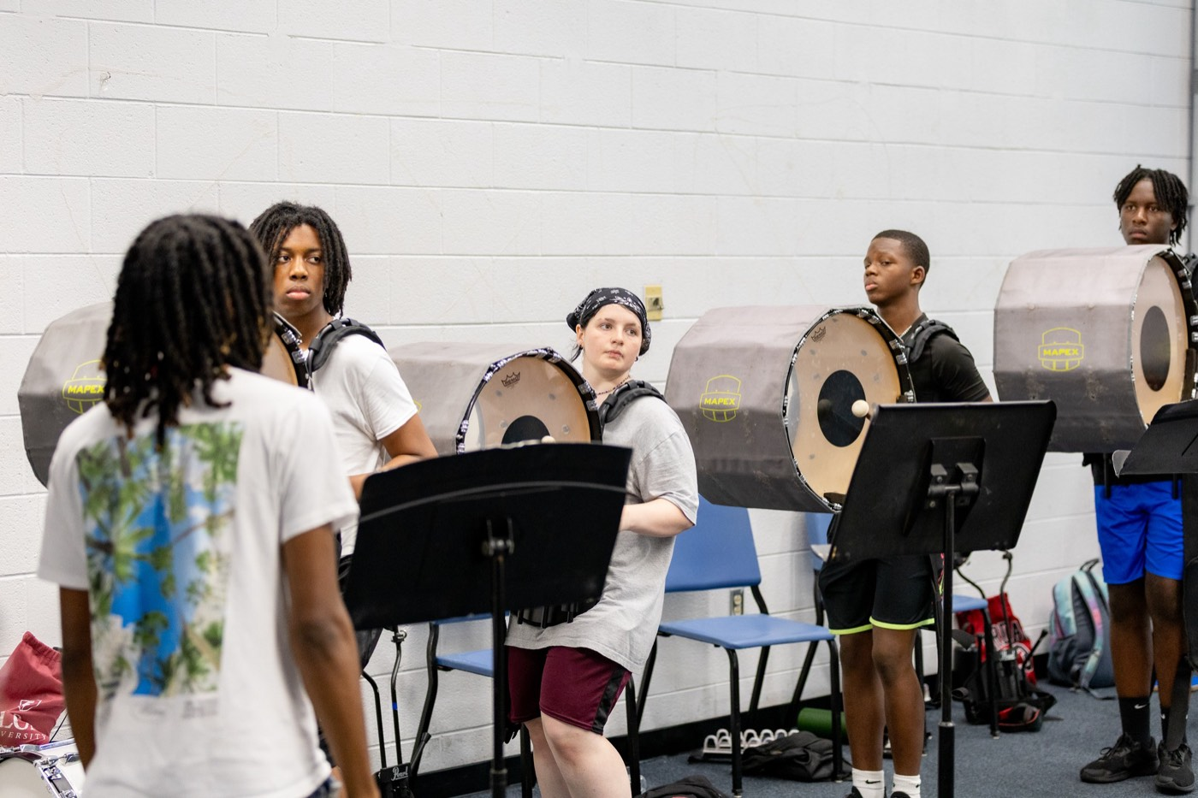
— COMMUNICATION AND AMBASSADORS
THE HAMPTON UNIVERSITY MARCHING FORCE
Communicating Up
Take it to the next rung—early, and with the facts.
◆ Go to your next level first. Skipping rungs makes the person you skipped look uninformed and slows the answer down.
◆ Bring the facts, not the rumor—who, what, when, and what you already tried. Report it straight, even when it makes you look bad.
◆ Escalate early. Small problems reported today beat big problems discovered on gameday.
◆ straight to the directorto the director, no matter the chain: hazing, safety, and anything that puts a member at risk.
Lead up: discipline escalates the same way—a first-degree verbal warning, a second-degree verbal and written, then third- and fourth-degree write-ups with consequences.
Pre-Drill Camp 2026 · Leadership Seminars
05
Notes:
SLIDE 5 — COMMUNICATING UP
"Go to your next level first. Skipping rungs makes the person you skipped look uninformed and slows the answer down."
"Bring facts, not rumor — who, what, when, and what you already tried. Report it straight even when it makes you look bad."
THE EXCEPTION, say it clearly: "Hazing and safety go straight to the director. No matter the chain."
Source line covers the discipline ladder — first-degree verbal, second verbal and written, then write-ups.

Slide 6
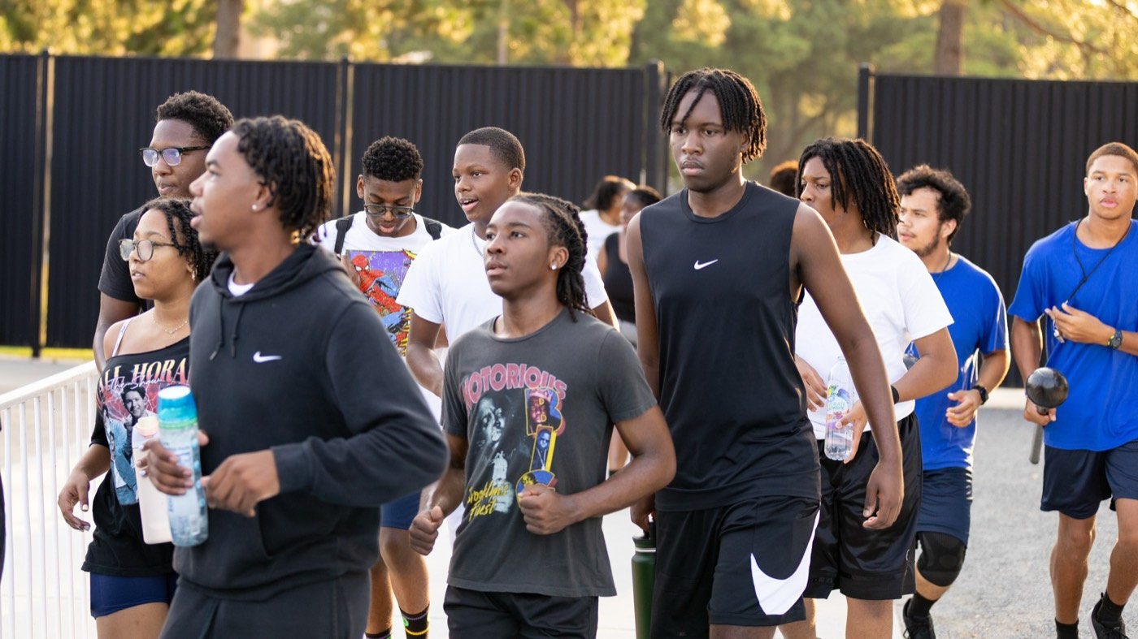
— COMMUNICATION AND AMBASSADORS
THE HAMPTON UNIVERSITY MARCHING FORCE
Communicating Down
Your line only knows what you tell them.
◆ Pass it on completely and quickly. Time, place, uniform, and what to bring. A detail you forget becomes a member standing in the wrong place in the wrong clothes.
◆ Confirm it landed. Posting it is not the same as knowing they got it. Get eyes, get a reply, take a count.
◆ Do not editorialize. Deliver the message as it was given, and take your disagreement back up the chain, not down it.
◆ Close the loop. Tell the person above you that your line has it, and report back what they said.
Pre-Drill Camp 2026 · Leadership Seminars
06
Notes:
SLIDE 6 — COMMUNICATING DOWN
"Your line only knows what you tell them."
COMPLETE AND FAST: time, place, uniform, what to bring. "A detail you forget becomes a member in the wrong place in the wrong clothes."
THE STEP PEOPLE SKIP: "Posting it is not the same as knowing they got it. Get eyes, get a reply, take a count."
AND: "Don't editorialize. Deliver the message as given; take your disagreement back UP the chain, not down it."

Slide 7
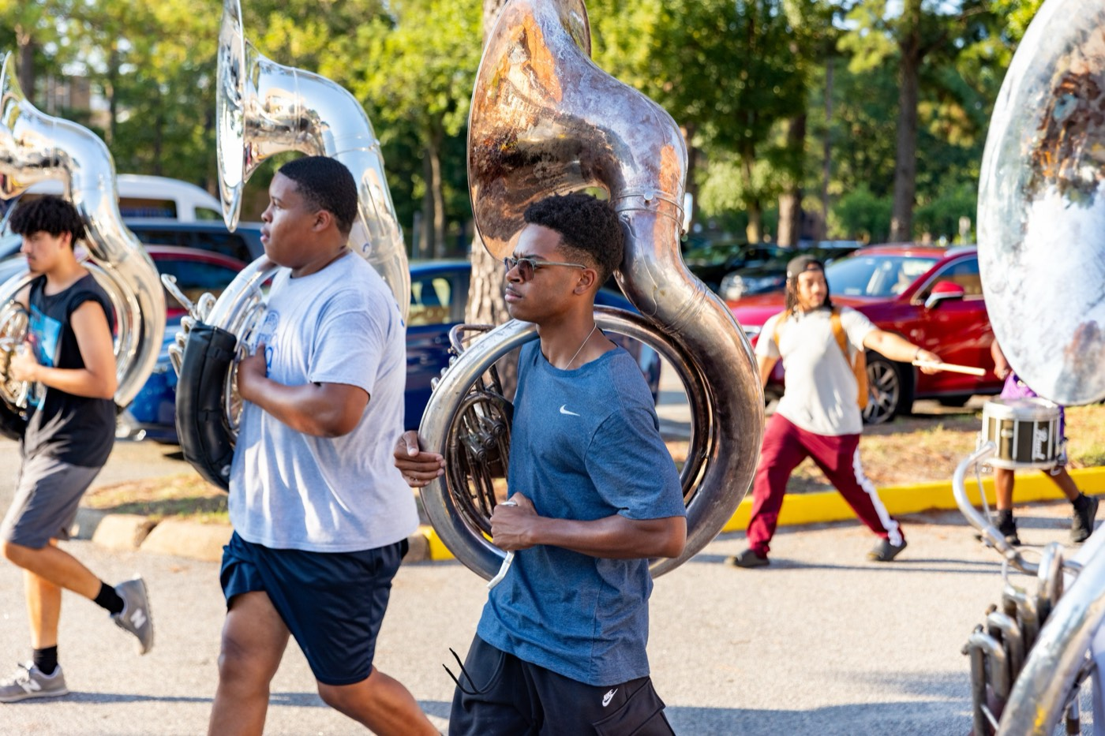
— COMMUNICATION AND AMBASSADORS
THE HAMPTON UNIVERSITY MARCHING FORCE
Teach Them How to Communicate
Correcting behavior is not the same as building a skill.
◆ stop talkingtelling members to stop talking, teach them how and when to talk—that is the difference between managing a section and developing one.
◆ Show them what "right" sounds like: when to speak up in a rehearsal, when to hold it, and who to bring it to.
◆ disciplineommunication is teaching discipline. A section that knows the protocol polices itself.
◆ Model it constantly. Your line will communicate the way they watch you communicate.
Source: Jay Jones, Leadership 101—teach members to be good communicators while you teach discipline.
Pre-Drill Camp 2026 · Leadership Seminars
07
Notes:
SLIDE 7 — TEACH THEM HOW TO COMMUNICATE
JAY'S LINE — use it as written: "Rather than telling members to stop talking, teach them how and when to talk."
"That's the difference between managing a section and developing one."
"Teaching communication is teaching discipline. A section that knows the protocol polices itself."

Slide 8
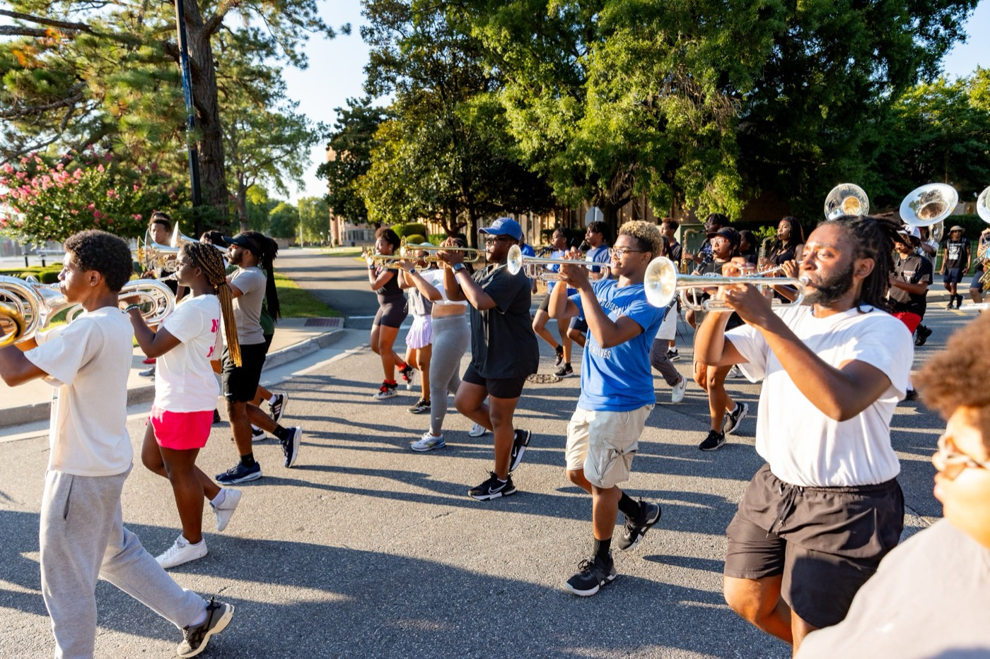
— COMMUNICATION AND AMBASSADORS
THE HAMPTON UNIVERSITY MARCHING FORCE
Core Communication Skills
Four habits that carry every message you send.
1
Listen First
Hear the whole thing before you answer. Most miscommunication is a listening failure, not a talking failure.
For the hard ones: see Difficult Conversations—Radical Candor, and naming the issue with Situation, Behavior, and Impact.
Pre-Drill Camp 2026 · Leadership Seminars
08
Notes:
SLIDE 8 — CORE COMMUNICATION SKILLS
Listen First, Be Clear, Mind the Tone, Pick the Moment.
BEST ONE: "Text has no tone. So give it one on purpose."
AND: "Public praise, private correction."
POINT FORWARD: the source line sends them to Difficult Conversations for the hard ones — don't re-teach that here.

Slide 9
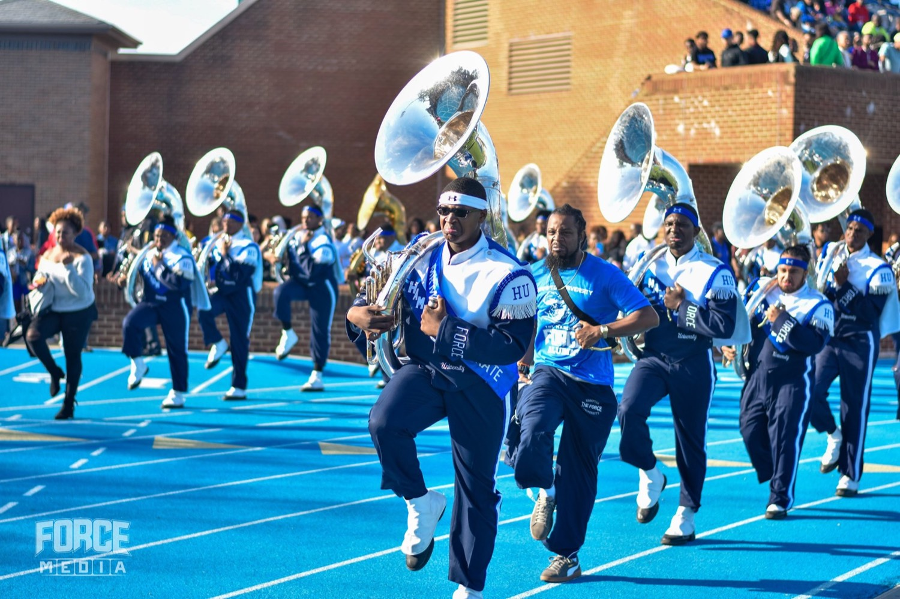
— COMMUNICATION AND AMBASSADORS
THE HAMPTON UNIVERSITY MARCHING FORCE
You Are an Ambassador
Off the field, you are the band to whoever is watching.
◆ Hamptonairport, the hotel, the restaurant, and the stands, people do not see a student. They see Hampton.
◆ one interaction with one of usalumni, and donors form their whole opinion of this program from one interaction with one of us.
◆ Speak to people. Say good morning, hold the door, thank the staff and the bus driver. That costs nothing and it is remembered.
◆ You are the pitch only what the staff does. You are the pitch—the way Ernie Davis was for Floyd Little.
Pre-Drill Camp 2026 · Leadership Seminars
09
Notes:
SLIDE 9 — YOU ARE AN AMBASSADOR
Second presenter takes over here if you're splitting.
"In the airport, the hotel, the restaurant, the stands — people don't see a student. They see Hampton."
CHEAP AND MEMORABLE: "Say good morning, hold the door, thank the staff and the bus driver. Costs nothing and it's remembered."
TIE BACK TO THE CLIP: "You are the pitch — the way Ernie Davis was for Floyd Little."

Slide 10
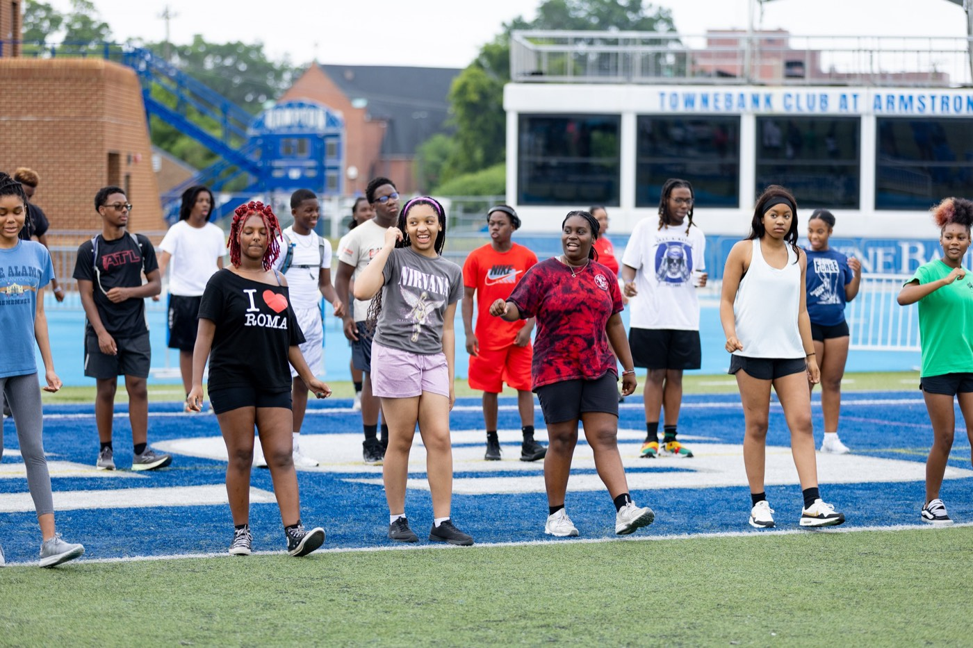
— COMMUNICATION AND AMBASSADORS
THE HAMPTON UNIVERSITY MARCHING FORCE
Social Media Is the Public Record
The internet does not forget, and it does not add context.
◆ the program speaking Force gear, at a Force event, or about a Force member is the program speaking, whether you meant it that way or not.
◆ Never air band business online. Conflicts, corrections, and complaints go up the chain—never on a timeline.
◆ Assume a future employer, an admissions officer, and a recruit's mother all see it. Post like that is true, because it is.
◆ recruiting toolr platform is a recruiting tool. Post the clean reps, the wins, and the culture we actually want people to join.
Pre-Drill Camp 2026 · Leadership Seminars
10
Notes:
SLIDE 10 — SOCIAL MEDIA IS THE PUBLIC RECORD
Be direct; this is the one with real consequences.
"Anything you post in Force gear, at a Force event, or about a Force member is the program speaking — whether you meant it that way or not."
HARD RULE: "Never air band business online. Conflicts and complaints go up the chain, never on a timeline."
"Assume a future employer, an admissions officer, and a recruit's mother all see it. Post like that's true, because it is."
THEN THE UPSIDE: used right, it's a recruiting tool.

Slide 11
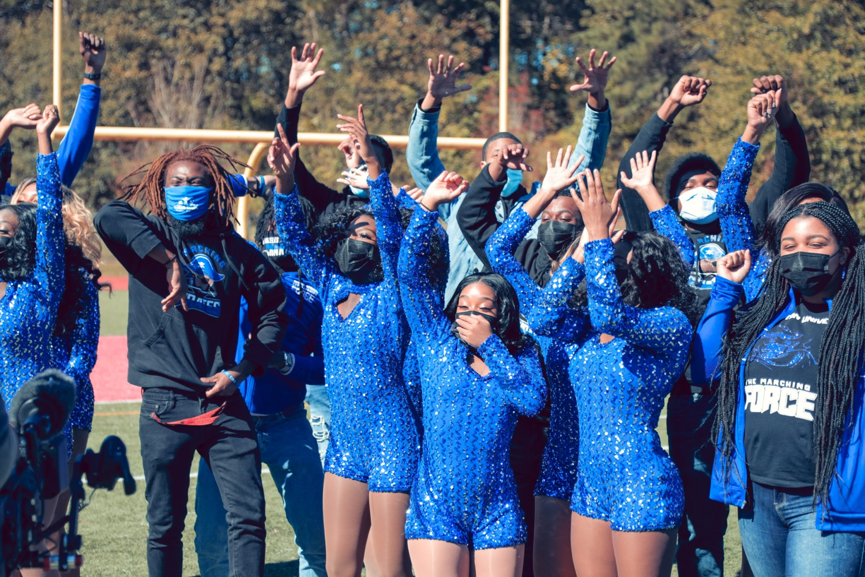
— COMMUNICATION AND AMBASSADORS
THE HAMPTON UNIVERSITY MARCHING FORCE
The Core of This Program
Every message you send should carry all four.
Source: Jay Jones, Leadership 101—spirit, unity, discipline, and attitude as the core of a band program and its leadership.
Pre-Drill Camp 2026 · Leadership Seminars
11
Notes:
SLIDE 11 — THE CORE OF THIS PROGRAM
JAY: spirit, unity, discipline, attitude — your framework. Take it.
Map each onto communication. The one to lean on: "Unity — leaders do not contradict each other in front of the band."

Slide 12
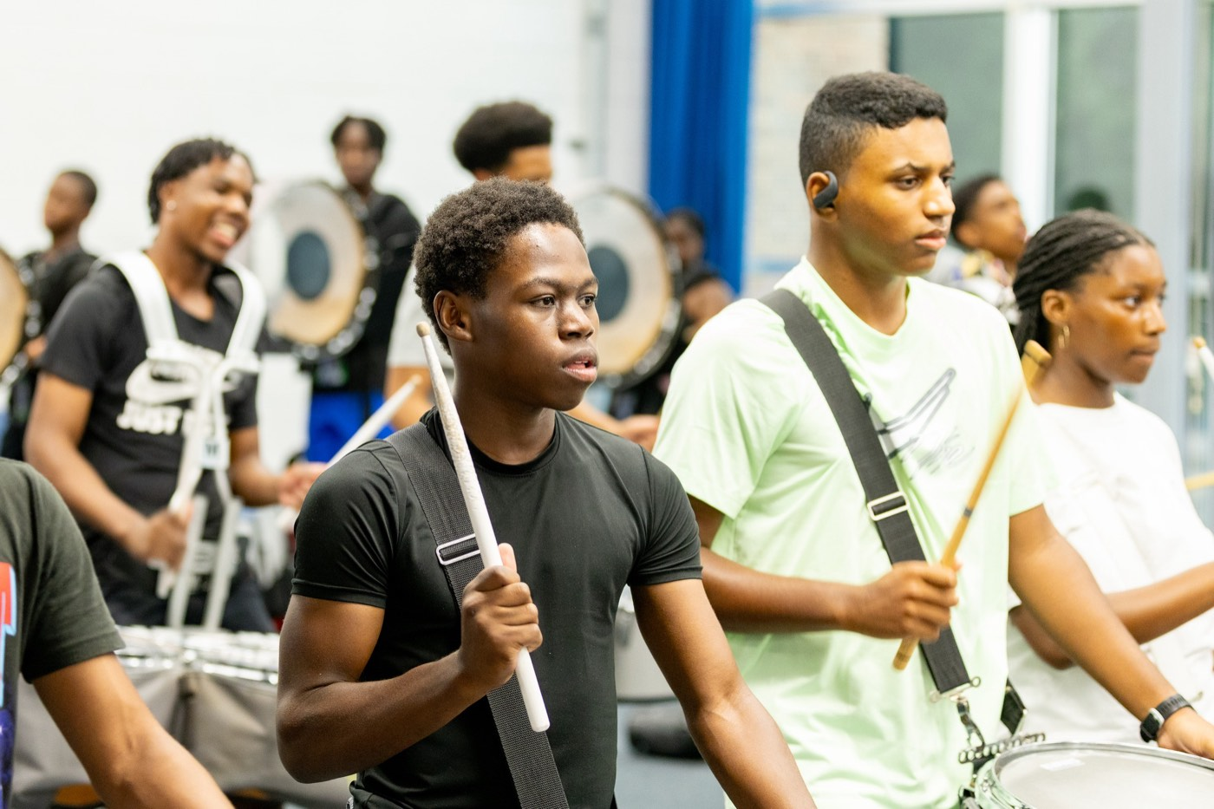
— COMMUNICATION AND AMBASSADORS
THE HAMPTON UNIVERSITY MARCHING FORCE
The Communication Playbook
Four moves, every day.
1
Know the Chain
Learn the rung above you and below you, and use them. Safety and hazing go straight to the director.
Pre-Drill Camp 2026 · Leadership Seminars
12
Notes:
SLIDE 12 — THE COMMUNICATION PLAYBOOK
Know the Chain, Move It Up, Move It Down, Represent Out.
Photograph slide.

Slide 13
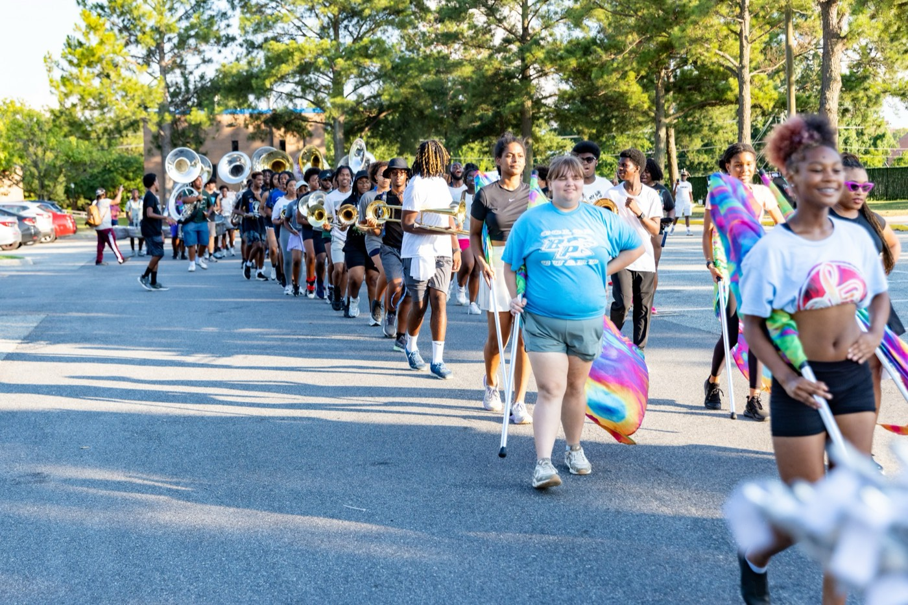
YOUR CHARGE
Speak Like
the Whole Band
Is Behind You.
Because it is. Every message you move up the chain, every detail you pass down to your line, and every word you put out in public or online carries this program's name with it. Learn the chain and use it. Bring problems early and bring them straight. Tell your people everything they need and make sure it landed. And when you are out in the world in Hampton gear, remember that somebody is deciding what they think of The Marching Force based entirely on you. Give them a reason to want in.
Serve First. Lead Always. — Drive the Legacy.
The Hampton University Marching Force
Hampton's Heartbeat
Notes:
SLIDE 13 — CLOSE: Speak Like the Whole Band Is Behind You.
"Because it is."
End on: "Somebody is deciding what they think of The Marching Force based entirely on you. Give them a reason to want in."

