Slide 1

PRE-DRILL CAMP 2026 · LEADERSHIP SEMINARS · DAY 2
Twirler Recruitment
"Go Find Them."
Madison Ramsingh
Twirler Recruitment · All Leaders, Sunday, August 2, 2026
The Hampton University Marching Force
Hampton's Heartbeat
Notes:
SLIDE 1 — TITLE: Twirler Recruitment
PRESENTER: Madison Ramsingh. She twirls in this program — that's her credibility, so let her use it.
OPEN: "We field three twirlers. Three. Today is about how we change that."

Slide 2
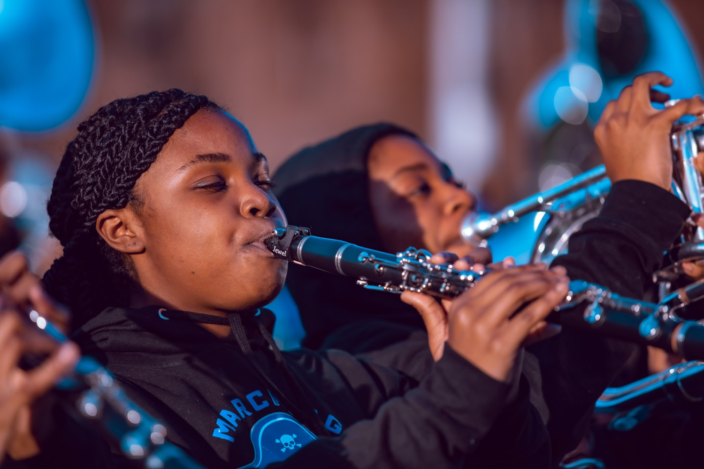
— TWIRLER RECRUITMENT
THE HAMPTON UNIVERSITY MARCHING FORCE
Icebreaker
Coach Don Haskins built a national championship team by driving to living rooms nobody else would visit and recruiting the players other programs would not go get. Watch him sit down in front of a kid and make it personal: "I didn't come here to find a player I could sit on the bench. I intend to start you."
▶
Glory Road — Haskins Makes the Pitch
youtu.be/JRhjHvIFYT4
WATCH · 1:42
Pre-Drill Camp 2026 · Leadership Seminars
02
Notes:
SLIDE 2 — ICEBREAKER: Glory Road, Haskins Makes the Pitch (1:42)
SET UP: "Coach Don Haskins won a national championship by driving to living rooms nobody else would visit."
Play it.
AFTER: "'I didn't come here to find a player I could sit on the bench. I intend to start you.' He went TO the kid, and he made it personal. That's the whole session."

Slide 3
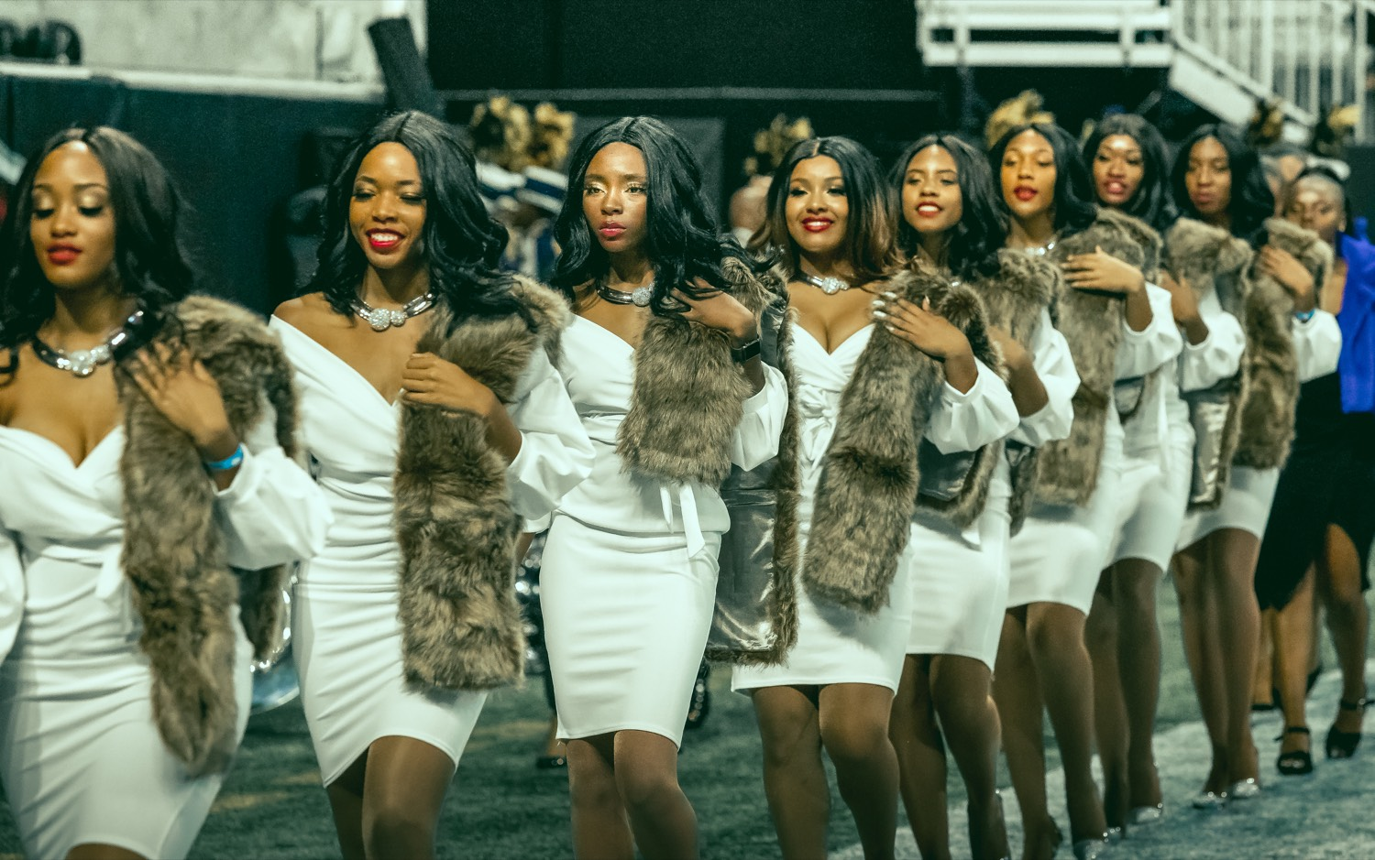
01
THE PREMISE
The Marching Force currently fields three twirlers. Three, in a band of more than two hundred. That is not a talent problem, it is a recruiting problem. Twirlers are out there right now, training in studios and competing in gyms nearly every weekend of the year. They are simply not going to walk into our band room on their own, because twirlers never come from the band room. If we want more of them, we do what we already do for horn players: we find them, we go to them, and we recruit them.
TALENT DOES NOT FIND US. WE FIND IT.
Notes:
SLIDE 3 — THE PREMISE (statement slide)
Read it.
THE NUMBER LANDS: "Three twirlers, in a band of more than two hundred. That's not a talent problem. It's a recruiting problem."
Takeaway: "Talent does not find us. We find it."

Slide 4
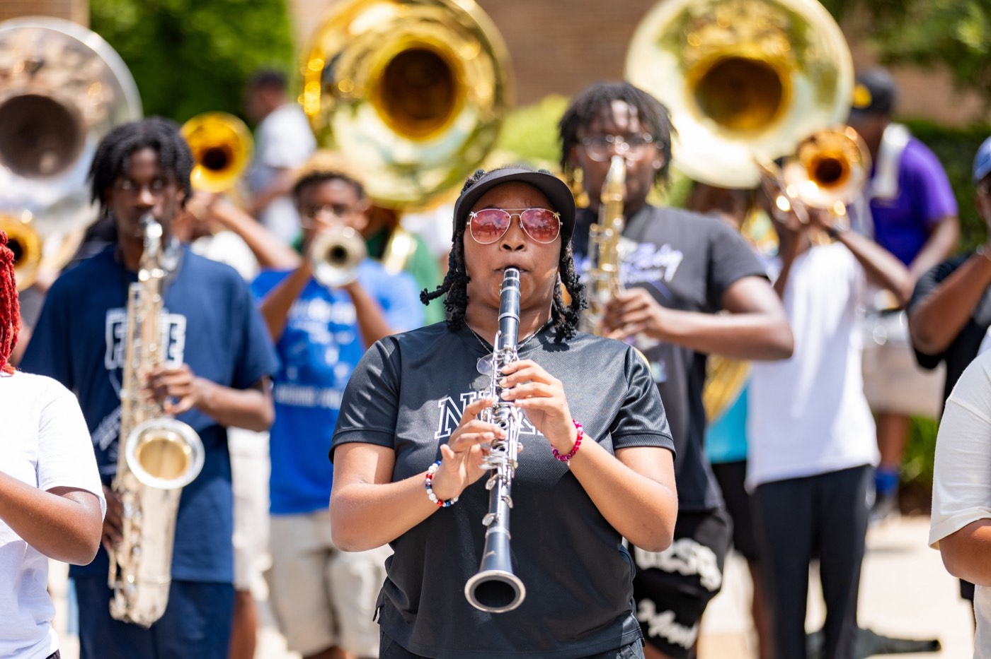
— TWIRLER RECRUITMENT
THE HAMPTON UNIVERSITY MARCHING FORCE
Why This Line Is Different
You cannot recruit twirlers the way you recruit trumpets.
◆ school pipelines come to us through a school pipeline—band class, district bands, all-state, and directors who know us and send us players.
◆ no school pipelinechool pipeline. Most high schools have one feature twirler, or none. There is no twirling class to visit.
◆ studios and clubsely, in studios and clubs, with their own coaches, on their own competitive circuit that runs all year.
◆ scouting groundse is identical to instrumentalist recruiting; only the scouting grounds change. If we look where we always look, we will keep finding three.
Pre-Drill Camp 2026 · Leadership Seminars
04
Notes:
SLIDE 4 — WHY THIS LINE IS DIFFERENT
The key strategic insight — make sure it lands before moving on.
"Instrumentalists come through a school pipeline — band class, district, all-state, directors who send us players."
"Twirlers have NO school pipeline. Most high schools have one feature twirler, or none. There's no twirling class to visit."
LAND: "Same discipline as recruiting horn players. Different scouting grounds. If we look where we always look, we'll keep finding three."

Slide 5
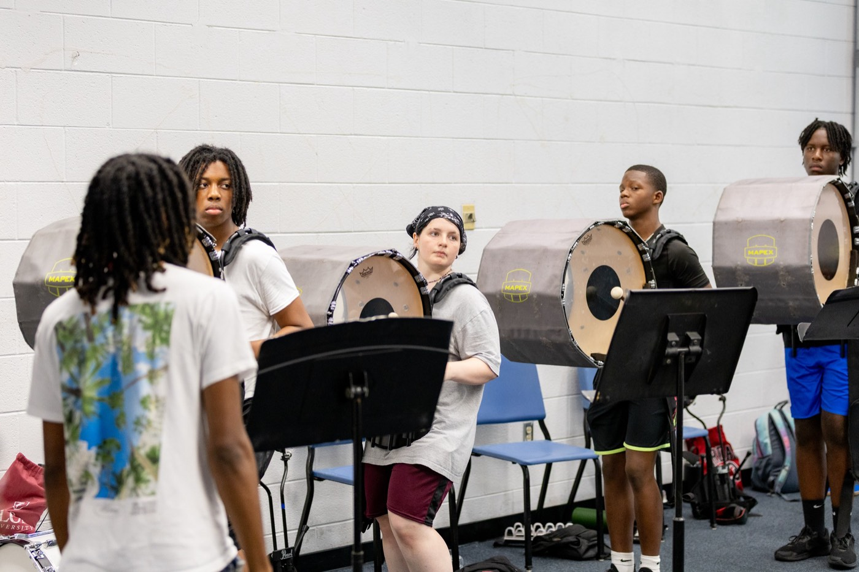
— TWIRLER RECRUITMENT
THE HAMPTON UNIVERSITY MARCHING FORCE
Where the Twirlers Actually Are
Four places worth our gas money.
◆ Private twirling studios and clubs. This is where nearly every serious twirler trains. Build relationships with the coaches, because the coach decides who hears about us.
◆ The competition circuit. Regionals, state championships, and nationals put hundreds of twirlers on one floor in one weekend.
◆ High school feature twirlers. The solo twirler in front of a marching band is already doing our job, in uniform, on Friday nights.
◆ Dance and gymnastics programs. Athletes with that body control convert quickly when a coach is willing to teach baton.
Pre-Drill Camp 2026 · Leadership Seminars
05
Notes:
SLIDE 5 — WHERE THE TWIRLERS ACTUALLY ARE
Four places: private studios and clubs, the competition circuit, high school feature twirlers, and dance/gymnastics programs.
MADISON: say where YOU came from. A real path makes this concrete.
KEY: "Build relationships with studio coaches — the coach decides who hears about us."

Slide 6
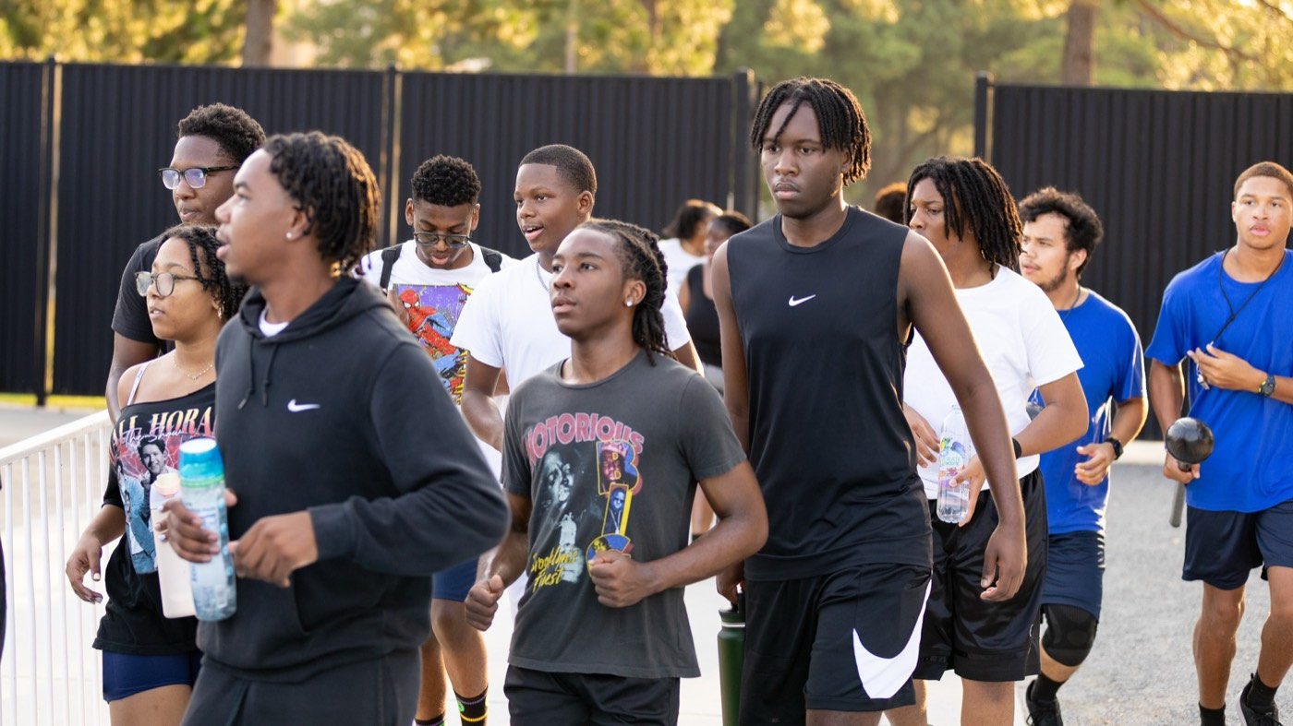
— TWIRLER RECRUITMENT
THE HAMPTON UNIVERSITY MARCHING FORCE
The Circuits to Scout
Know the organizations, and the calendar comes with them.
◆ NBTA (National Baton Twirling Association) runs America's Youth on Parade at Notre Dame each summer—one of the largest gatherings of twirlers in the country.
◆ USTA (United States Twirling Association) runs its own regional and national championships.
◆ Twirl Mania hosts an international championship at the ESPN complex in Orlando each winter.
◆ State championships run in the spring. Virginia, Maryland, the Carolinas, Georgia, and Florida are all inside a reasonable drive.
Note: confirm each season's dates and locations before we build the travel budget.
Pre-Drill Camp 2026 · Leadership Seminars
06
Notes:
SLIDE 6 — THE CIRCUITS TO SCOUT
NBTA and America's Youth on Parade at Notre Dame; USTA regionals and nationals; Twirl Mania at the ESPN complex in Orlando; state championships in spring.
GEOGRAPHY: Virginia, Maryland, the Carolinas, Georgia, Florida — all a reasonable drive.
SAY THE CAVEAT ON SCREEN: confirm each season's dates and locations before anybody builds a travel budget.

Slide 7
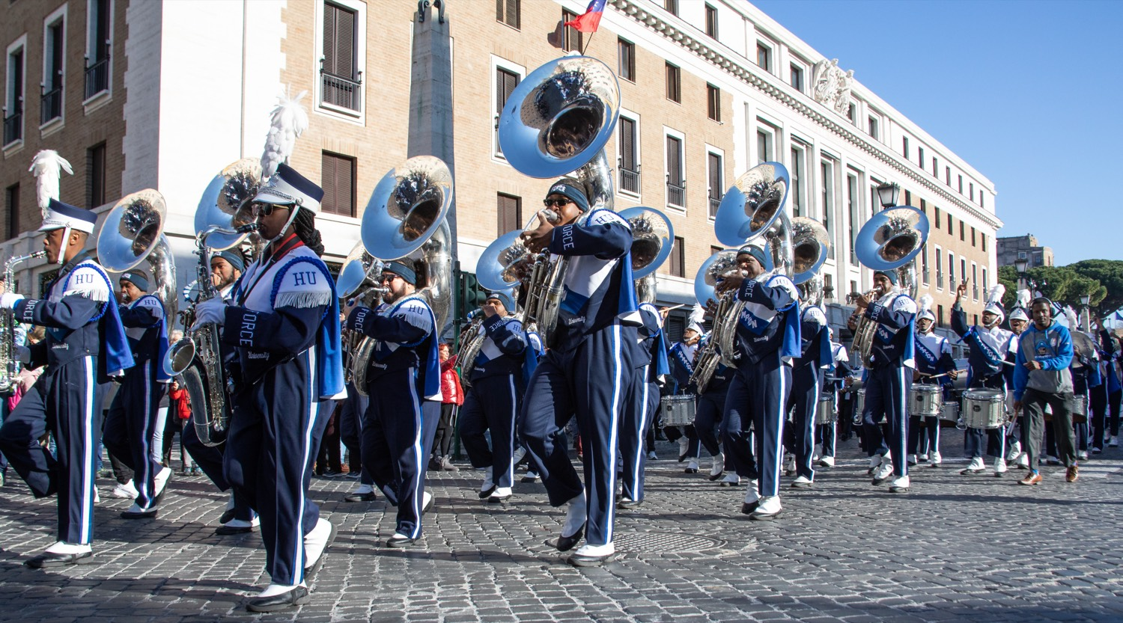
— TWIRLER RECRUITMENT
THE HAMPTON UNIVERSITY MARCHING FORCE
Go to Them
The same thing we do for instrumentalists—on a different map.
◆ travel to see twirlersplayers. We should travel to see twirlers, and we should be visible when we do: Hampton gear, on site, in the stands.
◆ herting in the audience at a competition tells a twirler and her coach that we came for her. Nothing we mail or post does that.
◆ coach and the parents the coach and the parents, not only the athlete. In this world, they are part of the decision.
◆ relationship, not an announcement an announcement. Showing up in person is how the relationship starts.
Pre-Drill Camp 2026 · Leadership Seminars
07
Notes:
SLIDE 7 — GO TO THEM
The heart of it.
"We travel to see horn players. We should travel to see twirlers — and be visible when we do. Hampton gear, on site, in the stands."
WHY IT WORKS: "Sitting in the audience at her competition tells her and her coach that we came for HER. Nothing we mail or post does that."
AND: "Meet the coach and the parents, not just the athlete. In this world they're part of the decision."

Slide 8
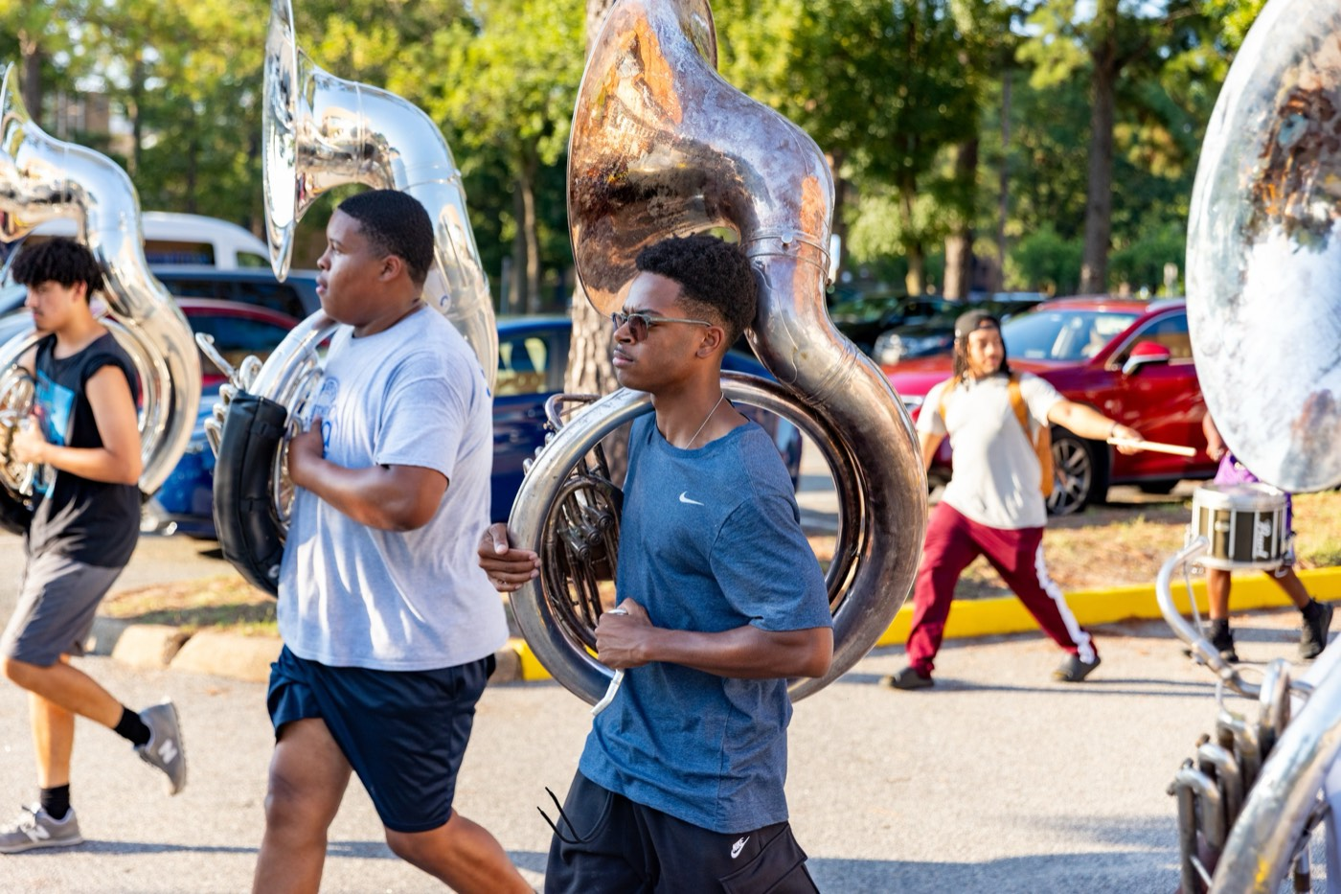
— TWIRLER RECRUITMENT
THE HAMPTON UNIVERSITY MARCHING FORCE
What We Are Looking For
Know the standard before you go scouting.
◆ Technique that holds up. Clean rolls, consistent tosses, and hands that stay quiet under pressure.
◆ Showmanship. This is an HBCU field. We need performers who can sell a routine to a full stadium, not just execute it for a judge.
◆ Coachability. Ask the coach how she takes correction. Talent we can build on, attitude we cannot.
◆ Academics. She has to be admissible and able to carry the load. Ask early so nobody's time gets wasted.
Pre-Drill Camp 2026 · Leadership Seminars
08
Notes:
SLIDE 8 — WHAT WE ARE LOOKING FOR
Technique, showmanship, coachability, academics.
HBCU-SPECIFIC: "We need performers who can sell a routine to a full stadium, not just execute it for a judge."
PRACTICAL: "Ask the coach how she takes correction. Talent we can build on; attitude we can't."
And ask about academics early so nobody's time is wasted.

Slide 9
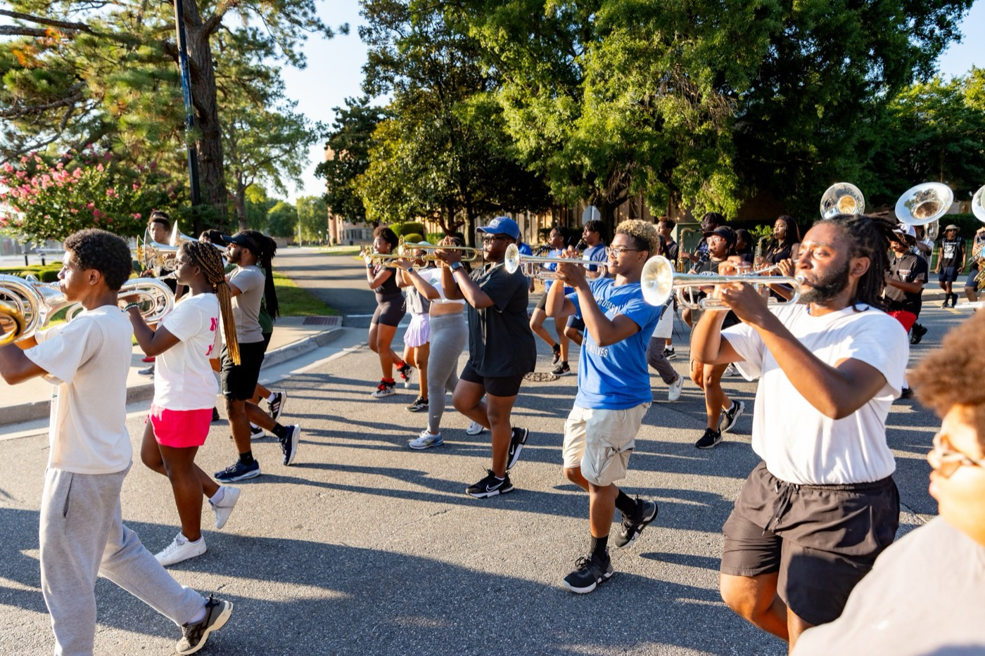
— TWIRLER RECRUITMENT
THE HAMPTON UNIVERSITY MARCHING FORCE
Make the Pitch
Know what we are offering, and say it plainly.
◆ Visibility. A twirler in the Marching Force performs in front of packed HBCU stadiums, at Homecoming, and on parade routes and broadcasts most twirlers never see.
◆ A real role. Our line is small, which means she is not buried on a roster. She will be seen from her first season.
◆ Hampton itself. The academics, the legacy, and a band family that will have her back for four years and long after.
◆ commitmentabout the commitment—camp, rehearsals, and the standard. The right recruit wants to hear it.
Pre-Drill Camp 2026 · Leadership Seminars
09
Notes:
SLIDE 9 — MAKE THE PITCH
What we're offering: visibility, a real role, and Hampton itself.
OUR ACTUAL ADVANTAGE: "Our line is small — she won't be buried on a roster. She'll be seen her first season." Say that plainly; it's the strongest card we hold.
Be honest about the commitment. The right recruit wants to hear it.

Slide 10
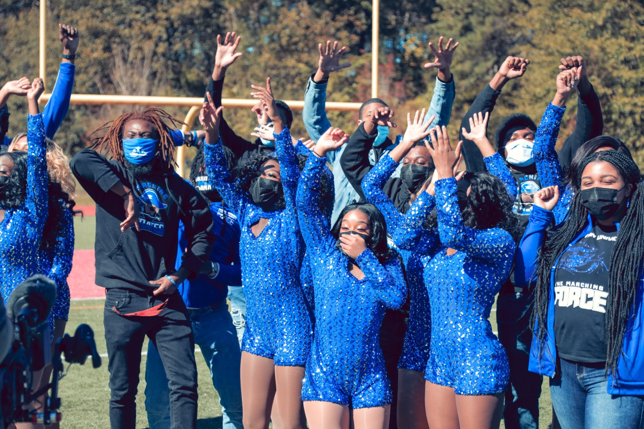
— TWIRLER RECRUITMENT
THE HAMPTON UNIVERSITY MARCHING FORCE
Every Twirler Is a Recruiter
Our best scouts already wear the uniform.
◆ Start there.twirlers know this world—their old studios, their coaches, and the girls coming up behind them. Start there.
◆ small, connected communitycted community. One good relationship with a respected coach can send us athletes for years.
◆ Post the film. Twirlers find programs on social media. Every clean clip of our line performing is a recruiting tool working while we sleep.
◆ Send our own twirlers home for breaks with something to hand out and something to say.
Pre-Drill Camp 2026 · Leadership Seminars
10
Notes:
SLIDE 10 — EVERY TWIRLER IS A RECRUITER
"Our best scouts already wear the uniform."
START WITH THE ROOM: our current twirlers know their old studios, their coaches, and the girls coming up behind them.
"Twirling is a small, connected community. One good relationship with a respected coach can send us athletes for years."
AND: "Post the film. Every clean clip of our line is a recruiting tool working while we sleep."

Slide 11
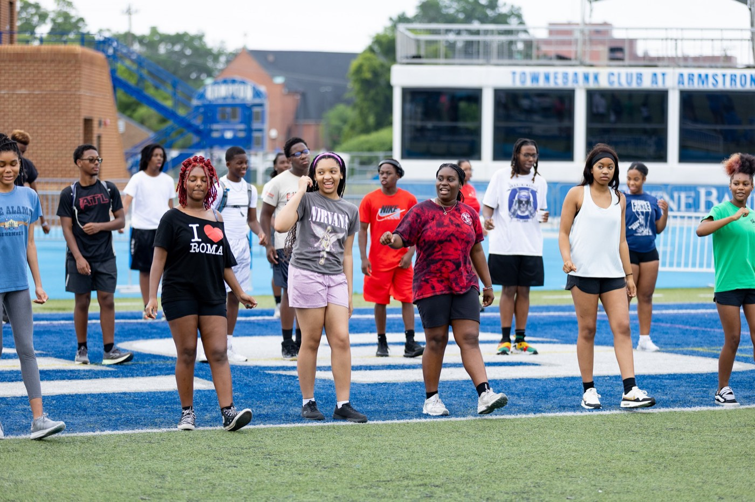
— TWIRLER RECRUITMENT
THE HAMPTON UNIVERSITY MARCHING FORCE
Work the Calendar
Recruiting is year-round, not a season.
◆ Fall: Friday nights. Feature twirlers are performing at high school games all over the region.
◆ Winter and spring: the championship season. This is when the most talent is in one room at one time.
◆ Summer: nationals, and our own camp. Invite prospects to come see us work.
◆ Always: follow up. A name in a notebook that nobody calls is not a recruit.
Pre-Drill Camp 2026 · Leadership Seminars
11
Notes:
SLIDE 11 — WORK THE CALENDAR
Fall: Friday-night feature twirlers. Winter and spring: championship season, most talent in one room. Summer: nationals, and invite prospects to our camp.
THE ONE THAT MATTERS: "Always follow up. A name in a notebook that nobody calls is not a recruit."

Slide 12
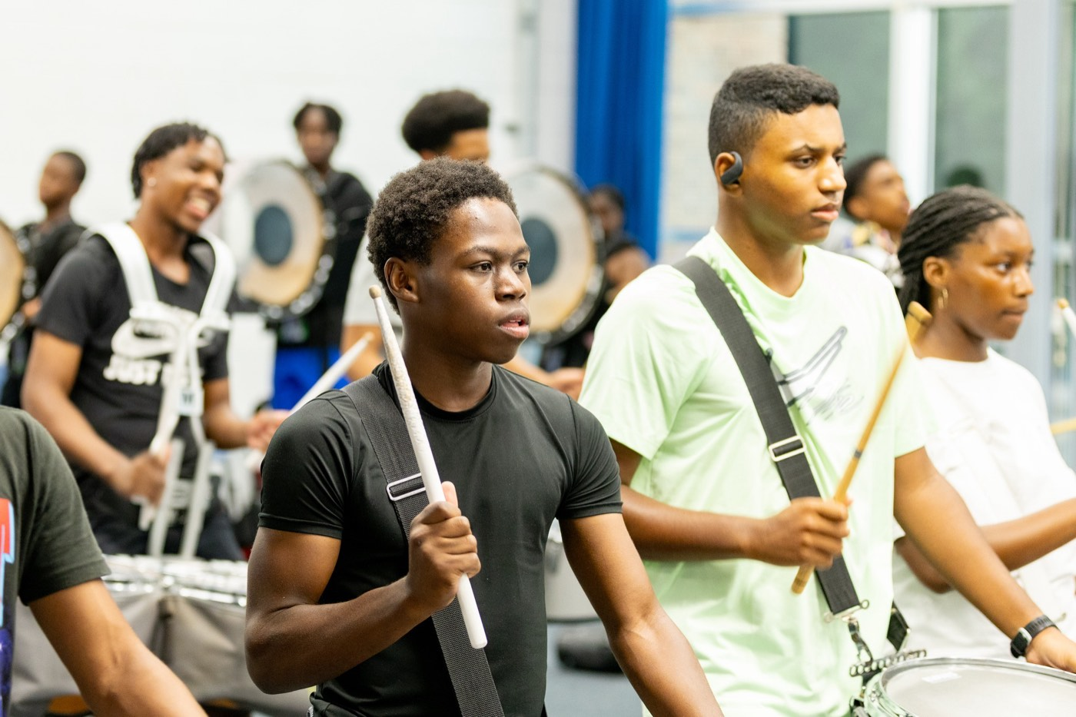
— TWIRLER RECRUITMENT
THE HAMPTON UNIVERSITY MARCHING FORCE
The Recruiting Playbook
Four moves to grow this line.
1
Scout
Work the studios, the circuits, and the Friday-night feature twirlers. Build a real prospect list.
Pre-Drill Camp 2026 · Leadership Seminars
12
Notes:
SLIDE 12 — THE RECRUITING PLAYBOOK
Scout, Travel, Pitch, Follow Up.
ASK FOR A COMMITMENT: "Name one competition or one studio we should be at this year." Write the answers down — this is where a real prospect list starts.

Slide 13
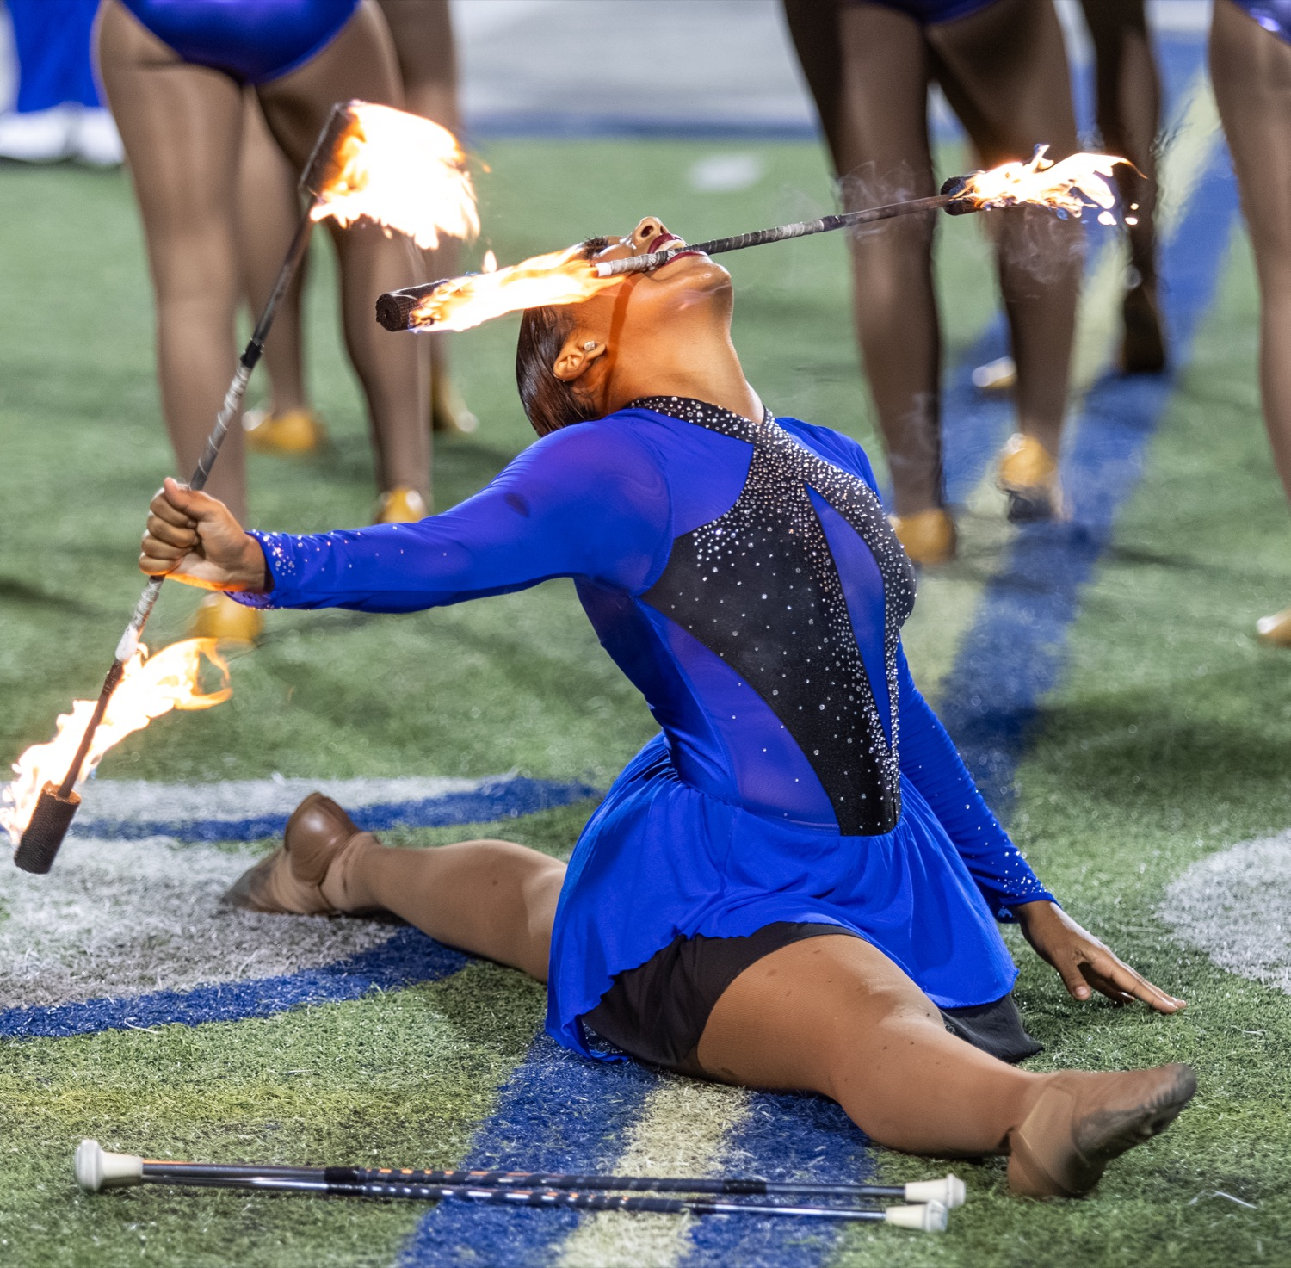
YOUR CHARGE
Go Find
Them.
Three twirlers is not the ceiling of this program, it is the size of the net we have been casting. The talent is already out there, spinning in a studio on a Tuesday night and competing in a gym on Saturday, waiting on somebody to tell her she belongs somewhere like Hampton. Nobody is going to hand her to us. So we scout the way we scout players, we get in the car, and we go where she already is. Build the line, and in a few seasons the Marching Force will have a twirling corps worth traveling to see.
Serve First. Lead Always. — Drive the Legacy.
The Hampton University Marching Force
Hampton's Heartbeat
Notes:
SLIDE 13 — CLOSE: Go Find Them.
"Three twirlers isn't the ceiling of this program. It's the size of the net we've been casting."
End on: "Build the line, and in a few seasons the Marching Force will have a twirling corps worth traveling to see."

