Slide 1
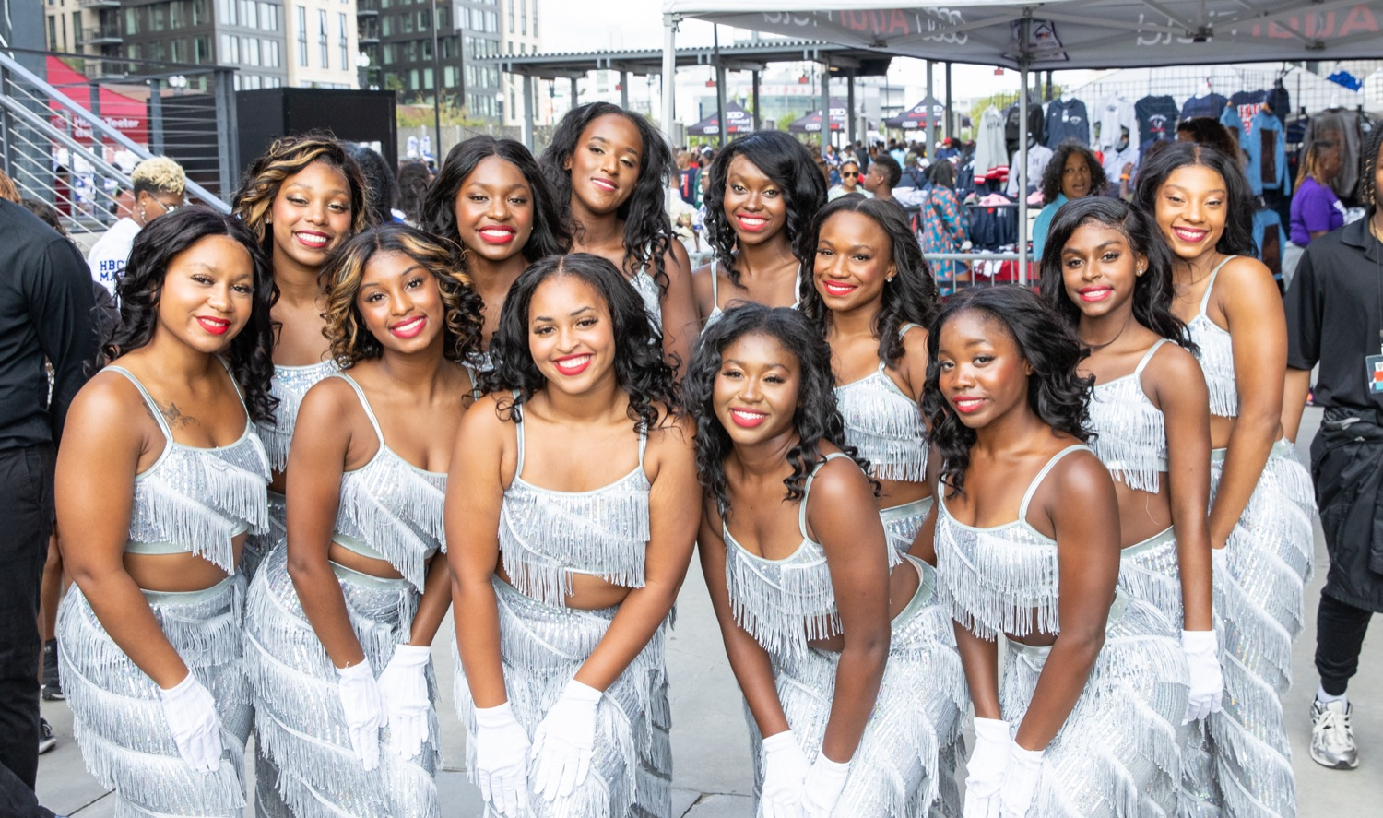
PRE-DRILL CAMP 2026 · LEADERSHIP SEMINARS · DAY 2
Supporting the Auxiliary
"Have Their Backs."
Coach Megan and Coach Brint
Auxiliary Coaches · Instrumentalists, Sunday, August 2, 2026
The Hampton University Marching Force
Hampton's Heartbeat
Notes:
SLIDE 1 — TITLE: Supporting the Auxiliary
PRESENTERS: Coach Megan and Coach Brint, the auxiliary coaches. AUDIENCE: instrumentalists only.
OPEN: "We coach the dancers, flags, and batons. Today we're talking to the band about them."
FRAME IT AS A PARTNERSHIP, not a complaint. Set that tone in the first thirty seconds or the room gets defensive.

Slide 2
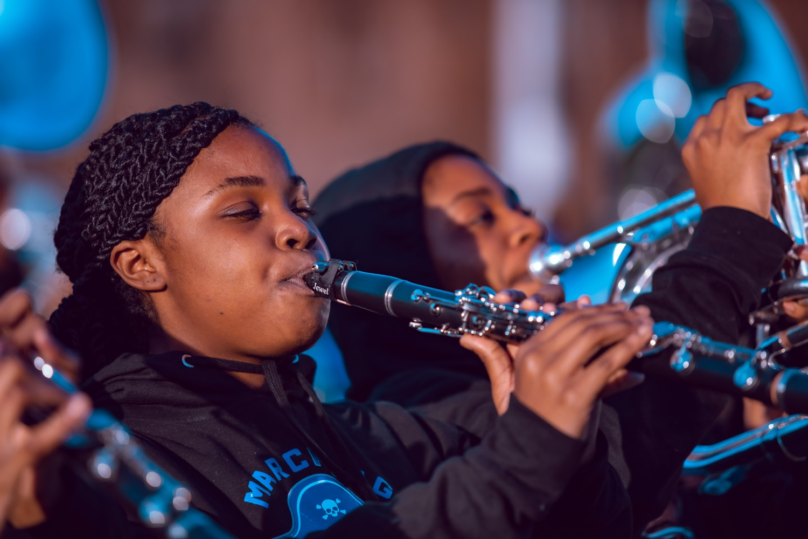
— SUPPORTING THE AUXILIARY
THE HAMPTON UNIVERSITY MARCHING FORCE
Icebreaker
Two moments from Hidden Figures: a team of people who get where they are going by backing each other, trusting each other's work, and making room for one another to shine. That is exactly the deal between the band and the auxiliary.
CLIP ONE
Hidden Figures — “You Are The Boss”
youtu.be/sQLYZ0Uxxvg
Pre-Drill Camp 2026 · Leadership Seminars
02
Notes:
SLIDE 2 — ICEBREAKER: two Hidden Figures clips (1:08 and 1:30)
Both are short — play them back to back.
Clip one: "You Are The Boss." Clip two: "Give or Take."
AFTER: "A team that gets where it's going by backing each other and trusting each other's work. That's the deal between the band and the auxiliary."

Slide 3
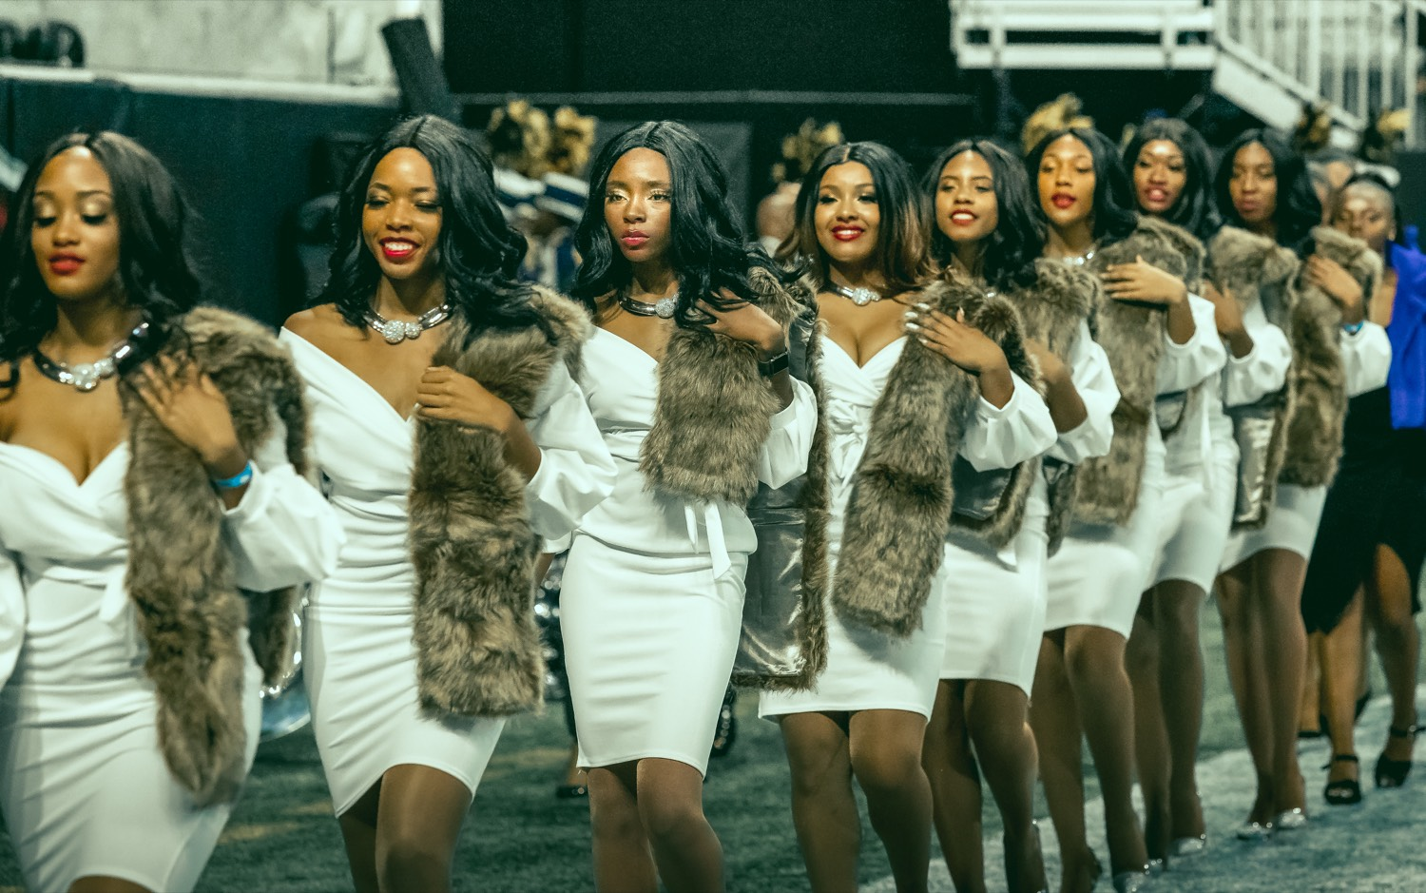
01
THE PREMISE
Coaches, talking to the band: the auxiliary is not decoration on the edge of your show—they are the visual voice of it. Every flag, every eight-count, every routine is built on the sound you make. When you are steady, they fly; when you are shaky, they fall, no matter how hard they have worked. The best bands in the country treat their auxiliary as full partners, not an afterthought—and it shows on the field.
ONE SHOW. TWO HALVES. ONE STANDARD.
Notes:
SLIDE 3 — THE PREMISE (statement slide)
Read it.
THE CORE: "The auxiliary is not decoration on the edge of your show. They are the visual voice of it."
AND: "When you're steady, they fly. When you're shaky, they fall — no matter how hard they worked."
Takeaway: "One show. Two halves. One standard."

Slide 4
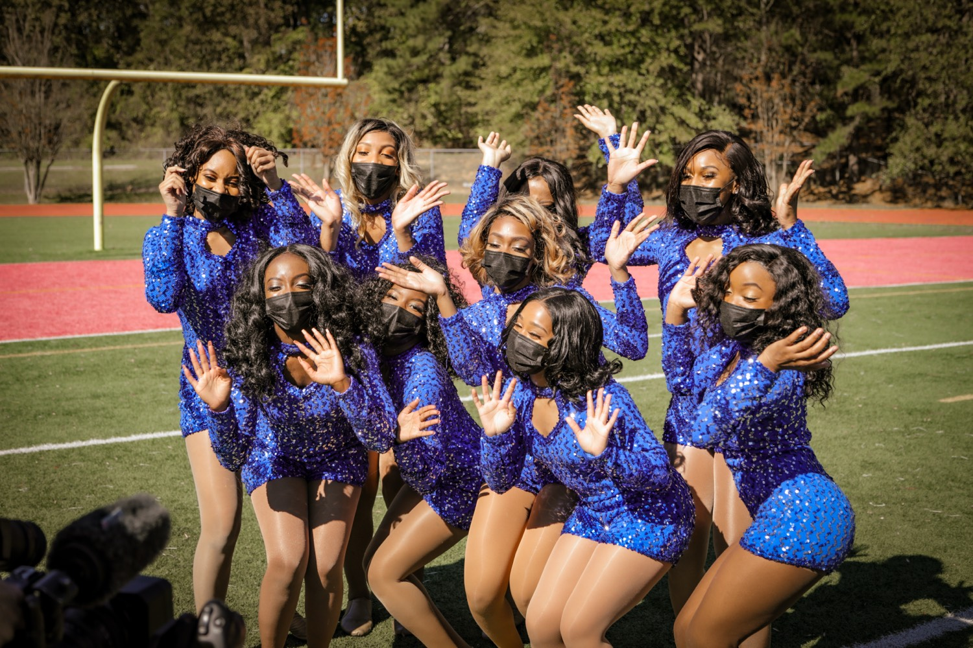
— SUPPORTING THE AUXILIARY
THE HAMPTON UNIVERSITY MARCHING FORCE
What the Auxiliary Actually Does
Before you support it, respect it.
◆ athletic batons, spinning flags, and dancing full-out for a whole show is athletic—it takes strength, timing, and hours most of you never see.
◆ nailing a tossas much choreography as you do music, and they perform it while nailing a toss or landing a turn on an exact count.
◆ They train through blisters, drops, and bruises to make it look effortless—and effortless is the hardest thing there is.
◆ The auxiliary is not the "extra." On most fields, they are the first thing the crowd's eyes find.
Reference: Winter Guard International calls color guard "the Sport of the Arts" — the auxiliary are performing athletes.
Pre-Drill Camp 2026 · Leadership Seminars
04
Notes:
SLIDE 4 — WHAT THE AUXILIARY ACTUALLY DOES
This is the respect slide. Spend real time.
"Twirling, spinning flags, dancing full-out for a whole show is athletic. Strength, timing, and hours you never see."
"They memorize as much choreography as you memorize music — and perform it while nailing a toss."
CUE: Coaches, give one concrete example from your own rehearsals — a number of hours, a specific skill. Specifics beat adjectives.
NOTE: we use flags and batons. No rifles or sabres.

Slide 5
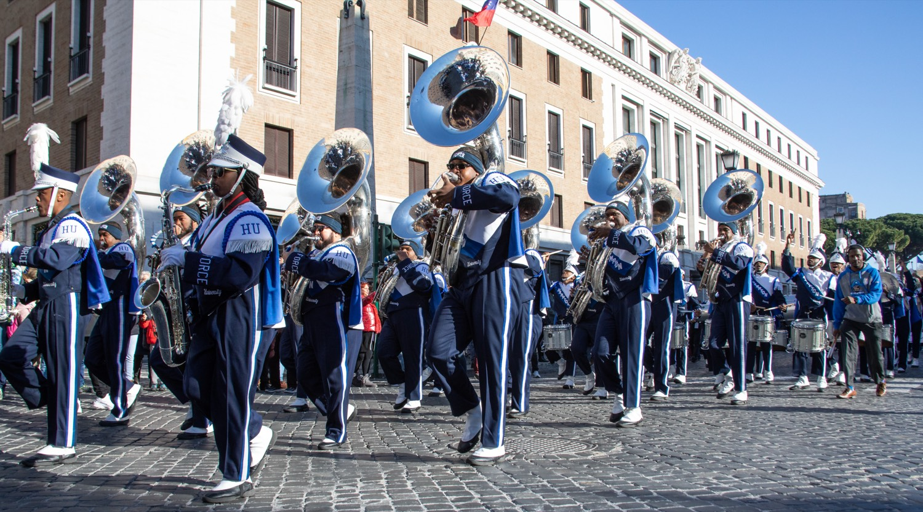
— SUPPORTING THE AUXILIARY
THE HAMPTON UNIVERSITY MARCHING FORCE
You Are Their Floor
Everything they do, they do on your sound.
◆ yourauxiliary doesn't perform to music in general—they perform to your music, on your counts, in real time.
◆ Your sound is the floor they dance on. A solid floor lets them take risks; a shaky one makes them play it safe.
◆ When the band is locked in, the aux can push harder, sell bigger, and trust that the hit will be there.
◆ your performance is part of theirs.e mindset: your performance is part of theirs.
Pre-Drill Camp 2026 · Leadership Seminars
05
Notes:
SLIDE 5 — YOU ARE THEIR FLOOR
"They don't perform to music in general. They perform to YOUR music, on YOUR counts, in real time."
THE IMAGE: "Your sound is the floor they dance on. A solid floor lets them take risks."

Slide 6
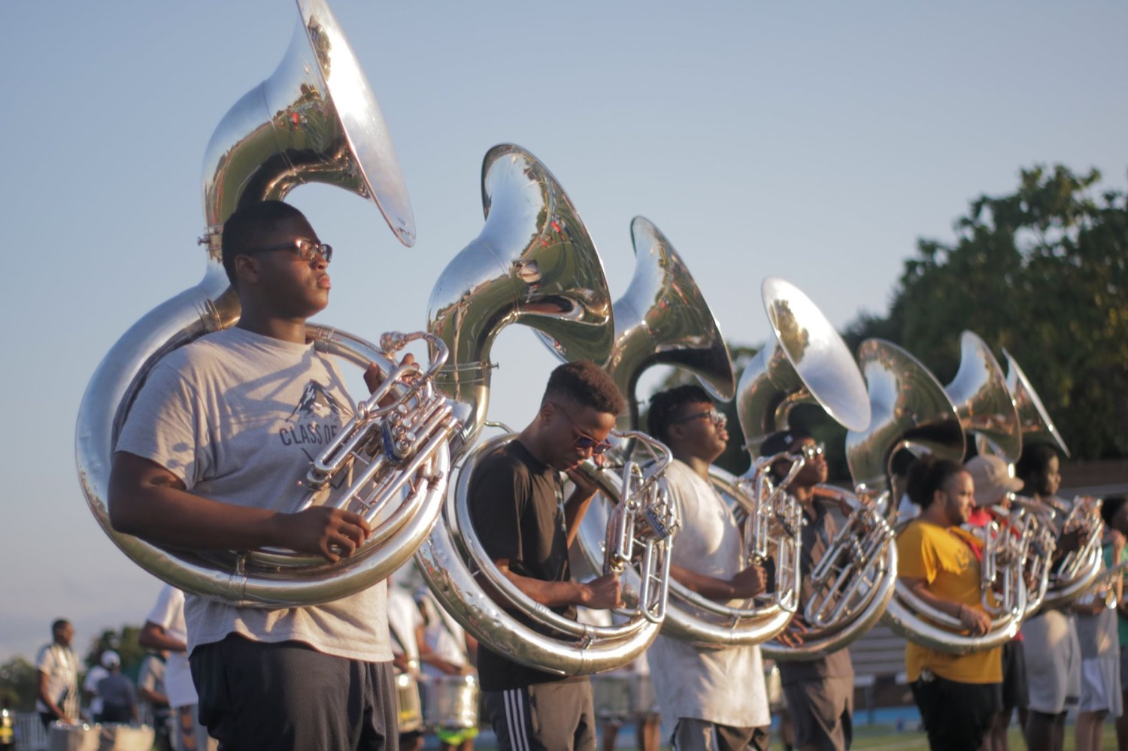
— SUPPORTING THE AUXILIARY
THE HAMPTON UNIVERSITY MARCHING FORCE
Hold the Tempo
The single biggest thing you do for the auxiliary.
◆ exact tempone is counted to an exact tempo. Rush it or drag it and their toss lands wrong, their turn finishes late, and the whole visual breaks—through no fault of theirs.
◆ Be the count they can trust.mid-routine the way you might. They are locked to the count you set. Be the count they can trust.
◆ Watch the drum major, not the excitement. The moments you most want to speed up are the moments they most need you steady.
◆ Rock-steady time is the greatest gift the band gives the auxiliary. Give it every rep.
Pre-Drill Camp 2026 · Leadership Seminars
06
Notes:
SLIDE 6 — HOLD THE TEMPO
The single most important slide in the deck for this audience.
"Every routine is counted to an exact tempo. Rush it and the toss lands wrong — through no fault of theirs."
KEY: "They can't feel it out mid-routine the way you might. They're locked to the count you set."
COACHES: if you have a story about a rushed tempo wrecking a routine, this is where it goes.

Slide 7

— SUPPORTING THE AUXILIARY
THE HAMPTON UNIVERSITY MARCHING FORCE
Hit Together, Give Them Dynamics
Clean sound gives them clean visuals.
◆ unified hitit gives the aux a sharp visual accent to nail. A ragged hit gives them nothing to catch.
◆ Dynamics give them levels to perform to—a swell to grow into, a drop to get delicate on. Flat sound is a flat canvas.
◆ Consistency lets them trust it. If the hit lands in a different spot every rep, they can't build a routine on it.
◆ Clean, together, and the same every time—that is what lets the aux design something great on top of you.
Pre-Drill Camp 2026 · Leadership Seminars
07
Notes:
SLIDE 7 — HIT TOGETHER, GIVE THEM DYNAMICS
"A unified hit gives them a sharp visual accent to nail. A ragged hit gives them nothing."
"Dynamics give them levels to perform to. Flat sound is a flat canvas."
AND consistency — "if the hit lands in a different spot every rep, they can't build on it."

Slide 8
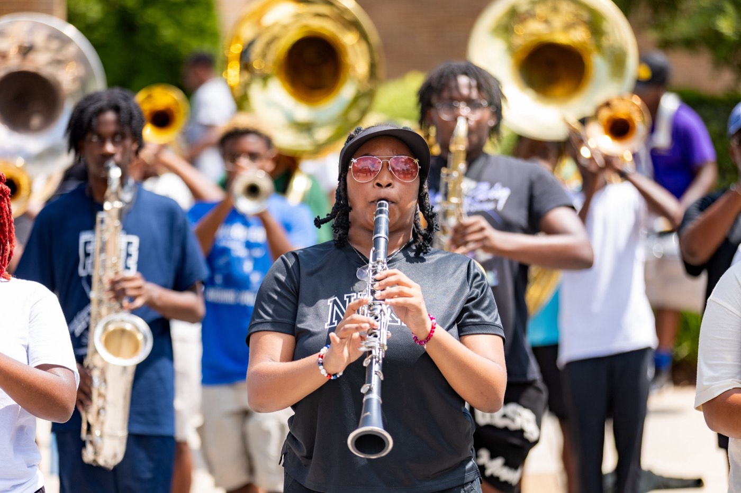
— SUPPORTING THE AUXILIARY
THE HAMPTON UNIVERSITY MARCHING FORCE
Give Them Room
Know where they are—and stay out of their space.
◆ airspaced batons need airspace; dancers need floor. Drift into their zone and you don't just crowd them—you can hurt them.
◆ spacing and intervals intervals cold, and know where the aux sets up in every drill. Your form protects their performance.
◆ Never make the auxiliary dodge the band. On a clean field, everyone has room to be great.
◆ Awareness is support: eyes up, know what's flying near you, and hold your form so they can hold theirs.
Pre-Drill Camp 2026 · Leadership Seminars
08
Notes:
SLIDE 8 — GIVE THEM ROOM
Safety slide. Be direct.
"Flags and batons need airspace. Dancers need floor. Drift into their zone and you don't just crowd them — you can hurt them."
"Know your spacing and know where the aux sets up in every drill."
"Never make the auxiliary dodge the band."

Slide 9
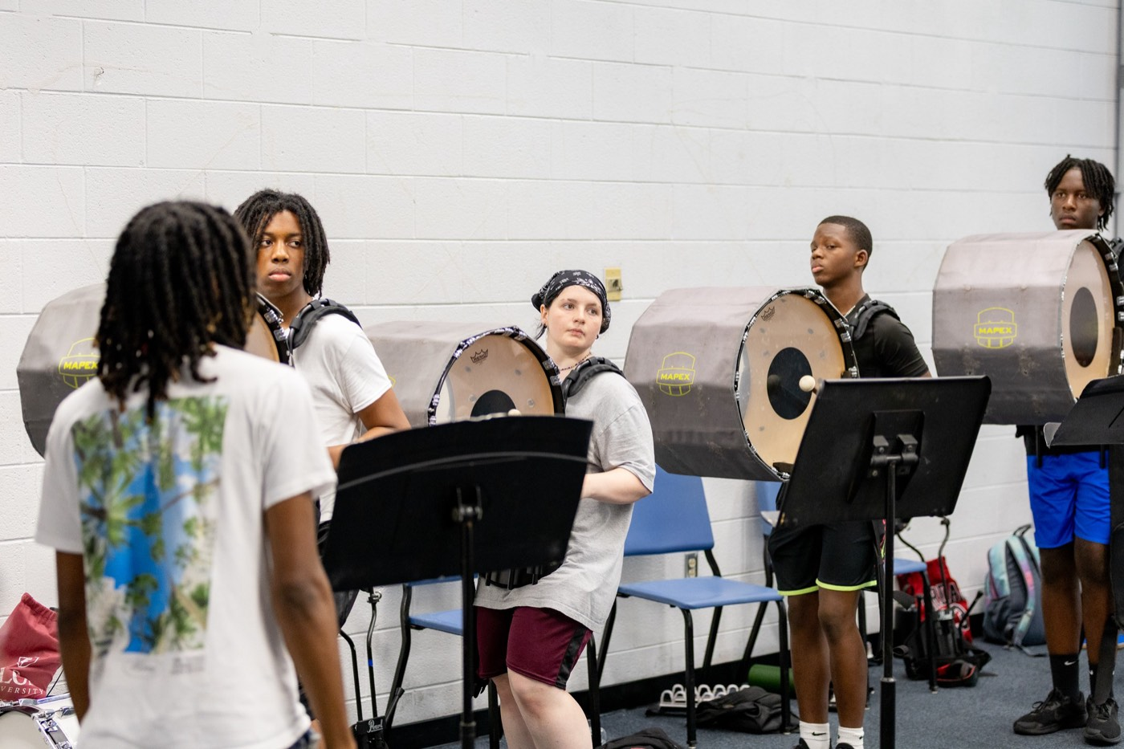
— SUPPORTING THE AUXILIARY
THE HAMPTON UNIVERSITY MARCHING FORCE
Know the Show Together
Learn their moments, not just your part.
◆ featuresre the auxiliary features are—the moments the show is built around them—and know them as well as you know your own.
◆ Learn their counts and their big hits so you can lock to them, not just to the page in front of you.
◆ whole show the whole show: what story it tells, where the visual lives, and how your part serves it.
◆ A band that knows the aux's show performs with them; a band that only knows its own notes performs next to them.
Pre-Drill Camp 2026 · Leadership Seminars
09
Notes:
SLIDE 9 — KNOW THE SHOW TOGETHER
"Know where the auxiliary features are, and know them as well as your own part."
LAND: "A band that knows the aux's show performs WITH them. A band that only knows its own notes performs NEXT to them."

Slide 10
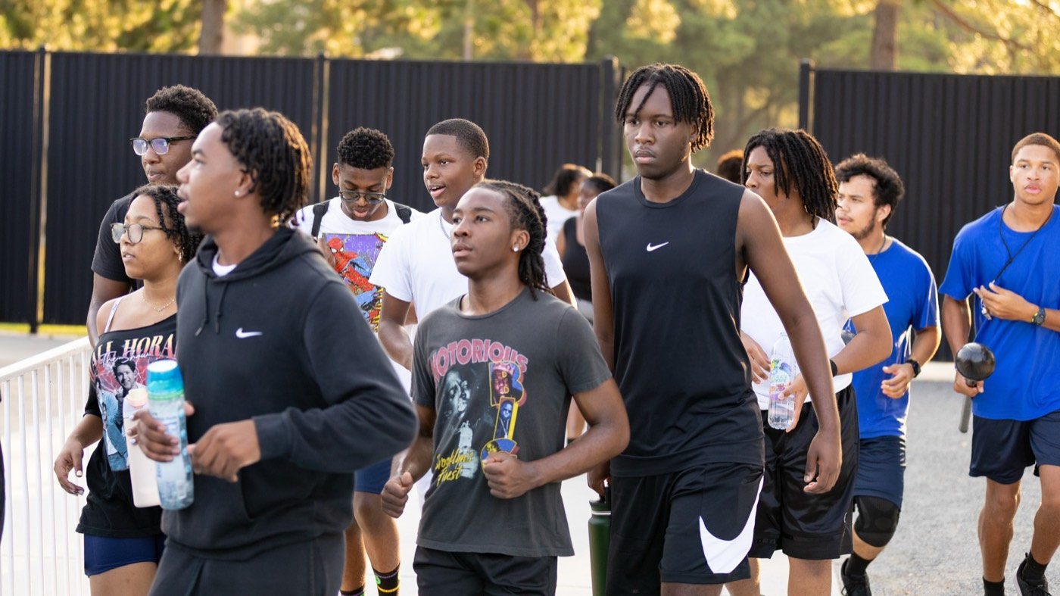
— SUPPORTING THE AUXILIARY
THE HAMPTON UNIVERSITY MARCHING FORCE
Be Their Hype
When they feature, you make the moment bigger.
◆ energyhe auxiliary takes the spotlight, your energy amplifies them. Play bigger, sell harder, and lift their moment.
◆ The crowd takes its cue from the band. React to a great toss, and the stands react with you.
◆ Be their loudest fans on the field—visible support tells everyone watching that this moment matters.
◆ handing not competing with the auxiliary for the crowd. You are handing them the crowd—and they hand it right back.
Pre-Drill Camp 2026 · Leadership Seminars
10
Notes:
SLIDE 10 — BE THEIR HYPE
"When they take the spotlight, your energy amplifies them. Play bigger, sell harder."
"The crowd takes its cue from the band. React to a great toss and the stands react with you."
REFRAME: "You're not competing with the auxiliary for the crowd. You're handing them the crowd — and they hand it right back."

Slide 11
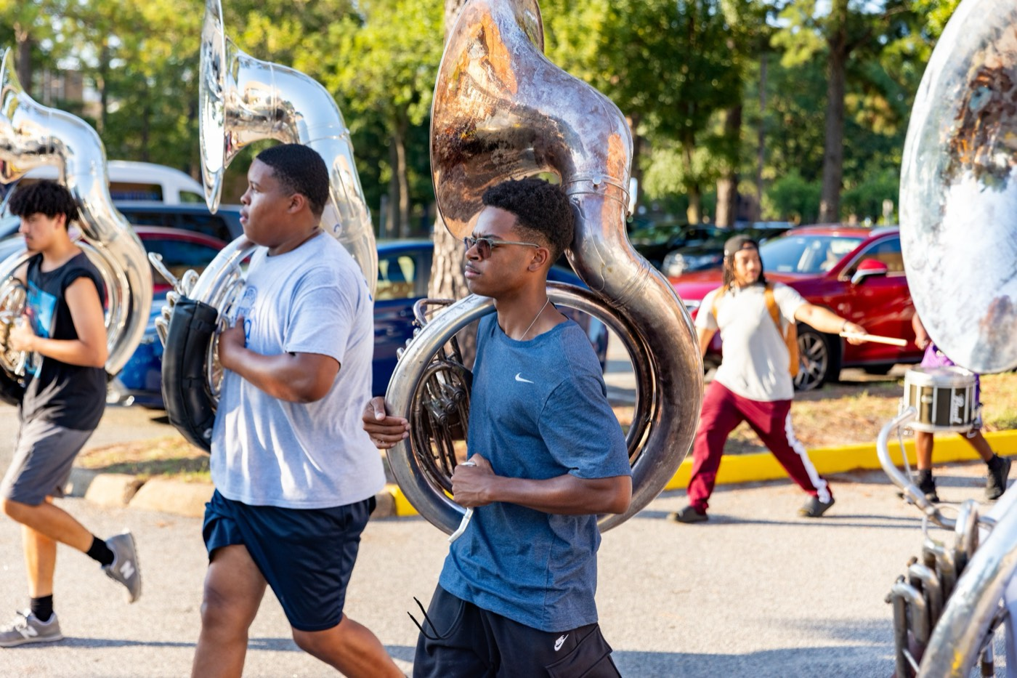
— SUPPORTING THE AUXILIARY
THE HAMPTON UNIVERSITY MARCHING FORCE
One Unit, No Cliques
The auxiliary is the band. Full stop.
◆ No "us and them." Dancers, guard, and twirlers are Marching Force, the same as any horn line or drum.
◆ Don't let the band and the auxiliary split into separate worlds—warm up together, eat together, celebrate together.
◆ Back them up when it's hard: the long days, the tough reps, the crowd that doesn't clap. Have their backs the way you want yours had.
◆ One unit is not a slogan. It is how a show becomes seamless instead of stitched together.
Pre-Drill Camp 2026 · Leadership Seminars
11
Notes:
SLIDE 11 — ONE UNIT, NO CLIQUES
"No us and them. Dancers, flags, and batons are Marching Force, same as any horn line."
PRACTICAL: warm up together, eat together, celebrate together.
"Have their backs the way you want yours had."

Slide 12
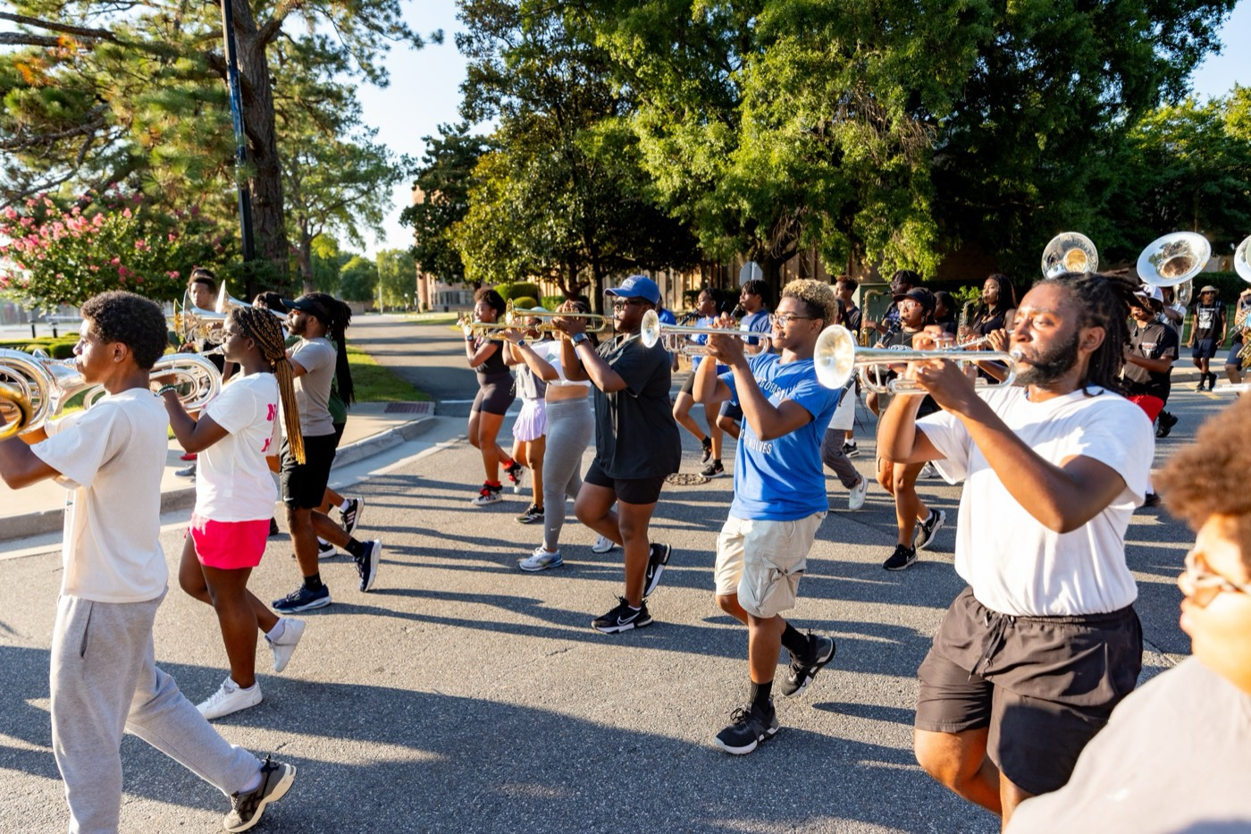
— SUPPORTING THE AUXILIARY
THE HAMPTON UNIVERSITY MARCHING FORCE
Communicate
The partnership is built off the field, too.
◆ Talk to the auxiliary and their coaches. Ask what they need from the band—then actually give it.
◆ Share feedback both ways, with respect: "that tempo felt rushed there" is a gift, not a complaint.
◆ Learn each other's language—counts, phrases, and cues—so a fix in rehearsal takes seconds, not arguments.
◆ The bands that look like one unit are the ones that talk like one unit all week long.
Pre-Drill Camp 2026 · Leadership Seminars
12
Notes:
SLIDE 12 — COMMUNICATE
"Talk to the auxiliary and their coaches. Ask what they need from the band — then actually give it."
"'That tempo felt rushed there' is a gift, not a complaint."
COACHES: tell them plainly how to reach you.

Slide 13
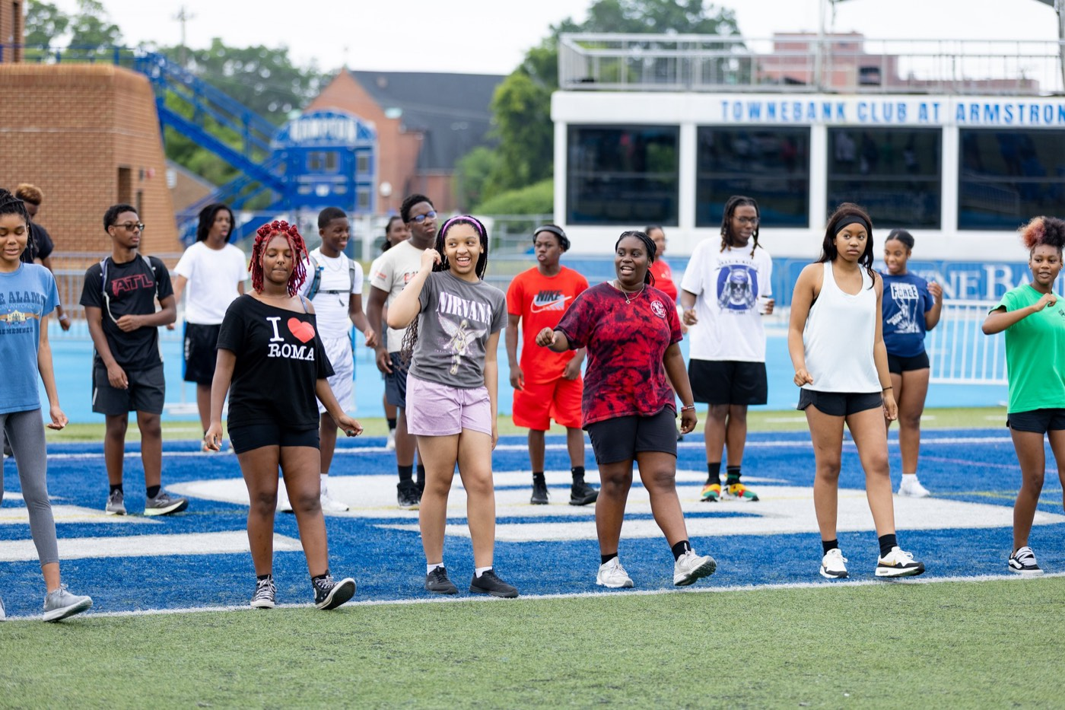
— SUPPORTING THE AUXILIARY
THE HAMPTON UNIVERSITY MARCHING FORCE
Supporting the Auxiliary: The Playbook
Four things every instrumentalist owes the auxiliary.
1
Steady Time
Hold the exact tempo and hit together. It is the floor they perform on.
Pre-Drill Camp 2026 · Leadership Seminars
13
Notes:
SLIDE 13 — THE PLAYBOOK
Steady Time, Give Them Room, Hype Their Moment, One Unit.
Four things every instrumentalist owes the auxiliary. Photograph slide.

Slide 14
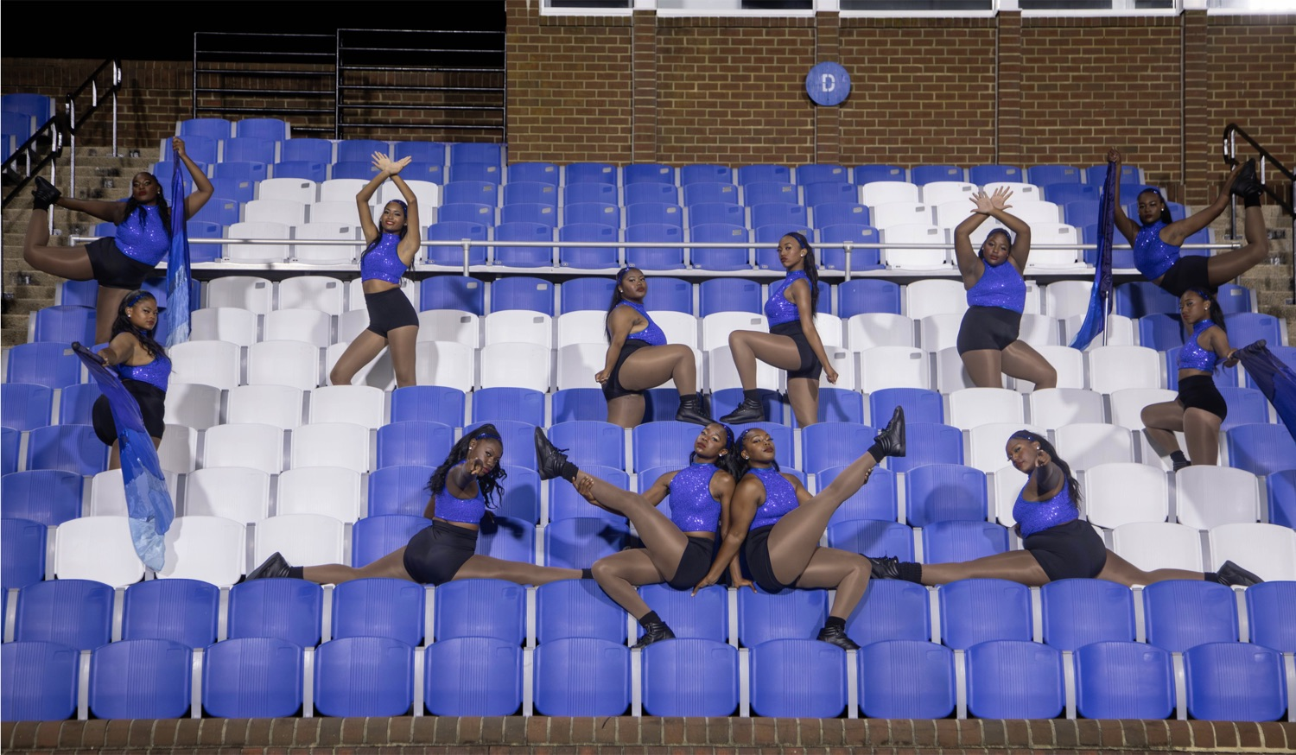
THE COACHES' CHARGE
Lift Them,
and We All Rise.
The auxiliary can only be as good as the band lets them be—and the band looks its best when the auxiliary is flying. So hold your tempo like their routine depends on it, because it does. Hit together, give them dynamics, and keep your spacing so they always have room. Learn their show, hype their moments, and treat every dancer, flag, and baton as Marching Force. Do that, and the crowd stops seeing a band and an auxiliary—and starts seeing one show.
Serve First. Lead Always. — Drive the Legacy.
The Hampton University Marching Force
Hampton's Heartbeat
Notes:
SLIDE 14 — CLOSE: Lift Them, and We All Rise.
Coaches deliver this together if you can.
"The auxiliary can only be as good as the band lets them be — and the band looks its best when the auxiliary is flying."
End on: "the crowd stops seeing a band and an auxiliary, and starts seeing one show."

