Slide 1

PRE-DRILL CAMP 2026 · LEADERSHIP SEMINARS · DAY 2
Difficult Conversations
"Care Enough to Say It."
Dr. Thomas L. Jones, Jr.
Director of University Bands · All Leaders, Sunday, August 2, 2026
The Hampton University Marching Force
Hampton's Heartbeat
Notes:
SLIDE 1 — TITLE: Difficult Conversations
SAY: "The conversation you're dreading is almost always the one you most need to have. That's the whole session."
NOTE: this is the confrontation session. Conflict Resolution was about mediating between two other people. This is about YOU having to say something hard.

Slide 2

— DIFFICULT CONVERSATIONS
THE HAMPTON UNIVERSITY MARCHING FORCE
Icebreaker
"How come you ain't never liked me?" Cory asks. Troy's answer is blunt and unforgettable: it was never about like—it's about responsibility. The hardest conversations we have as leaders are rarely about being liked. They're about caring enough to say the thing that has to be said.
▶
Fences — “I Ain't Got to Like You”
youtu.be/tVxYCeRXzGo
WATCH · 2:20
Pre-Drill Camp 2026 · Leadership Seminars
02
Notes:
SLIDE 2 — ICEBREAKER: Fences, "I Ain't Got to Like You" (2:20)
SET UP: "Denzel, in August Wilson's Fences. Cory asks his father why he never liked him. Listen to the answer."
Play it.
AFTER: "It was never about like. It was about responsibility." Then: "Most hard conversations you'll have aren't about being liked either."

Slide 3

01
THE PREMISE
The conversation you are dreading is almost always the one you most need to have. When a teammate is slipping, crossing a line, or hurting the group, silence feels kind—but it isn't. It just protects your comfort while the problem grows and the standard drops. Real accountability is a form of respect: it says I care about you and this team too much to let this slide. Leadership is the willingness to say the hard thing, the right way.
SAY IT BECAUSE YOU CARE.
Notes:
SLIDE 3 — THE PREMISE (statement slide)
Read it.
THE CORE: "Silence feels kind, but it isn't. It protects your comfort while the problem grows."
Takeaway: "Say it because you care."

Slide 4

— DIFFICULT CONVERSATIONS
THE HAMPTON UNIVERSITY MARCHING FORCE
Why We Avoid Them
Silence feels safe. It isn't.
◆ We avoid hard conversations because we fear the conflict, the awkwardness, and being disliked. That fear is human.
◆ But avoidance has a price: the behavior continues, the standard erodes, and resentment builds in everyone who sees it ignored.
◆ "ruinous empathy"ilence-to-be-nice "ruinous empathy"—you protect someone's feelings today and let them fail in the long run.
◆ Saying nothing is not neutral. It is a choice—and usually the wrong one.
Source: Kim Scott, Radical Candor — "ruinous empathy."
Pre-Drill Camp 2026 · Leadership Seminars
04
Notes:
SLIDE 4 — WHY WE AVOID THEM
Name the fear honestly — conflict, awkwardness, being disliked. "That's human."
THEN THE COST: Kim Scott's ruinous empathy — "you protect somebody's feelings today and let them fail long-term."
LAND: "Saying nothing is not neutral. It's a choice, and usually the wrong one."

Slide 5

— DIFFICULT CONVERSATIONS
THE HAMPTON UNIVERSITY MARCHING FORCE
Care Personally, Challenge Directly
The two things a hard conversation needs—at the same time.
◆ Radical Candordical Candor is the mix of both: you care personally about the person and you challenge them directly on the problem.
◆ obnoxious aggressionallenge becomes obnoxious aggression—honest, but it lands as an attack.
◆ ruinous empathynge and care becomes ruinous empathy—kind, but useless; the problem never gets fixed.
◆ manipulative insinceritynipulative insincerity—the fake-nice that helps no one. Aim for the corner with both.
Source: Kim Scott, Radical Candor (care personally + challenge directly).
Pre-Drill Camp 2026 · Leadership Seminars
05
Notes:
SLIDE 5 — CARE PERSONALLY, CHALLENGE DIRECTLY
Radical Candor's two axes. Walk all four quadrants — obnoxious aggression, ruinous empathy, manipulative insincerity, and the target.
MAKE THEM PLACE THEMSELVES: "Which quadrant do you fall into when it's hard? Most of us default to ruinous empathy."
NOTE: Jay Jones teaches this same model in his own Leadership 101 — if he's in the room, hand it to him for a minute.

Slide 6

— DIFFICULT CONVERSATIONS
THE HAMPTON UNIVERSITY MARCHING FORCE
Start With Heart
Check your motive before you open your mouth.
◆ really wantconversation, get clear on what you really want—for them, for the team, and for the relationship.
◆ If your goal is to win, to vent, or to look right, stop. That conversation will only make things worse.
◆ The right heart is simple: you want the person to succeed and the standard to hold. Lead with that, and it shows.
◆ People can feel your intent. Come in as an ally solving a problem, not a prosecutor making a case.
Source: Patterson, Grenny, McMillan, and Switzler, Crucial Conversations ("start with heart").
Pre-Drill Camp 2026 · Leadership Seminars
06
Notes:
SLIDE 6 — START WITH HEART
"Check your motive before you open your mouth."
THE TEST: "If your goal is to win, to vent, or to look right — stop. That conversation will make it worse."
"Come in as an ally solving a problem, not a prosecutor making a case."

Slide 7
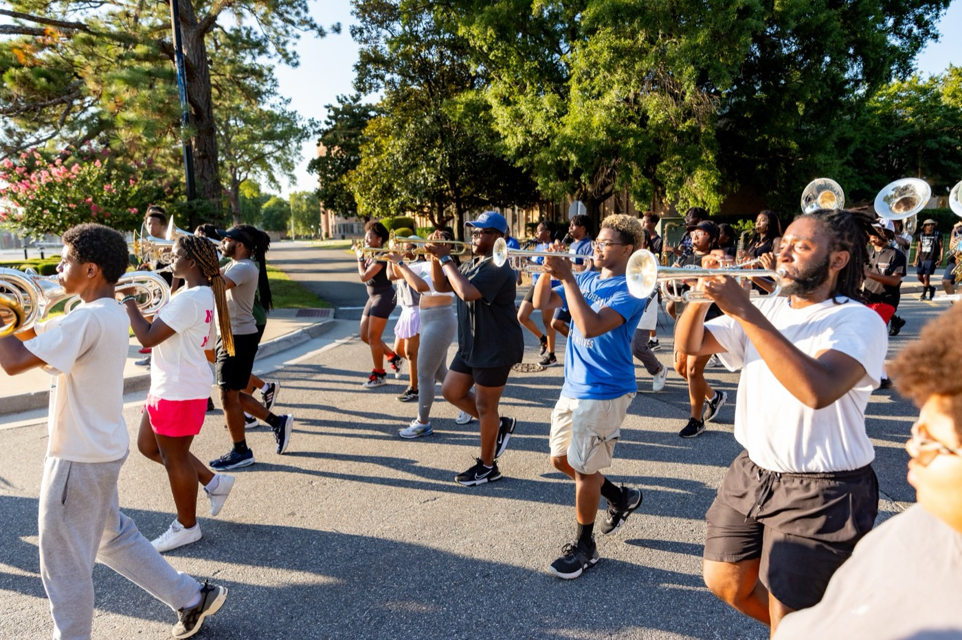
— DIFFICULT CONVERSATIONS
THE HAMPTON UNIVERSITY MARCHING FORCE
Facts, Not Stories
Separate what happened from what you decided it means.
◆ factct is what you saw or heard ("you missed the last three rehearsals"). A story is what you make it mean ("you don't care").
◆ We confuse the two constantly—and people will fight your story even while they agree with your facts.
◆ looselyth the facts, and hold your interpretation loosely: "here's what I saw—help me understand it."
◆ You are often wrong about the story. Ask before you accuse.
Source: Crucial Conversations — separate facts from the stories we tell ourselves.
Pre-Drill Camp 2026 · Leadership Seminars
07
Notes:
SLIDE 7 — FACTS, NOT STORIES
Teach the distinction crisply: "'You missed the last three rehearsals' is a fact. 'You don't care' is a story you built."
"People will fight your story even when they agree with your facts."
THE MOVE: "Lead with the facts and hold your interpretation loosely — 'here's what I saw, help me understand it.'"

Slide 8

— DIFFICULT CONVERSATIONS
THE HAMPTON UNIVERSITY MARCHING FORCE
Make It Safe
People get defensive when they feel unsafe—not when they hear truth.
◆ The moment someone feels attacked, they stop listening and start defending. No safety, no conversation.
◆ respect making your respect and your shared purpose clear: "I'm on your side, and I think we both want the same thing."
◆ Watch for the signs that safety broke—silence, sarcasm, shutting down—and pause to rebuild it before you push on.
◆ You can say almost anything to almost anyone, if they trust that you mean them well.
Source: Crucial Conversations — mutual purpose and mutual respect.
Pre-Drill Camp 2026 · Leadership Seminars
08
Notes:
SLIDE 8 — MAKE IT SAFE
"People get defensive when they feel unsafe — not when they hear truth."
OPEN WITH RESPECT AND SHARED PURPOSE: "I'm on your side, and I think we both want the same thing."
WATCH FOR THE BREAK: silence, sarcasm, shutting down. Pause and rebuild before pushing on.
LAND: "You can say almost anything to almost anyone if they trust you mean them well."

Slide 9

— DIFFICULT CONVERSATIONS
THE HAMPTON UNIVERSITY MARCHING FORCE
Name It: Situation, Behavior, Impact
A clean, fair way to put the issue on the table.
◆ Situation: anchor it in a specific time and place—"in yesterday's sectional…"—not a vague "you always."
◆ Behavior: describe exactly what they did, observably—"you were on your phone during the run"—no labels, no character read.
◆ Impact: name the effect it had—"so the section lost focus and we ran late."
◆ Specific and factual beats general and personal every time. SBI keeps it honest without making it an attack.
Source: Center for Creative Leadership — the Situation-Behavior-Impact (SBI) feedback model.
Pre-Drill Camp 2026 · Leadership Seminars
09
Notes:
SLIDE 9 — NAME IT: SITUATION, BEHAVIOR, IMPACT
The practical tool. Walk all three with the example.
Situation: 'in yesterday's sectional.' Behavior: 'you were on your phone during the run.' Impact: 'the section lost focus and we ran late.'
DRILL IT: have two leaders build an SBI out loud for a real situation. Two minutes. It's the most useful thing in the session.

Slide 10

— DIFFICULT CONVERSATIONS
THE HAMPTON UNIVERSITY MARCHING FORCE
Then Listen
It's a conversation, not a verdict.
◆ ask for theirs, then genuinely ask for theirs: "that's how it looked to me—what's your take?"
◆ Talk tentatively and stay curious. You may be missing context that changes the whole picture.
◆ Listen to understand, not to reload. When people feel heard, they are far more likely to change.
◆ The goal isn't to win the conversation. It's to fix the problem and keep the person.
Pre-Drill Camp 2026 · Leadership Seminars
10
Notes:
SLIDE 10 — THEN LISTEN
"It's a conversation, not a verdict."
GIVE THEM THE LINE: "'That's how it looked to me — what's your take?'"
"Listen to understand, not to reload. You may be missing context that changes the whole picture."
LAND: "The goal isn't to win the conversation. It's to fix the problem and keep the person."

Slide 11

— DIFFICULT CONVERSATIONS
THE HAMPTON UNIVERSITY MARCHING FORCE
Holding a Peer Accountable
The hardest accountability—because you have no rank.
◆ relationship you can't fall back on authority. Your only leverage is the relationship and the shared standard.
◆ Frame it as "us," not "me over you": "we hold each other to this—that's what makes us leaders."
◆ Do it privately and early, before it becomes a thing the whole section is watching.
◆ When peers hold each other accountable, the director rarely has to. That is a section running itself.
Pre-Drill Camp 2026 · Leadership Seminars
11
Notes:
SLIDE 11 — HOLDING A PEER ACCOUNTABLE
The hardest version — no rank to fall back on.
"Your only leverage is the relationship and the shared standard."
THE FRAMING: "'We hold each other to this — that's what makes us leaders.' Us, not me over you."
"When peers hold each other accountable, the director rarely has to."

Slide 12

— DIFFICULT CONVERSATIONS
THE HAMPTON UNIVERSITY MARCHING FORCE
When It's Hazing
The one conversation you never skip.
◆ non-negotiablee "difficult" becomes non-negotiable. The culture team's job is to see it, name it, and stop it—immediately.
◆ Silence is complicity. Looking away, laughing it off, or "not my business" makes you part of it.
◆ Confront it directly, and protect the person over the tradition, the comfort, or the friendship.
◆ escalate to the director.r talk: escalate to the director. On hazing, you are never handling it alone.
Reference: the HU Bands Handbook anti-hazing policy — hazing is prohibited, and every member is responsible for stopping and reporting it.
Pre-Drill Camp 2026 · Leadership Seminars
12
Notes:
SLIDE 12 — WHEN IT'S HAZING
STOP. Slow all the way down. This slide is non-negotiable and your tone should change.
"Hazing is where difficult becomes non-negotiable."
SAY IT FLAT: "Silence is complicity. Looking away, laughing it off, 'not my business' — that makes you part of it."
"Protect the person over the tradition, the comfort, or the friendship."
AND THE INSTRUCTION: "Escalate to the director. On hazing you are never handling it alone."
Do not rush off this slide. Let it be uncomfortable.

Slide 13

— DIFFICULT CONVERSATIONS
THE HAMPTON UNIVERSITY MARCHING FORCE
Follow Through
The conversation isn't the fix—the change is.
◆ End with something concrete: what changes, starting when. Vague agreement fades by the next rehearsal.
◆ Follow up. Check back, notice the effort, and say so—accountability includes catching people doing it right.
◆ If it doesn't change, have the next conversation. One talk rarely settles a real pattern.
◆ And when it does change, let it go completely. No grudges, no bringing it back up. Settled is settled.
Pre-Drill Camp 2026 · Leadership Seminars
13
Notes:
SLIDE 13 — FOLLOW THROUGH
"The conversation isn't the fix. The change is."
End with something concrete: what changes, starting when.
"Catch them doing it right — accountability includes noticing the improvement."
AND: "When it does change, let it go completely. No grudges."

Slide 14

— DIFFICULT CONVERSATIONS
THE HAMPTON UNIVERSITY MARCHING FORCE
The Hard-Conversation Playbook
Four moves for saying the thing that has to be said.
1
Start With Heart
Get your motive right: you want them to succeed and the standard to hold.
Pre-Drill Camp 2026 · Leadership Seminars
14
Notes:
SLIDE 14 — THE HARD-CONVERSATION PLAYBOOK
Start With Heart, State the Facts, Then Listen, Follow Through.
Photograph slide.

Slide 15

YOUR CHARGE
Care Enough
to Say It.
The conversations you least want to have are the ones your people most need you to have. Silence is easy and expensive—it lets good members drift and bad behavior harden. So start with heart, lead with facts instead of the story, make it safe, and say the hard thing plainly and kindly—then listen and follow through. Hold your peers to the standard because you respect them; and when it becomes hazing, speak up, protect people, and bring it to the director.
Serve First. Lead Always. — Drive the Legacy.
The Hampton University Marching Force
Hampton's Heartbeat
Notes:
SLIDE 15 — CLOSE: Care Enough to Say It.
"Hold your peers to the standard because you respect them, not in spite of it."
Re-state the hazing line one final time before the sign-off. It's the thing you most need them to leave with.

