Slide 1
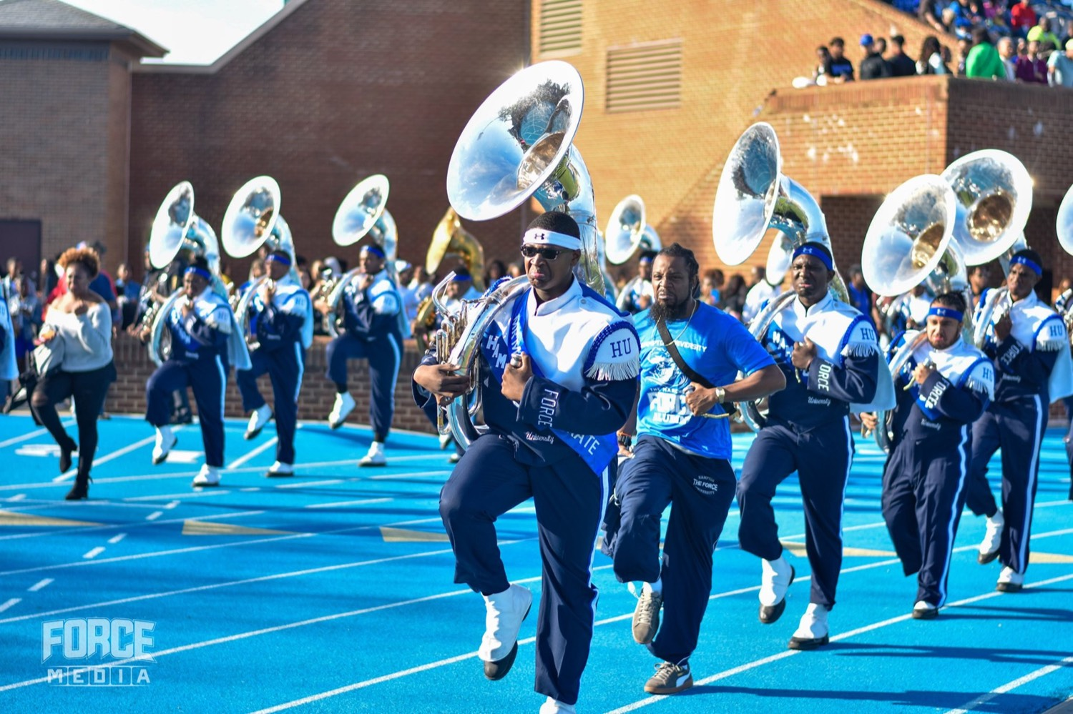
PRE-DRILL CAMP 2026 · LEADERSHIP SEMINARS · DAY 2
Conflict Resolution
"Early. Fair. Direct."
Dr. Thomas L. Jones, Jr.
Director of University Bands · All Leaders, Sunday, August 2, 2026
The Hampton University Marching Force
Hampton's Heartbeat
Notes:
SLIDE 1 — TITLE: Conflict Resolution
SAY: "Put a few hundred people together for hundreds of hours chasing perfection, and conflict is guaranteed. This session is about handling it — not avoiding it."
NOTE: this deck is framed on 12 Angry Men throughout, and there are TWO clips — one now, one at the midpoint.

Slide 2

— CONFLICT RESOLUTION
THE HAMPTON UNIVERSITY MARCHING FORCE
Icebreaker
One hot room, twelve jurors, and a boy's life on the line—and the very first vote is eleven to one. Watch what happens when one juror refuses to rush the verdict, and another chooses to actually listen. That jury room is every section you will ever lead.
▶
12 Angry Men — “Who Changed Their Vote?”
youtu.be/EqDd06GW76o
WATCH · 3:06
Pre-Drill Camp 2026 · Leadership Seminars
02
Notes:
SLIDE 2 — ICEBREAKER: 12 Angry Men, "Who Changed Their Vote?" (3:06)
SET UP: "One hot room, twelve jurors, a boy's life. The first vote is eleven to one."
Play it.
AFTER: "Watch what cracked the room. Not volume. One man refusing to rush, and another choosing to actually listen."

Slide 3
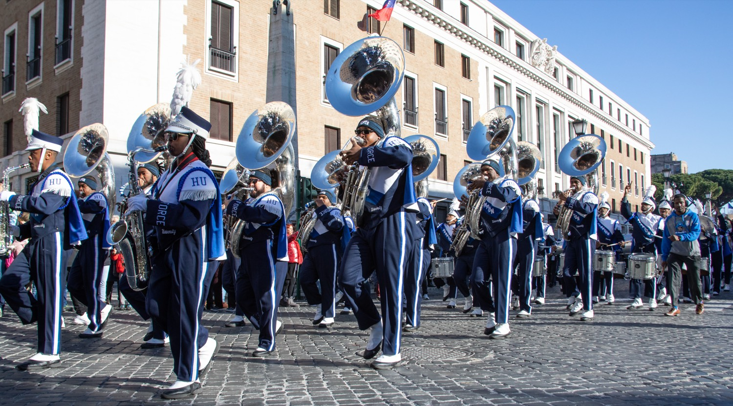
01
THE PREMISE
Twelve strangers, one hot room, and a disagreement no one is allowed to walk away from: 12 Angry Men may be the finest lesson in conflict resolution ever filmed. Eleven jurors want to go home; one wants to talk it through. Our band is that room—hundreds of people, real stakes, and friction that has to be worked out, not walked out on. What decides the outcome is not who is loudest. It is who is fair, patient, and willing to reason.
ADDRESS IT, OR IT FESTERS.
Notes:
SLIDE 3 — THE PREMISE (statement slide)
Read it.
"Our band is that room — hundreds of people, real stakes, friction that has to be worked out instead of walked out on."
Takeaway: "Address it, or it festers."

Slide 4
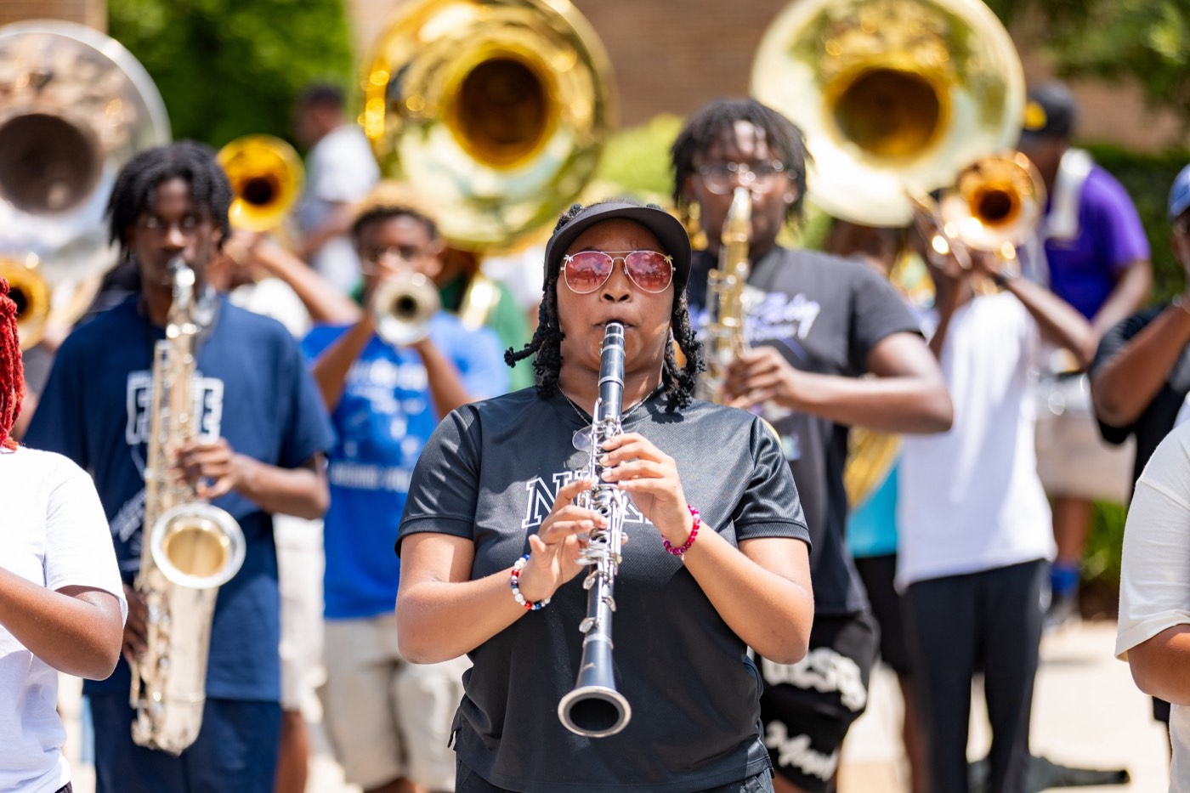
— CONFLICT RESOLUTION
THE HAMPTON UNIVERSITY MARCHING FORCE
Conflict Is Normal
The problem isn't disagreement—it's avoidance.
◆ willle who spend real time together and care about the outcome will disagree. That is a sign of investment, not dysfunction.
◆ stronger handled well makes a team stronger—it clears the air, sharpens ideas, and builds trust.
◆ undergroundoided doesn't go away; it goes underground—into gossip, resentment, and a section that quietly splits.
◆ handledb is not to prevent all conflict. It is to make sure conflict gets handled, not buried.
Pre-Drill Camp 2026 · Leadership Seminars
04
Notes:
SLIDE 4 — CONFLICT IS NORMAL
Relieve the pressure first: "People who care will disagree. That's investment, not dysfunction."
THE REAL PROBLEM: "Conflict avoided doesn't go away. It goes underground — gossip, resentment, a section that quietly splits."
"Your job isn't to prevent conflict. It's to make sure it gets handled instead of buried."

Slide 5
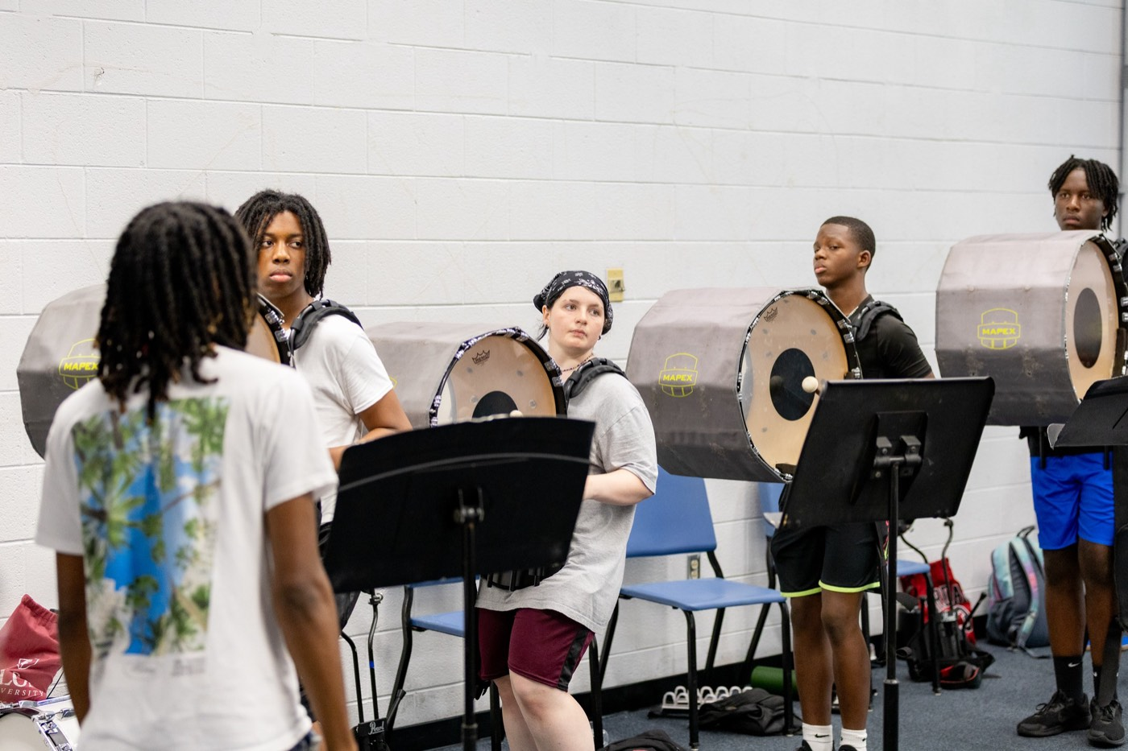
— CONFLICT RESOLUTION
THE HAMPTON UNIVERSITY MARCHING FORCE
Address It Early
Small problems are cheap to fix. Big ones aren't.
◆ Deal with friction while it's still small—a quiet word today beats a blow-up next week.
◆ The longer a problem sits, the more it grows: people take sides, stories harden, and trust erodes.
◆ Don't hope it "works itself out." Most conflict doesn't—it just waits for the worst possible moment.
◆ Early, direct, and private is almost always the right first move.
Pre-Drill Camp 2026 · Leadership Seminars
05
Notes:
SLIDE 5 — ADDRESS IT EARLY
"Small problems are cheap to fix. Big ones aren't."
KILL THE COMMON EXCUSE: "Don't hope it works itself out. Most conflict doesn't — it just waits for the worst possible moment."
RULE OF THUMB: early, direct, private.

Slide 6

— CONFLICT RESOLUTION
THE HAMPTON UNIVERSITY MARCHING FORCE
Positions vs. Interests
People argue what they want. Resolution lives in why.
◆ positionon is what someone demands ("I should get the solo"). An interest is the need underneath it—to be seen, to be trusted, to matter.
◆ Two positions can be dead opposite while the interests behind them overlap. You can't solve the position; you can often solve the interest.
◆ "why does this matter to you?"ou?" until you reach the real need. That's where a solution both sides accept becomes possible.
◆ Fight over positions and someone loses. Solve for interests and both sides can win.
Source: Roger Fisher and William Ury, Getting to Yes — interest-based negotiation.
Pre-Drill Camp 2026 · Leadership Seminars
06
Notes:
SLIDE 6 — POSITIONS VS. INTERESTS
The most useful idea in the session. Teach it with the example on screen.
"A position is 'I should get the solo.' The interest underneath is 'I want to be seen, to matter.'"
THE TOOL: "Ask 'why does this matter to you?' until you hit the real need."
LAND: "Fight over positions and someone loses. Solve for interests and both sides can win."

Slide 7
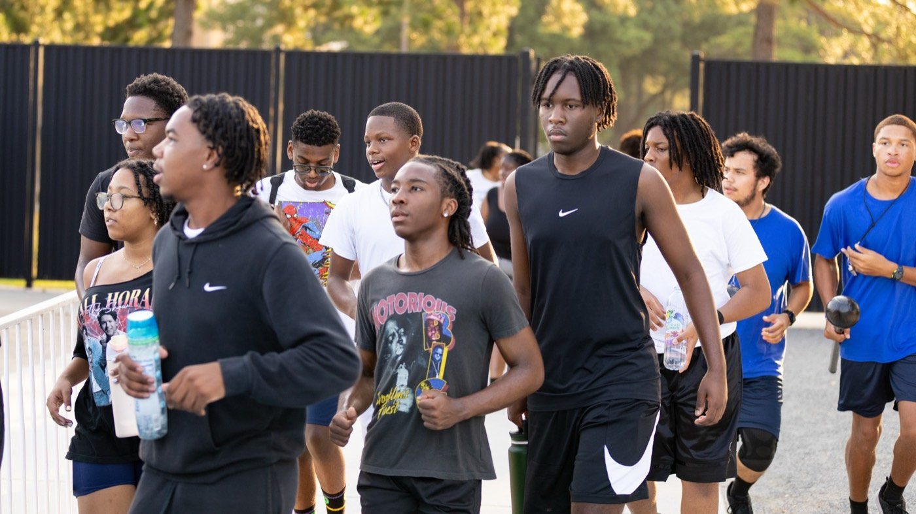
— CONFLICT RESOLUTION
THE HAMPTON UNIVERSITY MARCHING FORCE
Separate the People From the Problem
Be hard on the issue, soft on the person.
◆ problemthe problem, not the person. The moment it becomes "you vs. me," resolution stops and defense begins.
◆ Put the issue on the table where you can both look at it together, side by side, instead of across from each other.
◆ Name the behavior and its effect, not the character: "when the rep starts late, we lose time"—not "you're lazy."
◆ Protect the relationship while you solve the problem—you still have to stand next to this person tomorrow.
Source: Roger Fisher and William Ury, Getting to Yes.
Pre-Drill Camp 2026 · Leadership Seminars
07
Notes:
SLIDE 7 — SEPARATE THE PEOPLE FROM THE PROBLEM
"Hard on the issue, soft on the person."
CONTRAST OUT LOUD: "'When the rep starts late, we lose time' — not 'you're lazy.'"
WHY IT MATTERS HERE: "You still have to stand next to this person tomorrow."

Slide 8
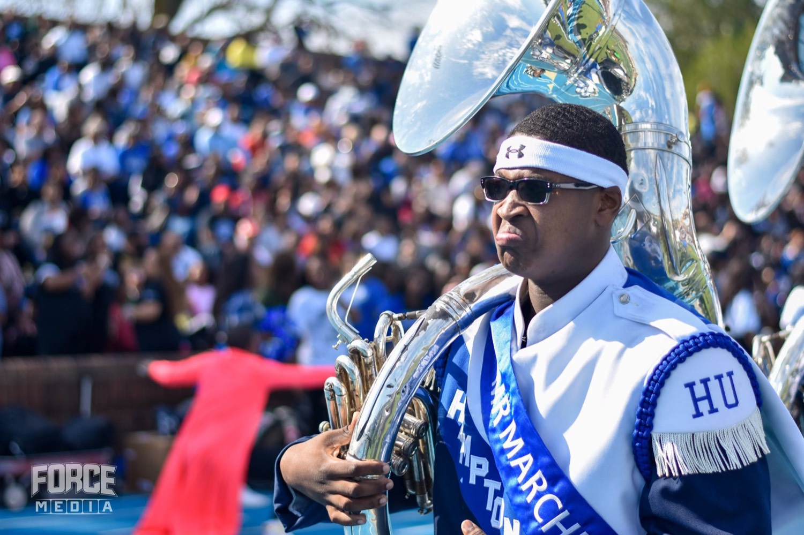
— CONFLICT RESOLUTION
THE HAMPTON UNIVERSITY MARCHING FORCE
Five Ways People Handle Conflict
Know your default—then choose the right one on purpose.
◆ Competing (I win): fast and firm—right for emergencies and non-negotiables, costly to relationships.
◆ Avoiding (walk away): fine for trivial things, dangerous when the issue actually matters.
◆ Accommodating (you win): builds goodwill when the issue is small to you, breeds resentment when you always fold.
◆ Compromising (split it): quick and fair-ish, but nobody walks away fully satisfied.
◆ Collaborating (we both win): the slowest—and the best when the relationship and the outcome both matter.
Source: the Thomas-Kilmann Conflict Mode Instrument (five conflict-handling modes).
Pre-Drill Camp 2026 · Leadership Seminars
08
Notes:
SLIDE 8 — FIVE WAYS PEOPLE HANDLE CONFLICT
Thomas-Kilmann's five modes: competing, avoiding, accommodating, compromising, collaborating.
MAKE IT PERSONAL: "Which one is your default? Not which is best — which do you actually reach for?" Give them ten seconds to decide privately.
THE POINT: "Each has a right moment. Know your default so you can choose on purpose instead of by habit."

Slide 9
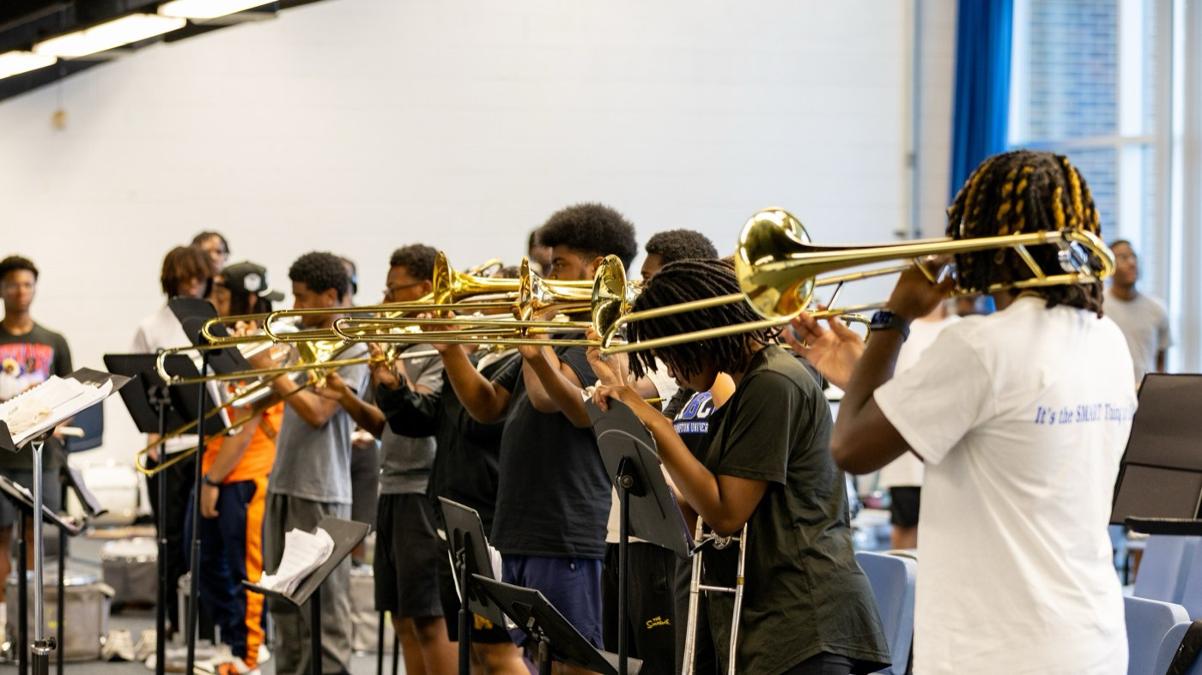
— CONFLICT RESOLUTION
THE HAMPTON UNIVERSITY MARCHING FORCE
One of Our Core Competencies
Conflict resolution is a skill we deliberately build in every Marching Force leader—a section is only as strong as its ability to work through friction. Before we practice resolving it, watch how fast conflict escalates when it runs unchecked: the anger, the ego, and the pressure boiling over in that same room.
▶
12 Angry Men — When Conflict Boils Over
youtu.be/iLL8OsUN73k
WATCH · 11:35
Pre-Drill Camp 2026 · Leadership Seminars
09
Notes:
SLIDE 9 — ONE OF OUR CORE COMPETENCIES (second clip, 11:35)
FRAME IT: "Conflict resolution is a skill we deliberately build in every Marching Force leader."
THEN: "Before we practice resolving it, watch how fast it escalates when nobody does."
CLIP IS LONG — 11:35. Plan for it, or cue a segment if you're tight on time. Watch the room; if energy sags, cut it and narrate the rest.

Slide 10
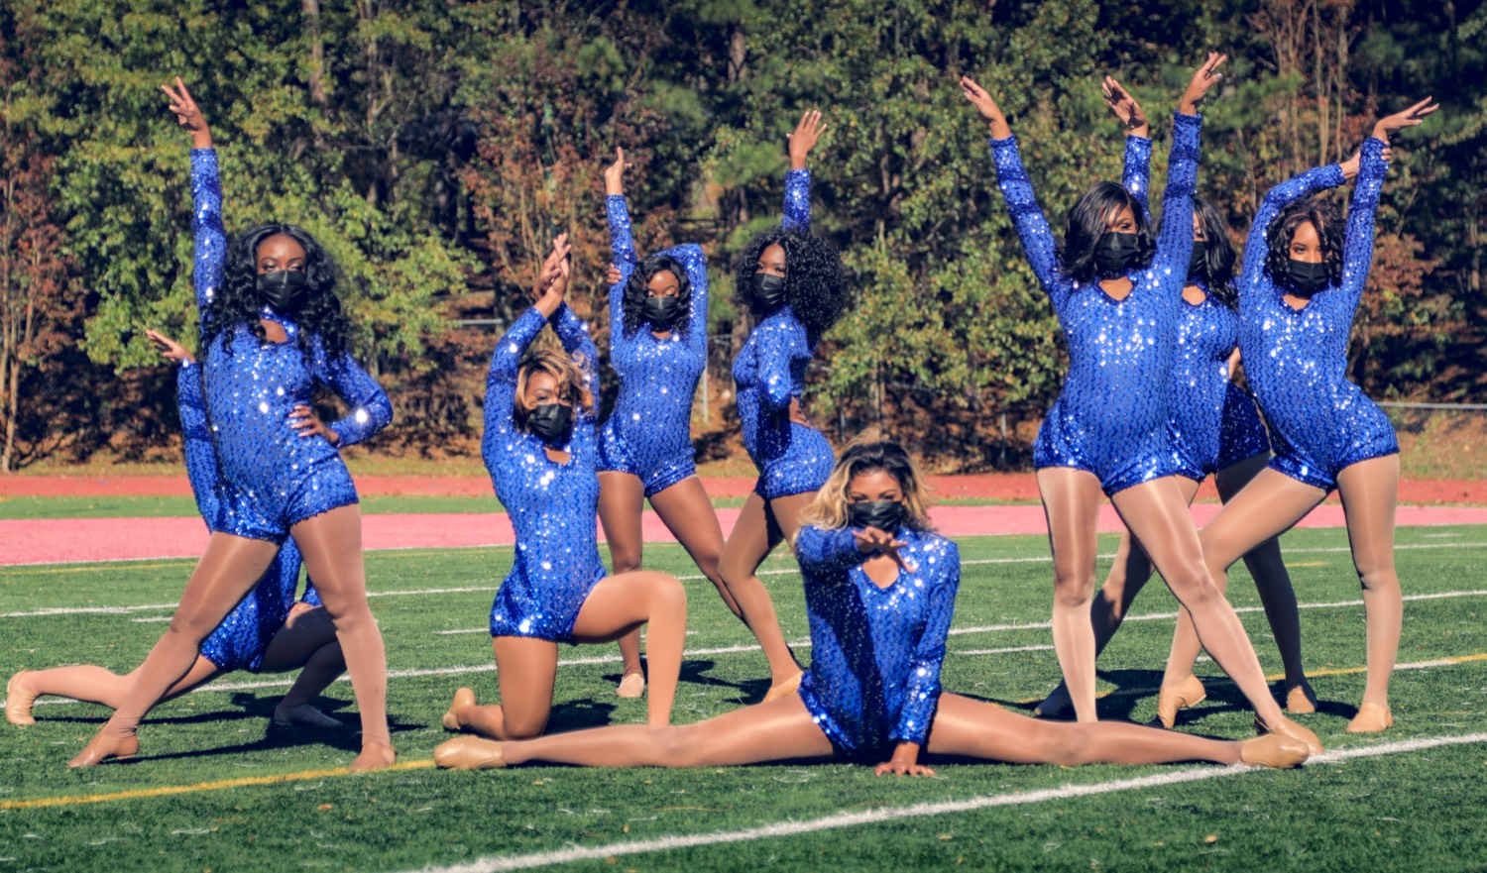
— CONFLICT RESOLUTION
THE HAMPTON UNIVERSITY MARCHING FORCE
Seek First to Understand
You can't resolve what you don't understand.
◆ listen you fix anything, listen—fully, to both sides, without planning your rebuttal while they talk.
◆ Acknowledge the feeling before the fact: "I can see this really frustrated you." People settle down once they feel heard.
◆ Play it back: "so what I'm hearing is…" It proves you listened and clears up the misreads that fuel conflict.
◆ Lower the temperature first. Nobody solves anything while they're still hot.
In the film: Juror 8 never argues louder than anyone else. He asks questions, examines the facts, and truly listens—and one calm, fair voice slowly turns the entire room.
Source: Stephen Covey, The 7 Habits of Highly Effective People — "seek first to understand, then to be understood."
Pre-Drill Camp 2026 · Leadership Seminars
10
Notes:
SLIDE 10 — SEEK FIRST TO UNDERSTAND
Covey's habit, applied.
"Listen fully, to both sides, without planning your rebuttal while they talk."
THE PHRASE THAT WORKS: "'So what I'm hearing is…' It proves you listened and clears up the misreads that fuel the conflict."
READ THE CALLOUT: Juror 8 never argues louder. One calm, fair voice turns the whole room.

Slide 11
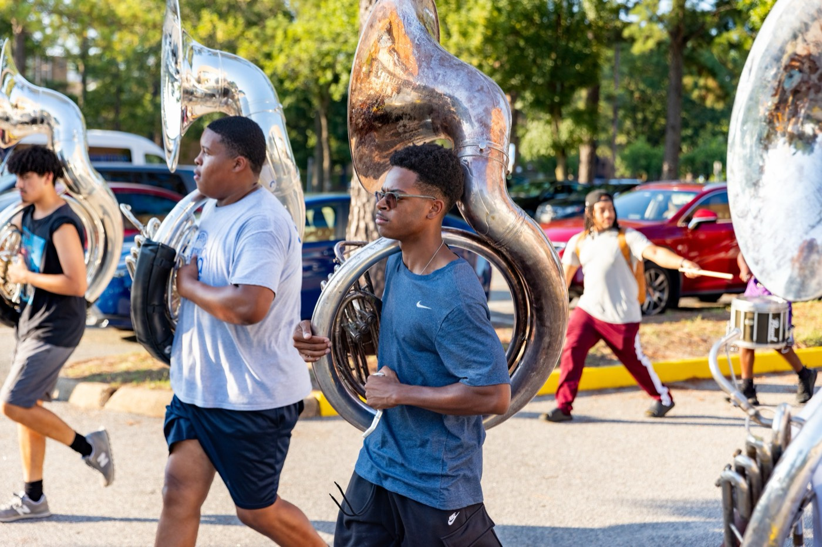
— CONFLICT RESOLUTION
THE HAMPTON UNIVERSITY MARCHING FORCE
Stay Fair and Neutral
When you mediate, you belong to no side.
◆ fair two members are in conflict and you step in, your job is to be fair—not to back the person you like more.
◆ Hear both sides fully before you form a verdict. Judging early—or being seen to—kills your credibility as a leader.
◆ private private. Public conflict humiliates people and hardens positions; handle it off to the side.
◆ Bring it to the director when it's bigger than you, involves safety, or you're too close to be neutral.
Pre-Drill Camp 2026 · Leadership Seminars
11
Notes:
SLIDE 11 — STAY FAIR AND NEUTRAL
For when they're mediating between two members.
"When you step in, your job is to be fair — not to back the person you like more."
CREDIBILITY WARNING: "Judging early, or being SEEN to judge early, kills you as a mediator."
ESCALATION: bigger than you, involves safety, or you're too close to be neutral — bring it to the director.

Slide 12
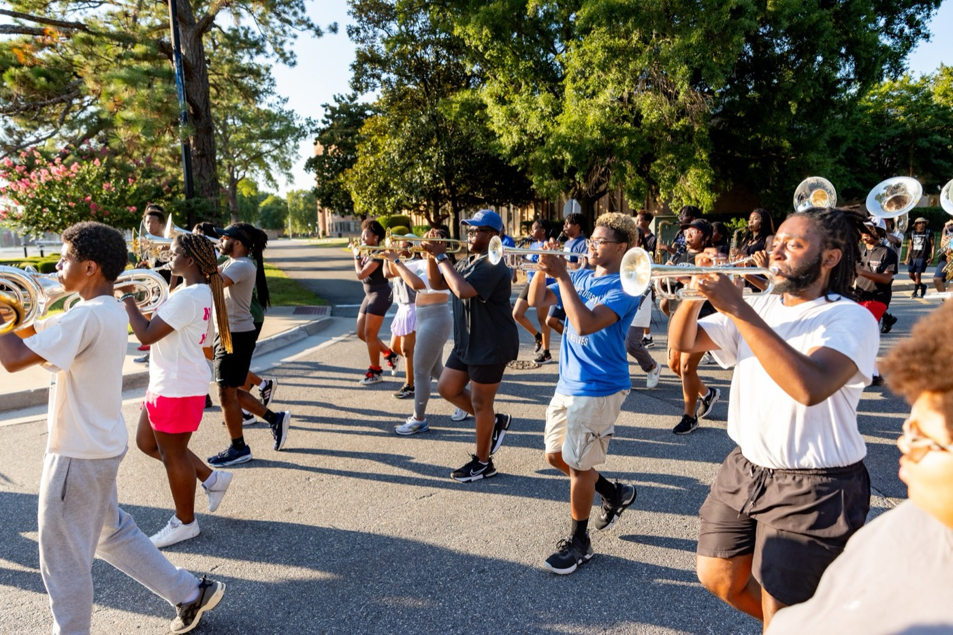
— CONFLICT RESOLUTION
THE HAMPTON UNIVERSITY MARCHING FORCE
Find the Common Ground
Point everyone back at what they share.
◆ Under almost every band conflict is a shared goal: the show, the section, the standard. Name it out loud.
◆ each othere from facing each other to facing the same direction—the thing you're all here to build.
◆ "We both want this section to be great" reframes opponents as teammates with a problem to solve.
◆ Shared purpose is the strongest tool you have. Use it to turn "me vs. you" into "us vs. the problem."
Pre-Drill Camp 2026 · Leadership Seminars
12
Notes:
SLIDE 12 — FIND THE COMMON GROUND
"Under almost every band conflict is a shared goal. Name it out loud."
THE MOVE: "Get them from facing each other to facing the same direction."
GIVE THEM THE SENTENCE: "'We both want this section to be great.' That turns opponents into teammates with a problem."

Slide 13

— CONFLICT RESOLUTION
THE HAMPTON UNIVERSITY MARCHING FORCE
Get to a Solution, Then Follow Up
A good talk isn't the finish line—a changed situation is.
◆ concreted with feelings vented and nothing decided. Land on something concrete: who does what, by when.
◆ Make the agreement specific and mutual—both people say out loud what they will do differently.
◆ follow upow up. Check back in a few days: did it hold? Resolution is a process, not a single conversation.
◆ Close the loop on the relationship, too. Once it's settled, let it be settled—no grudges, no scoreboard.
Pre-Drill Camp 2026 · Leadership Seminars
13
Notes:
SLIDE 13 — GET TO A SOLUTION, THEN FOLLOW UP
"A good talk isn't the finish line. A changed situation is."
CONCRETE: who does what, by when. Both people say out loud what they'll do differently.
THE STEP EVERYONE SKIPS: "Follow up in a few days. Did it hold?"
AND: "Once it's settled, let it be settled. No grudges, no scoreboard."

Slide 14
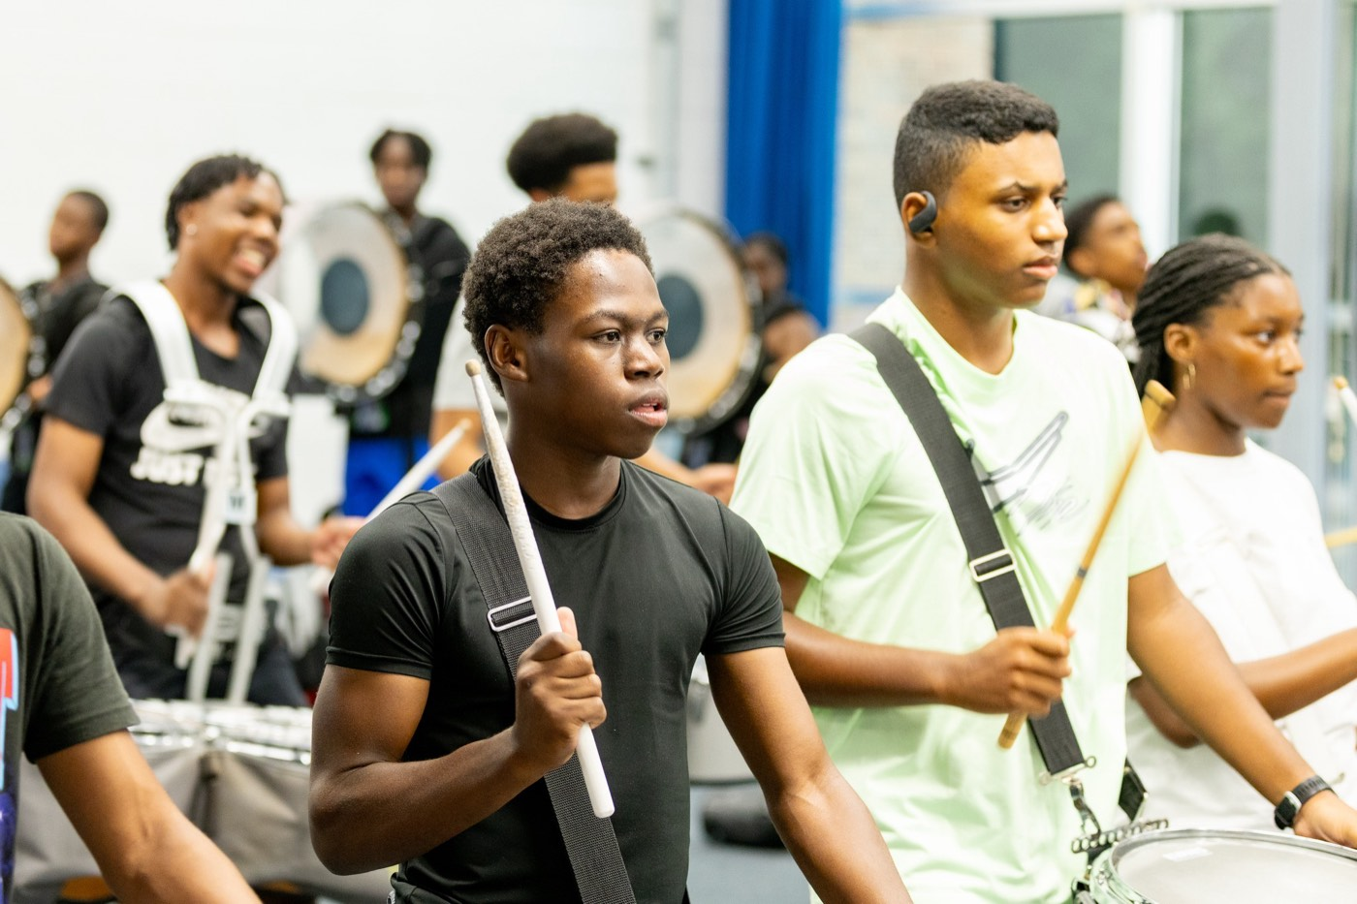
— CONFLICT RESOLUTION
THE HAMPTON UNIVERSITY MARCHING FORCE
The Conflict Playbook
Four moves, in order, when tension shows up.
1
Go Early
Handle friction while it's small and private, before it hardens and spreads.
Pre-Drill Camp 2026 · Leadership Seminars
14
Notes:
SLIDE 14 — THE CONFLICT PLAYBOOK
Go Early, Listen First, Stay Fair, Move Forward.
Photograph slide.

Slide 15
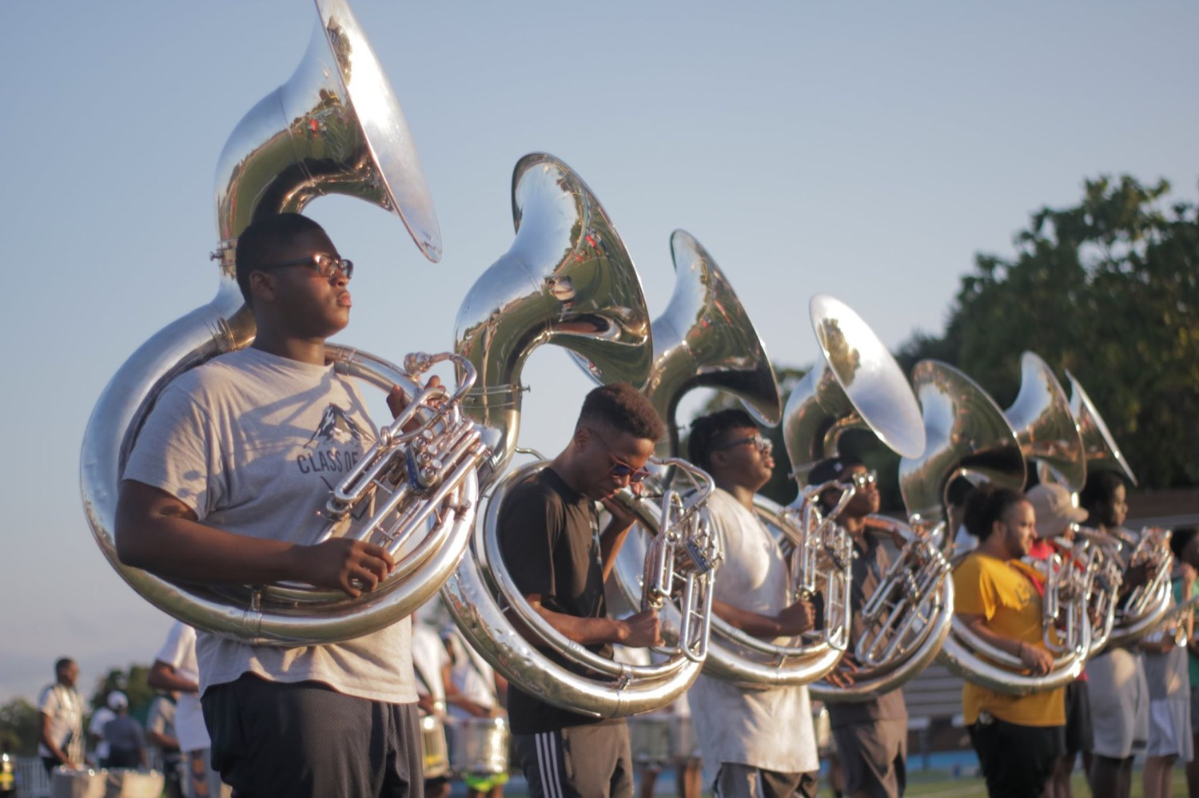
YOUR CHARGE
Settle It.
Don't Bury It.
That jury walked in eleven to one—certain, angry, ready to go home in five minutes. They walked out with a fair and unanimous verdict, not because anyone shouted the loudest, but because one person refused to rush, asked honest questions, and stayed fair when the room got hot. Conflict is the price of a group that cares. Go at it early, listen for the real need under the argument, stay hard on the problem and soft on the person, and point everyone back at the show you are all here to build. Be the one who turns eleven-to-one into justice.
Serve First. Lead Always. — Drive the Legacy.
The Hampton University Marching Force
Hampton's Heartbeat
Notes:
SLIDE 15 — CLOSE: Settle It. Don't Bury It.
Bring the film back around: "That jury walked in eleven to one and walked out with a fair, unanimous verdict — because one person refused to rush and stayed fair when the room got hot."
End on: "Be the one who turns eleven-to-one into justice."

