Slide 1
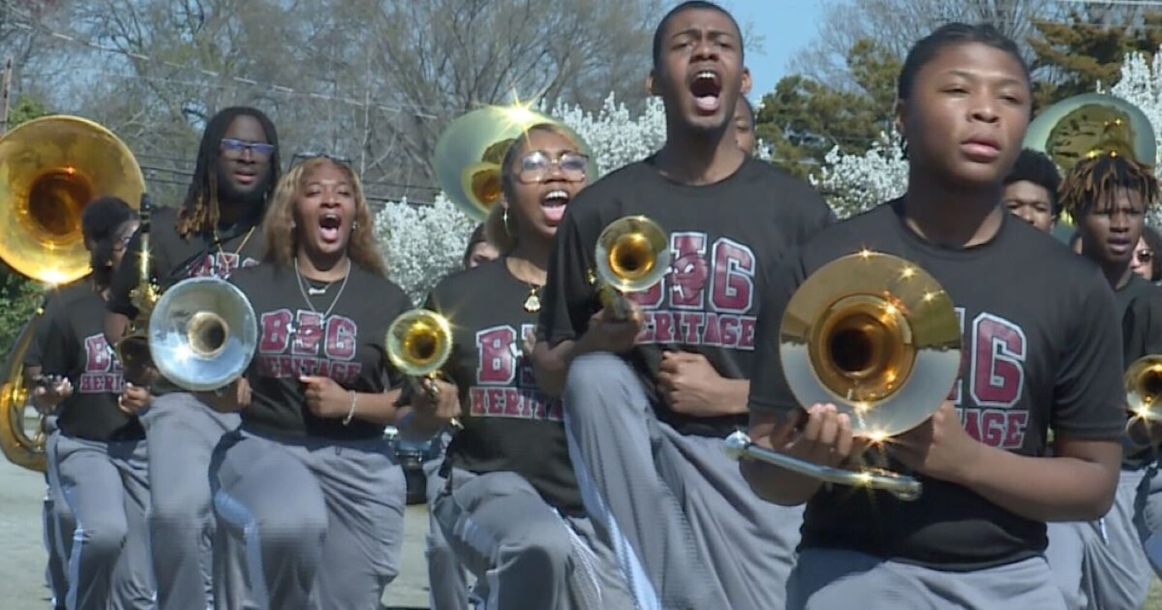
A BAND LEADERSHIP SEMINAR
Know Your People
"Meet Them Where They Are."
Mr. Jae Brown, M.M.Ed
Director of Bands · Heritage High School
A Leadership Seminar
Lead With Heart
Notes:
SLIDE 1 — TITLE: Know Your People
PRESENTER: Mr. Jae Brown, M.M.Ed — Director of Bands, Heritage High School. This deck is in Heritage maroon and silver, and it doubles as a deck he can give his own students.
OPEN: Introduce yourself and why you're here. These are not your students — buy credibility in the first sixty seconds.
SAY: "Band is one of the most emotional things any of us do. Today is about the people inside the uniform."

Slide 2
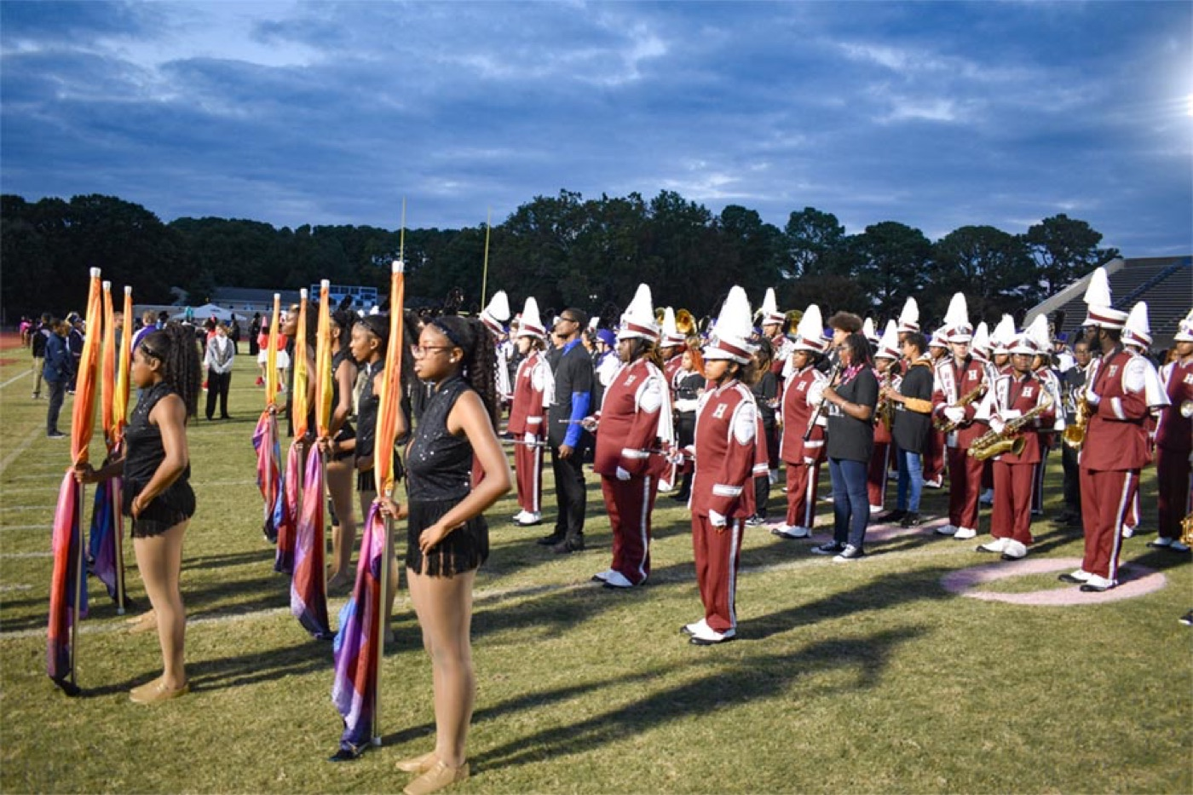
— KNOW YOUR PEOPLE
LEADERSHIP SEMINAR
Icebreaker
Empathy is not fixing, and it is not "at least…" It is climbing down into it with someone so they don't feel alone. That is the whole job of knowing your people.
▶
Brené Brown on Empathy
youtu.be/1Evwgu369Jw
WATCH · 2:53
Pre-Drill Camp 2026 · Leadership Seminars
02
Notes:
SLIDE 2 — ICEBREAKER: Brené Brown on Empathy (2:53)
SET UP: "Watch the difference between empathy and sympathy. One connects. One doesn't."
Play it — animated, short, and it lands on its own.
AFTER: "Empathy isn't fixing. It isn't 'at least.' It's climbing down into it with somebody so they aren't alone."
ASK: "When was the last time somebody 'at leasted' you?" You'll get a laugh of recognition — that's the door in.

Slide 3
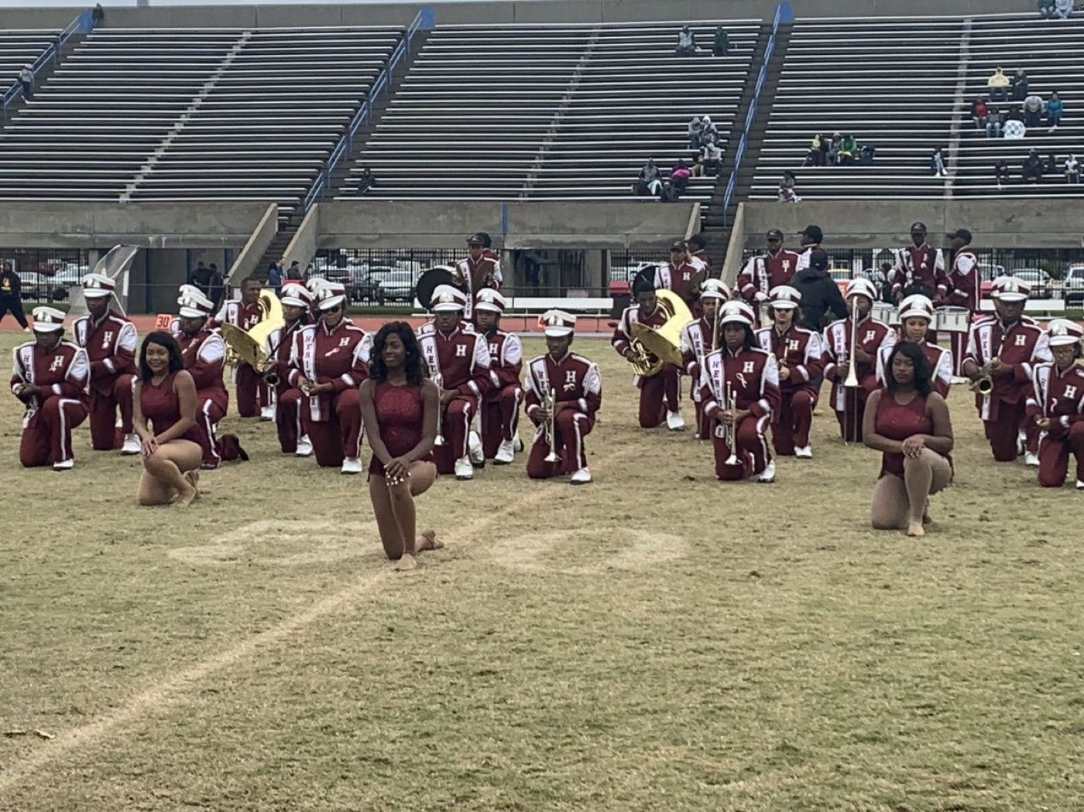
01
THE PREMISE
Band is one of the most emotional things we do. We spend more hours together than almost anyone else in the building, chasing something hard, in front of crowds, under pressure. That closeness is our strength—and it means real feelings, hard days, and friction come with the territory. You do not lead instruments. You lead people, and people bring their whole selves to the field.
LEAD THE PERSON, NOT JUST THE PLAYER.
Notes:
SLIDE 3 — THE PREMISE (statement slide)
Read it as written; don't paraphrase.
THE CORE: "You don't lead instruments. You lead people, and people bring their whole selves to the field."
Takeaway: "Lead the person, not just the player."

Slide 4
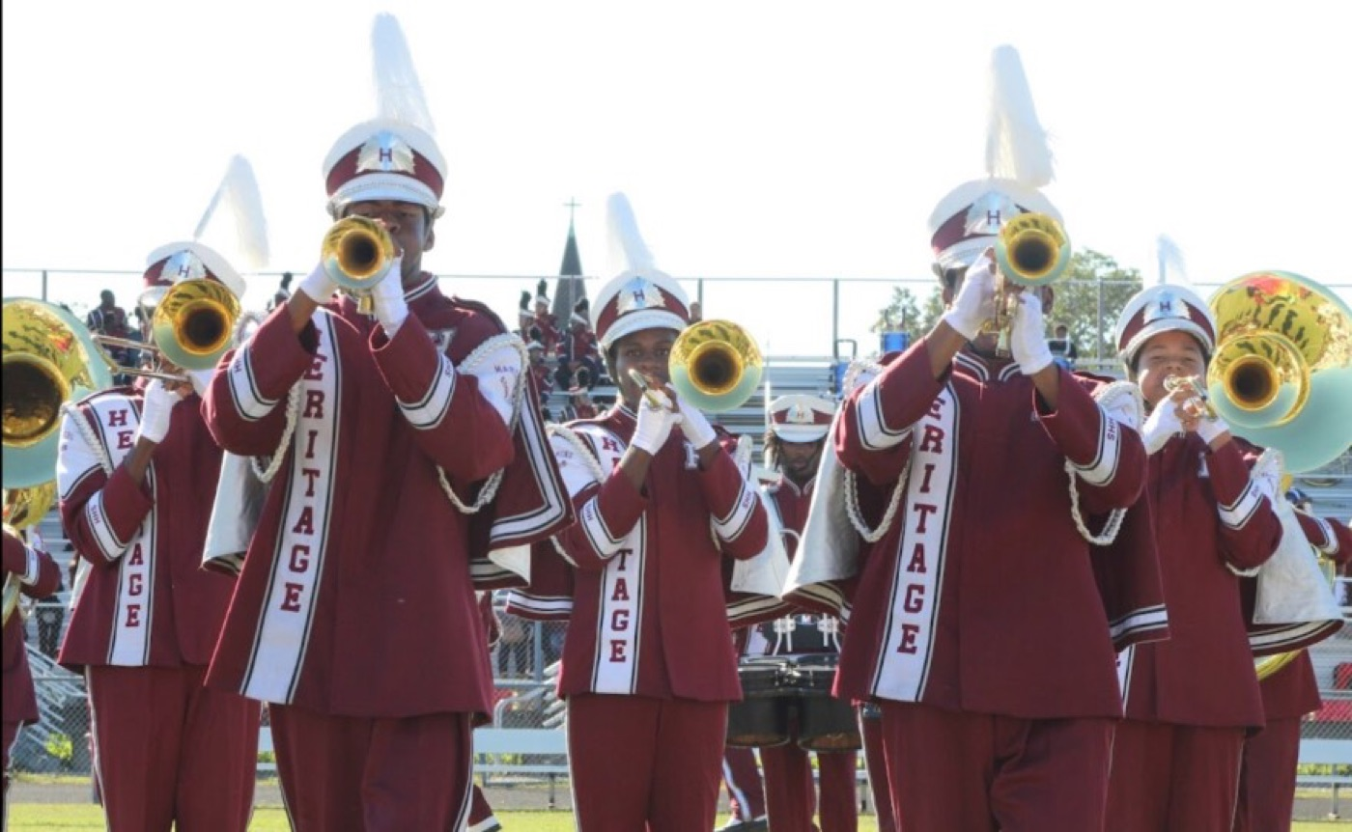
— KNOW YOUR PEOPLE
LEADERSHIP SEMINAR
Band Is an Emotional Activity
Recognize it—don't pretend it away.
◆ We spend enormous time together—long rehearsals, early mornings, road trips, high-stakes performances. That much time and pressure creates real emotion.
◆ People get tired, stressed, and irritated—with the work, and sometimes with each other. That is normal, not a sign the team is broken.
◆ "leave it at the door."it at the door." It is a good goal, but it is not always the reality—and pretending otherwise only makes it worse.
◆ Great leaders don't avoid the emotion in the room. They notice it, name it, and lead through it.
Pre-Drill Camp 2026 · Leadership Seminars
04
Notes:
SLIDE 4 — BAND IS AN EMOTIONAL ACTIVITY
Name the reality out loud — this is the permission-giving slide.
"We spend more hours together than almost anybody. That much time and pressure creates real emotion."
THE HONEST PART: "The old rule is leave it at the door. It's a good goal. It is not always the reality — and pretending otherwise makes it worse."
CUE: Watch the room here. This is where they realize you're going to talk about something real.

Slide 5
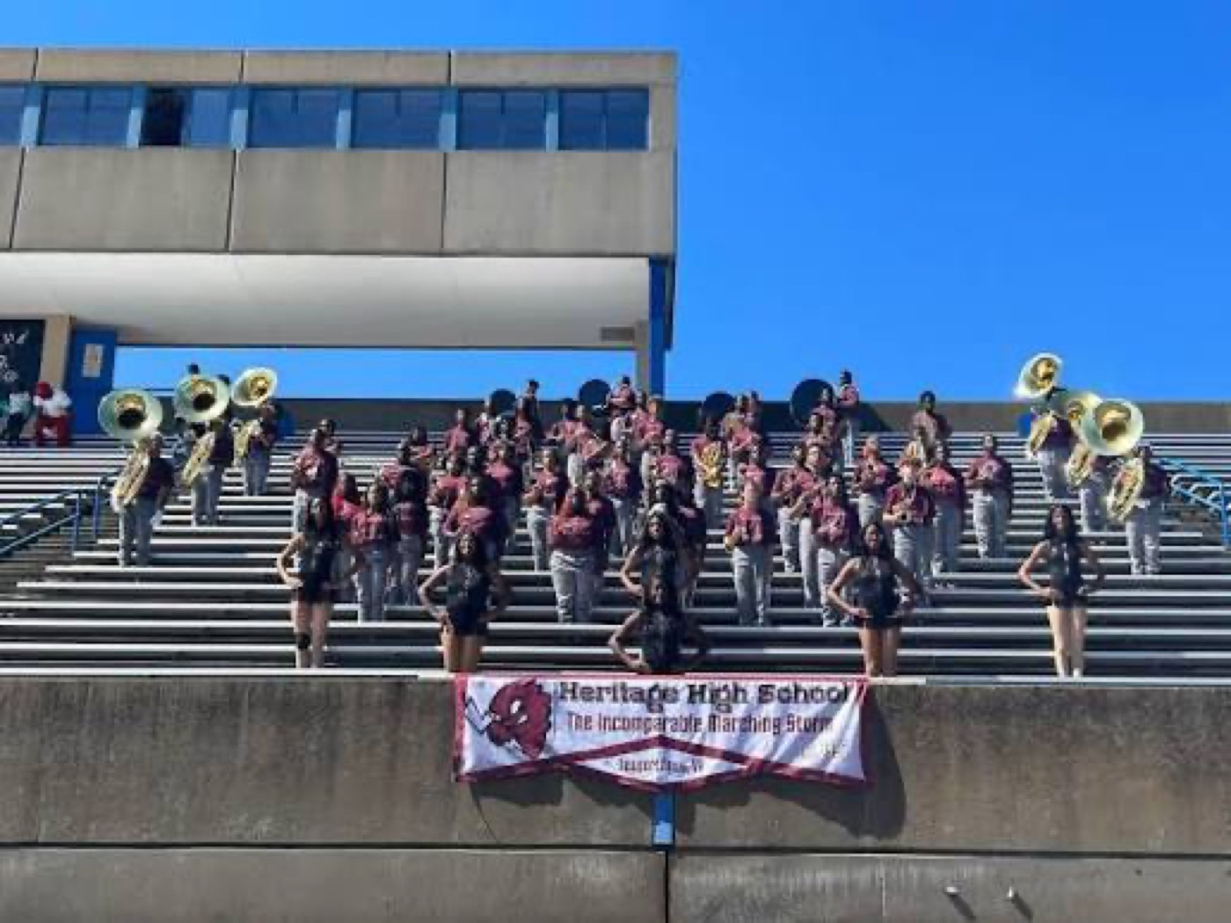
— KNOW YOUR PEOPLE
LEADERSHIP SEMINAR
Two Kinds of Awareness
Read both—or you will lead half-blind.
Emotional intelligence starts with awareness of yourself and grows into awareness of others. Both, every day.
Pre-Drill Camp 2026 · Leadership Seminars
05
Notes:
SLIDE 5 — TWO KINDS OF AWARENESS
Two columns: those you lead, and yourself.
SAY: "Most leadership training only teaches the first column. You'll lead half-blind if that's all you have."
Read the callout: awareness of self grows into awareness of others. Both, every day.

Slide 6
— KNOW YOUR PEOPLE
LEADERSHIP SEMINAR
Lead With Emotional Intelligence
The leader's real skill isn't the horn—it's people.
◆ Self-awareness: know what you are feeling, and how it is landing on others, in the moment.
◆ Self-management: handle your own emotions so a bad morning doesn't become the whole section's bad morning.
◆ Social awareness (empathy): read the room and the person—what are they actually feeling right now?
◆ Relationship management: use all of the above to connect, defuse, and move people forward together.
Source: Daniel Goleman, Emotional Intelligence and Primal Leadership — the four EI domains.
Pre-Drill Camp 2026 · Leadership Seminars
06
Notes:
SLIDE 6 — LEAD WITH EMOTIONAL INTELLIGENCE
Goleman's four domains: self-awareness, self-management, social awareness, relationship management.
KEEP IT MOVING — these are a framework, not the lesson. The lesson is the next four slides.
LINE TO USE: "The leader's real skill isn't the horn. It's people."

Slide 7
— KNOW YOUR PEOPLE
LEADERSHIP SEMINAR
Read Your People
You can't help what you don't notice.
◆ normaleach member's normal—their usual energy, tone, and habits. Then you can spot when something changes.
◆ Watch for the signs: pulling away, a short temper, going quiet, slipping attendance, a drop in effort from someone who usually gives it.
◆ outside the roomen outside the room—classes, money, home, health, sleep. Look past the behavior to the person.
◆ When you notice, don't diagnose from a distance. Get closer, and ask.
Pre-Drill Camp 2026 · Leadership Seminars
07
Notes:
SLIDE 7 — READ YOUR PEOPLE
The practical heart of the first half.
"Learn each member's normal — their usual energy, tone, habits. Then you can spot when it changes."
Walk the warning signs: pulling away, short temper, going quiet, slipping attendance, effort dropping from someone who usually gives it.
KEY: "The cause is usually outside the room. Look past the behavior to the person."
THEN THE GUARDRAIL: "Don't diagnose from a distance. Get closer and ask."

Slide 8
— KNOW YOUR PEOPLE
LEADERSHIP SEMINAR
Meet Them Where They Are
Same standard. A different approach, when it's needed.
◆ Not everyone shows up the same every day—and pretending they do costs you the person.
◆ notting people where they are is not lowering the bar. It is choosing the approach that actually gets them there today.
◆ Sometimes that's a harder push; sometimes it's a quieter word, a short break, or "let's talk after." Read which one the moment needs.
◆ both at oncend high standards are not opposites. The best leaders hold both at once.
Pre-Drill Camp 2026 · Leadership Seminars
08
Notes:
SLIDE 8 — MEET THEM WHERE THEY ARE
This is the phrase the whole session is built on. Say it, then define it against the obvious objection.
"Meeting people where they are is NOT lowering the bar. It's choosing the approach that actually gets them there today."
Give the range: sometimes a harder push, sometimes a quieter word, sometimes 'let's talk after.'
LAND: "Compassion and high standards are not opposites."

Slide 9
— KNOW YOUR PEOPLE
LEADERSHIP SEMINAR
Adjust Your Style
No single style fits every person or every moment.
◆ Situational Leadership Situational Leadership: the best leaders change their approach based on the person and the task in front of them.
◆ directioners need clear direction; some need coaching; some need support and encouragement; some just need you to delegate and trust them.
◆ Match the style to where the person actually is—in skill and in headspace—not to how you happen to like leading.
◆ A rigid, one-size leader loses the people who needed something different. Flexibility is a skill, not a weakness.
Source: Paul Hersey and Ken Blanchard — the Situational Leadership model (direct, coach, support, delegate).
Pre-Drill Camp 2026 · Leadership Seminars
09
Notes:
SLIDE 9 — ADJUST YOUR STYLE
Hersey and Blanchard's Situational Leadership: direct, coach, support, delegate.
MAKE IT CONCRETE: ask them to think of one member who needs direction and one who just needs to be trusted. Same section, opposite approaches.
LAND: "Match the style to where the person actually is — in skill AND in headspace — not to how you happen to like leading."

Slide 10
— KNOW YOUR PEOPLE
LEADERSHIP SEMINAR
The Mental Check-In
Build it in—don't wait for a crisis.
◆ "how are you, really?" the routine, the way you check instruments and attendance. A quick, genuine "how are you, really?" goes a long way.
◆ listenhen listen—more than you talk. You are not there to fix them; you are there to hear them and let them feel seen.
◆ connect them to helpu are a leader, not a counselor. When something is bigger than you, connect them to help—the director, a coach, campus or school support.
◆ Never carry a serious concern alone. Loop in the director. That is exactly what we are here for.
Pre-Drill Camp 2026 · Leadership Seminars
10
Notes:
SLIDE 10 — THE MENTAL CHECK-IN
This is your own practice from your program — teach it as something you actually do, not theory.
"Build it into the routine, the way you check instruments and attendance."
THE TOOL: "How are you, really?" Then listen more than you talk.
CRITICAL GUARDRAIL — say it plainly: "You are a leader, not a counselor. When it's bigger than you, connect them to help. Never carry a serious concern alone — loop in the director."
CUE: Dr. Jones should be visibly nodding here. Point to him.

Slide 11
— KNOW YOUR PEOPLE
LEADERSHIP SEMINAR
Know Your Own Headspace
You bring a whole self to the field too.
◆ Leaders have hard days—personal stuff, health, mood swings, pressure. Being in charge does not make you immune.
◆ knowve it at the door" is the ideal. When you can't fully, at least know it—name to yourself what you're carrying so it doesn't leak out sideways.
◆ Self-awareness keeps your bad day from becoming everyone's bad day. Manage it before it manages the section.
◆ You lead people best when you are honest with yourself about where you are.
Pre-Drill Camp 2026 · Leadership Seminars
11
Notes:
SLIDE 11 — KNOW YOUR OWN HEADSPACE
The pivot from others to self. Slow down — this is the part most leadership training skips.
"Leaders have hard days. Being in charge doesn't make you immune."
HONEST FRAMING: "'Leave it at the door' is the ideal. When you can't fully, at least know it — name what you're carrying so it doesn't leak out sideways."
Be willing to give a short personal example. It earns the room more than anything else in this deck.

Slide 12
— KNOW YOUR PEOPLE
LEADERSHIP SEMINAR
Share the Load
Asking for help is leadership, not weakness.
◆ say soou are not in the right headspace, say so—to your fellow leaders and to the director. Don't white-knuckle it alone.
◆ Lean on your team. Let a co-leader take the rep, cover the section, or run point while you reset.
◆ Don't pass your weight to someone already stretched thin. Share the load with the people equipped to carry it—starting with the director.
◆ A team that communicates about its own limits is stronger, not softer. That is how the whole leadership corps stays standing.
Pre-Drill Camp 2026 · Leadership Seminars
12
Notes:
SLIDE 12 — SHARE THE LOAD
"Asking for help is leadership, not weakness."
Walk the four. The one that matters most: "Don't pass your weight to somebody already stretched thin. Share it with the people equipped to carry it — starting with the director."
CUE: Some of these students think toughing it out silently is the job. Say directly that it isn't.

Slide 13
— KNOW YOUR PEOPLE
LEADERSHIP SEMINAR
Make It Safe
People bring their real selves only where it's safe.
◆ Build a section where it's okay to not be okay—no ridicule, no gossip, no punishing honesty.
◆ protect itne trusts you with something personal, protect it. Guard their trust, and only escalate for safety or when real help is needed.
◆ Handle friction between members early, directly, and privately—before it hardens into resentment.
◆ The safer your people feel, the more they will give you—and the more you will actually be able to lead them.
Source: Amy Edmondson, Harvard Business School — psychological safety in teams.
Pre-Drill Camp 2026 · Leadership Seminars
13
Notes:
SLIDE 13 — MAKE IT SAFE
Psychological safety, in plain terms: "Build a section where it's okay to not be okay."
THE TRUST RULE: "When somebody trusts you with something personal, protect it. Only escalate for safety, or when real help is needed."
Also: handle friction early, directly, privately — before it hardens.

Slide 14
— KNOW YOUR PEOPLE
LEADERSHIP SEMINAR
Know Your People: The Playbook
Four habits to lead the human, not just the musician.
1
Read the Room
Learn each person's normal, and notice when it changes—in them and in yourself.
Pre-Drill Camp 2026 · Leadership Seminars
14
Notes:
SLIDE 14 — THE PLAYBOOK
Four habits: Read the Room, Meet Them There, Check In, Share the Load.
This is the takeaway slide. Tell them to photograph it.
ASK FOR ONE COMMITMENT: "Name the one member you're going to check on this week." Have them say a real name to themselves.

Slide 15
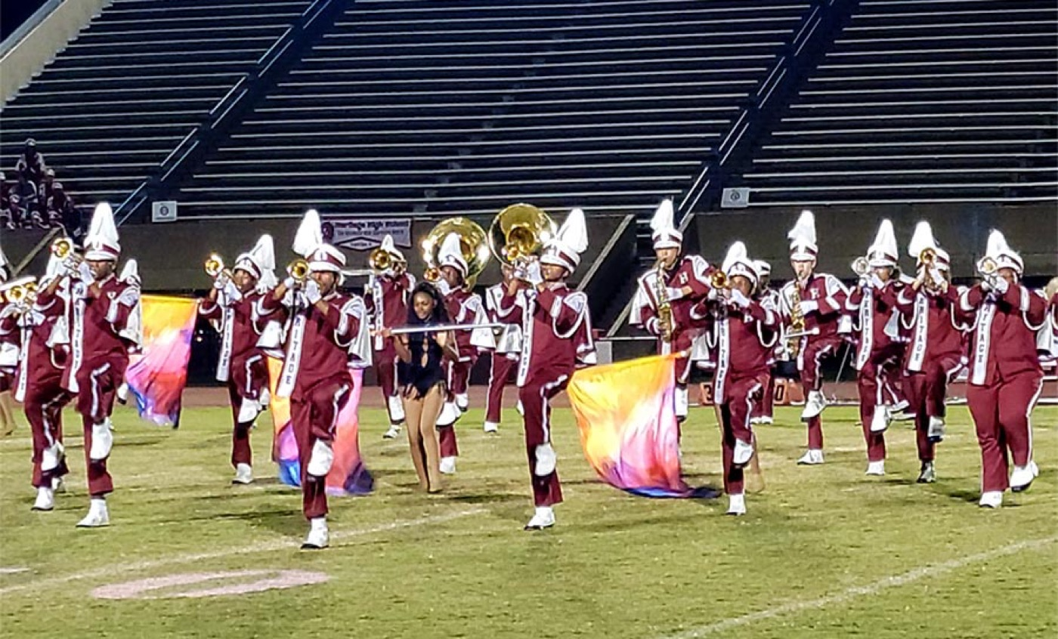
YOUR CHARGE
Lead the
Whole Person.
Band is emotional because it matters, and because we do it shoulder to shoulder for hundreds of hours. That closeness will test everyone—your members and you. So learn your people well enough to see when they're off, meet them where they are instead of where you wish they were, and adjust how you lead to serve who is actually in front of you. Know your own heart just as honestly, and when it is heavy, share the load. Take care of the people, and the people will take care of the show.
Know Them. Know Yourself. — Lead With Heart.
Presented by Mr. Jae Brown, M.M.Ed
Heritage High School Bands
Notes:
SLIDE 15 — CLOSE: Lead the Whole Person.
Deliver the charge in your own voice — this is where a guest presenter should sound like himself, not like the slide.
"Take care of the people, and the people will take care of the show."
Thank them, hand back to Dr. Jones.

