Slide 1
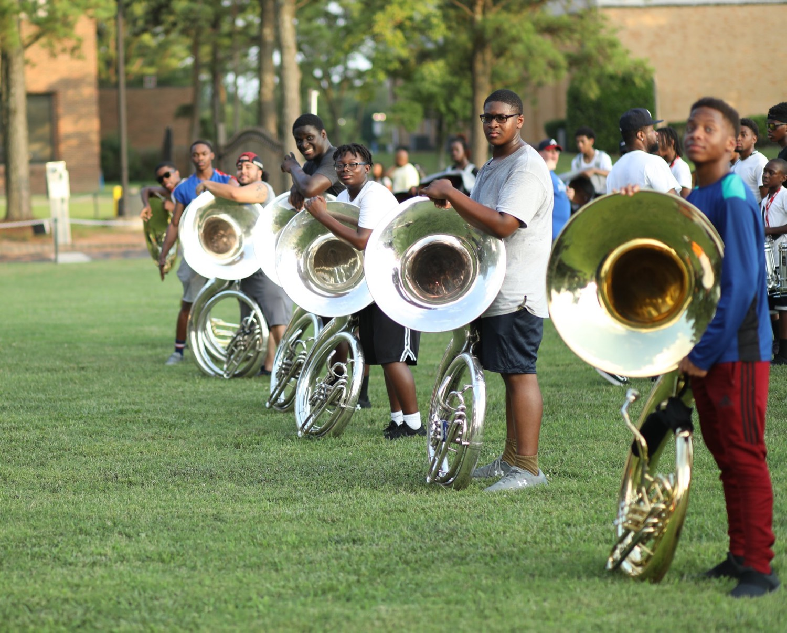
PRE-DRILL CAMP 2026 · LEADERSHIP SEMINARS · DAY 2
Leading Under Pressure
"Composed. Decisive. Steady."
Dr. Thomas L. Jones, Jr.
Director of University Bands · All Leaders, Sunday, August 2, 2026
The Hampton University Marching Force
Hampton's Heartbeat
Notes:
SLIDE 1 — TITLE: Leading Under Pressure
SAY: "Something is going to go wrong at camp. That's not pessimism, that's a schedule. Today is about who you are in that moment."

Slide 2

— LEADING UNDER PRESSURE
THE HAMPTON UNIVERSITY MARCHING FORCE
Icebreaker
Before Jackie Robinson broke baseball's color line, Branch Rickey warned him he would face vicious abuse—and asked for something harder than swinging back: the discipline not to. Under pressure, the toughest thing to command is your own response.
▶
42 — Rickey Recruits Robinson
youtu.be/nmxKEUXlO8s
WATCH · 1:20
Pre-Drill Camp 2026 · Leadership Seminars
02
Notes:
SLIDE 2 — ICEBREAKER: 42, Rickey Recruits Robinson (1:20)
SET UP: "Branch Rickey tells Jackie Robinson exactly what's coming, and then asks him for something harder than fighting back."
Play it.
AFTER: "He asked for a man with the guts NOT to fight back. That's composure under the worst pressure any athlete ever faced."
PERSONAL NOTE (Dr. Jones): you staffed the Jackie Robinson organization for years. Say so — it makes the clip land differently coming from you.

Slide 3

01
THE PREMISE
Pressure does not build character—it reveals it. When the tempo drops, the weather turns, or a member breaks down, every eye turns to the leader. What they read in your face and hear in your voice becomes what the whole group feels next. You cannot always control the moment, but you always control how you meet it.
PRESSURE REVEALS THE LEADER.
Notes:
SLIDE 3 — THE PREMISE (statement slide)
Read it.
THE LINE: "Pressure does not build character. It reveals it."
Then: "What they read in your face becomes what the whole group feels next."
Takeaway: "Pressure reveals the leader."

Slide 4

— LEADING UNDER PRESSURE
THE HAMPTON UNIVERSITY MARCHING FORCE
What Pressure Does to You
Know your body's stress response—so it doesn't run you.
◆ fight-or-flighthe brain's alarm center floods your body with adrenaline: heart racing, breath shortening, muscles tightening. This fight-or-flight response is automatic.
◆ "amygdala hijack"el Goleman calls the takeover an "amygdala hijack"—the emotional brain seizes control before the thinking brain can catch up.
◆ tunnel visionunnel vision: narrowed attention, worse memory, rushed decisions. The moment you most need to think clearly, your body makes it hardest.
◆ manage itt switch the response off, but you can manage it. That skill is the whole game.
Source: Daniel Goleman, Emotional Intelligence — the "amygdala hijack."
Pre-Drill Camp 2026 · Leadership Seminars
04
Notes:
SLIDE 4 — WHAT PRESSURE DOES TO YOU
Teach the physiology plainly — adrenaline, racing heart, tunnel vision.
NAME IT: Goleman's amygdala hijack — the emotional brain seizes control before the thinking brain catches up.
THE REFRAME: "You can't switch it off. You can manage it. That skill is the whole game."

Slide 5
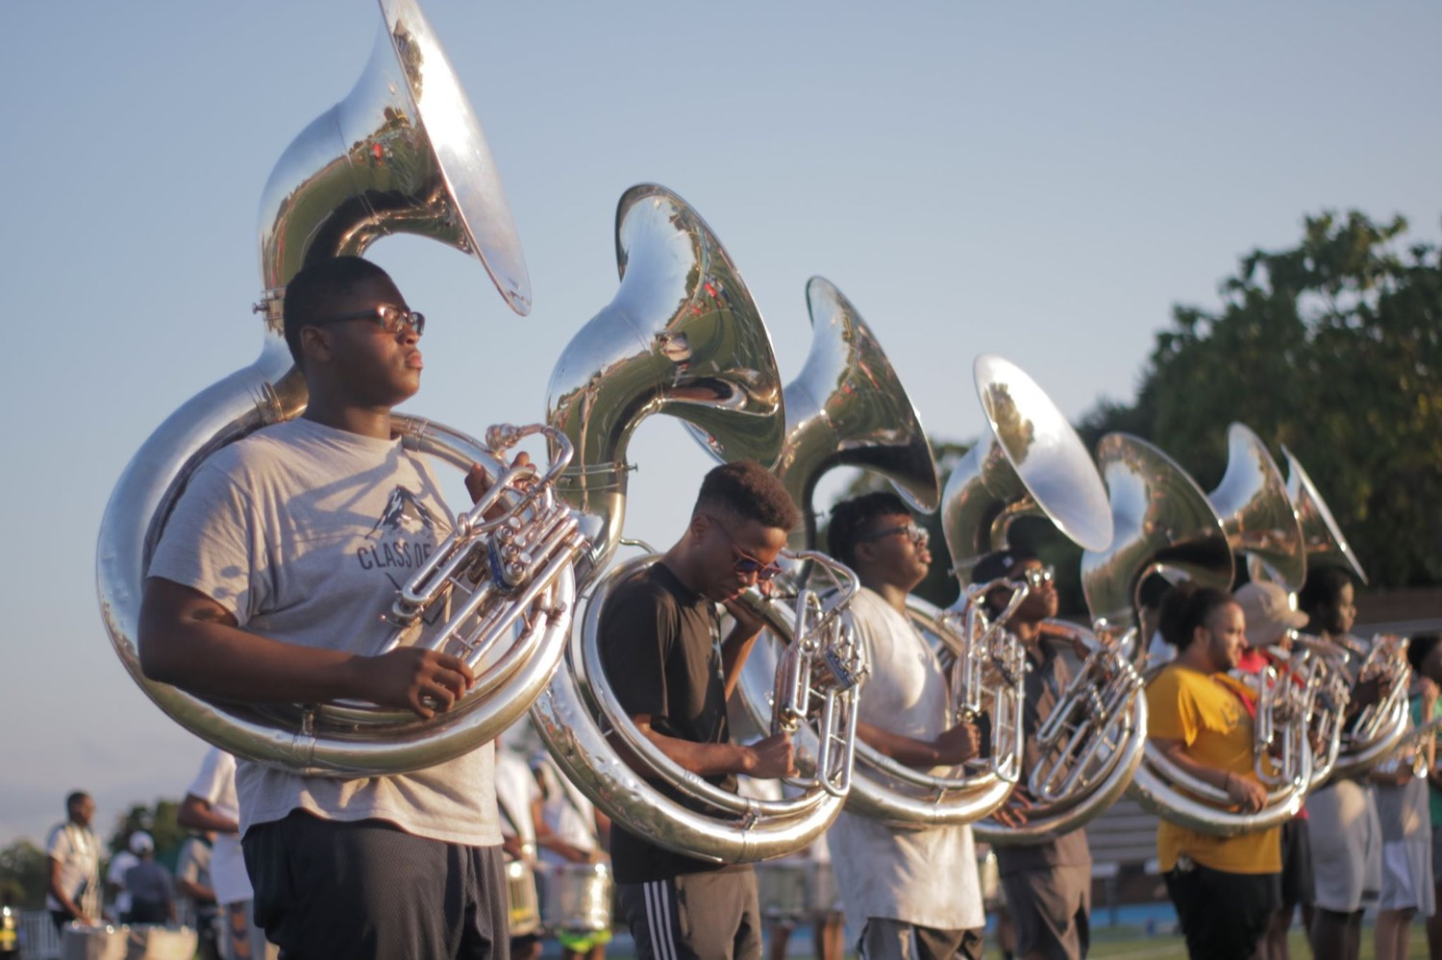
— LEADING UNDER PRESSURE
THE HAMPTON UNIVERSITY MARCHING FORCE
Use the Pressure
A little pressure sharpens you. Too much undoes you.
◆ inverted Utury ago, Yerkes and Dodson found performance follows an inverted U: too little pressure and you go flat; too much and you fall apart.
◆ peak sits in the middleddle—enough tension to focus and energize, not so much that you seize up.
◆ find your zonet the enemy. Flat, bored, and careless loses games too. The goal is to find your zone, not to feel nothing.
◆ Learn where your peak is—and learn to pull yourself back down when you have shot past it.
Source: the Yerkes-Dodson law (1908) — arousal and performance.
Pre-Drill Camp 2026 · Leadership Seminars
05
Notes:
SLIDE 5 — USE THE PRESSURE
Yerkes-Dodson, the inverted U. Draw it in the air with your hand — flat, peak, collapse.
"Too little pressure and you go flat. Too much and you fall apart. The peak is in the middle."
COUNTERINTUITIVE POINT: "Pressure isn't the enemy. Bored and careless loses games too."

Slide 6

— LEADING UNDER PRESSURE
THE HAMPTON UNIVERSITY MARCHING FORCE
Control the Body First
The fastest way to a calm mind is a slow breath.
◆ breathe your way your way calm in one second, but you can breathe your way there. Slow breathing signals the body that the threat has passed.
◆ box breathinghing—the tool soldiers and first responders train: in for four, hold four, out four, hold four. Two or three rounds resets you.
◆ exhale, controlled exhale is the switch. It slows the heart and clears the tunnel vision.
◆ beforebefore you speak or decide. Steady the body, and the steady mind follows.
Source: Lt. Col. Dave Grossman, On Combat — combat / tactical breathing.
Pre-Drill Camp 2026 · Leadership Seminars
06
Notes:
SLIDE 6 — CONTROL THE BODY FIRST
DO THIS ONE LIVE. Don't just describe box breathing — run it.
"Everybody with me. In for four. Hold four. Out four. Hold four." Do two rounds with the whole room.
Then: "That's the tool soldiers and first responders train. The long exhale is the switch."
RULE: "Do it before you speak or decide."

Slide 7
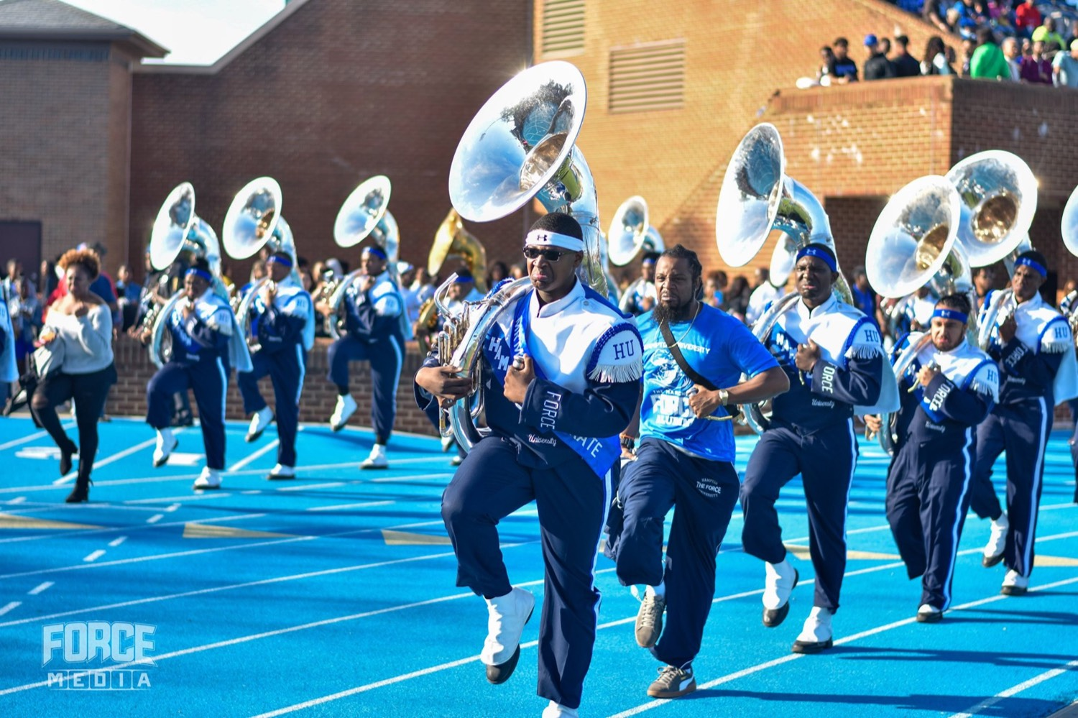
— LEADING UNDER PRESSURE
THE HAMPTON UNIVERSITY MARCHING FORCE
Threat or Challenge?
The same pressure, read two different ways.
◆ labelbody reacts to how you label a moment. Call it a threat and you brace to survive; call it a challenge and you rise to compete.
◆ fuel, not fearress shows the pounding heart before a big moment is fuel, not fear—your body getting you ready to perform.
◆ "this is our moment"our people, "this is our moment"—not "this is going wrong." The reframe changes the chemistry.
◆ Choose the read. pressure as a challenge decide better and recover faster. Choose the read.
Sources: Alia Crum (stress mindset); Jeremy Jamieson (stress reappraisal).
Pre-Drill Camp 2026 · Leadership Seminars
07
Notes:
SLIDE 7 — THREAT OR CHALLENGE?
"Your body reacts to how you label the moment."
THE USABLE BIT: "That pounding heart before a big moment is fuel, not fear."
GIVE THEM THE PHRASE: "Tell yourself and your people 'this is our moment' — not 'this is going wrong.'"

Slide 8

— LEADING UNDER PRESSURE
THE HAMPTON UNIVERSITY MARCHING FORCE
You Fall to the Level of Your Training
You don't rise to the occasion—you sink to your preparation.
◆ what you have drilleds you will not magically get better; you will do what you have drilled. Reps are what you fall back on.
◆ Rehearse the hard moments on purpose: the tempo change, the rain call, the confrontation. Practiced pressure is familiar pressure.
◆ smaller the shockr practice, the smaller the shock when it counts. This is why we drill a thing until it is boring.
◆ evidencece under pressure is not a feeling—it is evidence that you have been here before.
Source: stress inoculation training (Donald Meichenbaum); the maxim attributed to Archilochus.
Pre-Drill Camp 2026 · Leadership Seminars
08
Notes:
SLIDE 8 — YOU FALL TO THE LEVEL OF YOUR TRAINING
"You don't rise to the occasion. You sink to your preparation."
WHY WE DRILL: "Rehearse the hard moments on purpose — the tempo change, the rain call, the confrontation. This is why we drill a thing until it's boring."
LAND: "Confidence under pressure isn't a feeling. It's evidence you've been here before."

Slide 9

— LEADING UNDER PRESSURE
THE HAMPTON UNIVERSITY MARCHING FORCE
Decide, Then Move
Under pressure, indecision is its own decision—a bad one.
◆ OODA loopilot John Boyd taught the OODA loop: Observe, Orient, Decide, Act—then run it again, faster than the problem can change.
◆ Make the best call you canhe information. Make the best call you can with what you have, and adjust as you learn.
◆ good decision nowow usually beats a perfect one too late. Frozen is the worst option on the field.
◆ commitou decide, commit. A team can follow a clear call; it cannot follow a leader who keeps flinching.
Source: Col. John Boyd, USAF — the OODA loop (Observe, Orient, Decide, Act).
Pre-Drill Camp 2026 · Leadership Seminars
09
Notes:
SLIDE 9 — DECIDE, THEN MOVE
Boyd's OODA loop: Observe, Orient, Decide, Act — then run it again.
THE HARD TRUTH: "You'll rarely have all the information. A good decision now beats a perfect one too late."
"Frozen is the worst option on the field."
AND: "Once you decide, commit. A team can follow a clear call. It can't follow a leader who keeps flinching."

Slide 10
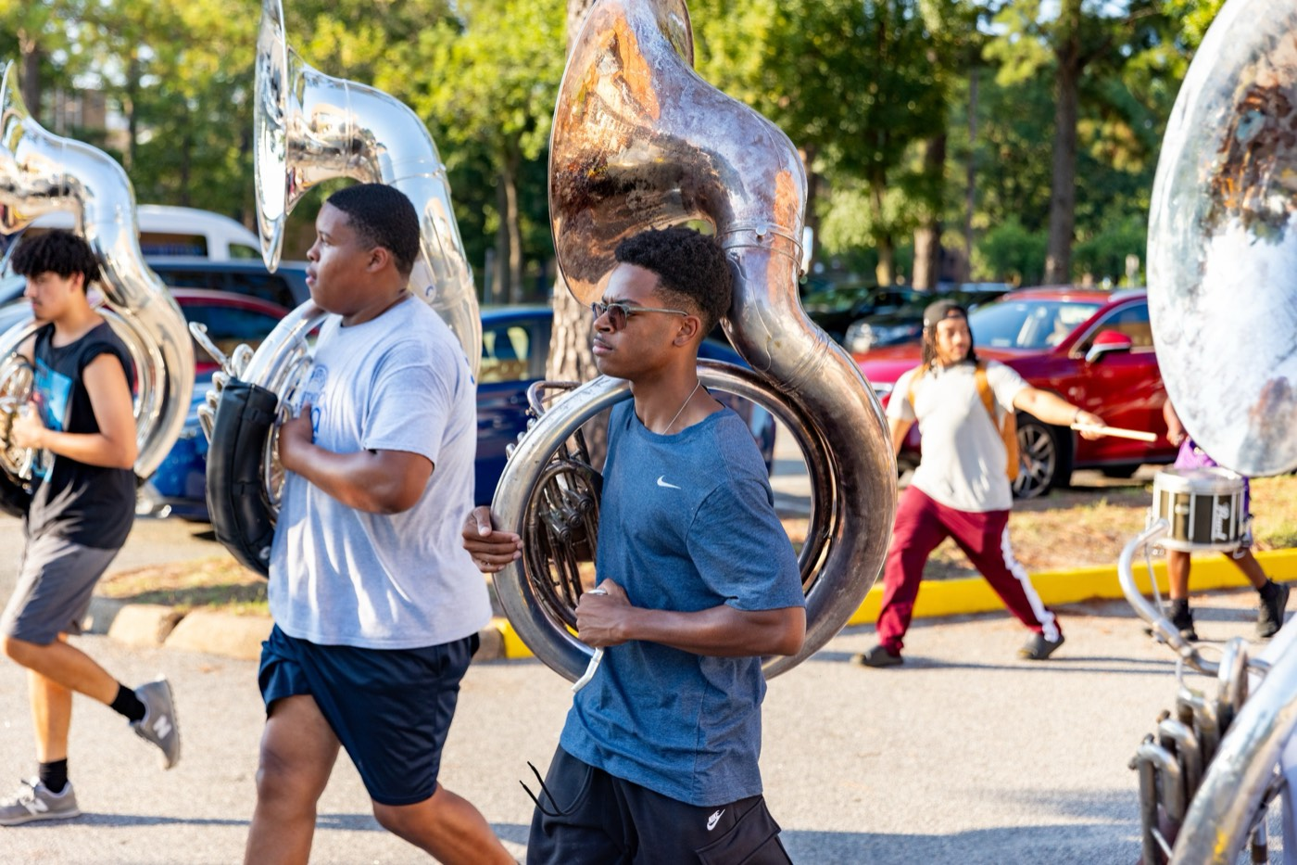
— LEADING UNDER PRESSURE
THE HAMPTON UNIVERSITY MARCHING FORCE
Slow Is Smooth, Smooth Is Fast
When it speeds up, you slow down.
◆ Deliberate beats franticure is to rush—and rushing is how mistakes stack up. Deliberate beats frantic, every time.
◆ Triage. Name the one thing that matters most right now and do that first. You cannot fix everything at once.
◆ slows the whole roomyour movements. A calm tempo from the leader slows the whole room to a pace it can handle.
◆ Take the extra half-second faster than fast reps done twice. Take the extra half-second and get it right.
Pre-Drill Camp 2026 · Leadership Seminars
10
Notes:
SLIDE 10 — SLOW IS SMOOTH, SMOOTH IS FAST
Say the title slowly — the delivery is the lesson.
TRIAGE: "Name the one thing that matters most right now and do that first."
PRACTICAL: "Slow your voice and your movements. A calm tempo from you slows the whole room."

Slide 11
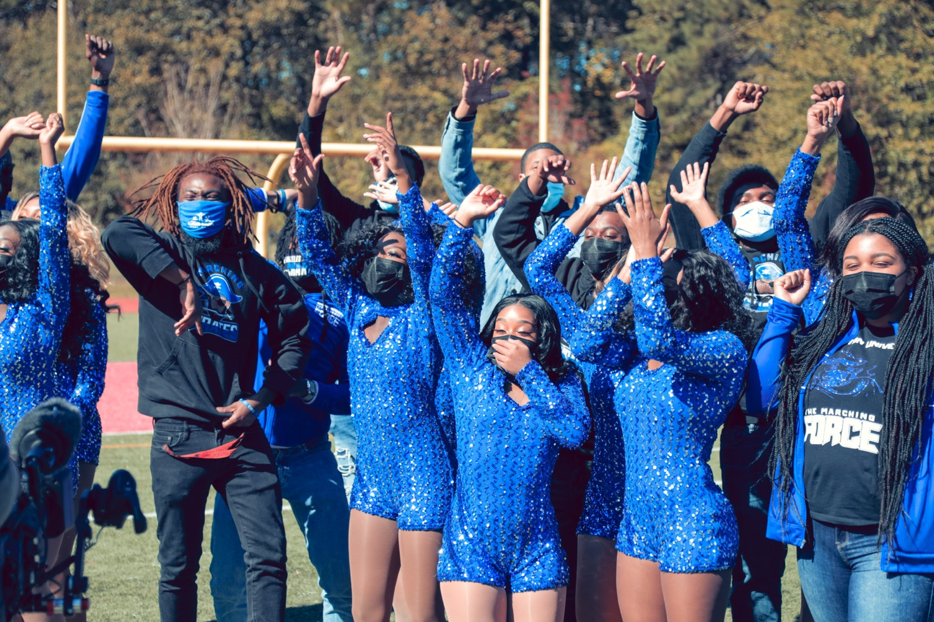
— LEADING UNDER PRESSURE
THE HAMPTON UNIVERSITY MARCHING FORCE
Your Calm Is Contagious
The group catches whatever the leader is feeling.
◆ emotional contagionsearchers call it emotional contagion—a group unconsciously syncs to the mood of the person in charge.
◆ Panic spreads. Poise spreads. Whichever one you show, you are handing it to everyone watching you.
◆ face, voice, and posture people read your face, voice, and posture before they hear a single word. Manage those first.
◆ projectnot have to feel calm to project calm. Project it anyway—and you will often talk yourself into it.
Source: Sigal Barsade, "The Ripple Effect" — emotional contagion in groups.
Pre-Drill Camp 2026 · Leadership Seminars
11
Notes:
SLIDE 11 — YOUR CALM IS CONTAGIOUS
Emotional contagion — the group syncs to the person in charge.
"Panic spreads. Poise spreads. Whichever one you show, you're handing it to everybody watching."
PERMISSION: "You don't have to FEEL calm to project calm. Project it anyway — you'll often talk yourself into it."

Slide 12
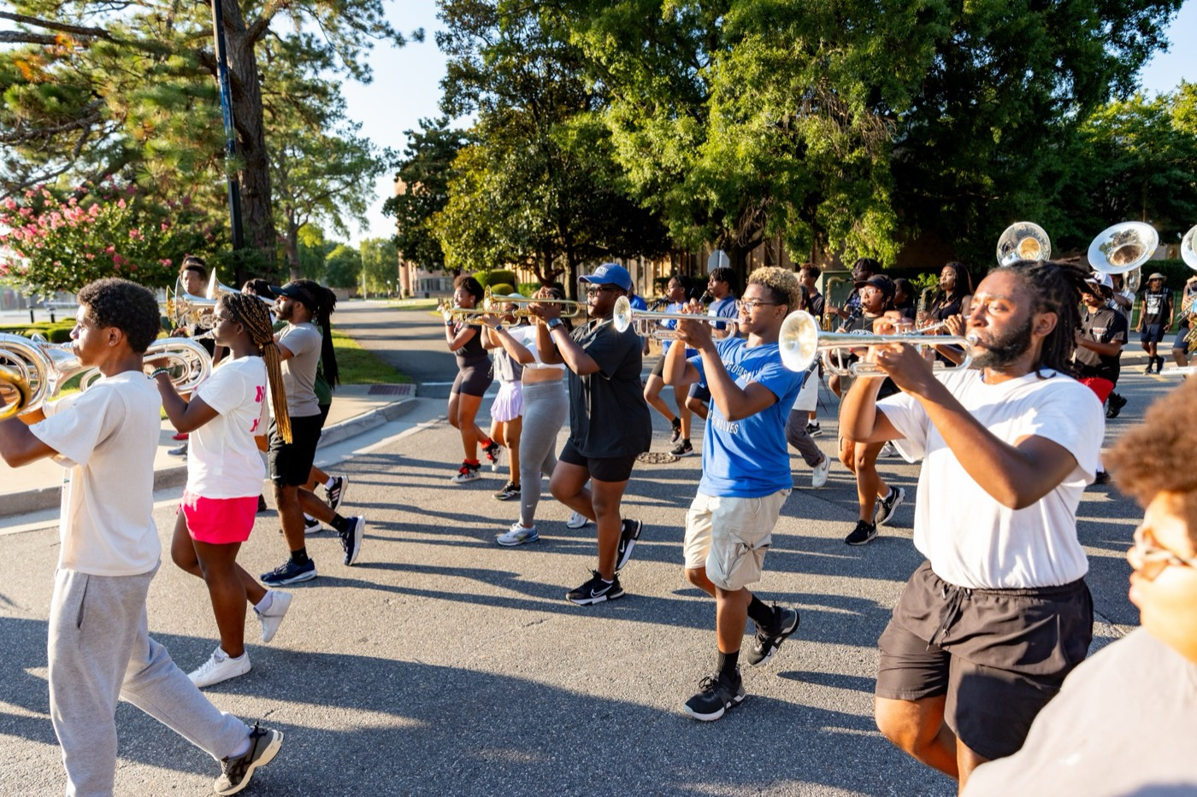
— LEADING UNDER PRESSURE
THE HAMPTON UNIVERSITY MARCHING FORCE
After the Moment
How you recover matters as much as how you respond.
◆ resetit is over, reset. Do not drag the last mistake into the next set—the group takes its cue from whether you let it go.
◆ Debrief, don't dwell. What worked, what didn't, what we change next time—then close the book.
◆ trains the teamyou saw out loud. Praising it trains the team to reach for it again.
◆ learn from pressuret are the ones who learn from pressure instead of being worn down by it.
Pre-Drill Camp 2026 · Leadership Seminars
12
Notes:
SLIDE 12 — AFTER THE MOMENT
The recovery half, which most people skip.
"Don't drag the last mistake into the next set. The group takes its cue from whether you let it go."
"Debrief, don't dwell."
AND: "Name the poise you saw out loud. Praising it trains them to reach for it again."

Slide 13

— LEADING UNDER PRESSURE
THE HAMPTON UNIVERSITY MARCHING FORCE
The Pressure Playbook
When it counts, run these four—in order.
1
Breathe
Steady the body first. One slow, controlled exhale before you speak or decide.
Pre-Drill Camp 2026 · Leadership Seminars
13
Notes:
SLIDE 13 — THE PRESSURE PLAYBOOK
Four, in order: Breathe, Prioritize, Decide, Project.
Make them repeat the four back. This is the slide they need at 2 p.m. on a hot Thursday.

Slide 14

YOUR CHARGE
Steady Under
Fire.
Pressure is coming—the dropped tempo, the hostile crowd, the member who breaks down, the call only you can make. You cannot stop the moment from arriving, but you decide who shows up to meet it. Breathe before you react. Read the pressure as a challenge, not a threat. Trust the reps you have put in. Make the call, and commit. And remember that every eye is reading your calm, so give them a steady one. Grace under fire is not something you are born with—it is something you train.
Serve First. Lead Always. — Drive the Legacy.
The Hampton University Marching Force
Hampton's Heartbeat
Notes:
SLIDE 14 — CLOSE: Steady Under Fire.
"Grace under fire is not something you're born with. It's something you train."
End on the sign-off.

