Slide 1

PRE-DRILL CAMP 2026 · LEADERSHIP SEMINARS · DAY 2
Interpreting
the Music
"Two Halves of One Show"
Dr. Thomas L. Jones, Jr.
Director of University Bands · Auxiliary and Ensemble, Sunday, August 2, 2026
The Hampton University Marching Force
Hampton's Heartbeat
Notes:
SLIDE 1 — TITLE: Interpreting the Music
TWO-PART SESSION. Part One is for the auxiliary; Part Two is for the instrumentalists. Both groups stay in the room for both halves — that's the point.
OPEN: "Two halves of one show. You each need to hear what the other is being asked for."

Slide 2
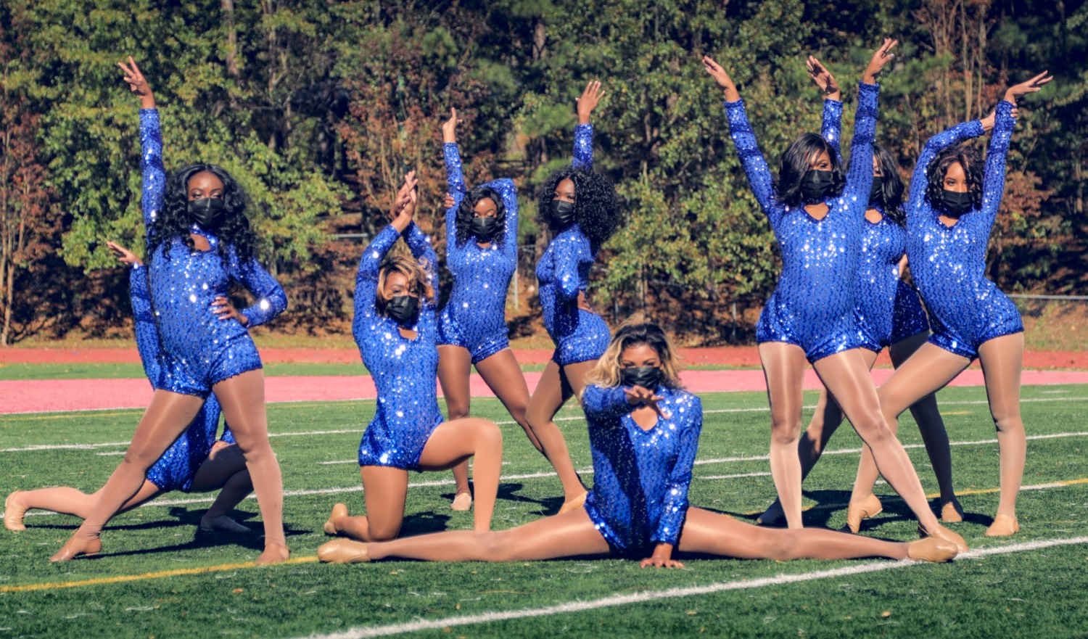
— INTERPRETING THE MUSIC
THE HAMPTON UNIVERSITY MARCHING FORCE
Icebreaker
The song is a spiritual; the dancers never say a word, yet they tell its whole story. This is interpretation at its highest—movement that means every note.
▶
Alvin Ailey — “Wade in the Water” from Revelations
youtu.be/k5IoS5gSA74
WATCH · 3:14
Pre-Drill Camp 2026 · Leadership Seminars
02
Notes:
SLIDE 2 — ICEBREAKER: Alvin Ailey, "Wade in the Water" from Revelations (3:14)
SET UP: "The song is a spiritual. The dancers never say a word, and they tell the whole story."
Play it.
AFTER: "Every movement meant something. That's interpretation at its highest."

Slide 3
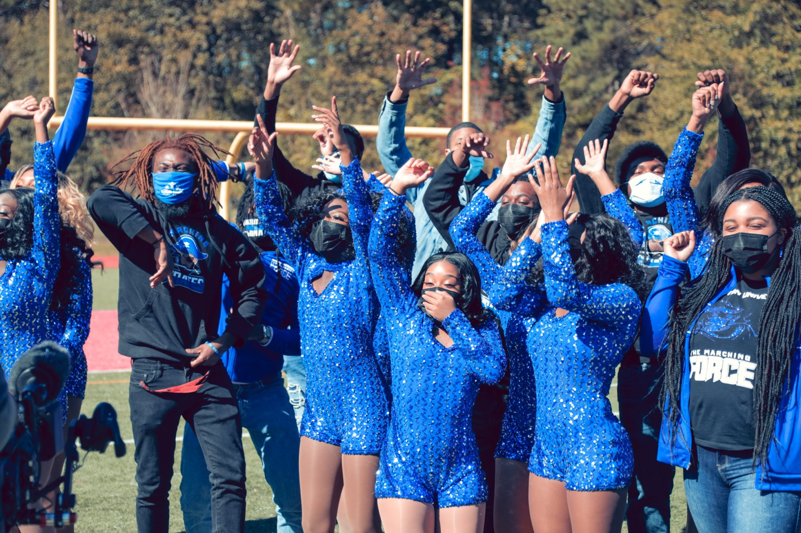
PART ONE
For the Auxiliary
You are the ones who make the music visible. This half is about turning what the band plays into movement the crowd can see and feel.
Notes:
SLIDE 3 — PART ONE DIVIDER: For the Auxiliary
Dark divider slide.
SAY: "Auxiliary — this half is yours. Band, listen anyway. You'll understand what they're building."

Slide 4

01
THE PREMISE
The band gives the music its sound. You give it its face. The crowd does not just hear the song—they watch you feel it. Your job is to make the music visible: to turn a melody into a moment they can see, and a lyric into a story they cannot look away from.
MAKE THE MUSIC VISIBLE.
Notes:
SLIDE 4 — THE PREMISE (statement slide)
Read it.
Takeaway: "Make the music visible."

Slide 5
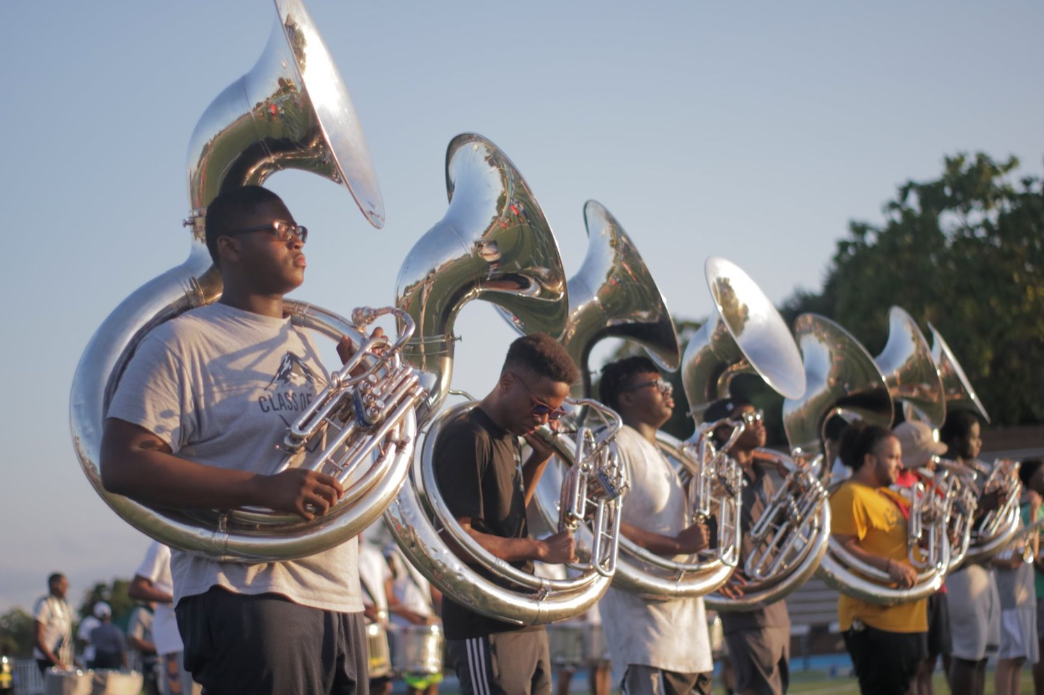
— INTERPRETING THE MUSIC
THE HAMPTON UNIVERSITY MARCHING FORCE
What You Really Do
The auxiliary is not decoration—it is the music, made visible.
1
Amplify the Music
When you hit the accent with the band, the whole crowd feels it twice—once in the ear, once in the eye.
Pre-Drill Camp 2026 · Leadership Seminars
05
Notes:
SLIDE 5 — WHAT YOU REALLY DO
"The auxiliary is not decoration. It is the music, made visible."
Amplify the music, tell the story, set the picture, move the crowd.
NOTE: our auxiliary is dancers, flags, and batons. No rifles or sabres.

Slide 6
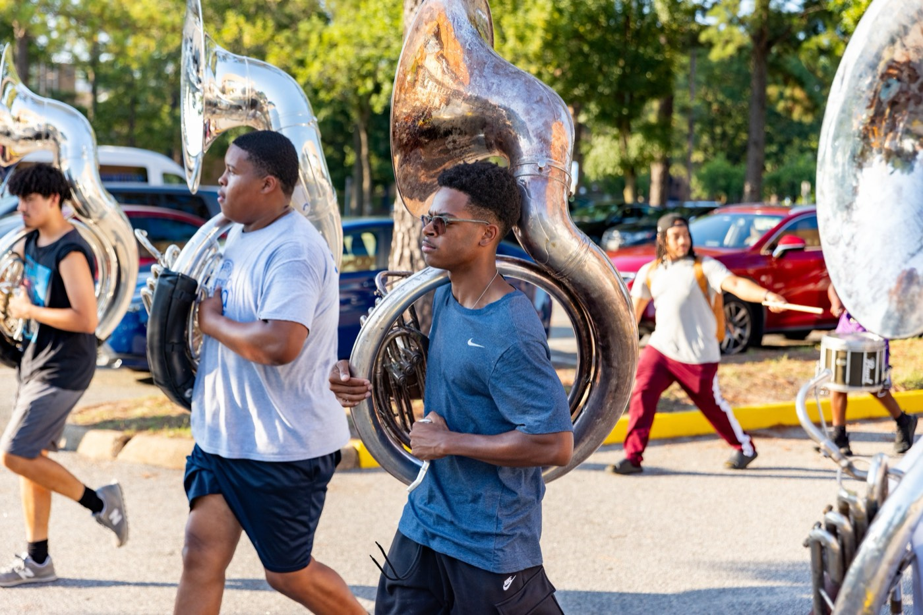
— INTERPRETING THE MUSIC
THE HAMPTON UNIVERSITY MARCHING FORCE
Listen First
You cannot interpret what you have not studied.
◆ learn the songent a single count, learn the song: its mood, its story, and where it builds and breaks.
◆ structuretructure—intro, verse, chorus, the hits, the pause before the hit. Movement lives inside that map.
◆ lyricshe lyrics like a script. What is the song saying, and how does it feel when it says it?
◆ accents and the pockethe pocket. Great interpretation starts with great listening, not great tricks.
Pre-Drill Camp 2026 · Leadership Seminars
06
Notes:
SLIDE 6 — LISTEN FIRST
"You cannot interpret what you have not studied."
PRACTICAL ASSIGNMENT: "Before you choreograph one eight-count — listen to the song ten times. Learn where it breathes, where it hits, where it goes quiet."

Slide 7

— INTERPRETING THE MUSIC
THE HAMPTON UNIVERSITY MARCHING FORCE
Move the Feeling
Match the quality of your movement to the feeling of the music.
◆ smooth and lyricalsmooth and lyrical, move sustained and flowing. When it is sharp and aggressive, move strong and direct.
◆ light or strong, sudden or sustained, direct or indirectned, direct or indirect. Choose the one that matches the sound.
◆ qualityballad danced hard, or a hard groove danced soft, tells the crowd the wrong story. The quality is the interpretation.
◆ Let the music decide how you move, not just what you do.
Sources: Rudolf Laban, The Mastery of Movement; Laban and Lawrence, Effort (movement effort qualities).
Pre-Drill Camp 2026 · Leadership Seminars
07
Notes:
SLIDE 7 — MOVE THE FEELING
Laban's effort qualities in plain language: match the QUALITY of movement to the quality of the music.
"Sharp music, sharp movement. Sustained music, sustained movement."
DEMONSTRATE if you can — show the same eight-count two ways. It teaches instantly.

Slide 8
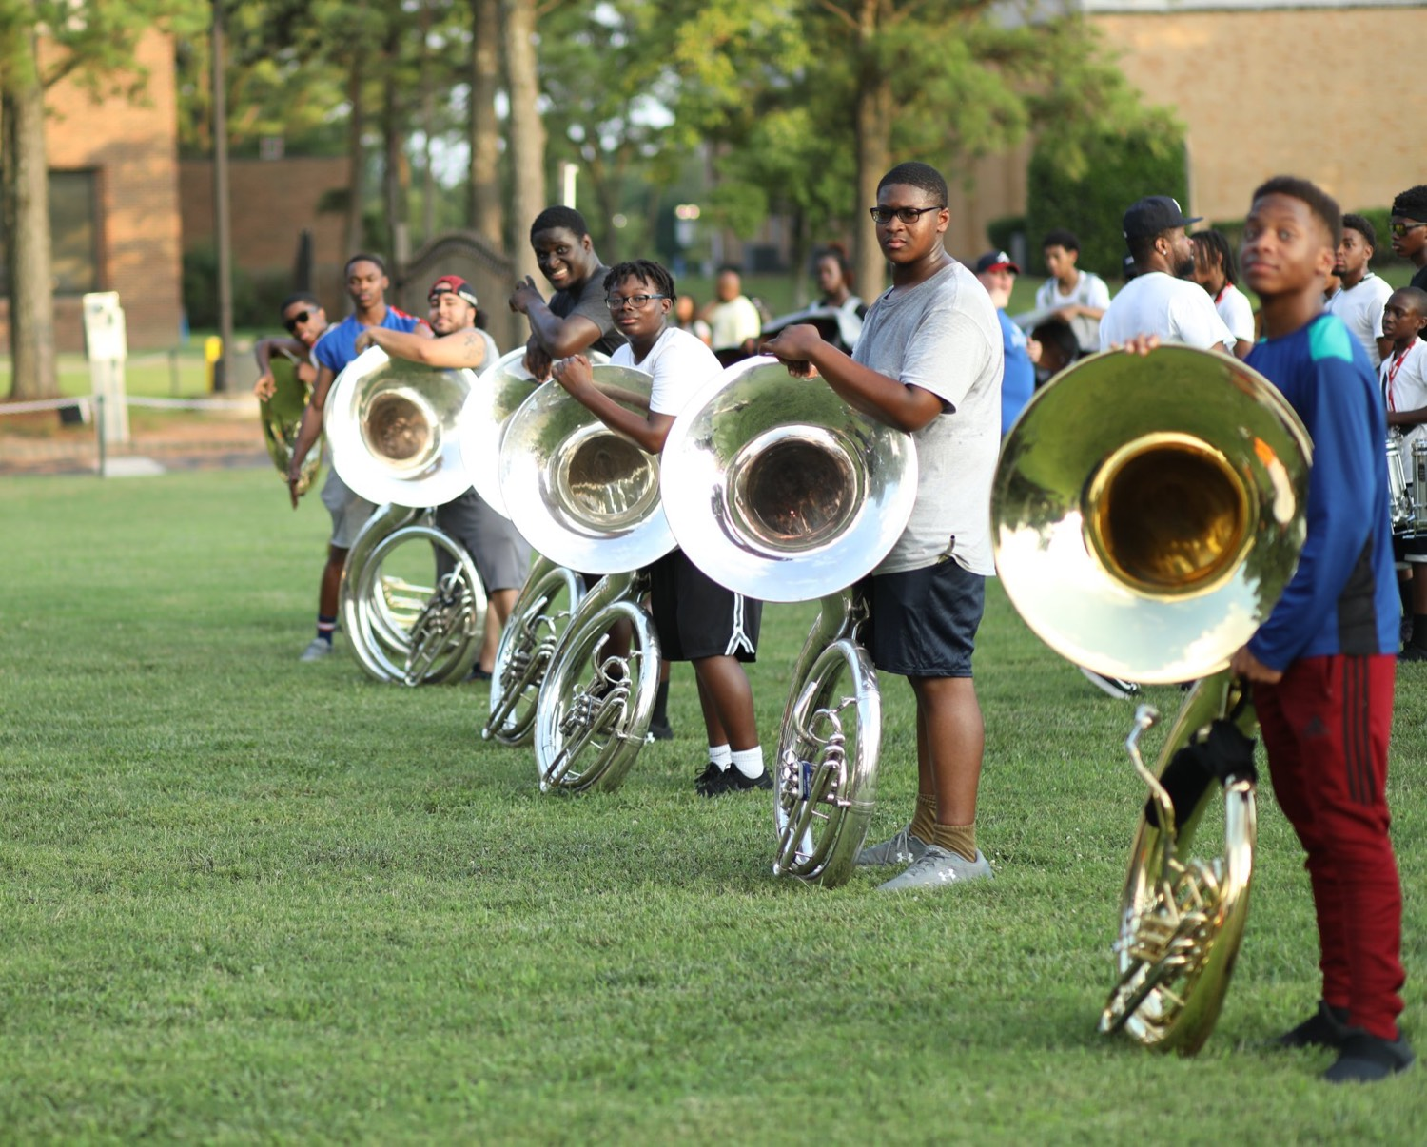
— INTERPRETING THE MUSIC
THE HAMPTON UNIVERSITY MARCHING FORCE
Hit the Music
Move on the music, not just to it. This is musicality.
◆ Catch the accents. When the band snaps a hit, you snap with it—together, on the exact count, or the effect is lost.
◆ Phrase your movement the way the music phrases: breathe with the melody, and let a musical line become a movement line.
◆ Use the pause. The silence before a hit is as powerful as the hit—stillness makes the next move explode.
◆ Ride the pocket. When you are locked to the groove, the crowd feels the music and your movement as one thing.
Sources: Doris Humphrey, The Art of Making Dances; Blom and Chaplin, The Intimate Act of Choreography.
Pre-Drill Camp 2026 · Leadership Seminars
08
Notes:
SLIDE 8 — HIT THE MUSIC
"Move ON the music, not just TO it. That's musicality."
Catch the accents. Phrase the movement the way the music phrases. And use the pause — "the silence right before the hit is yours too."

Slide 9
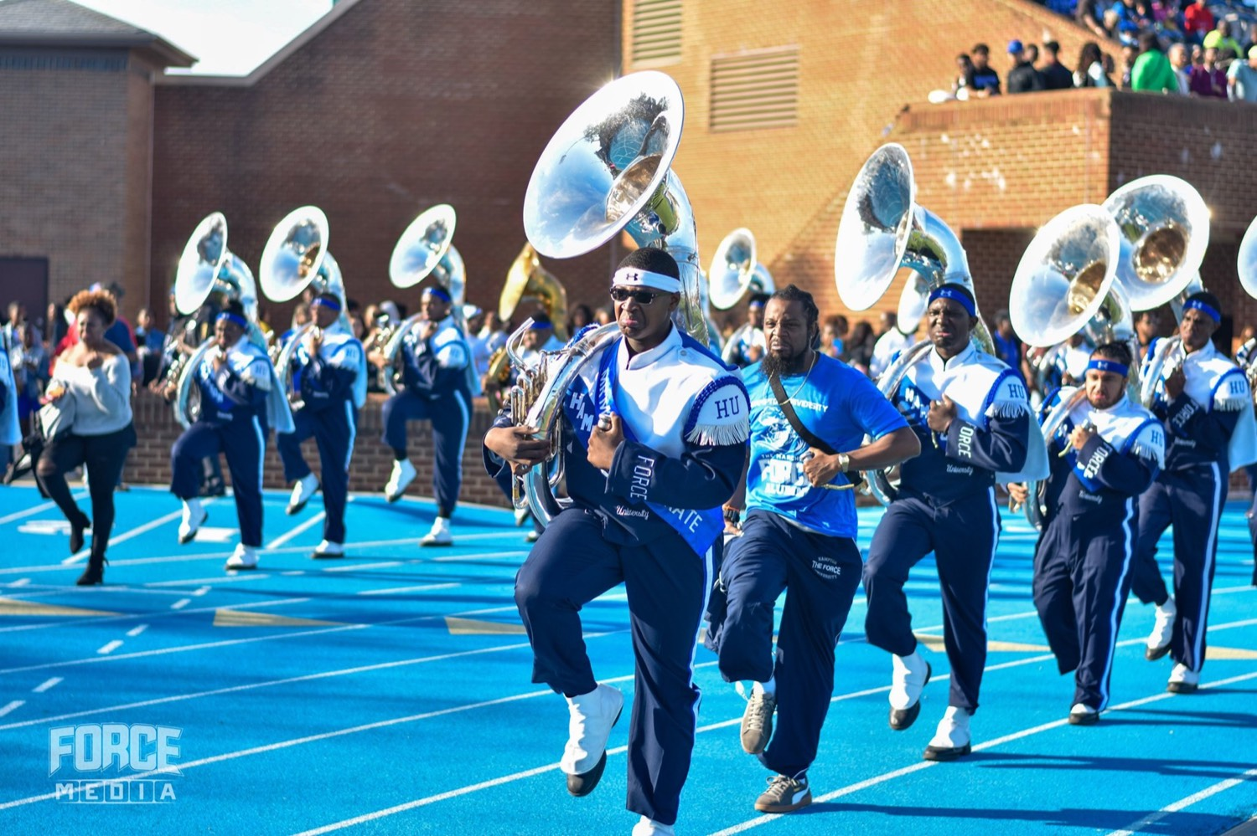
— INTERPRETING THE MUSIC
THE HAMPTON UNIVERSITY MARCHING FORCE
Tell the Story in the Lyrics
The words are your script. Act them.
◆ Know what the song is about, then let the gesture say it—reach on "rising," fall on "let go," open up on "free."
◆ Hit the key words. The title phrase and the hook are where the audience is listening hardest; give them something to see there.
◆ Show the arc. If the song travels from struggle to joy, your body should travel there too, from tight and low to open and high.
◆ feelingmime every word—capture the feeling of the line. Suggest the story; let the crowd complete it.
Pre-Drill Camp 2026 · Leadership Seminars
09
Notes:
SLIDE 9 — TELL THE STORY IN THE LYRICS
"The words are your script. Act them."
If the lyric says reaching, reach. Gesture the words — the crowd reads it even when they don't consciously notice.

Slide 10
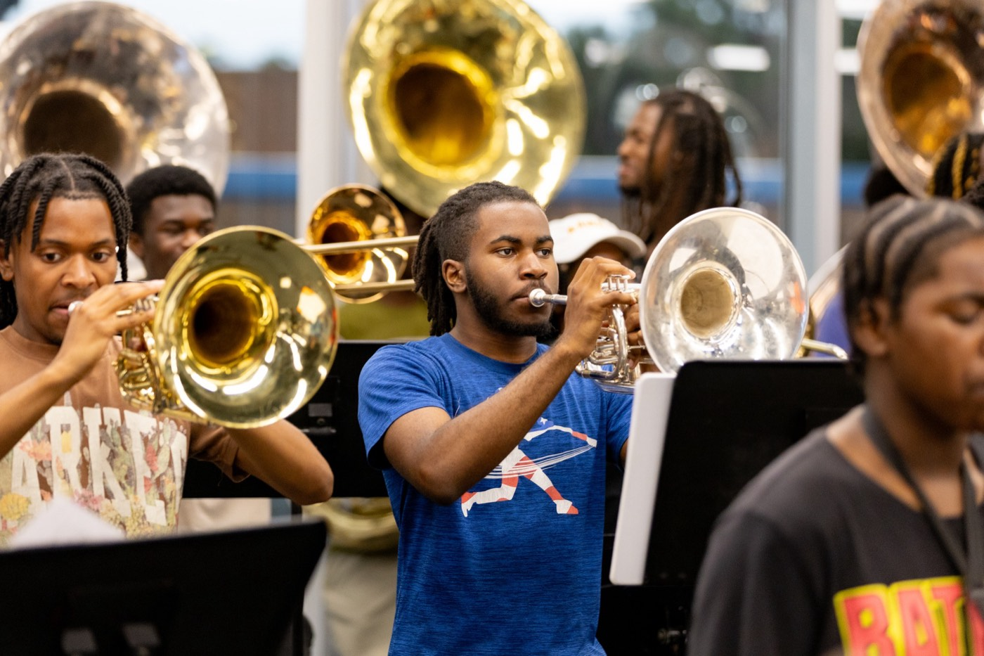
— INTERPRETING THE MUSIC
THE HAMPTON UNIVERSITY MARCHING FORCE
Bigger and Smaller
Match your dynamics to the music's—and use contrast to keep it alive.
◆ swellshe music swells, grow: bigger shapes, higher levels, more space. When it drops, shrink and settle.
◆ levelsn levels—low, middle, high. A flat visual reads flat no matter how clean it is.
◆ Contrast is what the eye loves. Unison, then a ripple; stillness, then a burst—the change is what people watch.
◆ Never dance every eight-count at the same size. Give the big moment its build-up so it actually lands big.
Sources: Doris Humphrey, The Art of Making Dances (dynamics, design, and contrast in choreography).
Pre-Drill Camp 2026 · Leadership Seminars
10
Notes:
SLIDE 10 — BIGGER AND SMALLER
Dynamics and levels. "Match your dynamics to the music's, and use contrast to keep it alive."
"If everything is big, nothing is big."

Slide 11

— INTERPRETING THE MUSIC
THE HAMPTON UNIVERSITY MARCHING FORCE
Serve the Show's Theme
Every show tells a story. Your job is to make the audience see it.
◆ theme-basedre theme-based: the music, the drill, and the visual all serve one idea. Your choreography has to serve it too.
◆ picturet picture this part of the show is painting, then choose movement and formations that paint it with the band.
◆ Visual storytelling is the evolution. The goal is not just clean—it is a moment the crowd will still be talking about.
◆ You are a co-author of the show, not an add-on. Interpret the theme, and the whole picture comes alive.
Pre-Drill Camp 2026 · Leadership Seminars
11
Notes:
SLIDE 11 — SERVE THE SHOW'S THEME
"Every show tells a story. Your job is to make the audience see it."
Tie to the season's theme shows. Visual storytelling is where this program is headed.

Slide 12
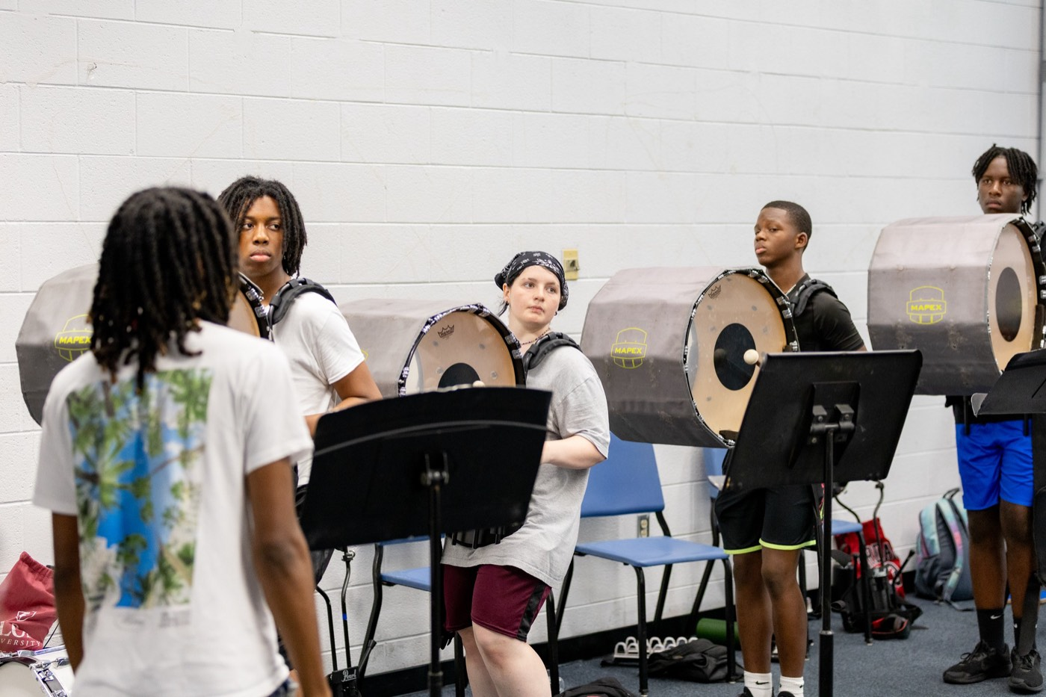
— INTERPRETING THE MUSIC
THE HAMPTON UNIVERSITY MARCHING FORCE
Clean and Together
Feeling only reads when the line is together.
◆ Unison is the frame that makes emotion readable. One person early or late, and the whole picture blurs.
◆ exact count and the exact anglee exact angle—same timing, same level, same finish. Precision is not the enemy of feeling; it is what lets feeling land.
◆ performhe counts until they are automatic, so your mind is free to perform, not to remember.
◆ A clean line moving as one is its own kind of power—the same "one voice" the band chases in its sound.
Pre-Drill Camp 2026 · Leadership Seminars
12
Notes:
SLIDE 12 — CLEAN AND TOGETHER
"Feeling only reads when the line is together."
One person off doesn't just look sloppy — it breaks the emotion for the whole audience.
"Unison is what makes emotion readable from the stands."

Slide 13
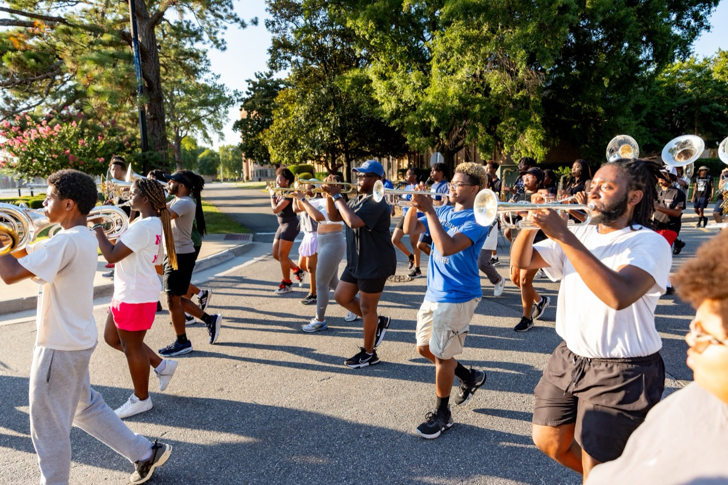
— INTERPRETING THE MUSIC
THE HAMPTON UNIVERSITY MARCHING FORCE
Sell It
A perfect routine with a blank face moves no one.
◆ Perform with your face, not just your body. The crowd feels exactly what you feel—so feel it, and show it.
◆ Commit all the way. Half-energy reads as no energy from the stands. Full-out, every rep, every time.
◆ Connect with the audience. Play to the crowd and the cameras; make them feel invited into the moment.
◆ Confidence is part of the choreography. Own the field, and the crowd will believe every step.
Pre-Drill Camp 2026 · Leadership Seminars
13
Notes:
SLIDE 13 — SELL IT
"A perfect routine with a blank face moves no one."
Perform with the face. Eye contact, commitment, energy through the last count.
"You are not finished when the movement is finished. You're finished when the crowd feels it."

Slide 14
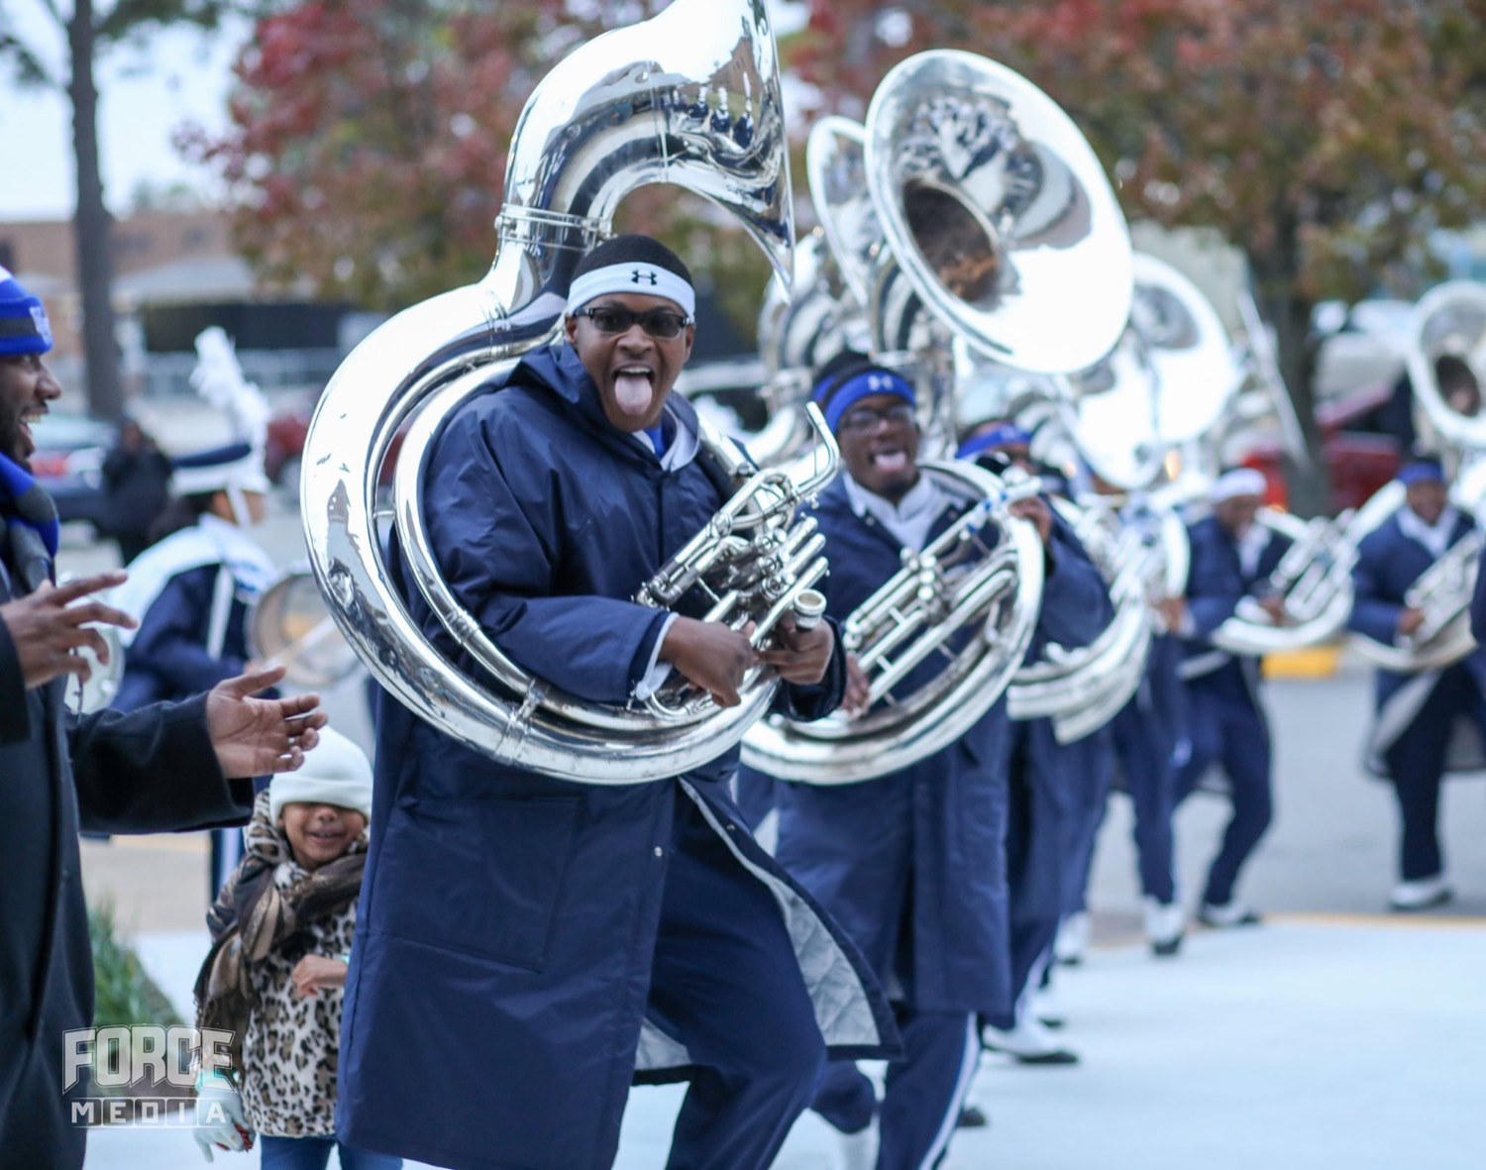
PART TWO
For the Ensemble
Instrumentalists, the auxiliary can only make visible what you actually play. This half is about giving them music worth interpreting.
Notes:
SLIDE 14 — PART TWO DIVIDER: For the Ensemble
SAY: "Instrumentalists — now it's your turn. Everything they just committed to depends on you."
CUE: watch the band's posture change here. Good.

Slide 15
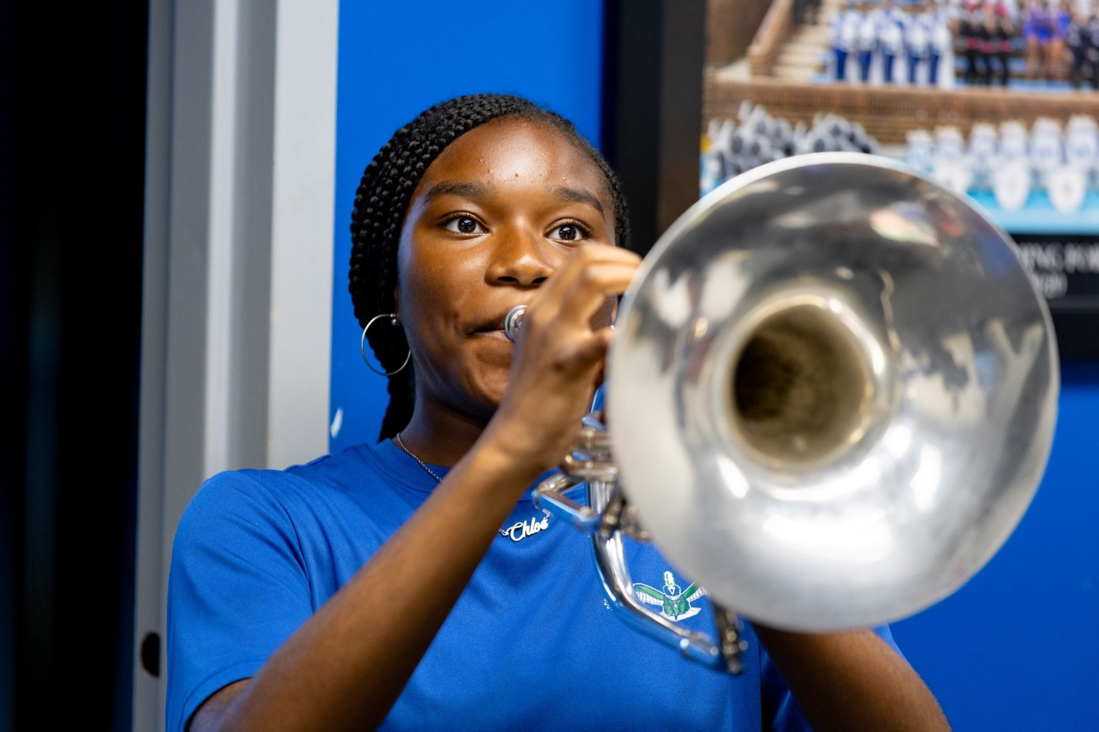
02
THE PREMISE
The auxiliary just learned to interpret the music—but they can only work with what you give them. A rushed tempo, a mushy hit, a flat dynamic, and there is nothing good to shape. Your playing is the raw material of their art. Your job is to make it worth shaping.
THEY CAN ONLY SHAPE WHAT YOU ACTUALLY PLAY.
Notes:
SLIDE 15 — THE PREMISE (statement slide)
Read it.
Takeaway: "They can only shape what you actually play."

Slide 16

— INTERPRETING THE MUSIC
THE HAMPTON UNIVERSITY MARCHING FORCE
They Ride Your Time
The auxiliary choreographs to a tempo—yours.
◆ rock-solidt they drilled assumes your tempo is rock-solid. Rush the exciting parts or drag the hard ones, and they cannot stay with the music.
◆ Lock to the drum major and the pulse. Steady time is the floor the whole visual stands on.
◆ When you move the tempo, you move the ground under their feet—their hits land early or late through no fault of their own.
◆ Hold the pocket, especially in the exact moment everyone wants to speed up.
Pre-Drill Camp 2026 · Leadership Seminars
16
Notes:
SLIDE 16 — THEY RIDE YOUR TIME
"The auxiliary choreographs to a tempo — yours."
"Rush it and their toss lands wrong. Drag it and their turn finishes late. Neither is their fault."

Slide 17
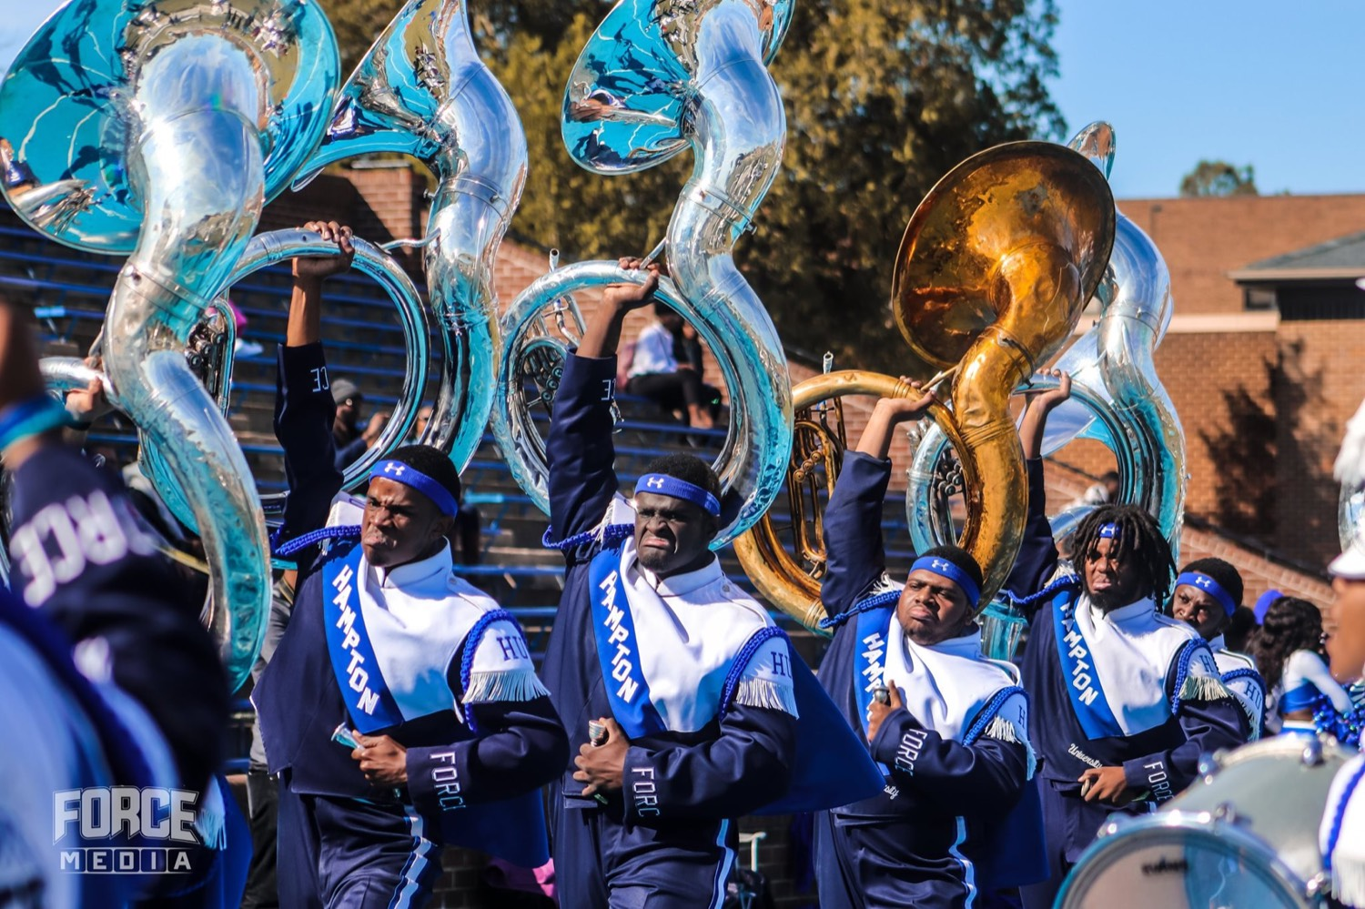
— INTERPRETING THE MUSIC
THE HAMPTON UNIVERSITY MARCHING FORCE
Hit the Hits Together
Their visual hit is only as clean as your musical hit.
◆ withauxiliary snaps with the band. If your hit is ragged—some early, some late—their hit looks ragged too.
◆ tight, unified accentscents: same attack, same length, same release. A clean band hit is what makes a clean visual hit possible.
◆ rest before the hitre the hit. The silence is theirs too; clip it and the pause lands for no one.
◆ One sloppy entrance can undo an entire eight-count of clean choreography.
Pre-Drill Camp 2026 · Leadership Seminars
17
Notes:
SLIDE 17 — HIT THE HITS TOGETHER
"Their visual hit is only as clean as your musical hit."
A ragged hit gives them nothing to catch.

Slide 18
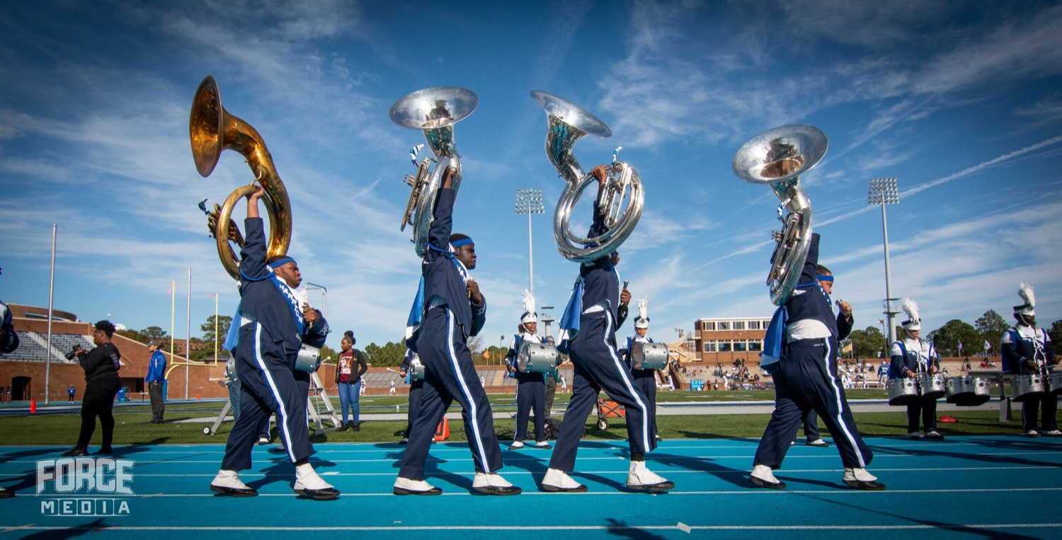
— INTERPRETING THE MUSIC
THE HAMPTON UNIVERSITY MARCHING FORCE
Give Them Dynamics
You cannot interpret a wall of one volume.
◆ swellsxiliary grows when the music swells and settles when it drops. Play everything the same, and there is nothing for them to match.
◆ for real crescendos and the softs for real. Your dynamic contrast is what gives their movement its build.
◆ A true pianissimo lets them go small and intimate; a real fortissimo lets them explode. Give them the whole range.
◆ Flat music makes flat choreography. Shape the music, and you shape the show.
Pre-Drill Camp 2026 · Leadership Seminars
18
Notes:
SLIDE 18 — GIVE THEM DYNAMICS
"You cannot interpret a wall of one volume."
Swells to grow into, drops to get delicate on. "Flat sound is a flat canvas."

Slide 19
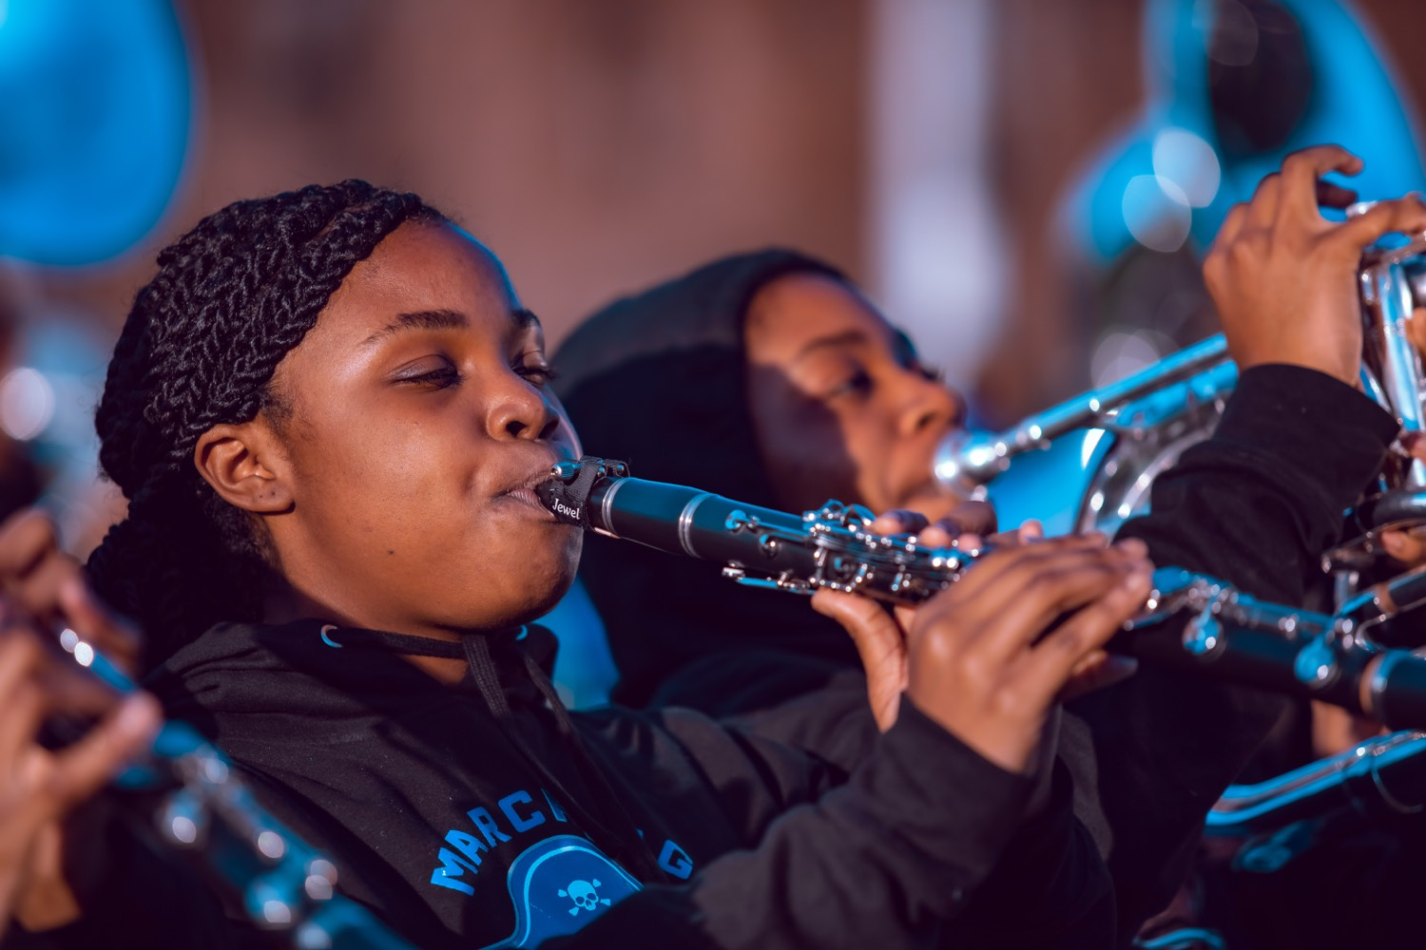
— INTERPRETING THE MUSIC
THE HAMPTON UNIVERSITY MARCHING FORCE
Play With Feeling
Clean is not enough—give them something to feel.
◆ stylethe style—the groove, the swing, the soul—so there is a feeling in the music for them to interpret.
◆ Bring the melody and the hook out. The crowd's ear is on the tune the auxiliary is telling the story of; make sure they can hear it.
◆ Phrase it. Let the music breathe. A phrased line gives the auxiliary a line to move.
◆ Your energy on the horn becomes their energy on the field. Play like you mean it.
Pre-Drill Camp 2026 · Leadership Seminars
19
Notes:
SLIDE 19 — PLAY WITH FEELING
"Clean is not enough. Give them something to feel."
Style, phrasing, and the melody sung rather than executed.

Slide 20
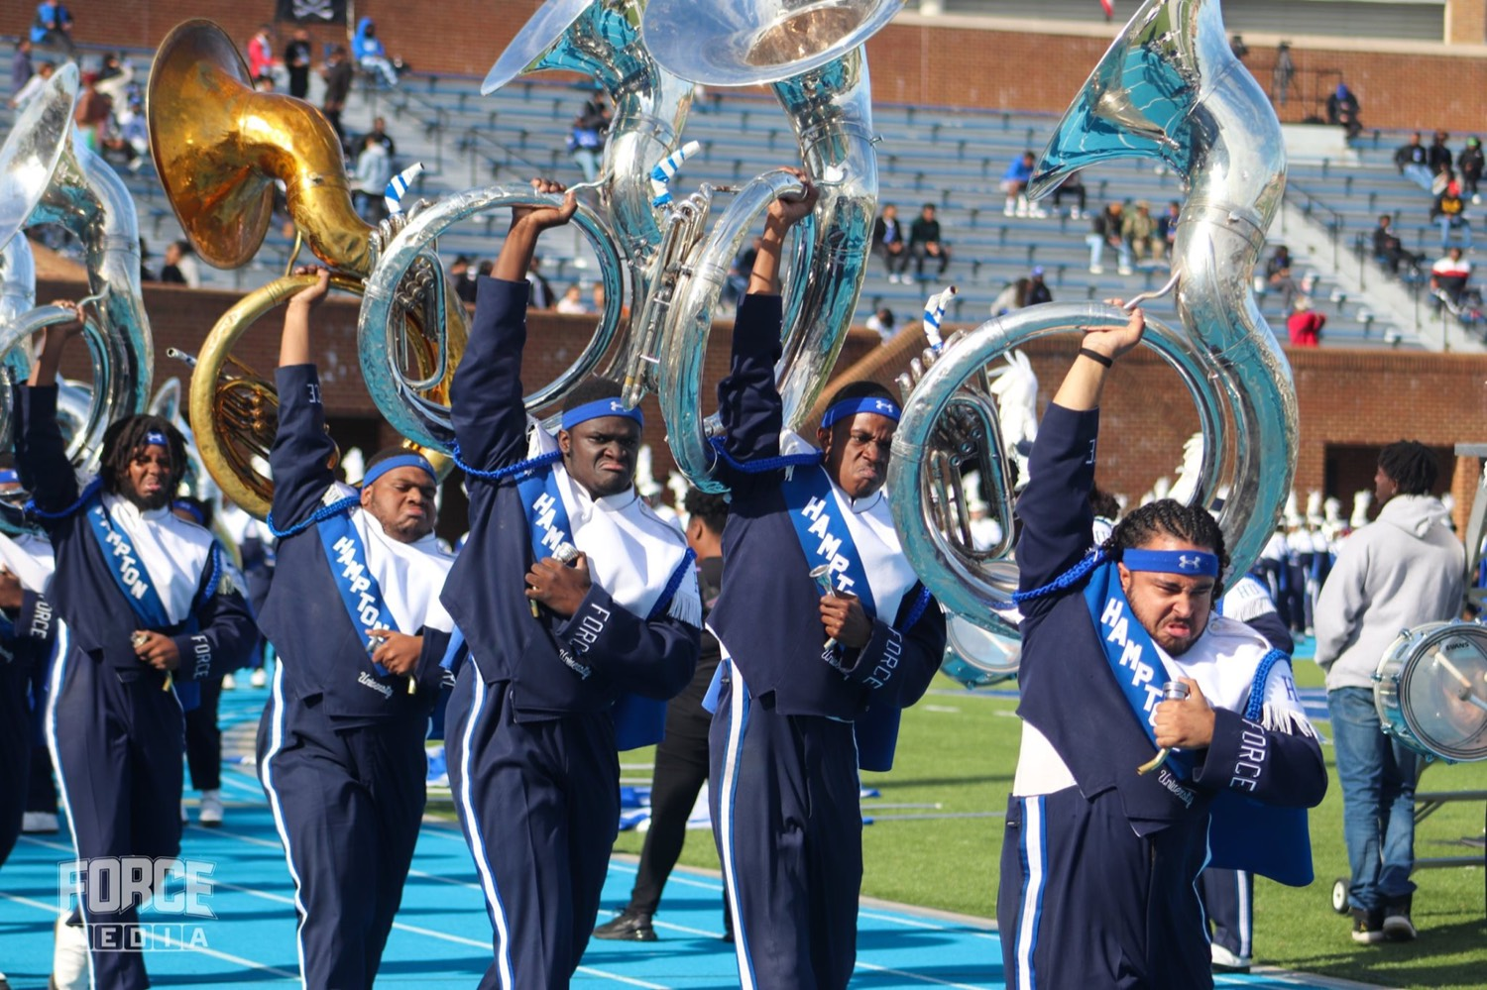
— INTERPRETING THE MUSIC
THE HAMPTON UNIVERSITY MARCHING FORCE
Be Consistent
They choreograph to how you played it—so play it that way every time.
◆ rehearsaliary sets their movement to your rehearsal performance. Change the tempo, the dynamics, or the feel on show day, and you pull the rug out from under them.
◆ one interpretationretation and repeat it. The same performance every time is what lets them count on you.
◆ tell them earlys to change, tell them early—the choreography has to change with it. Never surprise the auxiliary on the field.
◆ Reliable is a compliment. Be the section they never have to worry about.
Pre-Drill Camp 2026 · Leadership Seminars
20
Notes:
SLIDE 20 — BE CONSISTENT
"They choreographed to how you played it — so play it that way every time."
A rep that changes shape every run is unchoreographable.

Slide 21

— INTERPRETING THE MUSIC
THE HAMPTON UNIVERSITY MARCHING FORCE
Make Them Look Great
You are not each other's background. You are one show.
◆ Know the visual. When you understand what the auxiliary is doing, you play to make it land—you serve the moment together.
◆ auxiliary shinesght and full of feeling, the auxiliary shines—and when they shine, the whole crowd feels the music you are making.
◆ Rehearse as one. The band and the auxiliary locking in together is what turns a routine into a moment.
◆ Great bands make their auxiliary look great; great auxiliary makes the band unforgettable.
Pre-Drill Camp 2026 · Leadership Seminars
21
Notes:
SLIDE 21 — MAKE THEM LOOK GREAT
"You are not each other's background. You are one show."
THE MINDSET: "When they're flying, the band looks its best. Their moment is your moment."

Slide 22
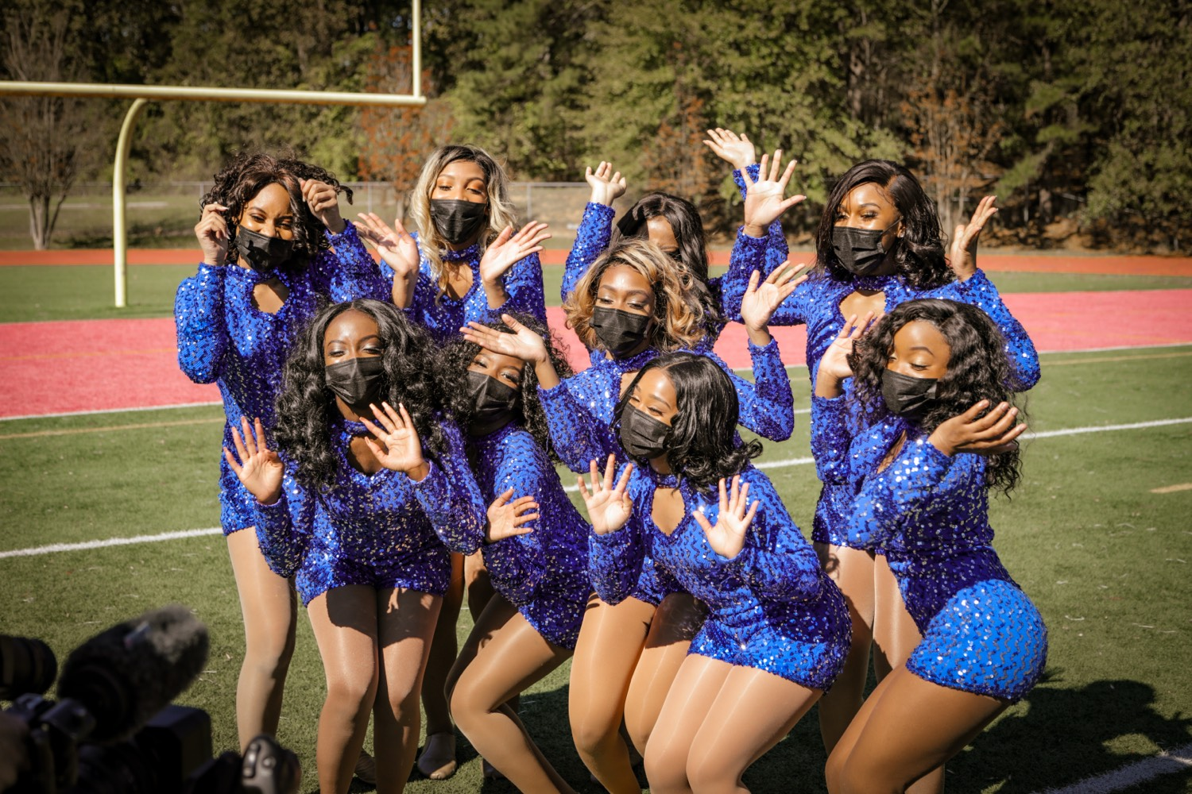
YOUR CHARGE
One Field.
One Show.
Auxiliary, make the music visible. Ensemble, make music worth making visible. The crowd does not see two units—they see one show. When the band plays tight and full of feeling, and the auxiliary moves it with everything they have, the whole field speaks with one voice. Give them a moment they will feel long after the last note.
Serve First. Lead Always. — Drive the Legacy.
The Hampton University Marching Force
Hampton's Heartbeat
Notes:
SLIDE 22 — CLOSE: One Field. One Show.
Both halves in one charge — address the auxiliary and the ensemble by name.
End on the sign-off.

