Slide 1
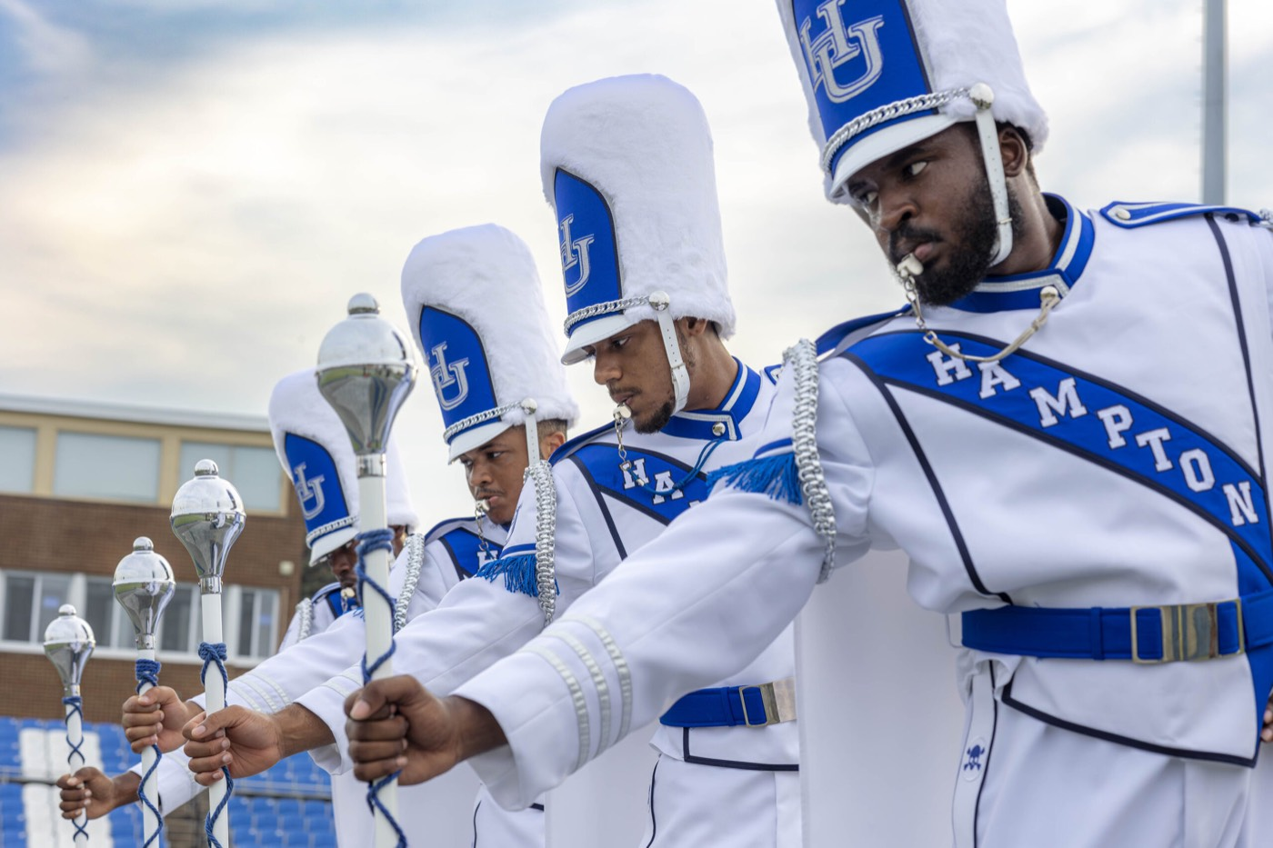
PRE-DRILL CAMP 2026 · LEADERSHIP SEMINARS · DAY 2
Drum Majors
"Command the Field. Own the Show."
Joshua Gibbons
Drum Majors Breakout · Sunday, August 2, 2026
The Hampton University Marching Force
Hampton's Heartbeat
Notes:
SLIDE 1 — TITLE: Drum Majors
PRESENTER: Joshua Gibbons. BREAKOUT — drum majors only.
OPEN: "Two sides to this job. The craft, and the show. Miss either one and it falls flat."

Slide 2
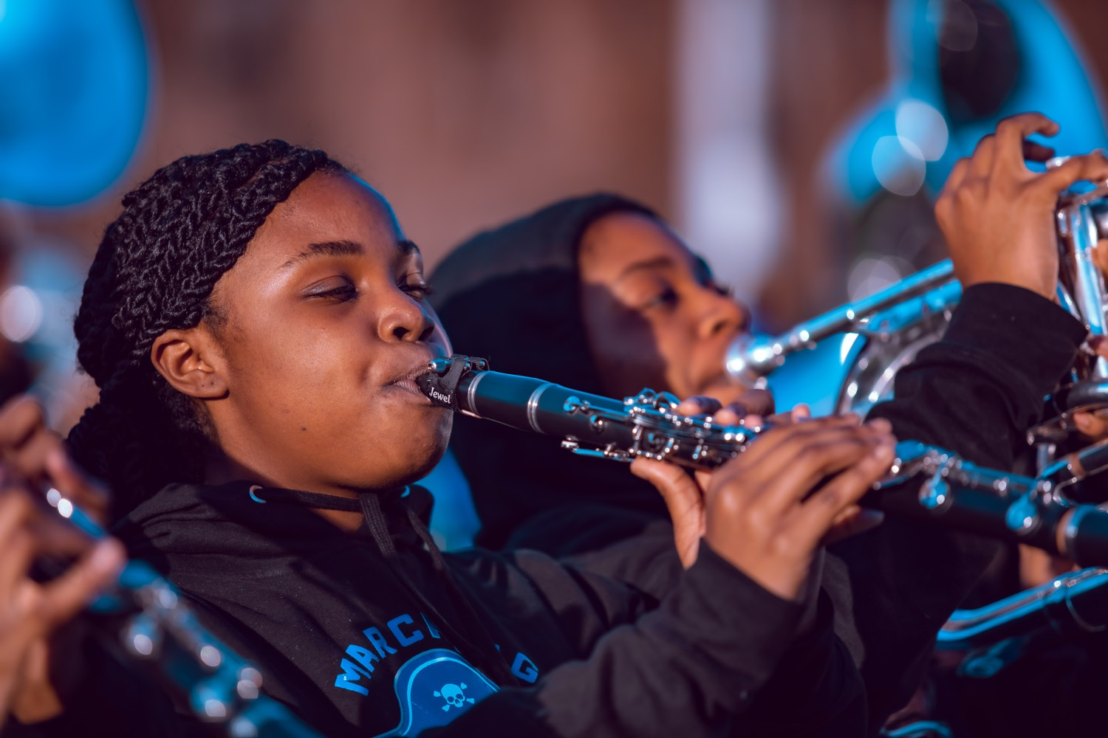
— DRUM MAJORS
THE HAMPTON UNIVERSITY MARCHING FORCE
Icebreaker
Great leaders lead from the front. Before a shot is fired, a commander swears he will be the first to set foot on the field and the last to step off. That is exactly what the field asks of a drum major.
▶
We Were Soldiers — “First On, Last Off”
youtu.be/Uu77LGPAlPA
WATCH · 2:41
Pre-Drill Camp 2026 · Leadership Seminars
02
Notes:
SLIDE 2 — ICEBREAKER: We Were Soldiers, "First On, Last Off" (2:41)
SET UP: "Hal Moore, before a shot is fired, swears he'll be the first to set foot on the field and the last to step off."
Play it.
AFTER: "That's exactly what the field asks of a drum major. And it's the creed — First In, Last Out — that bookends this whole camp."

Slide 3
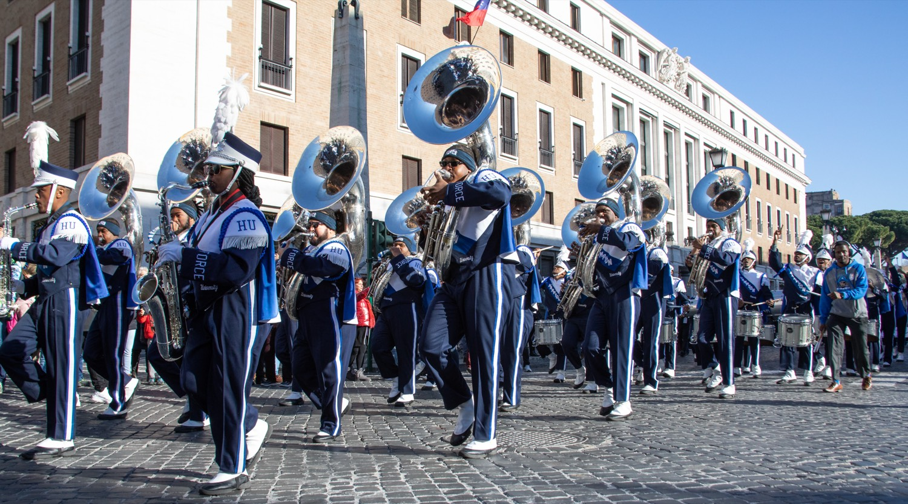
01
THE PREMISE
You are the most visible person in the band—every eye finds you first. But at an HBCU, the drum major is more than a conductor. You are the face of the show. You keep the time and you bring the energy; you command the field and you work the crowd. You are a leader and a performer at once, and the band and the stands both catch their fire from you.
CONDUCTOR AND SHOWMAN, AT ONCE.
Notes:
SLIDE 3 — THE PREMISE (statement slide)
Read it.
"Every eye finds you first. But at an HBCU the drum major is more than a conductor — you're the face of the show."
Takeaway: "Conductor and showman, at once."

Slide 4
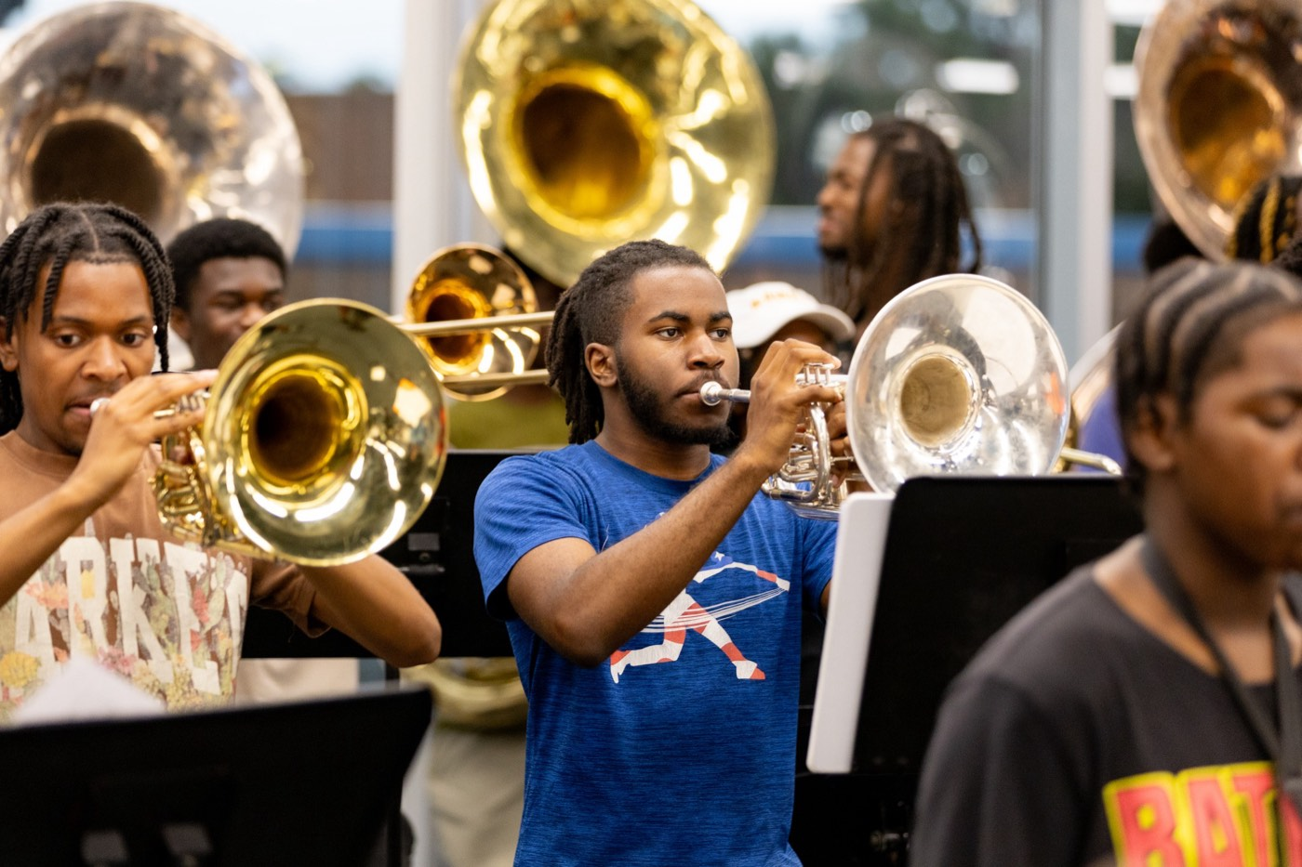
— DRUM MAJORS
THE HAMPTON UNIVERSITY MARCHING FORCE
The Role of the Drum Major
Four jobs at once, from the front of the field.
1
The Time Keeper
You are the living metronome. The whole show rides on the tempo you set and hold.
Pre-Drill Camp 2026 · Leadership Seminars
04
Notes:
SLIDE 4 — THE ROLE OF THE DRUM MAJOR
Four jobs: Time Keeper, Field Commander, Standard-Bearer, Showman.
Don't rush past Showman — that's the one most drum-major training leaves out, and it's half of this deck.

Slide 5
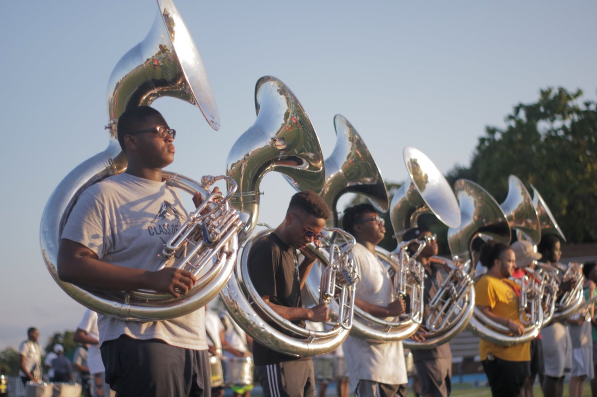
— DRUM MAJORS
THE HAMPTON UNIVERSITY MARCHING FORCE
Two Sides of the Same Job
Master both, or the show falls flat.
A drum major who can only conduct is a metronome; one who can only perform is a cheerleader. At an HBCU, you are both.
Pre-Drill Camp 2026 · Leadership Seminars
05
Notes:
SLIDE 5 — TWO SIDES OF THE SAME JOB
The hinge slide. Craft on the left, Show on the right.
READ THE CALLOUT: "A drum major who can only conduct is a metronome. One who can only perform is a cheerleader. At an HBCU, you are both."
Tell them the deck now splits — craft first, then show.

Slide 6
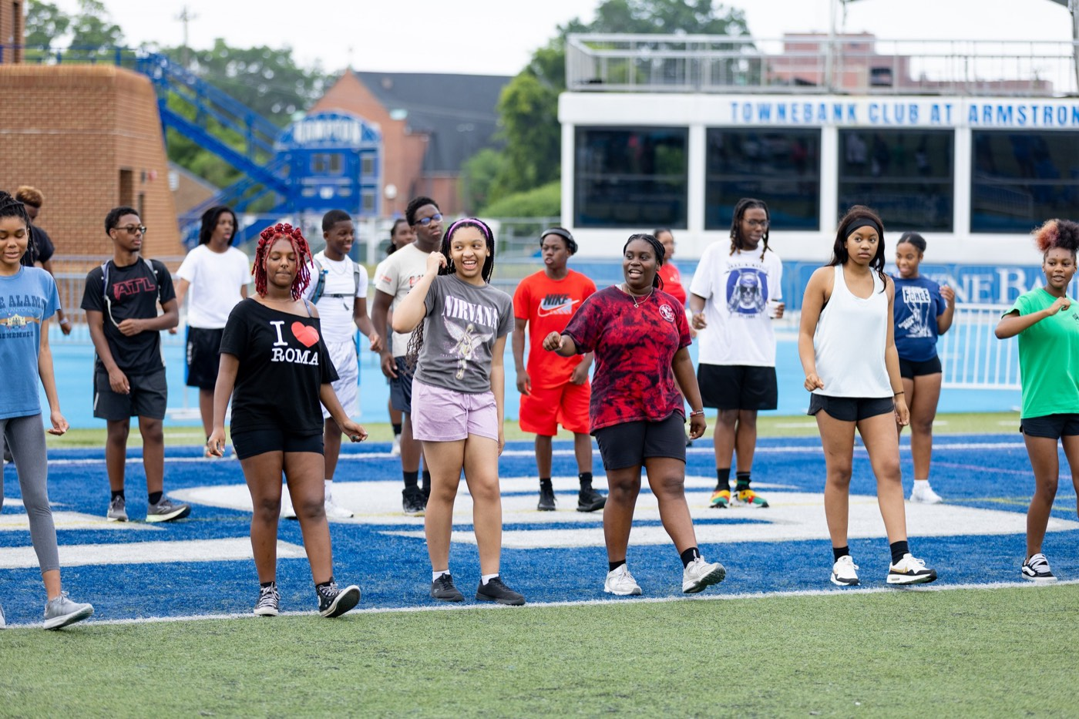
— DRUM MAJORS
THE HAMPTON UNIVERSITY MARCHING FORCE
The Craft: Conducting Is Athletic
Controlled, economical motion—the kinesiology of the podium.
◆ Stand tall and set. A still, strong body is the frame; only the arms move. Tension in the shoulders shows up as noise in the beat.
◆ Isolate the motion. The gesture comes from the wrist and forearm—small, clean, and repeatable.
◆ Work in a plane. Keep the pattern in a consistent window in front of your chest so every player reads the same picture.
◆ Economy wins. The clearest conductor uses the least motion. Flailing is not energy—it is confusion.
Sources: Elizabeth A. H. Green, The Modern Conductor; Max Rudolf, The Grammar of Conducting.
Pre-Drill Camp 2026 · Leadership Seminars
06
Notes:
SLIDE 6 — CONDUCTING IS ATHLETIC
DEMONSTRATE, don't describe. Stand and show posture, isolation, the plane, economy of motion.
"A still, strong body is the frame. Only the arms move."
"The clearest conductor uses the least motion. Flailing is not energy — it's confusion."

Slide 7
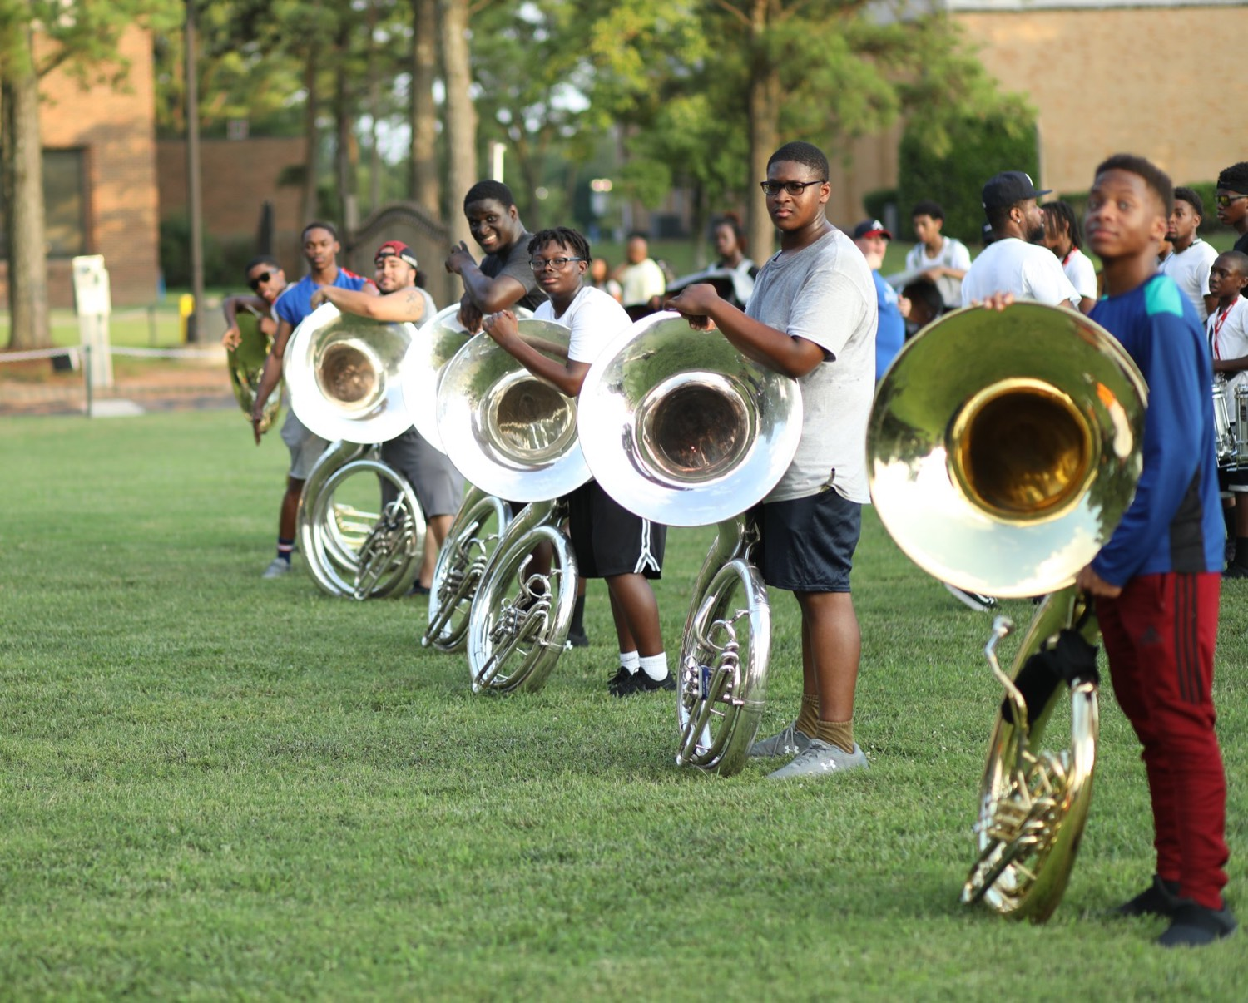
— DRUM MAJORS
THE HAMPTON UNIVERSITY MARCHING FORCE
The Beat and the Patterns
Make every beat a picture the band can read.
◆ ictusctus is the exact instant of the beat, the bottom of the stroke. A clear ictus is a clear band; a mushy one is a ragged one.
◆ preparatory beatry beat in tempo before they play, and a definite release so the sound starts and ends as one.
◆ patterns colderns cold: the downbeat drops straight down; two is down-up; three is down-out-up; four is down-in-out-up.
◆ consistent size and speedtent size and speed—bigger for louder, smaller for softer, never sloppy.
Sources: Elizabeth A. H. Green, The Modern Conductor; Hunsberger and Ernst, The Art of Conducting.
Pre-Drill Camp 2026 · Leadership Seminars
07
Notes:
SLIDE 7 — THE BEAT AND THE PATTERNS
The ictus is the exact instant of the beat, the bottom of the stroke. "A clear ictus is a clear band; a mushy one is a ragged one."
Preparatory beat in tempo, and a definite release.
RUN THE PATTERNS LIVE: down; down-up; down-out-up; down-in-out-up. Have them do it with you.

Slide 8
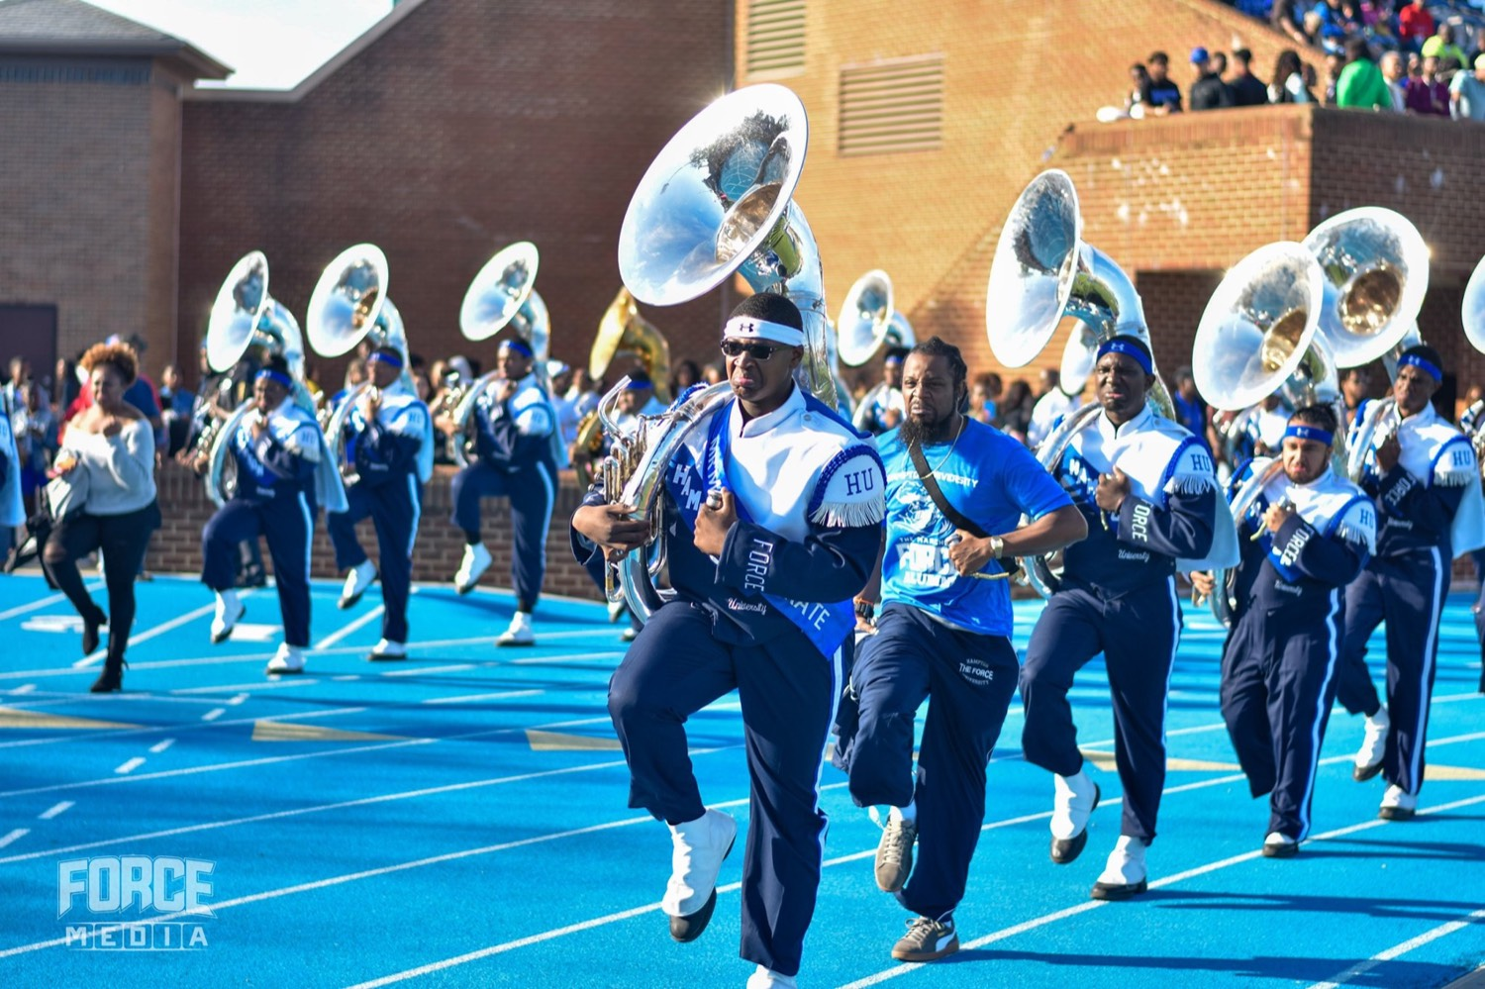
— DRUM MAJORS
THE HAMPTON UNIVERSITY MARCHING FORCE
Lead With Your Eyes, Not Your Ears
On a football field, the sound lies to you.
◆ 1,130 feet per second,130 feet per second. Across a field, the back of the band hears the front a noticeable fraction of a second late.
◆ hearveryone plays to what they hear, the band drifts apart and slows down. The only fix is a single visual clock: you.
◆ The band watches, it does not listen. Conduct so clearly that a player 80 yards away can lock to your hands, not their ears.
◆ Hold your tempo even when the sound coming back tempts you to chase it. Trust the beat, not the echo.
Sources: the physics of sound (~1,130 ft/sec); George N. Parks Drum Major Academy.
Pre-Drill Camp 2026 · Leadership Seminars
08
Notes:
SLIDE 8 — LEAD WITH YOUR EYES, NOT YOUR EARS
The core marching-drum-major idea. Take your time.
"Sound travels about 1,130 feet per second. Across a field the back of the band hears the front late."
"If everyone plays to what they HEAR, the band drifts apart and slows down. The only fix is one visual clock — you."
LAND: "The band watches. It does not listen. Conduct so clearly a player 80 yards out can lock to your hands."

Slide 9
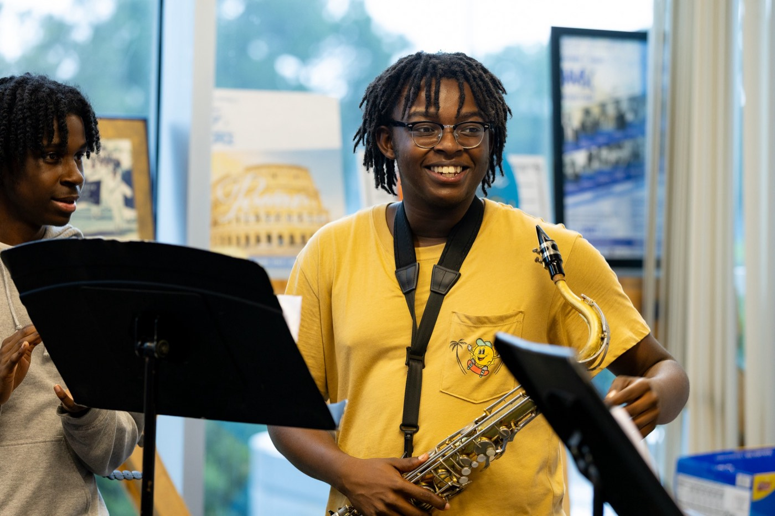
— DRUM MAJORS
THE HAMPTON UNIVERSITY MARCHING FORCE
Be the Metronome
Steady time is the drum major's first gift to the band.
◆ Internalize the pulse. Practice with a metronome until a given tempo lives in your body and you can produce it on demand.
◆ Do not rush the exciting parts or drag the hard ones—the moments the band most wants to speed up are exactly where you hold firm.
◆ the same way every timeway every time so the band knows what is coming from your first preparatory beat.
◆ on top ofhe middle of the biggest show, the time never wavers. That steadiness is what lets the show go wild on top of a solid floor.
Pre-Drill Camp 2026 · Leadership Seminars
09
Notes:
SLIDE 9 — BE THE METRONOME
"Steady time is the drum major's first gift to the band."
"Do not rush the exciting parts. The moments the band most wants to speed up are exactly where you hold firm."
"That steadiness is what lets the show go wild on top of a solid floor."

Slide 10
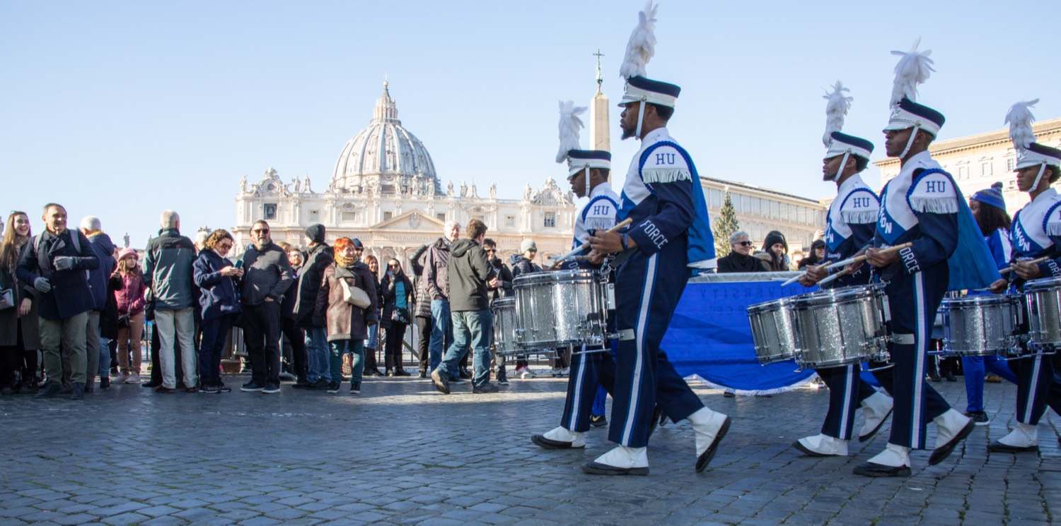
— DRUM MAJORS
THE HAMPTON UNIVERSITY MARCHING FORCE
The Show: This Is Entertainment
HBCU bands don't just perform—they entertain. You lead that.
◆ shown HBCU, the band is a show. The crowd came to be moved, and the drum major sets the energy that moves them.
◆ Full-out, always. Half-energy from the podium tells the whole band and the whole crowd to relax. You set the ceiling for the energy.
◆ feel somethinggger than the beat. Your job is to make people feel something, not only to keep time.
◆ Your fire is contagious—bring it, and the band brings it, and the stands bring it right back.
Pre-Drill Camp 2026 · Leadership Seminars
10
Notes:
SLIDE 10 — THE SHOW: THIS IS ENTERTAINMENT
The deck pivots here. Change your energy with it.
"At an HBCU the band is a SHOW. The crowd came to be moved, and you set the energy that moves them."
"Full-out, always. Half-energy from the podium tells the whole band and the whole crowd to relax."

Slide 11
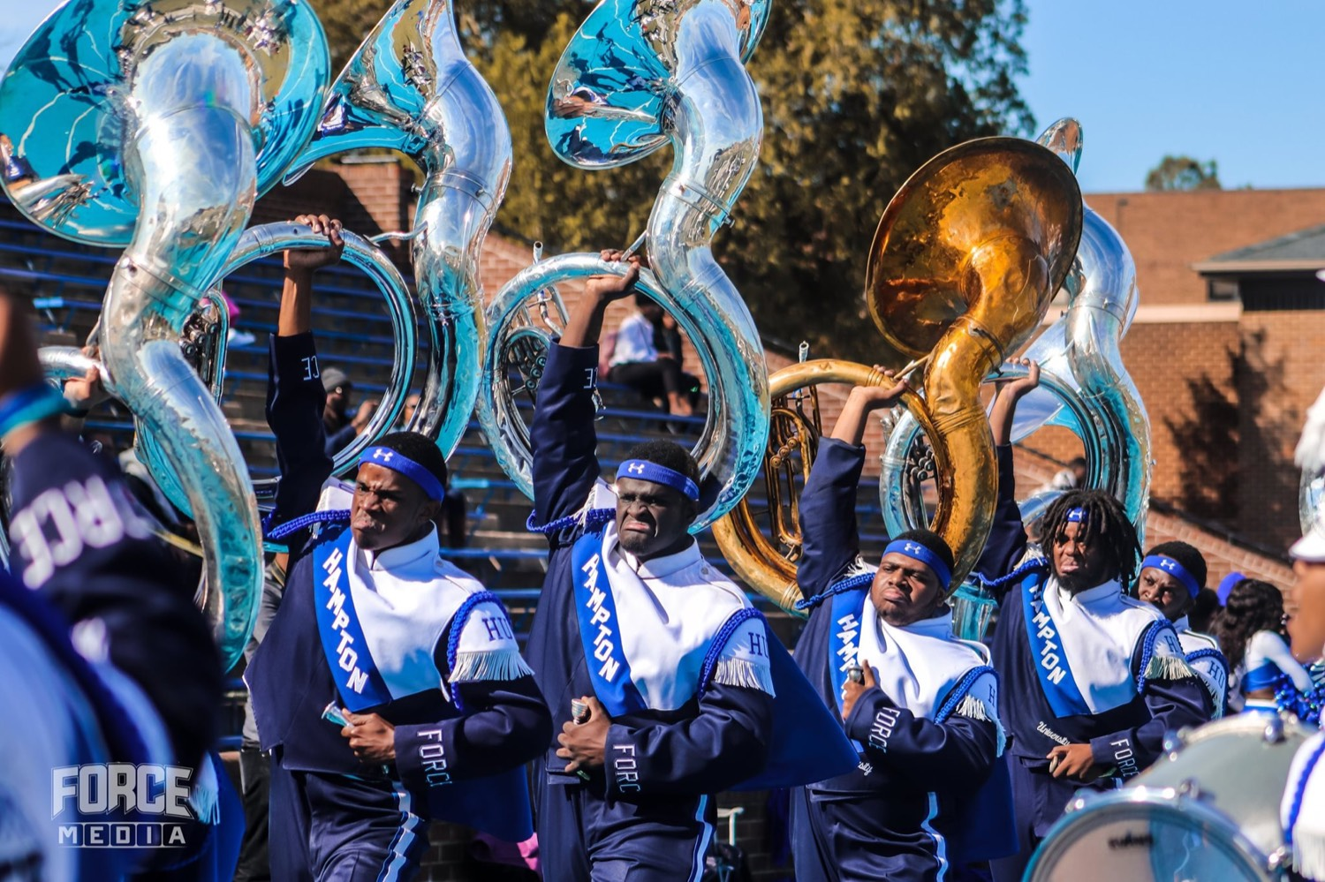
— DRUM MAJORS
THE HAMPTON UNIVERSITY MARCHING FORCE
Make an Entrance
The show starts the second you step onto the field.
◆ statementnce is a statement. Before you conduct a single note, your strut, your salute, and your presence tell the crowd who runs this field.
◆ Own the walk. High, sharp, and confident—every step says The Marching Force has arrived.
◆ Command the moment. Make them feel you coming; make the whole stadium turn to watch.
◆ beforehe entrance and you have the crowd before the first downbeat—then you never let them go.
Pre-Drill Camp 2026 · Leadership Seminars
11
Notes:
SLIDE 11 — MAKE AN ENTRANCE
"The show starts the second you step onto the field."
"Before you conduct a single note, your strut, your salute, and your presence tell the crowd who runs this field."
Every step says The Marching Force has arrived.
"Nail the entrance and you have the crowd BEFORE the first downbeat."

Slide 12
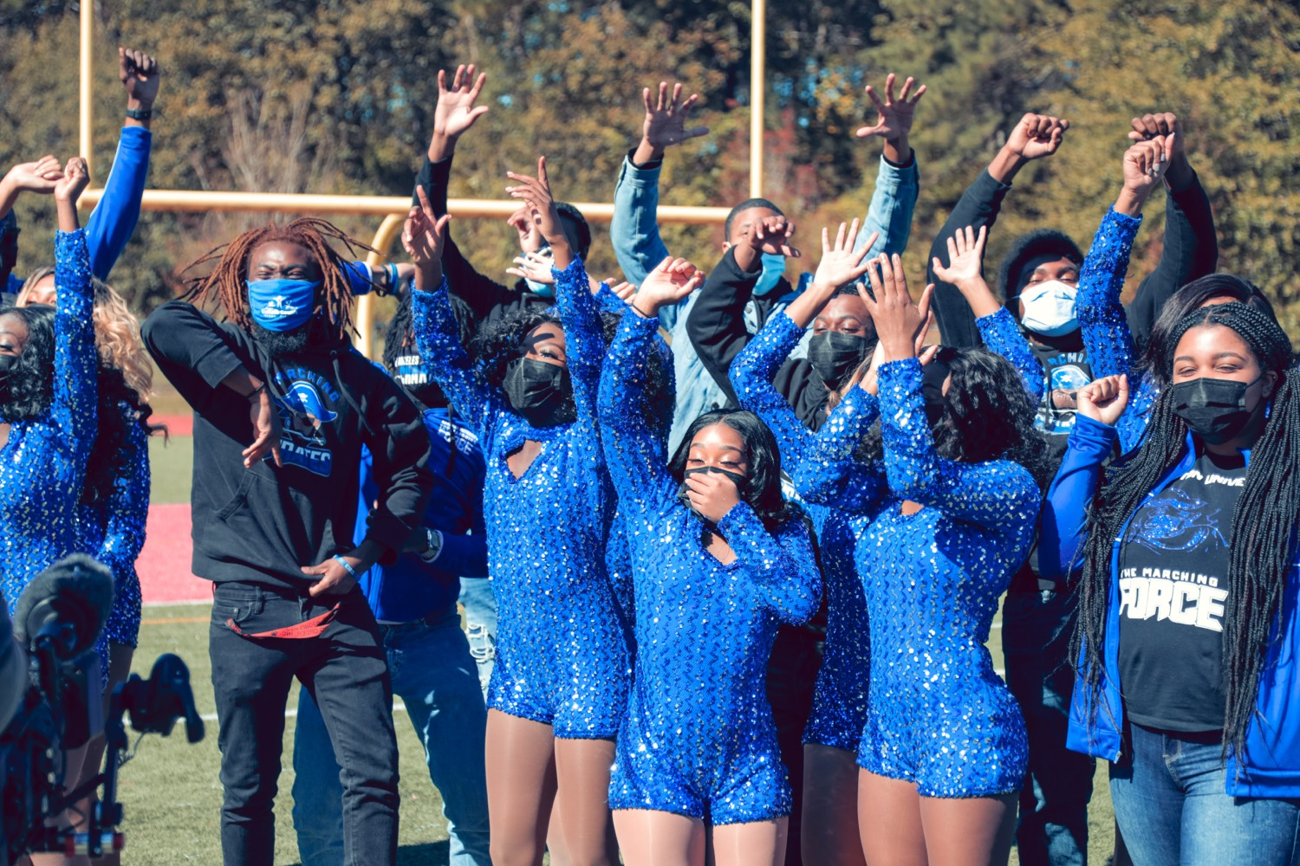
— DRUM MAJORS
THE HAMPTON UNIVERSITY MARCHING FORCE
March It, Dance It
You don't just stand and beat time—you perform.
◆ high energyum major marches with high energy—the strut, the high-step, the sharp and powerful style the tradition is built on.
◆ You dance. Hit the moves with the band, feel the music, and bring the flair. Showmanship is part of the job, not extra credit.
◆ clean and controlledclean and controlled. High energy is not sloppy energy—the precision is what makes the show pop.
◆ When you move, the crowd moves. Your body is the spark that lights the whole field.
Pre-Drill Camp 2026 · Leadership Seminars
12
Notes:
SLIDE 12 — MARCH IT, DANCE IT
"You don't just stand and beat time. You perform."
High energy, the strut, the high-step. And you dance — hit the moves with the band.
CRITICAL GUARDRAIL: "Every move is still clean and controlled. High energy is not sloppy energy — the precision is what makes it pop."
CUE: this is a good place to actually get them up and moving.

Slide 13
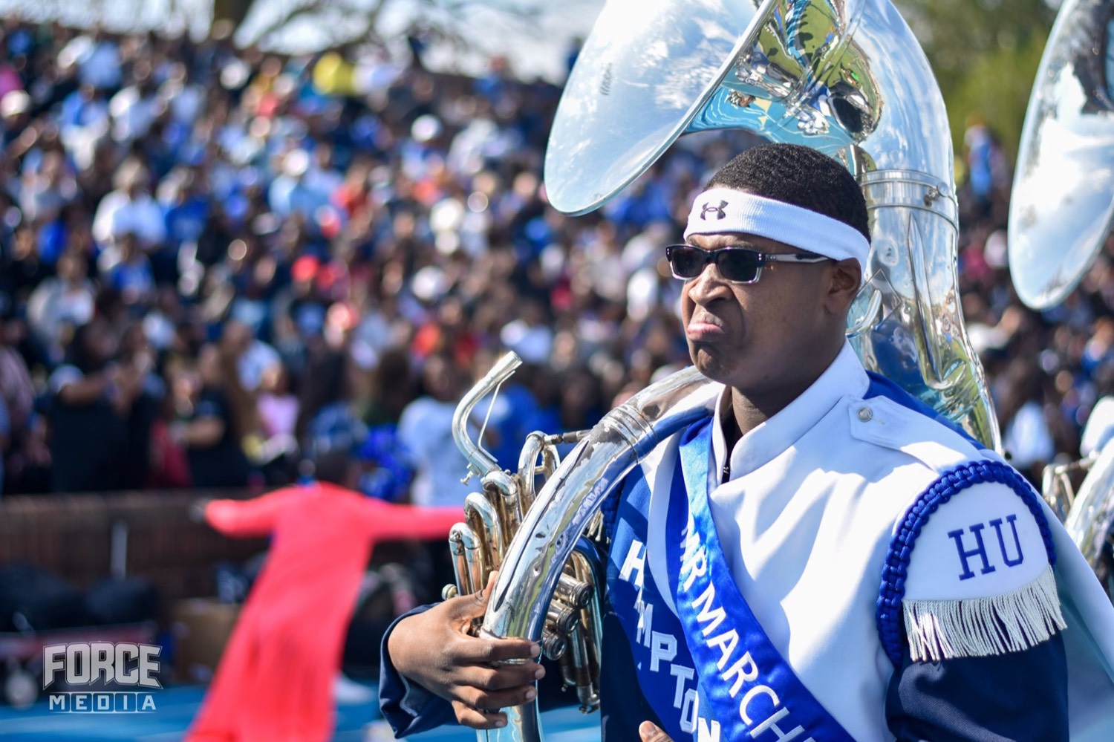
— DRUM MAJORS
THE HAMPTON UNIVERSITY MARCHING FORCE
Work the Crowd
The crowd is part of the show. Play them like an instrument.
◆ hype them, feed off them, and give it right backype them, feed off them, and give it right back.
◆ Charisma is a skill. Eye contact, big gestures, and pure confidence turn a routine into a moment people never forget.
◆ The parades, the battle, and the fifth quarter are yours—this is where showmanship wins and where the Force makes its name.
◆ Never break character. On the field you are always performing, always selling the show.
Pre-Drill Camp 2026 · Leadership Seminars
13
Notes:
SLIDE 13 — WORK THE CROWD
"The crowd is part of the show. Play them like an instrument."
Parades, the battle, the fifth quarter — "this is where showmanship wins and where the Force makes its name."
"Never break character. On the field you are always performing."

Slide 14
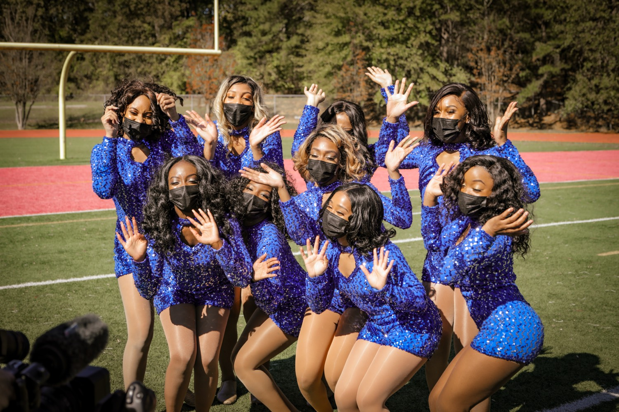
— DRUM MAJORS
THE HAMPTON UNIVERSITY MARCHING FORCE
Command the Field
Authority is projected—on purpose, every time.
1
Voice
Commands are crisp, loud, and confident. Mumble a command and you have already lost the field.
Reference: George N. Parks Drum Major Academy — leadership and field presence for marching drum majors.
Pre-Drill Camp 2026 · Leadership Seminars
14
Notes:
SLIDE 14 — COMMAND THE FIELD
Voice, whistle and signal, presence, poise.
"Mumble a command and you've already lost the field."
DRILL IT: have each drum major give one command at full voice right now. Correct it on the spot.

Slide 15
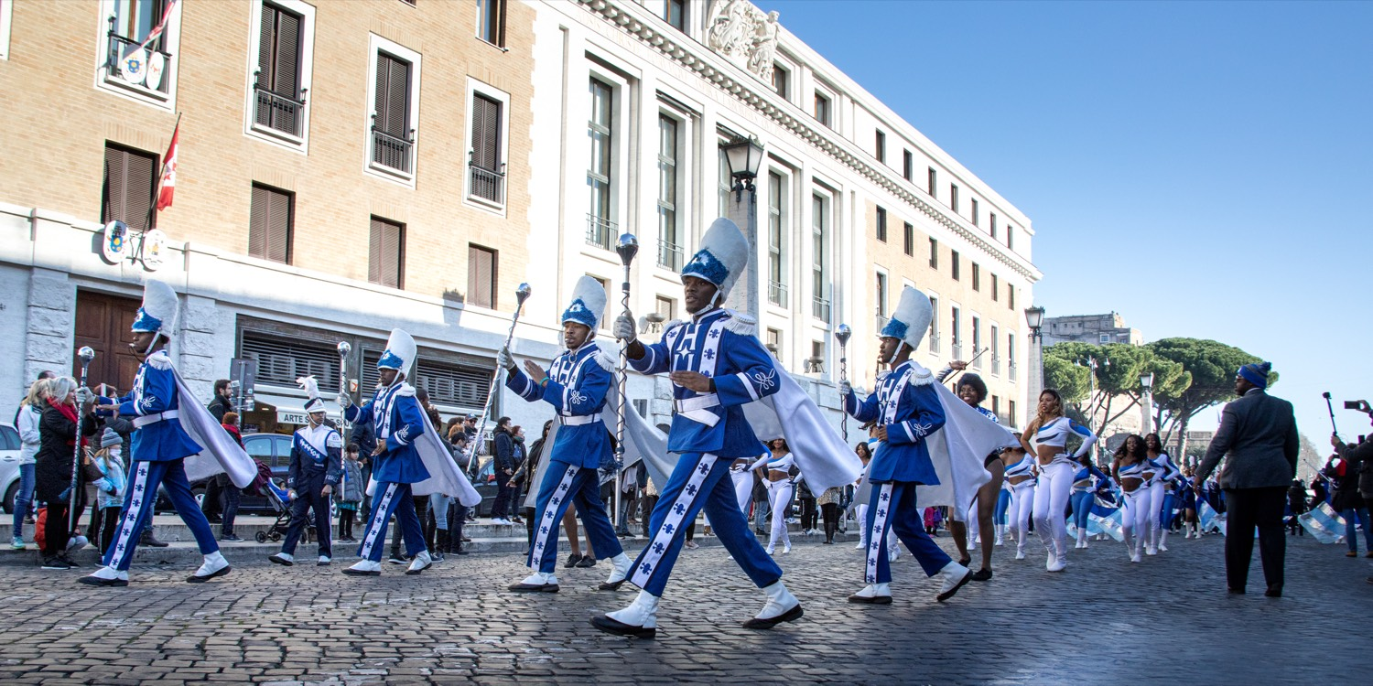
— DRUM MAJORS
THE HAMPTON UNIVERSITY MARCHING FORCE
Poise Under Pressure
Something will go wrong. The band will do whatever you do next.
◆ your calm is the band's calm.s, the weather turns—your calm is the band's calm. Panic on the podium spreads instantly.
◆ Fix it without flinching. Give the clear beat, hold the tempo, and let your steadiness pull the band back together.
◆ Never show frustration to the field or the stands. Handle it in your face and your hands, then debrief later.
◆ The greatest compliment to a drum major is a band that never looked worried—because you never did.
Pre-Drill Camp 2026 · Leadership Seminars
15
Notes:
SLIDE 15 — POISE UNDER PRESSURE
"Something will go wrong. The band will do whatever you do next."
"Your calm is the band's calm. Panic on the podium spreads instantly."
"Never show frustration to the field or the stands. Handle it in your face and your hands, then debrief later."
LAND: "The greatest compliment is a band that never looked worried — because you never did."

Slide 16
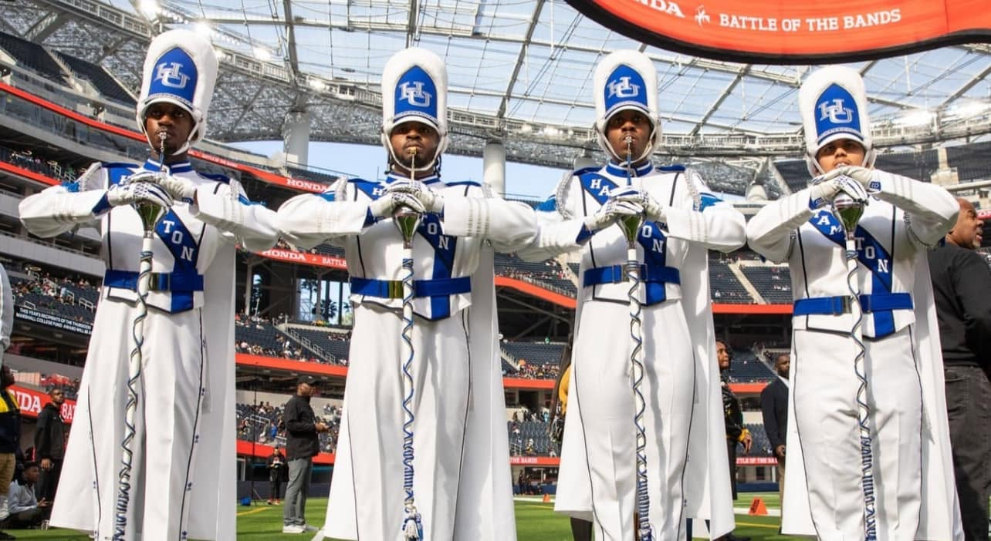
YOUR CHARGE
Command the Field.
Own the Show.
Every eye finds you first, so give them a leader worth following and a show worth watching. Master the mechanics until the beat is unmistakable and hold your tempo when the field tempts you to chase it—then bring the energy, the strut, and the swagger that make an HBCU band unforgettable. The craft earns their respect; the show wins their hearts. Be both, and the whole field—band and crowd—moves with you.
Serve First. Lead Always. — Drive the Legacy.
The Hampton University Marching Force
Hampton's Heartbeat
Notes:
SLIDE 16 — CLOSE: Command the Field. Own the Show.
"The craft earns their respect. The show wins their hearts. Be both."
End on the sign-off.

