Slide 1
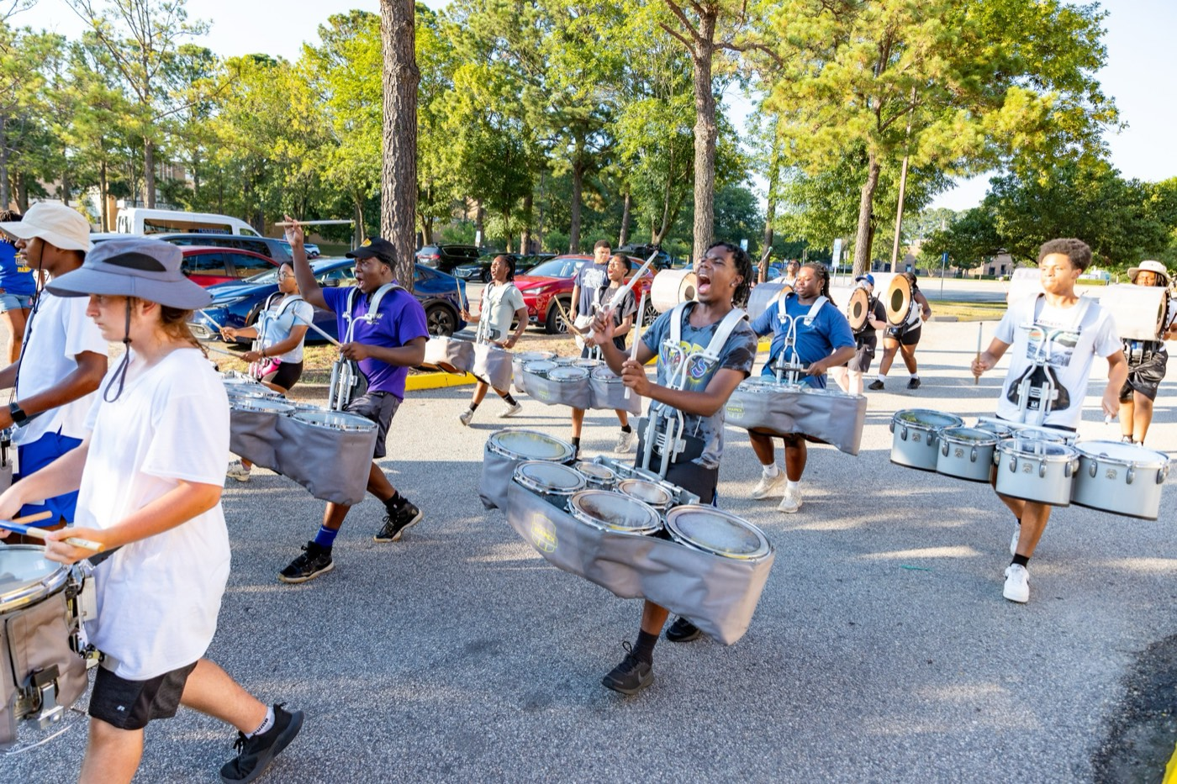
PRE-DRILL CAMP 2026 · LEADERSHIP SEMINARS · DAY 2
Teach How
to Teach
"Train the Trainer"
Dr. Thomas L. Jones, Jr.
Director of University Bands · All Leaders, Sunday, August 2, 2026
The Hampton University Marching Force
Hampton's Heartbeat
Notes:
SLIDE 1 — TITLE: Teach How to Teach
SAY: "Every one of you got picked partly because you can do it. Today is about whether you can make somebody else able to do it. Those are two different skills."

Slide 2

— TEACH HOW TO TEACH
THE HAMPTON UNIVERSITY MARCHING FORCE
Icebreaker
A great teacher does not just hand you the answer—he drills it until it is yours. Watch a master at work at an HBCU, and listen to how the room learns.
▶
The Great Debaters — “Who's the Judge?”
youtu.be/xsrkNeInaiw
WATCH · 2:25
Pre-Drill Camp 2026 · Leadership Seminars
02
Notes:
SLIDE 2 — ICEBREAKER: The Great Debaters, "Who's the Judge?" (2:25)
SET UP: "Denzel, playing Melvin Tolson at Wiley College — an HBCU. Watch how he drills it until it's theirs."
Play it.
AFTER: "He didn't hand them the answer. He made them produce it, over and over, until it was automatic. That's teaching."

Slide 3

01
THE PREMISE
You earned your spot because you can play it, march it, twirl it, dance it. But being able to do it yourself is not the same as being able to make someone else able to. Teaching is its own skill—and as a leader, most of your job is teaching. This session gives you a method.
DOING IT IS NOT TEACHING IT.
Notes:
SLIDE 3 — THE PREMISE (statement slide)
Read it.
THE LINE: "You earned your spot because you can play it, march it, twirl it, dance it. Being able to do it yourself is not the same as being able to make someone else able to."
Takeaway: "Doing it is not teaching it."

Slide 4

— TEACH HOW TO TEACH
THE HAMPTON UNIVERSITY MARCHING FORCE
Why Your Best Players Struggle to Teach
The better you are, the easier it is to teach badly.
◆ note a skill is automatic for you, you forget what it felt like not to have it. Researchers call this the curse of knowledge.
◆ So you go too fast, skip the steps that feel obvious to you, and explain in shorthand only you understand.
◆ you beginner is not slow—you are teaching from where you are, not from where they are.
◆ The fix is deliberate: slow down, break it down, and teach from the very first step.
Sources: Camerer, Loewenstein, and Weber, "The Curse of Knowledge in Economic Settings," Journal of Political Economy (1989); Heath and Heath, Made to Stick (2007).
Pre-Drill Camp 2026 · Leadership Seminars
04
Notes:
SLIDE 4 — WHY YOUR BEST PLAYERS STRUGGLE TO TEACH
This is counterintuitive — spend a minute.
"The better you are, the easier it is to teach badly." Name it: the curse of knowledge. Once a skill is automatic you forget what it felt like not to have it.
THE REFRAME: "The beginner isn't slow. You're teaching from where you are instead of where they are."

Slide 5
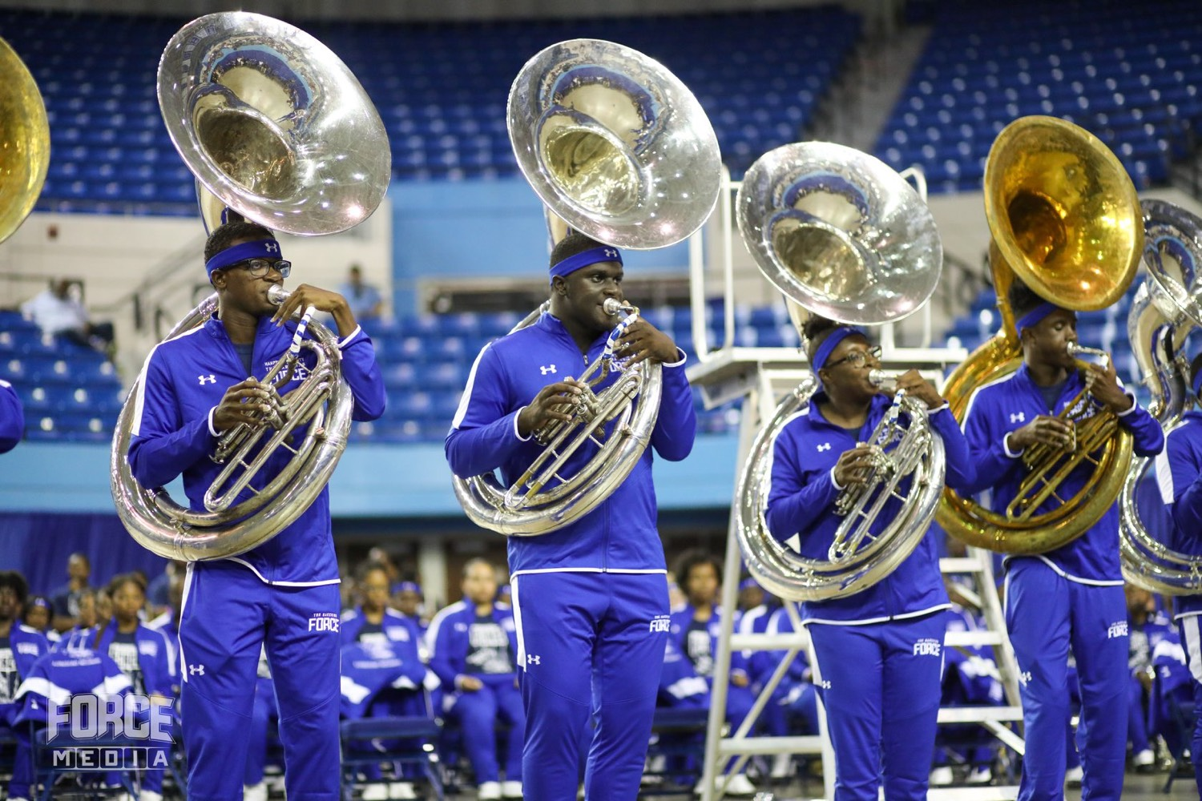
— TEACH HOW TO TEACH
THE HAMPTON UNIVERSITY MARCHING FORCE
Break It Down
No one learns a whole skill at once. Teach it in pieces.
◆ Deconstruct the skill into its smallest teachable parts—the foot, then the leg, then the horn, then the timing.
◆ one chunk at a timea time, and do not add the next until the first is solid. Working memory can only hold a few things at once.
◆ Name each part so your people have language for it—you cannot fix what you cannot name.
◆ Assemble the chunks back into the whole only after each one holds on its own.
Sources: Miller, "The Magical Number Seven, Plus or Minus Two," Psychological Review (1956); Gagné, The Conditions of Learning (1965).
Pre-Drill Camp 2026 · Leadership Seminars
05
Notes:
SLIDE 5 — BREAK IT DOWN
"Nobody learns a whole skill at once."
Deconstruct: the foot, then the leg, then the horn, then the timing.
RULE: "Teach one chunk at a time, and don't add the next until the first is solid." Working memory only holds a few things.

Slide 6

— TEACH HOW TO TEACH
THE HAMPTON UNIVERSITY MARCHING FORCE
I Do. We Do. You Do.
The core of every good lesson—you carry the load, then hand it over.
The load starts on you and ends on them. That gradual handoff—the release of responsibility—is what turns watching into doing.
Sources: Pearson and Gallagher, "The Instruction of Reading Comprehension," Contemporary Educational Psychology (1983); Fisher and Frey, Better Learning Through Structured Teaching (2008); Rosenshine, "Principles of Instruction," American Educator (2012).
Pre-Drill Camp 2026 · Leadership Seminars
06
Notes:
SLIDE 6 — I DO. WE DO. YOU DO.
The backbone of the session. Make them say it back.
"I do — you carry the whole load. We do — you share it. You do — they carry it."
Read the callout: that gradual handoff is what turns watching into doing.
CUE: Reference this phrase on every remaining slide so it sticks.

Slide 7

— TEACH HOW TO TEACH
THE HAMPTON UNIVERSITY MARCHING FORCE
Model the Standard
Show, don't just tell. Your body is the lesson.
◆ Demonstrate it perfectly, slowly, and more than once. People copy what they see far more than what they hear.
◆ Narrate as you go—say what you are doing and why, so they learn the thinking, not just the shape.
◆ youthe reference. The standard is whatever you show them, so never model it sloppy.
◆ Show the wrong way once if it helps them see the difference—then erase it with three reps of the right way.
Sources: Bandura, Social Learning Theory (1977); Rosenshine, "Principles of Instruction," American Educator (2012).
Pre-Drill Camp 2026 · Leadership Seminars
07
Notes:
SLIDE 7 — MODEL THE STANDARD
"Show, don't just tell. Your body is the lesson."
Demonstrate perfectly, slowly, more than once. Narrate as you go so they learn the thinking, not just the shape.
WARNING: "The standard is whatever you show them. Never model it sloppy."
On showing the wrong way: allowed once for contrast — then erase it with three reps of the right way.

Slide 8

— TEACH HOW TO TEACH
THE HAMPTON UNIVERSITY MARCHING FORCE
Check Before You Move On
The step every leader skips—and the reason people fall behind.
◆ noty questions?” is not checking for understanding. Silence is not proof that they got it.
◆ Make them show you. Have them do a rep, or teach the step back to you in their own words.
◆ everyoneeryone, not just the confident one up front—the quiet ones are often the ones who are lost.
◆ youthey cannot do it yet, that is information for you: re-teach the chunk a new way, do not just repeat it louder.
Sources: Black and Wiliam, "Assessment and Classroom Learning," Assessment in Education (1998); Rosenshine, "Principles of Instruction" (2012).
Pre-Drill Camp 2026 · Leadership Seminars
08
Notes:
SLIDE 8 — CHECK BEFORE YOU MOVE ON
This is the step everybody skips. Say so.
"'Any questions?' is not checking for understanding. Silence is not proof."
THE FIX: "Make them show you. A rep, or teach the step back to you in their own words."
AND: "Check everyone, not just the confident one up front. The quiet ones are usually the lost ones."
If they can't do it: re-teach it a different way. Don't repeat it louder.

Slide 9
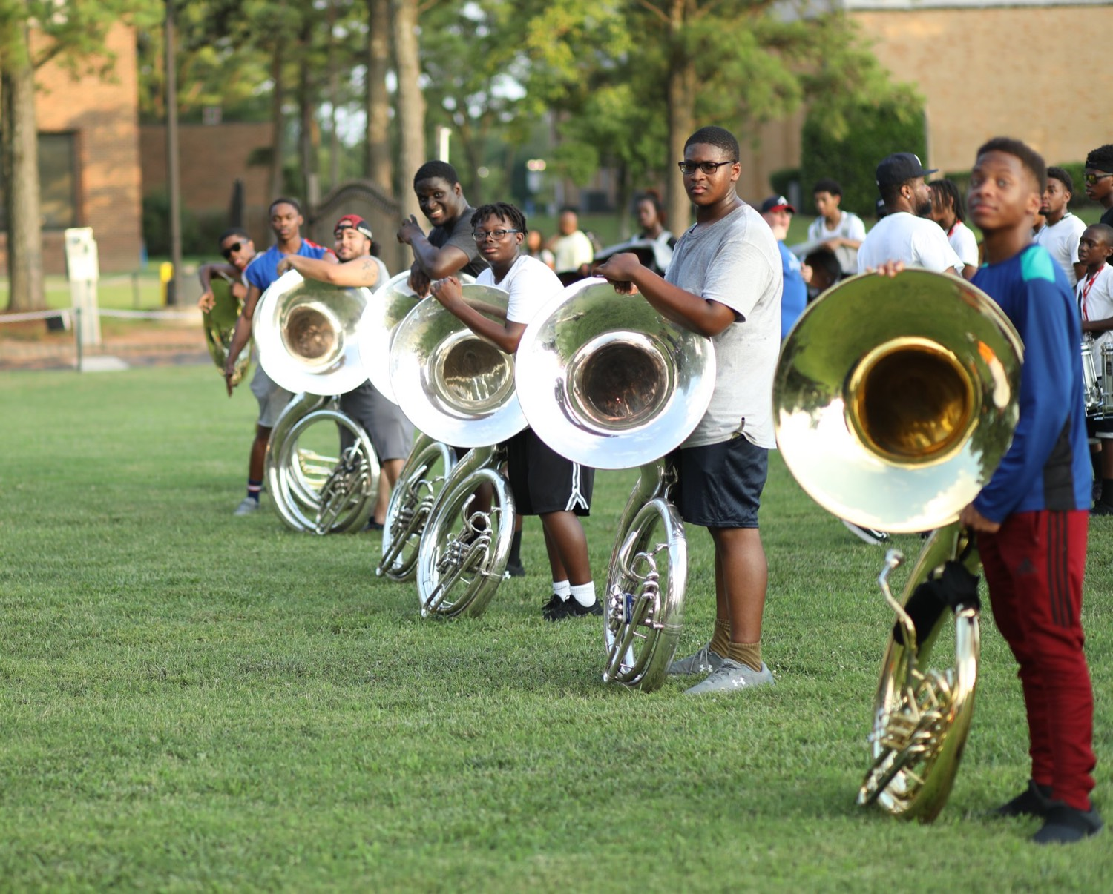
— TEACH HOW TO TEACH
THE HAMPTON UNIVERSITY MARCHING FORCE
Feedback That Actually Fixes It
Feedback is the single highest-leverage thing a teacher does.
◆ Be specific. "Fix your timing" is useless—"you're a half-count early on the horn snap" can be acted on.
◆ Be immediate. Correct it in the moment, before the wrong rep sets in.
◆ what to dowhat to do, not just what is wrong. Feedback without a next step is only criticism.
◆ effort and the processthe process, not just the talent—that is what keeps them working.
Sources: Hattie and Timperley, "The Power of Feedback," Review of Educational Research (2007); Wiggins, "Seven Keys to Effective Feedback," Educational Leadership (2012).
Pre-Drill Camp 2026 · Leadership Seminars
09
Notes:
SLIDE 9 — FEEDBACK THAT ACTUALLY FIXES IT
Contrast useless and useful out loud: "'Fix your timing' versus 'you're a half-count early on the horn snap.'"
Four rules: specific, immediate, tell them what to DO, praise the process.
LAND: "Feedback without a next step is just criticism."

Slide 10

— TEACH HOW TO TEACH
THE HAMPTON UNIVERSITY MARCHING FORCE
Repetition Is the Mother of Learning
One correct rep is a start, not a finish.
◆ automatic under pressurentil it is automatic under pressure. That takes many correct reps, not one.
◆ deliberatedeliberate reps—slow and perfect, then up to tempo—not mindless run-throughs that only rehearse mistakes.
◆ Don't practice until you get it right; practice until you can't get it wrong..”
◆ This is THE Standard of Excellence: we keep drilling the fundamentals long after they already look fine.
Sources: Ericsson, Krampe, and Tesch-Römer, "The Role of Deliberate Practice," Psychological Review (1993); Duke, Simmons, and Cash, "It's Not How Much; It's How," Journal of Research in Music Education (2009).
Pre-Drill Camp 2026 · Leadership Seminars
10
Notes:
SLIDE 10 — REPETITION IS THE MOTHER OF LEARNING
This is the program's phrase — say it as ours.
"A skill isn't learned until it's automatic under pressure."
QUOTE IT: "Don't practice until you get it right. Practice until you can't get it wrong."
Distinguish deliberate reps from mindless run-throughs — ties straight back to the SOP session.

Slide 11
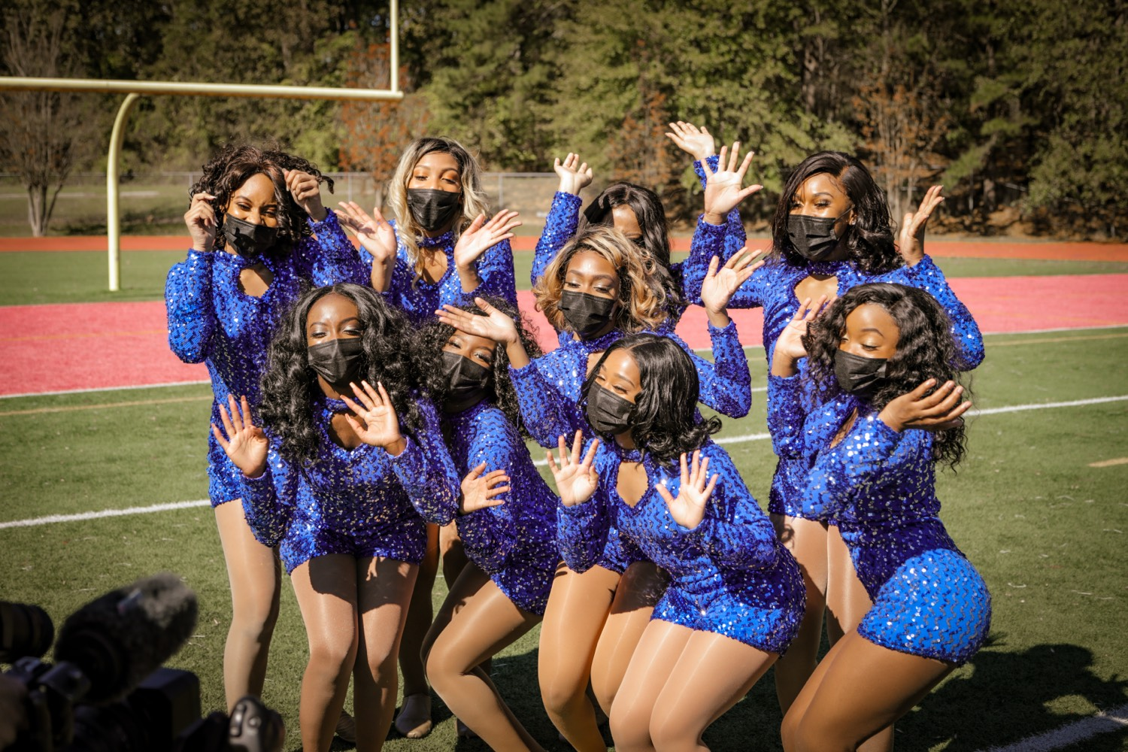
— TEACH HOW TO TEACH
THE HAMPTON UNIVERSITY MARCHING FORCE
Then Let Go
The goal of teaching is to make yourself unnecessary.
◆ without youught it when they can do it without you—and, better still, teach it to the next person.
◆ Hand off responsibility as they prove ready; hovering forever only keeps them dependent on you.
◆ This is scaffolding: build the support, then take it away one piece at a time.
◆ A section that can run itself is the highest compliment to the leader who taught it.
Sources: Vygotsky, Mind in Society (1978); Wood, Bruner, and Ross, "The Role of Tutoring in Problem Solving," Journal of Child Psychology and Psychiatry (1976).
Pre-Drill Camp 2026 · Leadership Seminars
11
Notes:
SLIDE 11 — THEN LET GO
"The goal of teaching is to make yourself unnecessary."
Scaffolding: build the support, then remove it a piece at a time.
LAND IT: "A section that can run itself is the highest compliment to the leader who taught it."
CUE: Some leaders like being needed. Name that trap directly.

Slide 12

— TEACH HOW TO TEACH
THE HAMPTON UNIVERSITY MARCHING FORCE
The Whole Rep
The method, start to finish—teaching a single eight-count.
◆ Break it down. One eight-count becomes the mark time, the step-off, the horn carriage, and the timing.
◆ I do. Demonstrate the full eight-count clean, then each chunk on its own, narrating the how and the why.
◆ We do. Walk it together at half tempo; they try it while you count and catch errors on the spot.
◆ You do and check. They run it alone; you watch each person and confirm before moving on.
◆ Feedback and reps. Fix the one thing that is off, drill it until it cannot fall apart—then release.
Pre-Drill Camp 2026 · Leadership Seminars
12
Notes:
SLIDE 12 — THE WHOLE REP
Walk the full method on one eight-count: break it down, I do, we do, you do and check, feedback and reps.
BEST USE OF THIS SLIDE: don't just read it — actually demonstrate it. Pick one leader, teach them one eight-count in front of the room using the five steps. Two minutes, and it teaches more than the slide does.

Slide 13
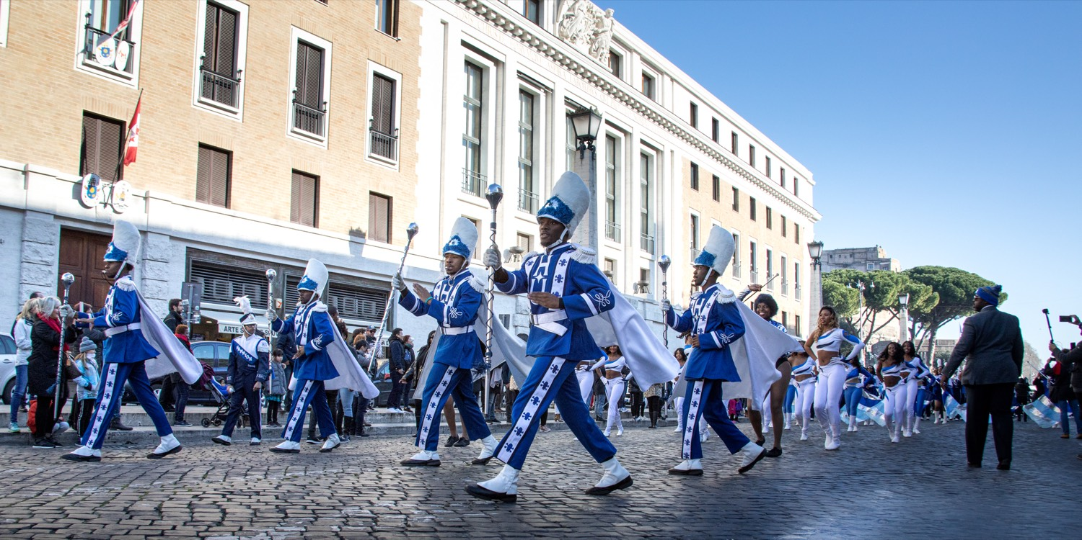
YOUR CHARGE
Teach So They
Can Teach.
You were not made a leader to be the only one who can do it. Break the skill down, model it, guide it, check it, and drill it until it holds—then let go. Teach so well that your people can teach the next class, and the standard outlives every one of us. That is how The Marching Force stays great.
Serve First. Lead Always. — Drive the Legacy.
The Hampton University Marching Force
Hampton's Heartbeat
Notes:
SLIDE 13 — CLOSE: Teach So They Can Teach.
"You weren't made a leader to be the only one who can do it."
End on the sign-off.

