Slide 1
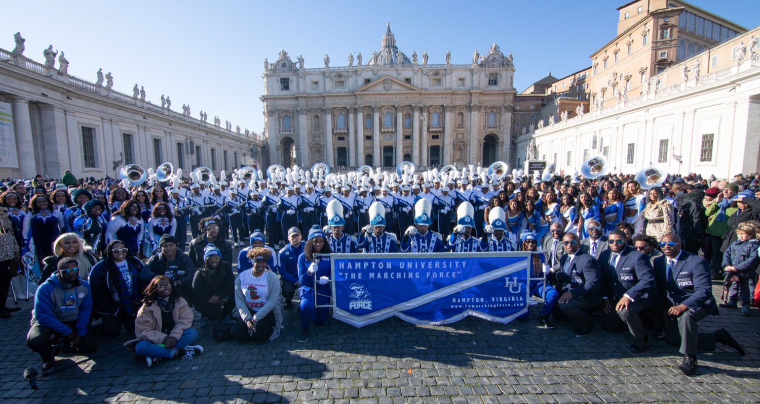
PRE-DRILL CAMP 2026 · LEADERSHIP SEMINARS · DAY 1
Day 1 Close
"First In" — The First Half of the Creed
Dr. Thomas L. Jones, Jr. and the Captains
Director of University Bands · Day 1 Close, Saturday, August 1, 2026
The Hampton University Marching Force
Hampton's Heartbeat
Notes:
SLIDE 1 — TITLE: Day 1 Close, "First In"
Hold the room before anyone starts packing. Captains stand with you.
SAY: "Nobody move yet. We opened this morning on the standard and the why. We're closing on the first half of the creed that runs this program — First In."
CUE: Keep them seated and together. This close only lands if they aren't already halfway out the door.

Slide 2
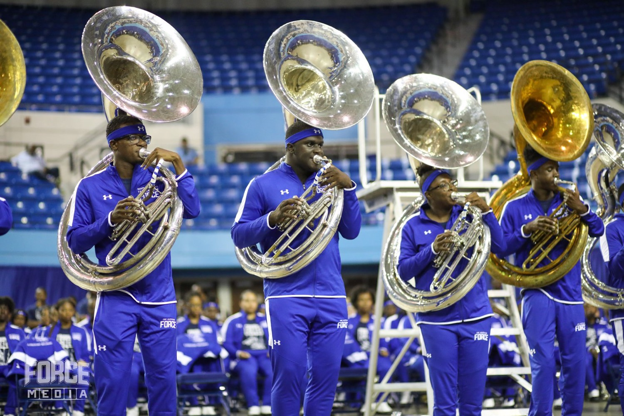
— DAY 1 CLOSE · FIRST IN
THE HAMPTON UNIVERSITY MARCHING FORCE
Icebreaker
His edge was never talent—it was mindset, chosen every single day. Being First In is that same decision, made before anyone else shows up.
▶
Kobe Bryant — “Mindset”
youtu.be/obKqJaSnQK0
WATCH · 4:25
Pre-Drill Camp 2026 · Leadership Seminars
02
Notes:
SLIDE 2 — ICEBREAKER: Kobe Bryant, "Mindset" (4:25)
SET IT UP IN ONE LINE: "Watch what he credits. It isn't talent."
Play it. Do not talk over it.
AFTER: "What did he say the edge actually was?" Take two answers — no more. The clip teaches this, not the discussion.
BRIDGE: "Mindset, chosen every single day. First In is that same decision, made before anybody else shows up."

Slide 3
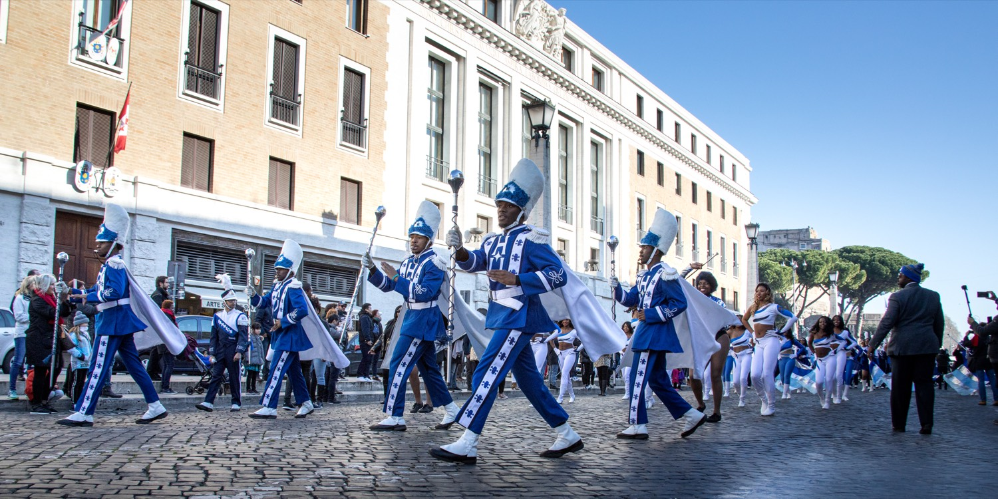
— DAY 1 CLOSE · FIRST IN
THE HAMPTON UNIVERSITY MARCHING FORCE
Day 1 in Review
Everything we covered points at one standard.
◆ Who we are. Welcome and Vision named our purpose, mission, and this year's watchword—OPTIMIZE.
◆ Know yourself. Know Yourself First and Emotional Intelligence taught you to lead the person in the mirror before you lead anyone else.
◆ How we lead. Servant-Leadership, Command Respect, and Bonds Not Fear set the model: serve first, earn respect, build trust.
◆ The line we hold. Why Hazing Happens drew the bright lines we will not cross.
◆ The craft. The Line Leader, SOP and the MSA, and The Hampton Sound turned the standard into the daily work of the section.
Pre-Drill Camp 2026 · Leadership Seminars
03
Notes:
SLIDE 3 — DAY 1 IN REVIEW
Move briskly. This is orientation, not re-teaching. One breath per bullet.
Who we are · Know yourself · How we lead · The line we hold · The craft.
If a presenter from one of those sessions is in the room, gesture to them as you name it.
CLOSE THE SLIDE: "Every one of those points at the same standard. Here it is."

Slide 4
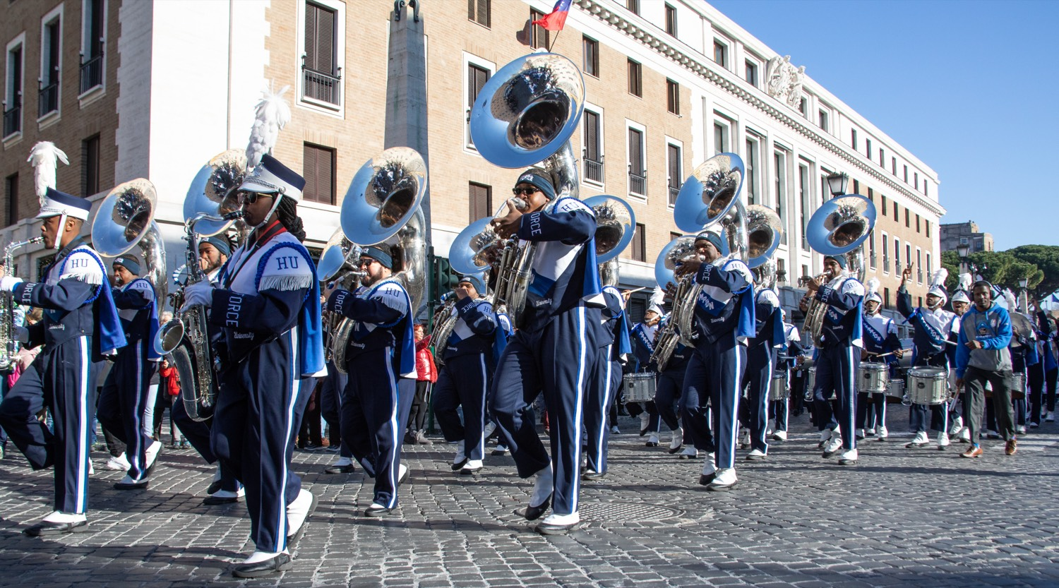
01
THE CREED
Everything from Day 1 lands on four words that every leader in this program lives by: First In, Last Out. You are measured by the readiness of your section and the state of everything you touch. Right now, we take the first half—First In. The second half, Last Out, closes Day 2.
FIRST IN, LAST OUT.
Notes:
SLIDE 4 — THE CREED (statement slide)
Slow all the way down. Read the statement — don't paraphrase it.
Then stop. Let the silence sit longer than is comfortable.
SAY: "First In, Last Out. Four words. Tonight we take the first half. The second half closes Day 2 tomorrow."
CUE: This is the hinge of the whole close. Don't rush off it.

Slide 5
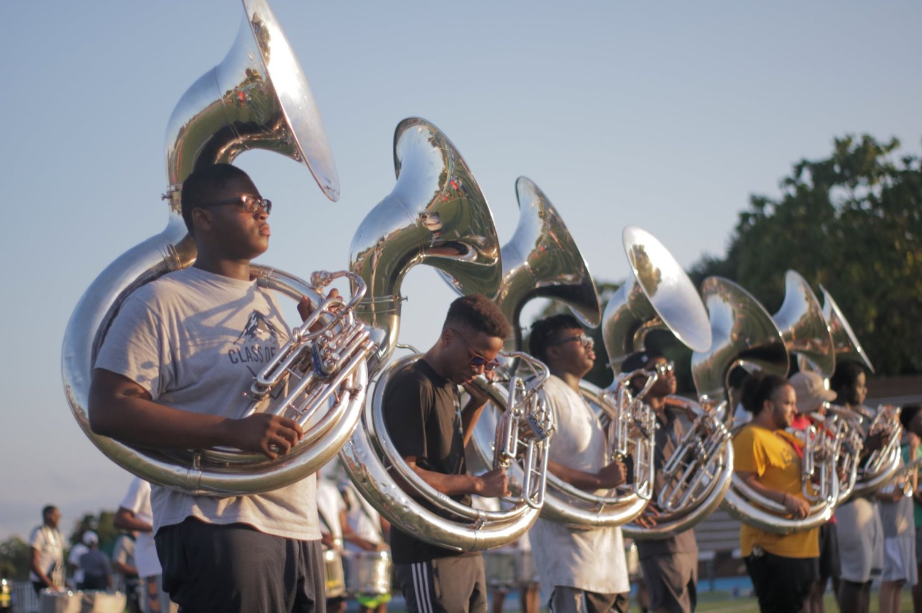
— DAY 1 CLOSE · FIRST IN
THE HAMPTON UNIVERSITY MARCHING FORCE
What "First In" Means
A habit of readiness, not a single act.
◆ First to arrive. You are in the room before your section—never rushing in alongside them.
◆ First prepared. Your part is learned, your horn is ready, and you have already gotten your own reps in.
◆ First to set the tone. The energy and the standard of the rehearsal are set before anyone else walks in—by you.
◆ First to serve. You are first in to get others ready, not first in line for the credit.
Pre-Drill Camp 2026 · Leadership Seminars
05
Notes:
SLIDE 5 — WHAT "FIRST IN" MEANS
Walk the four: first to arrive, first prepared, first to set the tone, first to serve.
LAND HARD ON THE LAST ONE: "First in to get others ready — not first in line for credit. Say that back to me."
CUE: This is where First In stops sounding like punctuality and starts sounding like leadership.

Slide 6
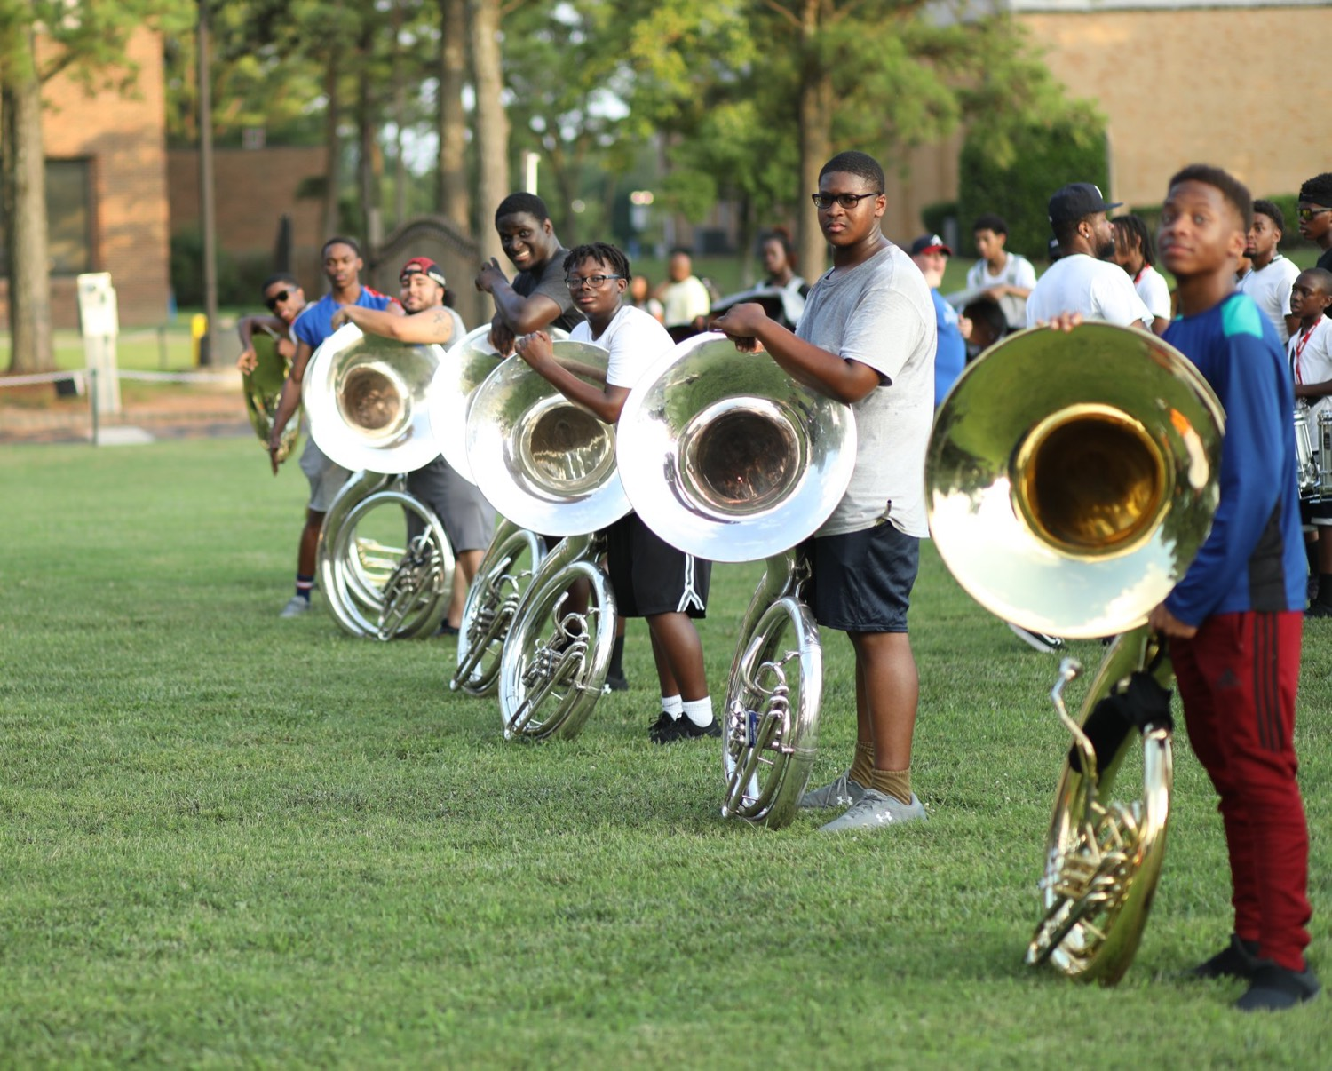
— DAY 1 CLOSE · FIRST IN
THE HAMPTON UNIVERSITY MARCHING FORCE
First In Has a Clock
Readiness is not a feeling—it is a schedule.
“If you stay ready, you don't have to get ready.” The director's downbeat is the start of the work, not the warm-up—by the time it comes, being First In means you are already there.
Pre-Drill Camp 2026 · Leadership Seminars
06
Notes:
SLIDE 6 — FIRST IN HAS A CLOCK
This is the operational heart of the session. Be specific and leave no ambiguity.
SAY: "Leaders: thirty minutes before the downbeat. Not thirty minutes to arrive — thirty minutes to be warm, set, and ready to teach."
"Your section: fifteen minutes. You are responsible for them knowing that and living it."
ASK: "What time does that make it for you tomorrow?" Make them say the actual clock time out loud. Don't move until they do.

Slide 7
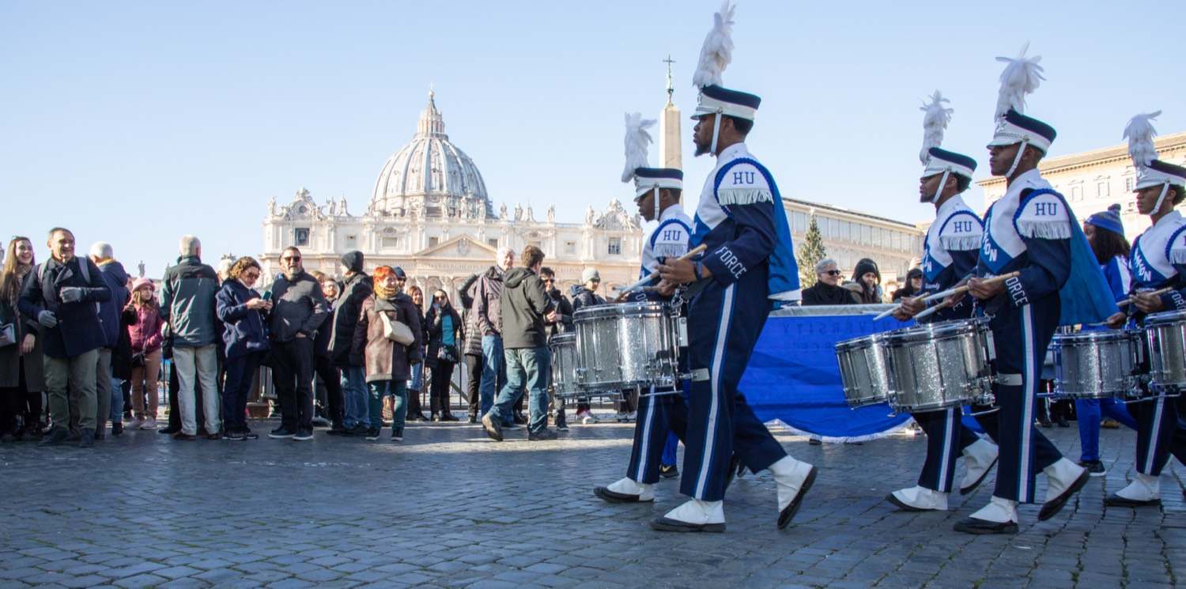
— DAY 1 CLOSE · FIRST IN
THE HAMPTON UNIVERSITY MARCHING FORCE
You Set the Tone
Your section takes its cue from you—before a note is played.
◆ The section reads you the moment you walk in. If you are ready and locked in, they lock in. If you are late and scrambling, so are they.
◆ Readiness is the standard you model, not the one you announce. They meet the bar you actually set, never the one you only talk about.
◆ Being First In is how you lead without saying a word—the room is already at the standard when the director arrives.
◆ Set the tone on purpose. It is the most important thing you do all day, and it happens before rehearsal even starts.
Pre-Drill Camp 2026 · Leadership Seminars
07
Notes:
SLIDE 7 — YOU SET THE TONE
SAY: "Whatever walks in with you becomes the section's energy. That's not a motivational line — that's just what happens."
Walk the bullets, then: "They meet the bar you actually set. Never the one you announce."
OPTIONAL: Name one leader in this room who set the tone well today. Specific and by name lands far harder than general praise.

Slide 8
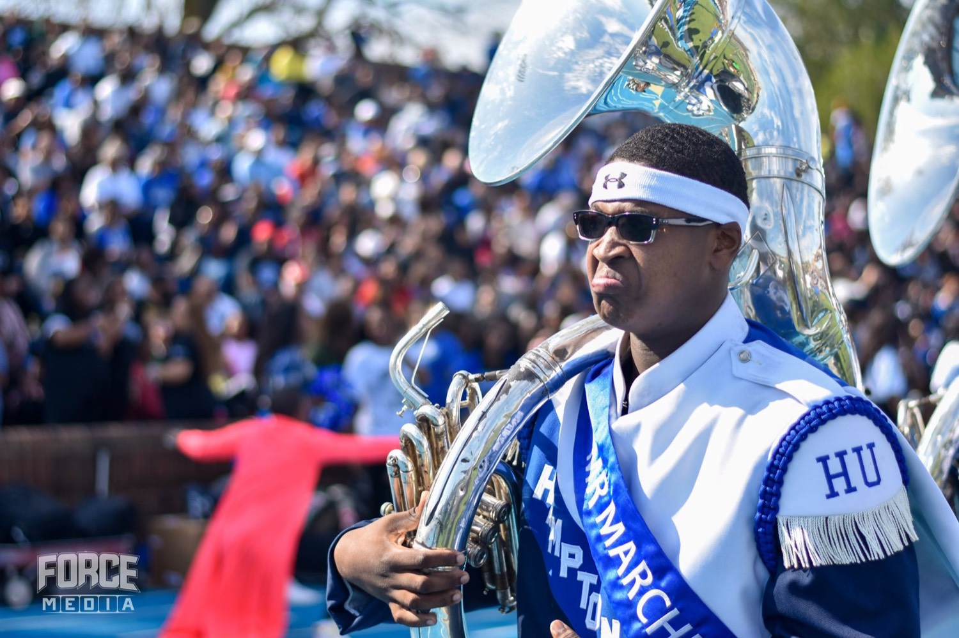
— DAY 1 CLOSE · FIRST IN
THE HAMPTON UNIVERSITY MARCHING FORCE
First In to Serve
"First In" is a servant's habit, not a spotlight.
◆ make others readyst to make others ready—to set up, to teach the fix, to warm the section—not to be seen doing it.
◆ Model the behavior you demand. Never ask your section to do what you have not already done yourself.
◆ The leader who is First In has no standing to skip the reps. You hold the bar by clearing it first.
◆ This is Servant-Leadership on the clock: your preparation is in service of theirs.
Ties directly to the Servant-Leadership and Command Respect seminars from Day 1.
Pre-Drill Camp 2026 · Leadership Seminars
08
Notes:
SLIDE 8 — FIRST IN TO SERVE
Tie it straight back to the Servant-Leadership session.
SAY: "You get there first to make other people ready. Set up, teach the fix, warm the section. Not to be seen doing it."
KEY LINE: "You hold the bar by clearing it first. A leader who is First In has no standing to skip his own reps."

Slide 9
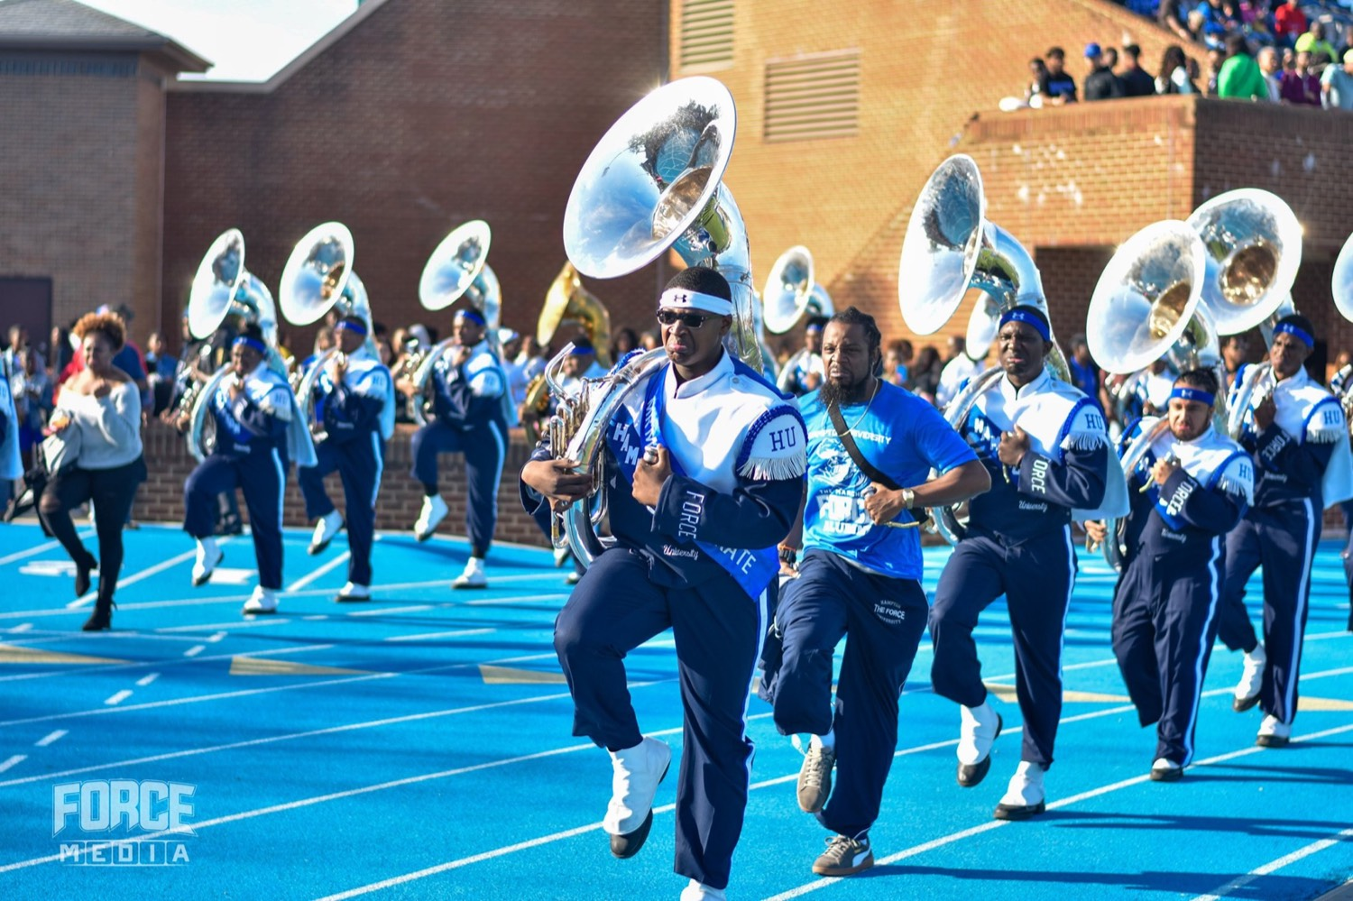
— DAY 1 CLOSE · FIRST IN
THE HAMPTON UNIVERSITY MARCHING FORCE
Why Readiness Is the Standard
Recap the standard—and the reason behind it.
◆ Excellence is a habit, not an event. You do not rise to the occasion; you fall to the level of your preparation.
◆ The members mirror the leaders. A section is only ever as ready as the person leading it.
◆ Time is respect. Being First In respects everyone's time—rehearsal starts on the downbeat because the work started before it.
◆ This is THE Standard of Excellence in practice: we are ready before we are asked to be.
Pre-Drill Camp 2026 · Leadership Seminars
09
Notes:
SLIDE 9 — WHY READINESS IS THE STANDARD
This is the why behind the clock. Don't skip it — the clock without the why is just a rule.
SAY: "You don't rise to the occasion. You fall to the level of your preparation."
"Time is respect. Being First In respects everybody's time."
BRIDGE: "That's the Standard of Excellence in practice — ready before we're asked to be."

Slide 10
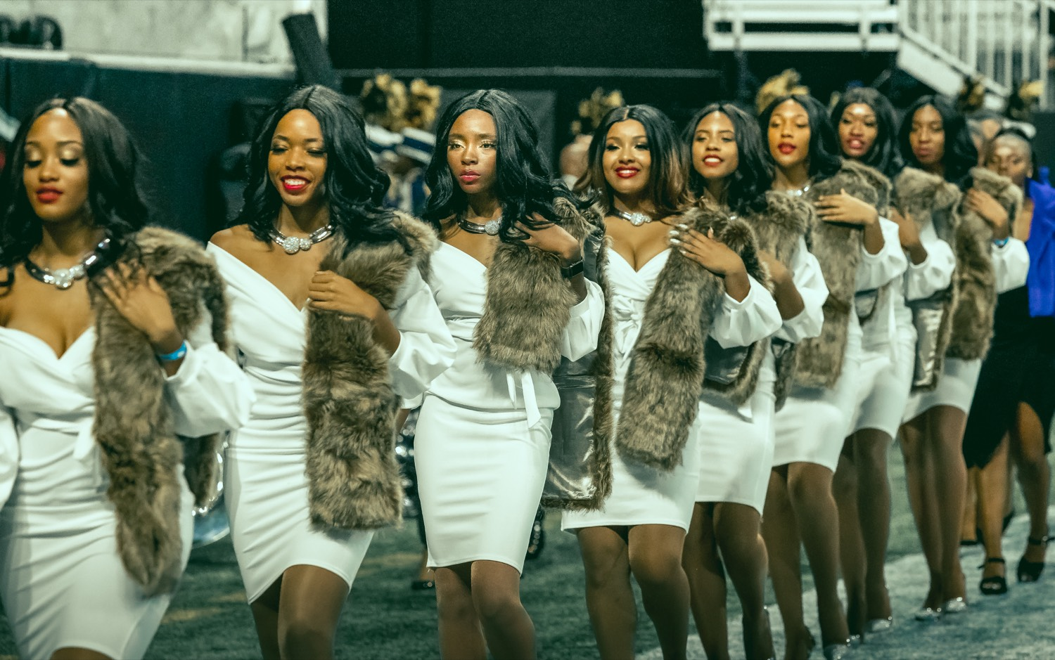
— DAY 1 CLOSE · FIRST IN
THE HAMPTON UNIVERSITY MARCHING FORCE
Your Commitments Into Day 2
Name the standard you will hold—starting with the very next rehearsal.
1
Be First In
Arrive 30 minutes early—prepared and warmed up—before your section does.
Pre-Drill Camp 2026 · Leadership Seminars
10
Notes:
SLIDE 10 — YOUR COMMITMENTS INTO DAY 2
Slow down. This is the ask, and it needs real air.
SAY: "Before you leave this room — one thing you will be early for tomorrow, and one person you will check on."
Have them say it OUT LOUD to the leader beside them. Wait for the room to actually do it. The silence while they turn to each other is fine — let it happen.
CUE: Do not narrate over this. Just wait.

Slide 11
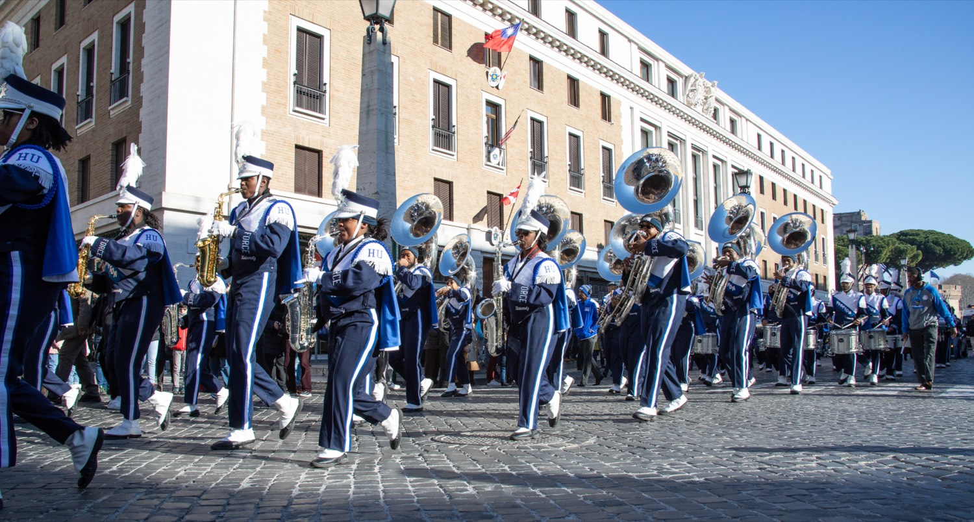
YOUR CHARGE
First In.
Every Time.
Day 1 gave you the standard and the why. Now live the first half of the creed: First In. Arrive early, prepare first, and set the tone before anyone else walks in—because a section is only ever as ready as its leader. Rest well, and come back ready to close the creed. Day 2 belongs to the other half: Last Out.
Serve First. Lead Always. — Drive the Legacy.
The Hampton University Marching Force
Hampton's Heartbeat
Notes:
SLIDE 11 — CLOSE: "First In. Every Time."
Deliver standing, without notes if you can.
SAY: "Tomorrow morning, before anybody else is on that field, I want to see you. Not because I'm checking — because that's who you are now."
Give the report time and location for Day 2 before the sign-off.
End on the creed line and let the Captains dismiss. Add nothing after it. Let it land.

