Slide 1
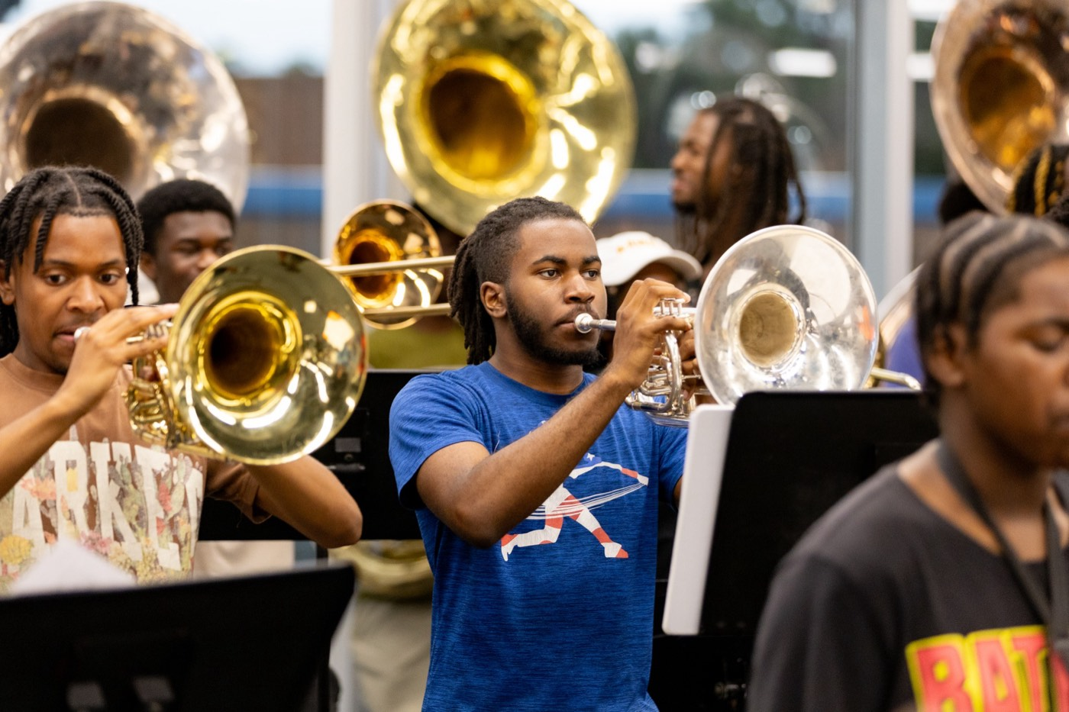
PRE-DRILL CAMP 2026 · LEADERSHIP SEMINARS · DAY 1
The Hampton
Sound
"The Best of Both Worlds"
Dr. Thomas L. Jones, Jr.
Director of University Bands · Instrumentalist Session, Saturday, August 1, 2026
The Hampton University Marching Force
Hampton's Heartbeat
Notes:
SLIDE 1 — TITLE: The Hampton Sound
INSTRUMENTALIST SESSION. Dr. Jones presenting — this is the sound concept and the arranging behind it.
OPEN: "You can pick us out of a hundred bands in three notes. That's not luck. It's design."

Slide 2
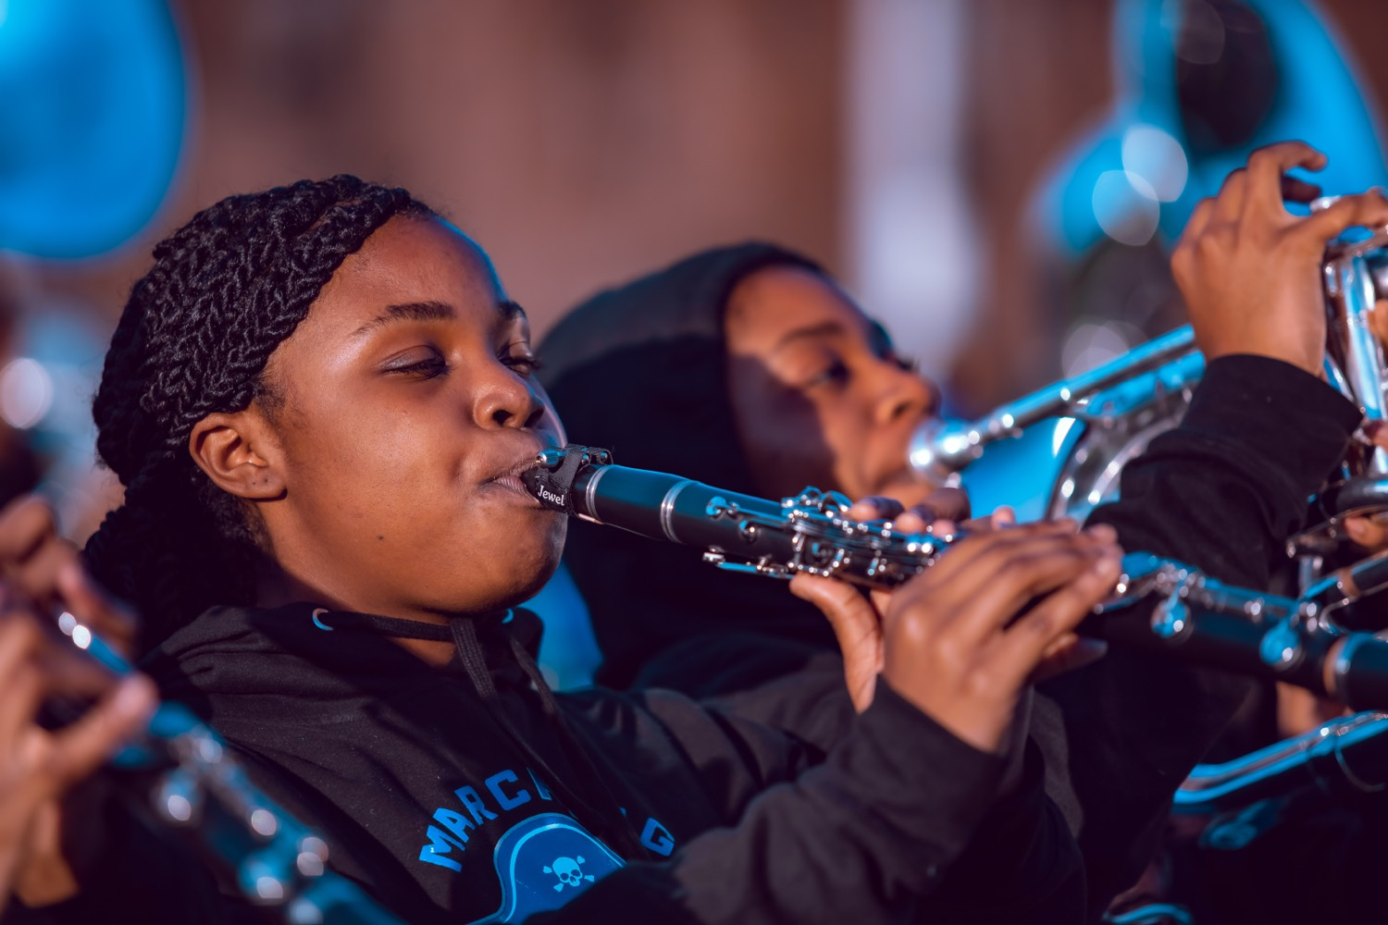
— THE HAMPTON SOUND
THE HAMPTON UNIVERSITY MARCHING FORCE
Hear It First
Three recordings, in order—raw power, then power under control, then the two combined. That combination is The Hampton Sound.
RAW POWER
Southern University Human Jukebox, live at UGA
youtu.be/PbQ8uJCJpq8
Pre-Drill Camp 2026 · Leadership Seminars
02
Notes:
SLIDE 2 — HEAR IT FIRST (three reference clips)
Don't explain first — play first. Order matters.
1. RAW POWER — Southern University Human Jukebox (2:46)
2. POWER WITH CONTROL — Phantom Regiment, Elsa's Procession (1:51)
3. THE COMBINATION — North Carolina A&T (2:49)
AFTER EACH, one question: "What did you hear?" Don't lecture between clips.
AFTER THE THIRD: "That combination — power and control together — is The Hampton Sound."
TIME CHECK: about eight minutes of audio. Budget for it.

Slide 3

01
THE PREMISE
You can pick us out of a hundred bands in three notes. That is not luck—it is design. The Hampton Sound is calculated: the best of both worlds, power and precision, with every note doing a job. It has to be rebuilt and taught every single year, and as an instrumentalist leader, you are now its keeper.
EVERY NOTE SERVES A PURPOSE.
Notes:
SLIDE 3 — THE PREMISE (statement slide)
Read it.
Takeaway: "Every note serves a purpose." That phrase recurs — plant it here.

Slide 4
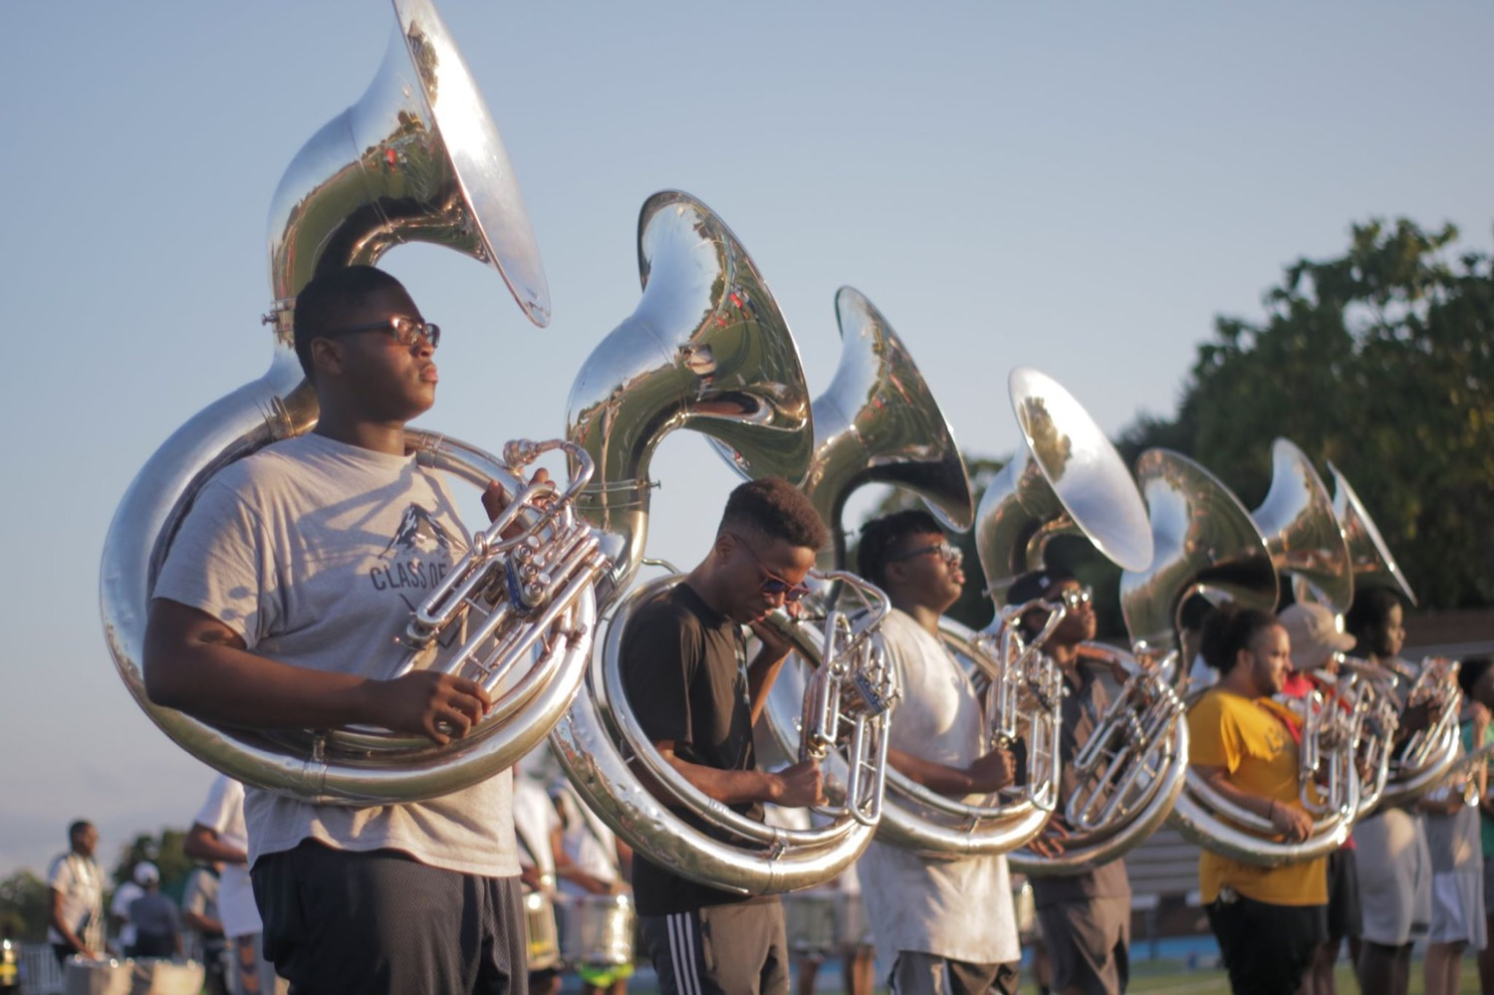
— THE HAMPTON SOUND
THE HAMPTON UNIVERSITY MARCHING FORCE
What The Hampton Sound Is
Not one or the other—both, at the same time.
The Hampton Sound is efficient and calculated—every note serves a purpose. It is the best of both worlds: power and precision, married.
Pre-Drill Camp 2026 · Leadership Seminars
04
Notes:
SLIDE 4 — WHAT THE HAMPTON SOUND IS
Two columns — power on one side, precision on the other.
READ THE CALLOUT VERBATIM: "efficient and calculated — every note serves a purpose. The best of both worlds: power and precision, married."
KILL THE FALSE CHOICE: "Not one or the other. Both, at the same time."

Slide 5
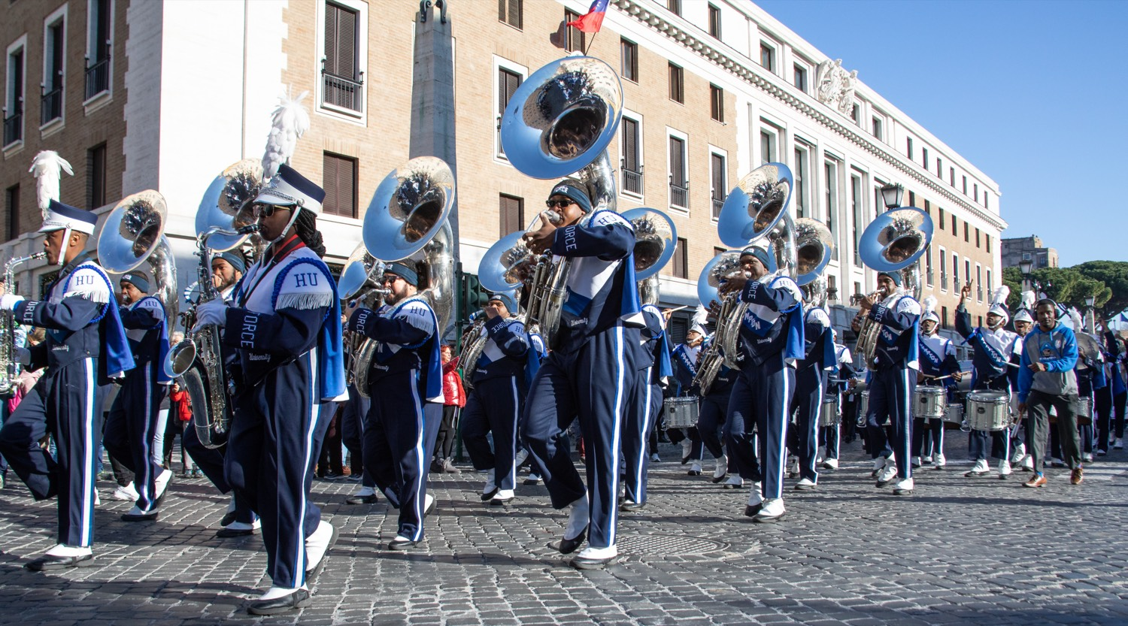
— THE HAMPTON SOUND
THE HAMPTON UNIVERSITY MARCHING FORCE
The Color: Dark and Resonant
Depth and core—never thin, never brittle.
◆ dark, resonantk, resonant sound: full of core, rich underneath, with real weight behind every note.
◆ DCI drum corps of the 1980s and 90sps of the 1980s and 90s—the era of the big G bugles.
◆ larger and harder to playnd harder to play, but they packed a punch and the sound carried across the entire field.
◆ Chase that depth. A dark, resonant core projects farther—and ages better—than a bright, thin edge ever will.
Pre-Drill Camp 2026 · Leadership Seminars
05
Notes:
SLIDE 5 — THE COLOR: DARK AND RESONANT
"Dark, resonant, full of core, with real weight behind every note."
THE MODEL: the great DCI corps of the 80s and 90s, the era of the big G bugles — larger horns, harder to play, and the sound carried across the whole field.
LAND: "A dark, resonant core projects farther — and ages better — than a bright, thin edge ever will."

Slide 6
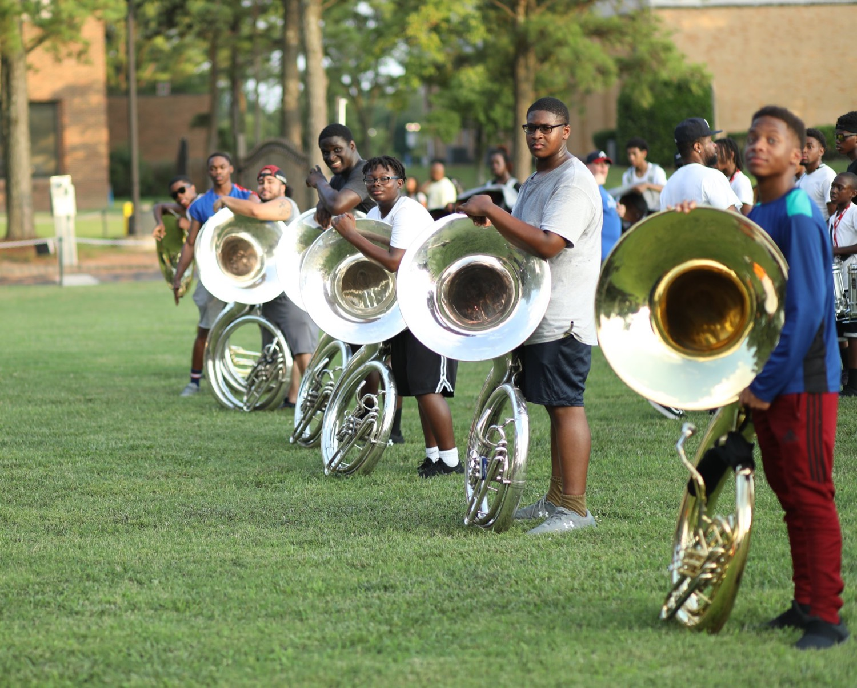
— THE HAMPTON SOUND
THE HAMPTON UNIVERSITY MARCHING FORCE
Tone at Volume
Volume is easy. Tone at volume is the whole craft.
◆ best characteristic tone at full volumeour best characteristic tone at full volume—full, centered, and controlled.
◆ more air, not more forceforce. Open the throat, keep the core; projection, never distortion.
◆ louder for longeronger. Endurance is part of the sound—the wall cannot sag in the fifth quarter.
◆ The instant tone breaks into blatt or spread, you have left The Hampton Sound. Back off to the core and rebuild.
Pre-Drill Camp 2026 · Leadership Seminars
06
Notes:
SLIDE 6 — TONE AT VOLUME
"Anyone can play loud. Tone at volume is the whole craft."
TECHNICAL: "Move more air, not more force. Open the throat, keep the core. Projection, never distortion."
OUR PHRASE: "The wall cannot sag in the fifth quarter." Explain it if any freshmen are present — fifth quarter is when HBCU bands stay after the game and play, usually against the opposing band.
THE LINE: "The instant tone breaks into blatt or spread, you've left The Hampton Sound."

Slide 7
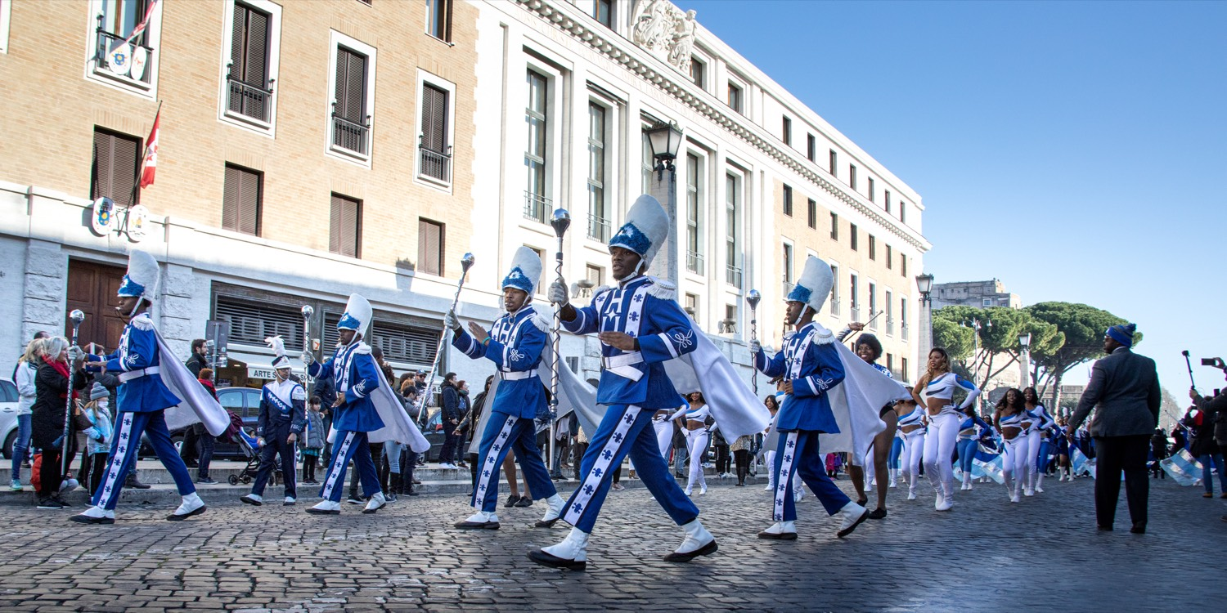
— THE HAMPTON SOUND
THE HAMPTON UNIVERSITY MARCHING FORCE
Balance, Blend, and Intonation
This is where the sound is actually built.
◆ Balance: listen across the whole band so no voice is buried and no voice sticks out—every part heard in proportion.
◆ Blend: match your tone, pitch, and volume to the players around you until the section rings as one. When it truly locks, you hear overtones no one is playing.
◆ Intonation: tune from the bottom up and hold it. Power means nothing out of tune.
◆ complement—they do not competethey do not compete. Each section makes room for the others.
Sources: W. Francis McBeth, Effective Performance of Band Music (1972) — the pyramid-of-sound balance concept; Edward S. Lisk, The Creative Director: Alternative Rehearsal Techniques (Meredith Music).
Pre-Drill Camp 2026 · Leadership Seminars
07
Notes:
SLIDE 7 — BALANCE, BLEND, AND INTONATION
"This is where the sound is actually built."
Balance — nobody buried, nobody sticking out.
Blend — match tone, pitch, and volume until the section rings as one; when it truly locks you hear overtones.
Intonation — tune from the bottom up. "Power means nothing out of tune."
KEY IDEA: "Colors complement. They do not compete."

Slide 8
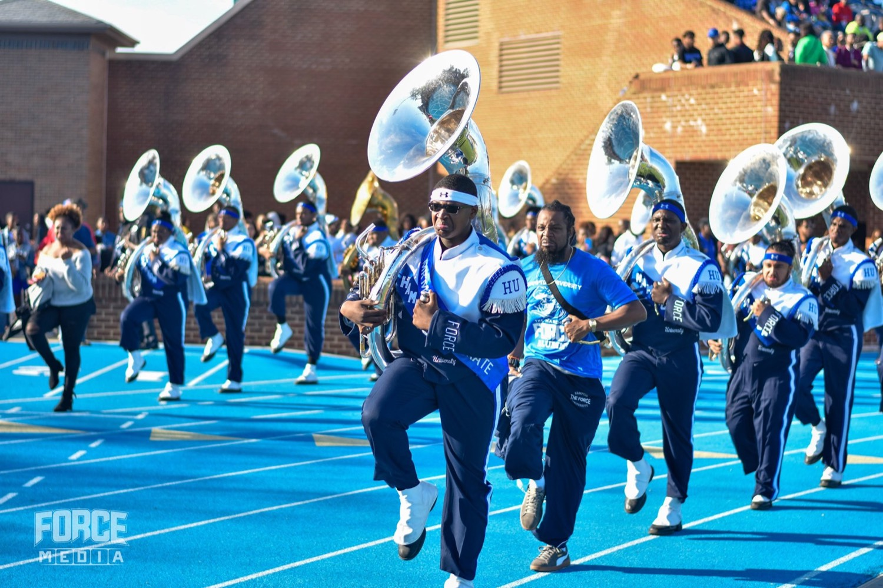
— THE HAMPTON SOUND
THE HAMPTON UNIVERSITY MARCHING FORCE
Every Section Owns a Piece
The Hampton Sound is all of us—not just the brass.
1
Woodwinds
Color and agility up top—piccolos, clarinets, and saxes add brilliance and speed the brass cannot.
Four different colors, one sound. Each section is written and played to complement the others, never to compete with them.
Pre-Drill Camp 2026 · Leadership Seminars
08
Notes:
SLIDE 8 — EVERY SECTION OWNS A PIECE
Woodwinds (color and agility), High Brass (melody and edge), Low Brass (foundation and drive), Percussion (time, pocket, power).
NOTE: our percussion has no pit — everything is on the move.
READ THE CALLOUT: "Four different colors, one sound."

Slide 9

— THE HAMPTON SOUND
THE HAMPTON UNIVERSITY MARCHING FORCE
How It's Built on the Page
The sound starts in the arrangement, long before the first rehearsal.
◆ Voiced from the bottom up. The low brass lays a wide, deep foundation, and everything else is stacked on top of it.
◆ The instruments talk to each other. Colors and timbres are voices in one cohesive conversation—each placed to answer and support the others, never to outcompete them for the same space.
◆ Soulful harmonic color. Gospel, funk, and R&B harmony give the sound its soul over concert-band cleanliness—that marriage is the Hampton in The Hampton Sound.
◆ Hits and call-and-response. Tutti hits, the silence right before the hit, and sections answering each other give the sound its shape and its punch.
◆ Every note serves a purpose. The writing is efficient and calculated—nothing is on the page for decoration.
Pre-Drill Camp 2026 · Leadership Seminars
09
Notes:
SLIDE 9 — HOW IT'S BUILT ON THE PAGE
The arranging half. This is where you speak as a former Chief Music Arranger — say so.
Voiced bottom-up. Low brass lays a wide, deep foundation.
THE IDEA TO EMPHASIZE: "The instruments talk to each other. They're voices in one cohesive conversation — they don't try to outcompete one another."
Soulful harmonic color — gospel, funk, and R&B harmony over concert-band cleanliness. That marriage is the Hampton identity.
Hits and call-and-response — including the silence right before the hit.

Slide 10
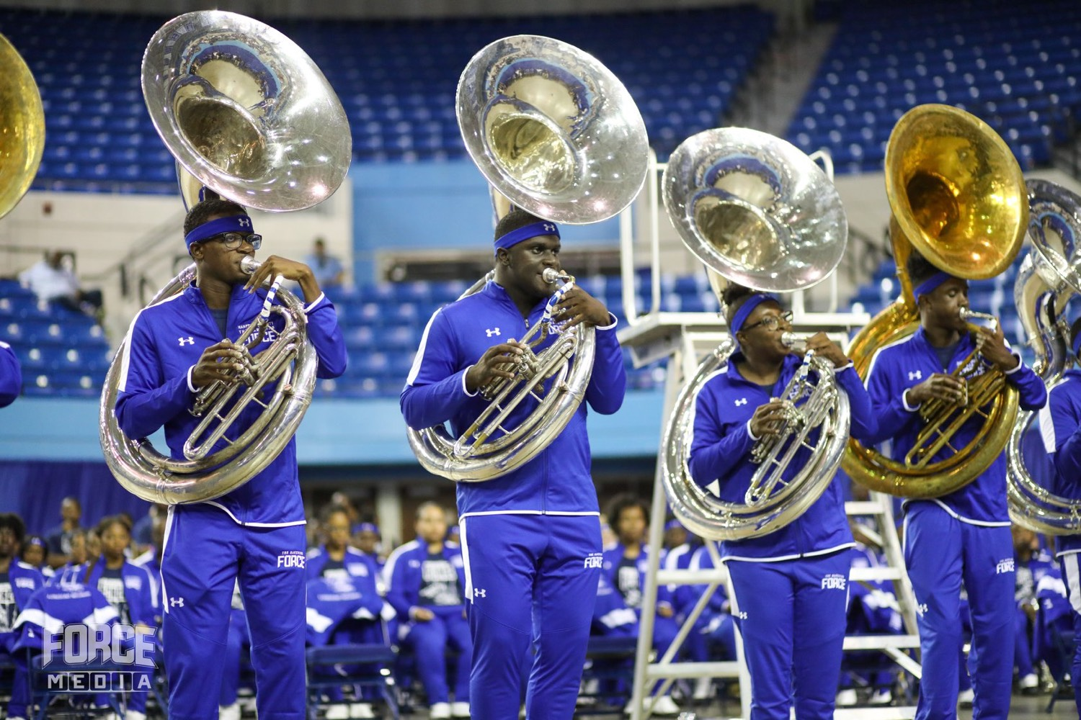
— THE HAMPTON SOUND
THE HAMPTON UNIVERSITY MARCHING FORCE
Part Alignments: The Brass
The brass carry the harmony in four voices—high brass and low brass an octave apart. Read down a chart to see each part, or across a voice to see who shares the line.
Pre-Drill Camp 2026 · Leadership Seminars
10
Notes:
SLIDE 10 — PART ALIGNMENTS: THE BRASS
Two charts side by side: high brass and low brass, an octave apart.
HOW TO READ IT: "Read DOWN a chart to see each part. Read ACROSS a voice to see who you're locked with."
Have players find their own part on the chart before you move on. Give it a beat.

Slide 11
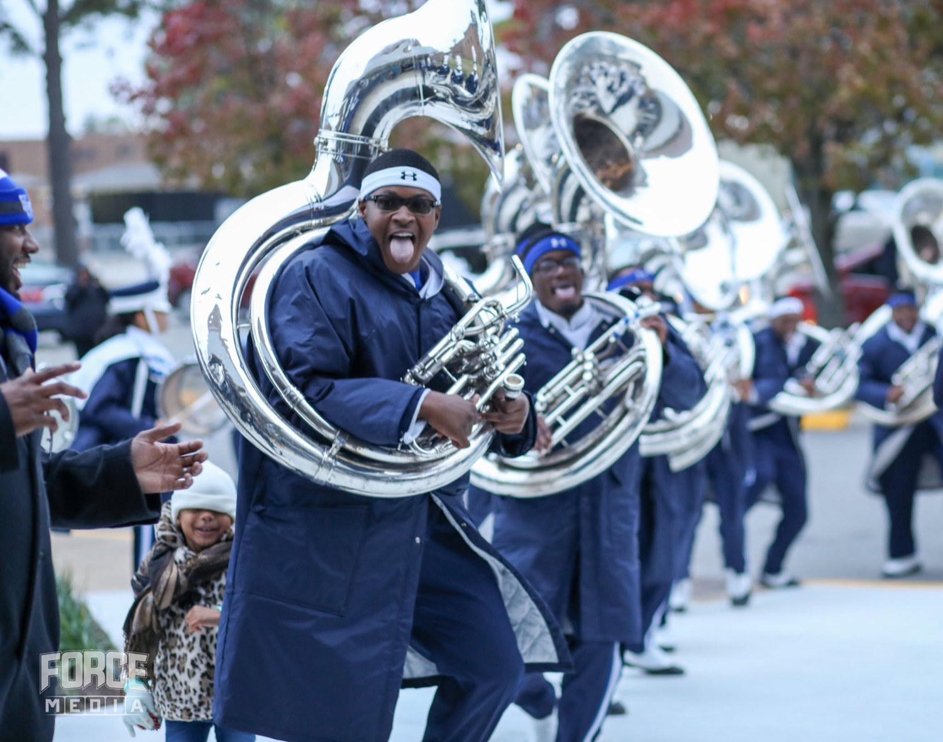
— THE HAMPTON SOUND
THE HAMPTON UNIVERSITY MARCHING FORCE
Where the Woodwinds Align
The woodwinds don't hold their own voices—each one aligns with a brass line, part for part.
Pre-Drill Camp 2026 · Leadership Seminars
11
Notes:
SLIDE 11 — WHERE THE WOODWINDS ALIGN
The featured chart. Woodwinds don't hold independent voices — each aligns to a brass line, part for part.
CALL OUT THE EXCEPTION EXPLICITLY: alto saxes and clarinets do NOT align with each other. That's the most common misunderstanding in the room — make sure it's said out loud.
Also show where flugelhorns and saxes align.

Slide 12
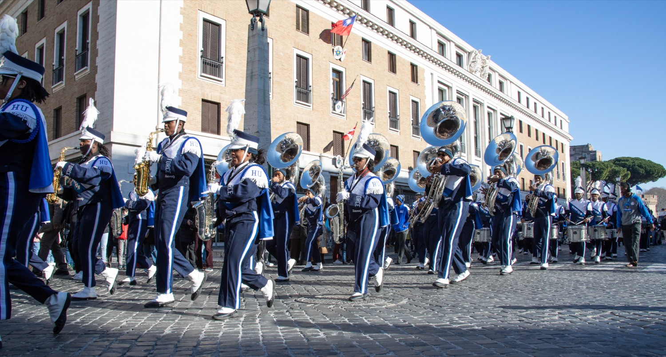
02
THE TRADITION
Hampton has owned this sound for generations. It is not automatic—every August a new class arrives that has never made it, and it has to be taught from the first long tone. Learning it takes about a semester. Keeping it takes a career. And one day it will be your job to pass it to the person who takes your chair.
LEARN IT IN A SEMESTER. KEEP IT A CAREER. PASS IT ON.
Notes:
SLIDE 12 — THE TRADITION (statement slide)
Read it.
THE POINT: "Every August a new class arrives that has never made this sound. It has to be taught from the first long tone."
Takeaway: "Learn it in a semester. Keep it a career. Pass it on."

Slide 13
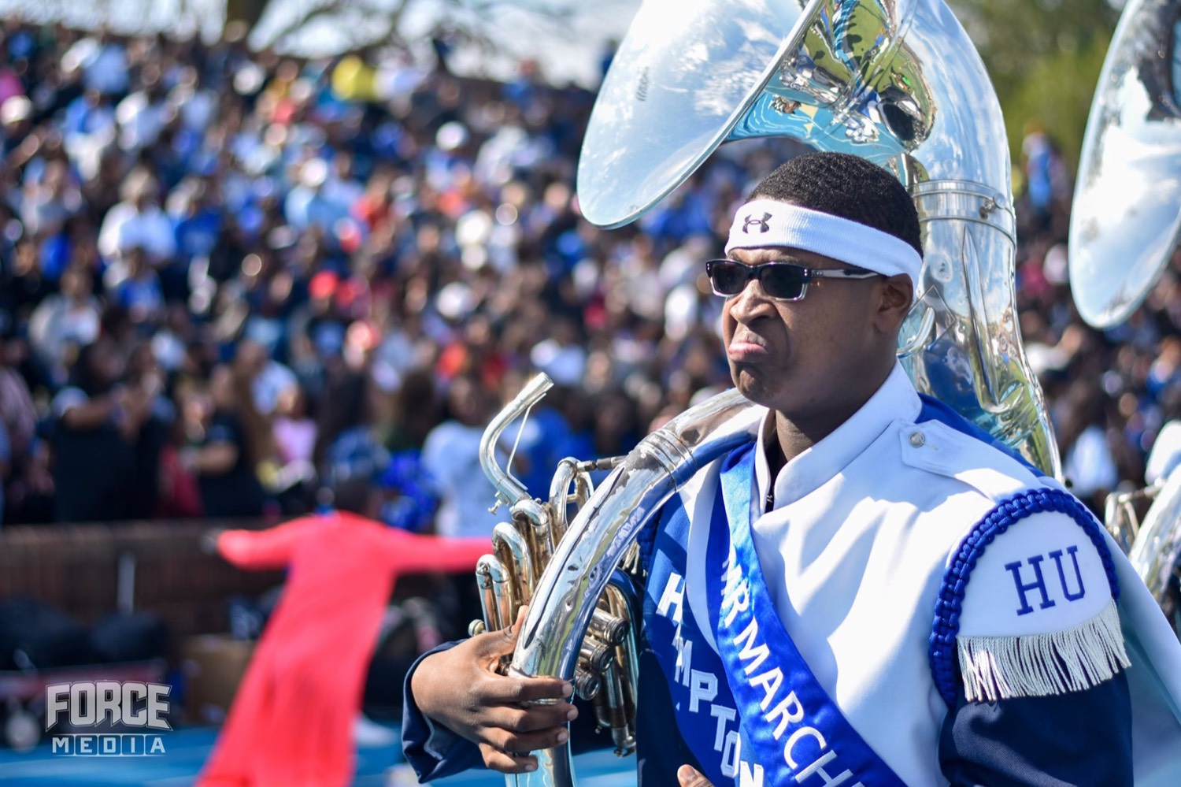
— THE HAMPTON SOUND
THE HAMPTON UNIVERSITY MARCHING FORCE
Your Job: Keep the Sound
As a section leader, you are the carrier of the sound.
1
Model It
Your horn is the reference. Play the dark, resonant, full tone you want the section to match.
Pre-Drill Camp 2026 · Leadership Seminars
13
Notes:
SLIDE 13 — YOUR JOB: KEEP THE SOUND
Four: Model It, Build It in Warmups, Hold It at Volume, Protect Balance and Blend.
"Your horn is the reference." That's the whole responsibility in four words.
"The core tone is built before the music starts."

Slide 14
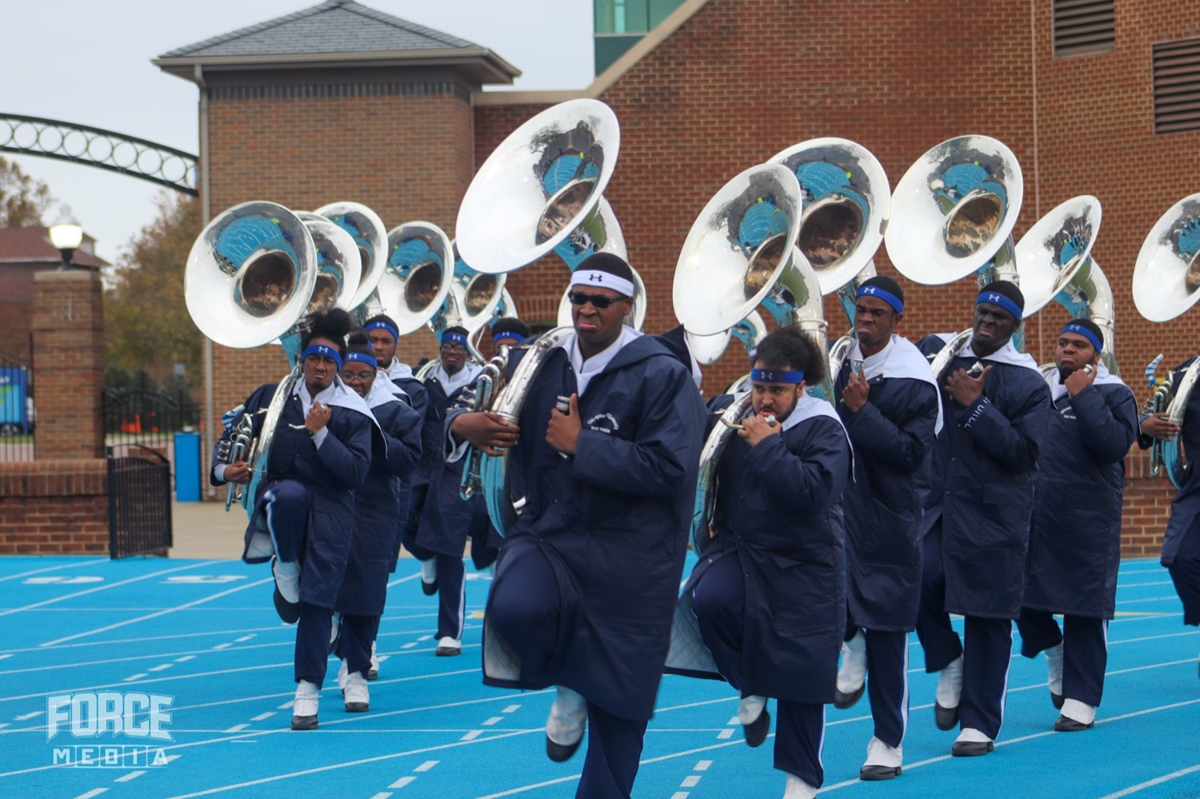
YOUR CHARGE
Own the Sound.
Pass It On.
The Hampton Sound is power and precision married—dark, resonant, in tune, and efficient, with every note serving a purpose. It is taught, not inherited, and it lives or dies with the leaders who carry it. Model the tone, build it in warmups, hold it at volume, and protect the blend—then hand it to the next player better than you found it.
Serve First. Lead Always. — Drive the Legacy.
The Hampton University Marching Force
Hampton's Heartbeat
Notes:
SLIDE 14 — CLOSE: Own the Sound. Pass It On.
"It is taught, not inherited, and it lives or dies with the leaders in this room."
End on the sign-off.

