Slide 1
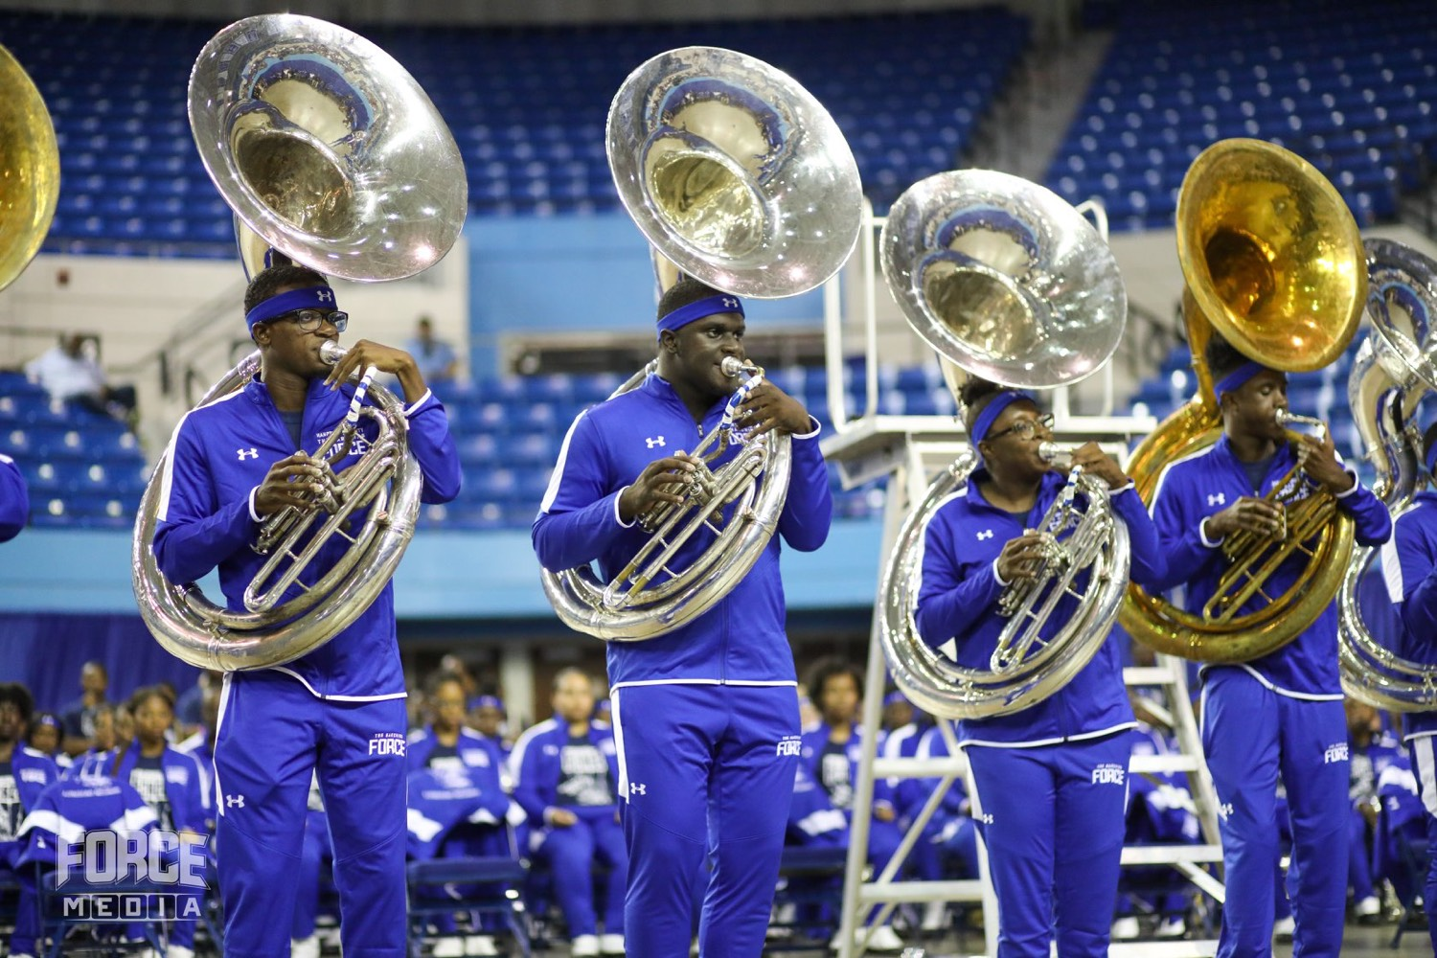
PRE-DRILL CAMP 2026 · LEADERSHIP SEMINARS · DAY 1
The Sectional
Standard
"SOP and the Minimum Skills Audition"
Led by the Section Leaders
Instrumentalist Breakout · Saturday, August 1, 2026
The Hampton University Marching Force
Hampton's Heartbeat
Notes:
SLIDE 1 — TITLE: The Sectional Standard
INSTRUMENTALIST SESSION — section leaders are presenting or co-presenting.
SAY: "Two things today. The MSA is the bar every player has to clear. The SOP is how you run the room that gets them over it."

Slide 2

— SOP AND THE MSA
THE HAMPTON UNIVERSITY MARCHING FORCE
Icebreaker
In a sectional, you are not just a player—you are the teacher. Hear how a master approaches teaching: a high standard and real care for every student.
▶
Wynton Marsalis — “On Teaching”
youtu.be/sSUhfUyI1bg
WATCH · 1:20
Pre-Drill Camp 2026 · Leadership Seminars
02
Notes:
SLIDE 2 — ICEBREAKER: Wynton Marsalis, "On Teaching" (1:20)
SET UP: "In a sectional you're not a player. You're the teacher. Listen to how he holds a high standard and still cares about the student."
Play it.
AFTER: "Both at once. High bar, real care. That's the job."

Slide 3

01
THE PREMISE
Every member can march the show. But can every member play their scales? The Minimum Skills Audition is the floor—the proof that you own your instrument, not just your part. And the sectional is where that floor is built: not by playing pretty, but by attacking the hard spots until they are clean. This session is how we hold the standard, together.
OWN THE INSTRUMENT, NOT JUST THE PART.
Notes:
SLIDE 3 — THE PREMISE (statement slide)
Read it.
THE QUESTION THAT LANDS: "Every member can march the show. But can every member play their scales?"
Takeaway: "Own the instrument, not just the part."

Slide 4

— SOP AND THE MSA
THE HAMPTON UNIVERSITY MARCHING FORCE
Two Standards Today
One measures the player. One runs the room.
◆ MSA MSA—the Minimum Skills Audition—is the individual proficiency floor every instrumentalist must clear.
◆ SOP SOP—our Standard Operating Procedure for sectionals—is how a leader builds that proficiency in the room.
◆ The MSA sets the bar. The SOP is how you get everyone over it.
Pre-Drill Camp 2026 · Leadership Seminars
04
Notes:
SLIDE 4 — TWO STANDARDS TODAY
Keep this short — it's a signpost.
"MSA measures the player. SOP runs the room. The MSA sets the bar; the SOP is how you get everyone over it."

Slide 5

— SOP AND THE MSA
THE HAMPTON UNIVERSITY MARCHING FORCE
The MSA: Minimum Skills Audition
The proficiency floor for every instrumentalist.
This is the floor, not the ceiling—the minimum every member owes the band. Anything below 70% is not good standing.
Pre-Drill Camp 2026 · Leadership Seminars
05
Notes:
SLIDE 5 — THE MSA
Be exact, because members will quote you on this: twelve major scales with arpeggios, plus a two-octave chromatic. **70 percent or better to stay in good standing.**
READ THE CALLOUT: "This is the floor, not the ceiling."
CUE: Expect a question about consequences below 70. Answer it plainly — not in good standing.

Slide 6

— SOP AND THE MSA
THE HAMPTON UNIVERSITY MARCHING FORCE
Why Scales Are the Whole Game
The fundamentals are not separate from the music—they are the music.
◆ scales and arpeggiosl ever play is built from scales and arpeggios. Own them, and the music comes faster and cleaner.
◆ chromatic scalecale is your fingers' and your ear's road map to every note on the horn.
◆ no one is carried clears the floor, no one is carried, and the whole section starts to sound like one player.
◆ The MSA is not busywork. It is the shortest path to The Hampton Sound.
Pre-Drill Camp 2026 · Leadership Seminars
06
Notes:
SLIDE 6 — WHY SCALES ARE THE WHOLE GAME
Head off the eye-roll: some of them think scales are busywork.
"Every phrase you'll ever play is built from scales and arpeggios."
LAND IT: "The MSA is not busywork. It's the shortest path to The Hampton Sound." That connects it to the session they'll have later today.

Slide 7
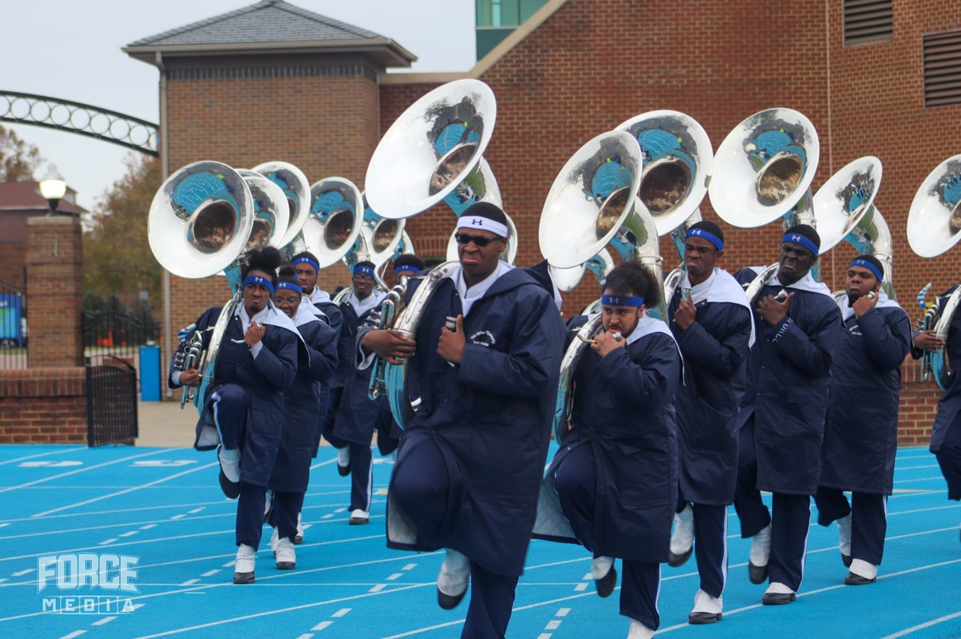
— SOP AND THE MSA
THE HAMPTON UNIVERSITY MARCHING FORCE
Helping Your Section Pass
Your job is not to judge them once—it is to get them there.
◆ Know it cold yourself first. You cannot check off what you have not mastered.
◆ Hold regular check-offs—small, frequent, and honest—so no one is surprised at audition time.
◆ Diagnose the sticking point: is it the fingering, the tempo, or the reps? Fix the cause, not the symptom.
◆ Drill it and re-check. A failed scale is a to-do list, not a verdict.
Pre-Drill Camp 2026 · Leadership Seminars
07
Notes:
SLIDE 7 — HELPING YOUR SECTION PASS
Shift the frame: "Your job isn't to judge them once. It's to get them there."
FOUR MOVES: know it cold yourself, check off often and honestly, diagnose the actual sticking point, drill and re-check.
BEST LINE: "A failed scale is a to-do list, not a verdict."

Slide 8

— SOP AND THE MSA
THE HAMPTON UNIVERSITY MARCHING FORCE
Running a Sectional: The SOP
A sectional is a repair shop, not a concert.
◆ Attack the tough spots. Spend your time on the four bars that are broken, not the ones already clean.
◆ Repeat for proficiency. Run the hard passage slowly and correctly, again and again, until it cannot fall apart.
◆ Do not run entire songs. Full run-throughs feel productive but fix nothing—reserve them for memorization only.
◆ Leave every sectional with something measurably better than when you walked in.
Pre-Drill Camp 2026 · Leadership Seminars
08
Notes:
SLIDE 8 — RUNNING A SECTIONAL: THE SOP
This is the operational core.
"A sectional is a repair shop, not a concert."
Three rules: attack the tough spots, repeat for proficiency, do not run entire songs.
SAY THE EXCEPTION CLEARLY: "Full run-throughs are for memorization only."

Slide 9

— SOP AND THE MSA
THE HAMPTON UNIVERSITY MARCHING FORCE
Attack the Tough Spots
This is not just our opinion—it is how mastery is actually built.
◆ deliberate practiceert performance calls it deliberate practice: you improve by working at the edge of what you cannot yet do, not by repeating what you already can.
◆ target their errorss in the practice room found the same thing—the best players target their errors, isolate the passage, and repeat it in context until it is reliable.
◆ isolate the hard spot, slow it down, repeat it clean, then bring the tempo back up.mpo back up.
◆ Slow and correct beats fast and sloppy, every time.
Sources: Ericsson, Krampe, and Tesch-Römer, "The Role of Deliberate Practice," Psychological Review (1993); Ericsson and Pool, Peak (2016); Duke, Simmons, and Cash, "It's Not How Much; It's How," Journal of Research in Music Education (2009).
Pre-Drill Camp 2026 · Leadership Seminars
09
Notes:
SLIDE 9 — ATTACK THE TOUGH SPOTS
Back the method with the research so it isn't just opinion — deliberate practice means working at the edge of what you can't yet do.
THE METHOD, say it as a sequence: isolate, slow it down, repeat it clean, bring the tempo back.
"Slow and correct beats fast and sloppy, every time."

Slide 10
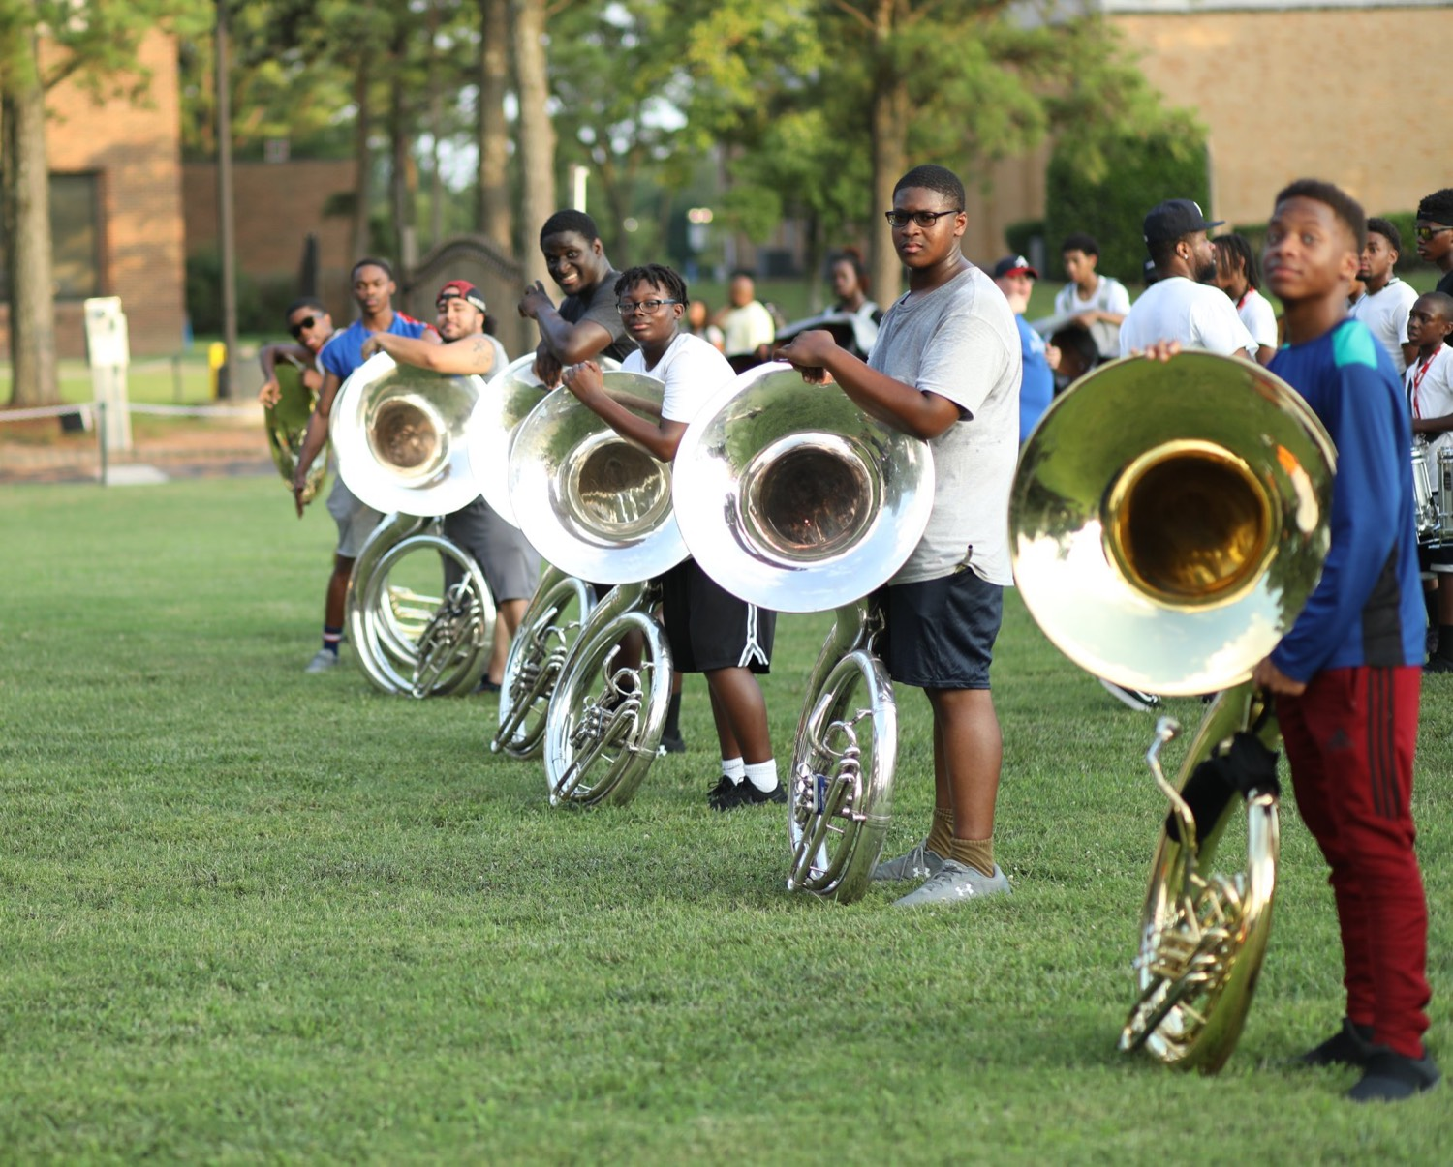
— SOP AND THE MSA
THE HAMPTON UNIVERSITY MARCHING FORCE
Playing Through Is Not Practicing
The most common way to waste a sectional.
◆ feelsng the whole song from the top feels productive—but you spend most of it playing what you already know.
◆ performingrough is performing, not practicing. It rehearses the mistakes right alongside the good parts.
◆ memorizationson to run a full piece in a sectional is memorization—locking the map into your head and hands.
◆ If you are not fixing something, you are not practicing. Go back to the tough spot.
Pre-Drill Camp 2026 · Leadership Seminars
10
Notes:
SLIDE 10 — PLAYING THROUGH IS NOT PRACTICING
This is the habit you're trying to break. Be blunt.
"Running the song from the top feels productive. You spend most of it playing what you already know."
KILLER LINE: "Playing through rehearses the mistakes right alongside the good parts."
TEST: "If you're not fixing something, you're not practicing."

Slide 11

— SOP AND THE MSA
THE HAMPTON UNIVERSITY MARCHING FORCE
A Sectional Blueprint
A simple order that works every time.
1
Warm Up on Fundamentals
Open with long tones and the MSA scales. The warmup is the standard, every single time.
Pre-Drill Camp 2026 · Leadership Seminars
11
Notes:
SLIDE 11 — A SECTIONAL BLUEPRINT
Give them the order: warm up on fundamentals, check off, attack the tough spots, lock it in.
CUE: Tell them the bulk of the time goes to step three. Most leaders over-spend on warmup and run out of clock.
"Leave every sectional with something measurably better than when you walked in."

Slide 12

— SOP AND THE MSA
THE HAMPTON UNIVERSITY MARCHING FORCE
Demand, Don't Demean
Hold the bar high—and hold it the right way.
◆ Rigor is not hazing not a cruel one. Rigor is not hazing: you push the standard, never the person's dignity.
◆ Intellectual Hesitationesitation: before you correct, ask whether the gap is a resource, an understanding, or an effort problem—then fix that.
◆ demanding and encouraging at oncence. People run through walls for the leader who believes they can clear the bar.
◆ The goal is not to expose who cannot play. It is to make sure everyone can.
Sources: Jones, doctoral dissertation, North Carolina A&T State University (2014); see the Servant-Leadership and Why Hazing Happens seminars.
Pre-Drill Camp 2026 · Leadership Seminars
12
Notes:
SLIDE 12 — DEMAND, DON'T DEMEAN
The guardrail. Do not skip it.
"A hard sectional is not a cruel one. Rigor is not hazing — you push the standard, never the person's dignity."
TEACH INTELLECTUAL HESITATION: before you correct, ask whether the gap is a resource problem, an understanding problem, or an effort problem. Fix the one it actually is.
"The goal is not to expose who cannot play. It's to make sure everyone can."

Slide 13
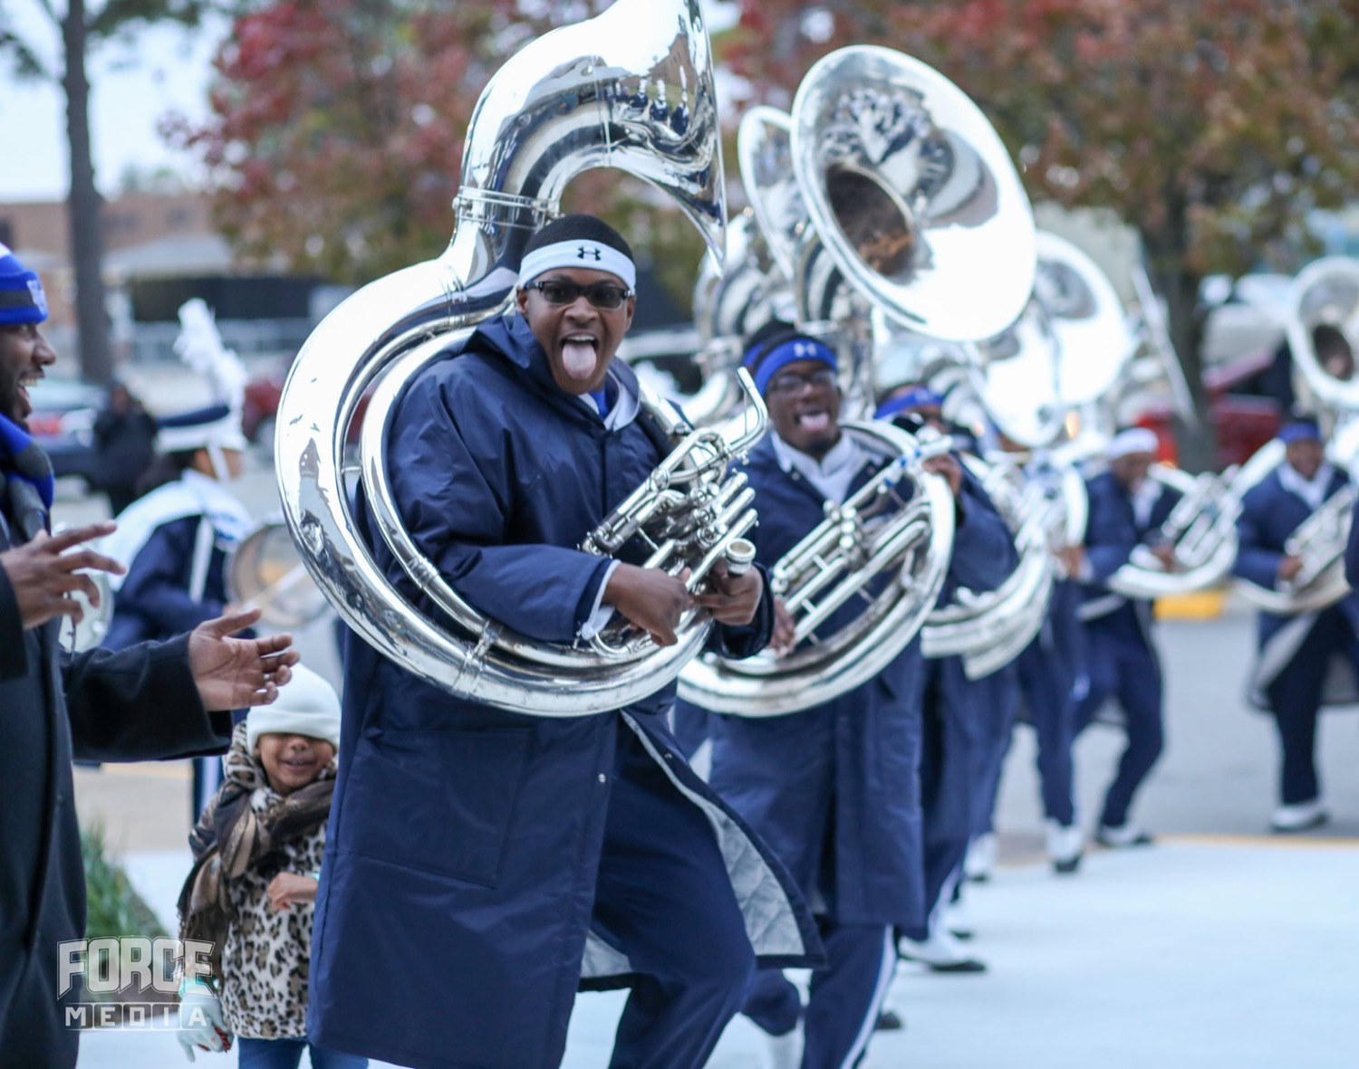
YOUR CHARGE
Own the Scales.
Fix the Spots.
The MSA is the floor, and the sectional is where you build to it. Know your scales cold, hold honest check-offs, and spend your reps on the four bars that are broken—not the ones already clean. Demand the standard, encourage the person, and leave every sectional better than you found it. That is how a section becomes one sound.
Serve First. Lead Always. — Drive the Legacy.
The Hampton University Marching Force
Hampton's Heartbeat
Notes:
SLIDE 13 — CLOSE: Own the Scales. Fix the Spots.
"Know your scales cold, hold honest check-offs, and spend your reps on the four bars that are broken."
End on the sign-off.

