Slide 1

PRE-DRILL CAMP 2026 · LEADERSHIP SEMINARS · DAY 1
The Line
Leader
"Growing the Next Leader, One Rep at a Time"
Dr. Thomas L. Jones, Jr.
Director of University Bands · Winds Breakout, Saturday, August 1, 2026
The Hampton University Marching Force
Hampton's Heartbeat
Notes:
SLIDE 1 — TITLE: The Line Leader
AUDIENCE NOTE: framed for the Winds, but the ladder is the same in every section. Say that early so Percussion and Auxiliary don't tune out.
OPEN: "Nobody gets handed a section and told good luck. This is where leaders get built."

Slide 2

— THE LINE LEADER
THE HAMPTON UNIVERSITY MARCHING FORCE
Icebreaker
Your deepest fear is not that you are weak, but that you are powerful. A great leader steps into that power—and gives everyone on the line permission to do the same.
▶
Coach Carter — “Our Deepest Fear”
youtu.be/2_fDhqRk_Ro
WATCH · 2:29
Pre-Drill Camp 2026 · Leadership Seminars
02
Notes:
SLIDE 2 — ICEBREAKER: Coach Carter, "Our Deepest Fear" (2:29)
SET UP: "Listen to what he says the real fear is."
Play it.
AFTER: "Not that you're weak. That you're powerful. A leader steps into that — and gives everyone on the line permission to do the same."

Slide 3

01
THE PREMISE
No one is handed a section and told good luck. Leaders are built, not born—and every Drum Major, every Captain, every Section Leader started on a single line, learning the basics. The Line Leader is where leadership begins. This session is framed for the Winds, but the structure and the standard apply to every section in the band.
LEADERS ARE BUILT, NOT BORN.
Notes:
SLIDE 3 — THE PREMISE (statement slide)
Read it.
"Every Drum Major, every Captain, every Section Leader started on a single line learning the basics."
Takeaway: "Leaders are built, not born."

Slide 4

— THE LINE LEADER
THE HAMPTON UNIVERSITY MARCHING FORCE
The Leadership Ladder
Before we zoom in, see the whole chain of command—the same in every section.
◆ Director of University Bandsands sets the vision and the standard.
◆ Drum Majorsjors command the field; the Student Director / Graduate Assistant supports the staff.
◆ Hornline Captainsains keep an entire division—Woodwind, High Brass, and Low Brass—sounding and marching as one.
◆ Section Leadersders run each instrument section—and the Line Leaders guard a single line beneath them.
Every tier exists to serve the one below it. We are in the Winds today, but Percussion, Auxiliary, and every section run the same ladder.
Reference: HUMF Student Leadership Positions (2026).
Pre-Drill Camp 2026 · Leadership Seminars
04
Notes:
SLIDE 4 — THE LEADERSHIP LADDER
Show the whole chain before zooming in: Director, Drum Majors, Captains, Section Leaders, Line Leaders.
READ THE CALLOUT: "Every tier exists to serve the one below it." That's the philosophy of the whole program — don't skip it.
NOTE: this ladder matches the chain of command in Sunday's Communication session.

Slide 5
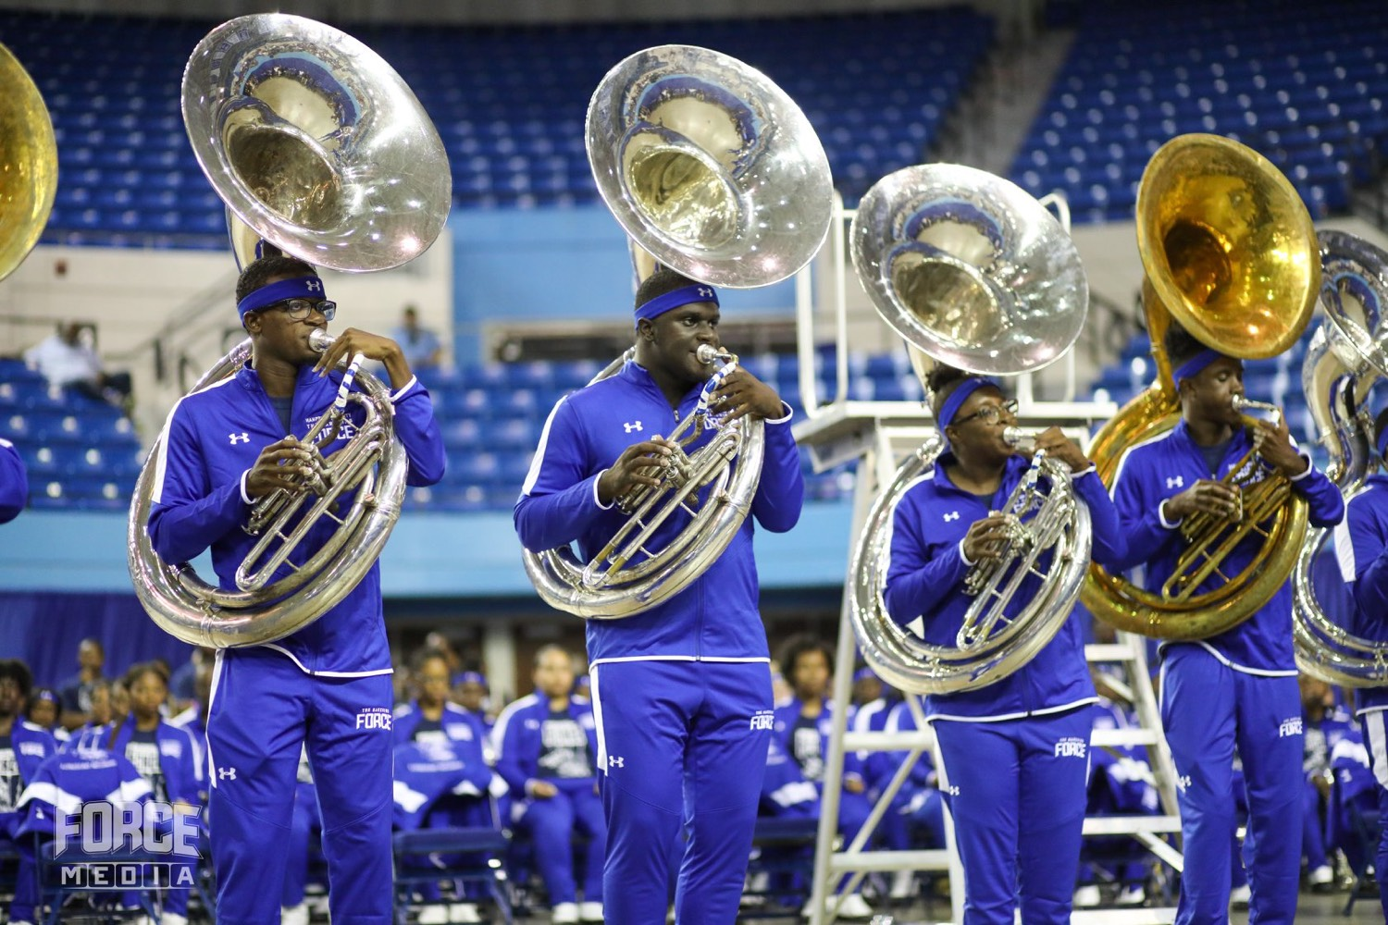
— THE LINE LEADER
THE HAMPTON UNIVERSITY MARCHING FORCE
Where the Line Leader Fits
The first rung—and the doorway to everything above it.
◆ entry tiere entry tier of student leadership, reporting directly to your Section Leader.
◆ pipeline to Section Leaderction Leader—this is where the next one is grown.
◆ open to freshmenfreshmen: the earliest place to start leading, with the grade requirement waived for a freshman's first semester.
◆ training groundu are the training ground for the future of the band.
Pre-Drill Camp 2026 · Leadership Seminars
05
Notes:
SLIDE 5 — WHERE THE LINE LEADER FITS
"First rung, and the doorway to everything above it."
SAY THE ACCESS POINT CLEARLY: "Open to freshmen — the grade requirement is waived for a freshman's first semester." That's the recruiting line for future leaders; make sure the freshmen in the room hear it.
"You're the pipeline to Section Leader. This is where the next one gets grown."

Slide 6

— THE LINE LEADER
THE HAMPTON UNIVERSITY MARCHING FORCE
What a Line Leader Is
The eyes and ears of a single line.
◆ subsection subsection—2nd Trumpets, 3rd Clarinets, a single part within the larger section.
◆ granular, desk-level quality control quality control a Section Leader managing dozens of players cannot reach.
◆ leader-in-trainingn-training: mastering the craft while learning to lead a few before you lead many.
◆ Small scope. Real responsibility.
Pre-Drill Camp 2026 · Leadership Seminars
06
Notes:
SLIDE 6 — WHAT A LINE LEADER IS
"The eyes and ears of a single line — 2nd Trumpets, 3rd Clarinets, one part inside the bigger section."
"You provide the desk-level quality control a Section Leader managing dozens can't reach."
LAND: "Small scope. Real responsibility."

Slide 7

— THE LINE LEADER
THE HAMPTON UNIVERSITY MARCHING FORCE
Two Ways to Lead
Transactional leadership manages the task. Transformational leadership grows the person. The Line Leader is where you start learning the difference.
Sources: Burns, Leadership (1978); Bass, Leadership and Performance Beyond Expectations (1985); Bass and Riggio, Transformational Leadership (2006).
Pre-Drill Camp 2026 · Leadership Seminars
07
Notes:
SLIDE 7 — TWO WAYS TO LEAD
Transactional versus transformational. Read the two columns with different energy.
Transactional: rewards and consequences, tasks and compliance — "keeps the line running, but keeps it the same."
Transformational: example, vision, belief — develops the individual.
ASK: "Which one were you led by last year? Which one do you want to be?"

Slide 8
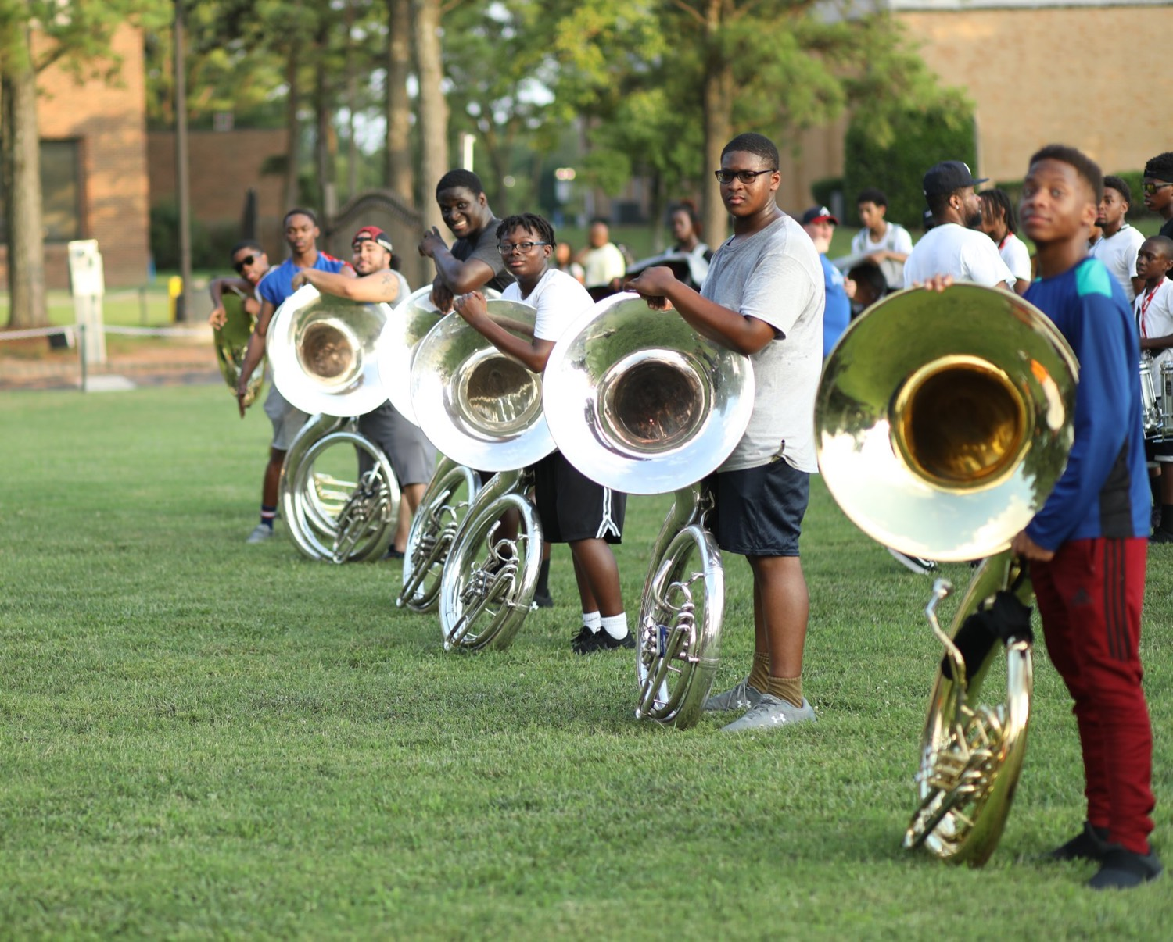
— THE LINE LEADER
THE HAMPTON UNIVERSITY MARCHING FORCE
We Do Not Throw You to the Wolves
Great leaders are grown in stages—never dropped into the deep end.
◆ progressive stages of responsibilitypreparation and you set them up to fail. The research on leadership development is clear: leaders grow through progressive stages of responsibility, not sink-or-swim.
◆ Leadership Pipelineline model frames leadership as a series of passages—each one preparing you for the next. The Line Leader is your first passage.
◆ Situational leadership and scaffolding teach the same lesson: match the challenge to the person's readiness, then raise it as they grow.
◆ confidence and competenceds the confidence and competence to lead more tomorrow.
Sources: Charan, Drotter, and Noel, The Leadership Pipeline (2001); Hersey and Blanchard, situational leadership (1969); Vygotsky, scaffolding and the zone of proximal development (1978); Bandura, self-efficacy (1977).
Pre-Drill Camp 2026 · Leadership Seminars
08
Notes:
SLIDE 8 — WE DO NOT THROW YOU TO THE WOLVES
This is the reassurance slide — a lot of new leaders are quietly nervous.
"Hand somebody a full section with no preparation and you've set them up to fail."
The Leadership Pipeline: leadership as a series of passages, each preparing you for the next.
"Every small win here builds the competence to lead more tomorrow."

Slide 9

— THE LINE LEADER
THE HAMPTON UNIVERSITY MARCHING FORCE
How We Grow Leaders Here
A deliberate ladder from follower to leader—the Force's Scaffolding Model.
◆ Deconstruct—master the fundamentals of your own part first.
◆ Supported Integration—lead small, with your Section Leader close by.
◆ Differentiated Repetition—take on more as you prove ready.
◆ Peer-Led Instruction—teach your line and correct its errors yourself.
◆ Release and Accountability—own your line, and you are ready for the next rung.
Sources: HUMF Scaffolding Instruction Model (Staff Handbook, 2025); Jones, doctoral dissertation, North Carolina A&T State University (2014).
Pre-Drill Camp 2026 · Leadership Seminars
09
Notes:
SLIDE 9 — HOW WE GROW LEADERS HERE
Our Scaffolding Model, five stages: Deconstruct, Supported Integration, Differentiated Repetition, Peer-Led Instruction, Release and Accountability.
CUE: connect it to Teach How to Teach — same logic, applied to growing a leader instead of teaching a skill.

Slide 10

— THE LINE LEADER
THE HAMPTON UNIVERSITY MARCHING FORCE
Make the Section Leader's Job Easier
Your first duty is to carry the basics—so your Section Leader can lead.
1
Own the Basics
Handle the small, granular tasks—attendance spot-checks, part accuracy, folder and equipment counts—so nothing basic ever lands on the Section Leader's desk.
Pre-Drill Camp 2026 · Leadership Seminars
10
Notes:
SLIDE 10 — MAKE THE SECTION LEADER'S JOB EASIER
This is the practical heart. Four: own the basics, catch it early, cut the stress, report up clean.
THE FRAME THAT MATTERS: "Your first duty is to carry the basics so your Section Leader can actually lead."
"Bring clear, early information. Never surprises."

Slide 11
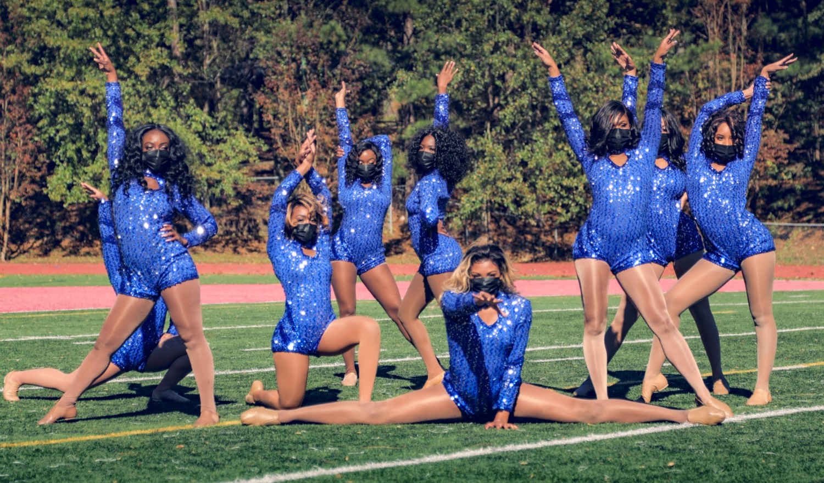
— THE LINE LEADER
THE HAMPTON UNIVERSITY MARCHING FORCE
What You Actually Do
The daily work of leading a line.
◆ accuracy of your linef your line and give immediate, desk-level corrections.
◆ musical resourcee's musical resource—articulations, fingerings, and The Hampton Sound.
◆ first-level facility upkeep upkeep, and account for all sheet music, music folders, and equipment.
◆ Mentor incoming freshmen into the line and the culture.
◆ Surface issues upward to your Section Leader before they escalate.
Pre-Drill Camp 2026 · Leadership Seminars
11
Notes:
SLIDE 11 — WHAT YOU ACTUALLY DO
The daily list. Keep it brisk — it's a job description.
HIGHLIGHT TWO: being the line's musical resource (articulations, fingerings, The Hampton Sound), and mentoring incoming freshmen into the culture.
"Surface issues upward BEFORE they escalate."

Slide 12

— THE LINE LEADER
THE HAMPTON UNIVERSITY MARCHING FORCE
Who Can Lead the Line
The one rule: master your own part first.
◆ Open to freshmen—the grade requirement is waived for a freshman's first semester, so the earliest leaders can start early.
◆ Total mastery of your assigned part—you cannot lead a line you have not mastered.
◆ organizationization and steady progress toward your degree.
◆ desire to growto grow into more.
Reference: HUMF Student Leadership Positions (2026).
Pre-Drill Camp 2026 · Leadership Seminars
12
Notes:
SLIDE 12 — WHO CAN LEAD THE LINE
"The one rule: master your own part first. You cannot lead a line you haven't mastered."
Repeat the freshman waiver — some of them still won't have registered it.

Slide 13

— THE LINE LEADER
THE HAMPTON UNIVERSITY MARCHING FORCE
Your Path Forward
Everything you do now is training for what comes next.
◆ Section Leadere, and the Section Leader role is the next rung.
◆ repry correction you give, every freshman you mentor, and every folder you account for is a rep—building the leader you are becoming.
◆ The basics you drill today are the foundation you will lead from tomorrow.
◆ The pipeline runs through you.
Pre-Drill Camp 2026 · Leadership Seminars
13
Notes:
SLIDE 13 — YOUR PATH FORWARD
"Everything you do now is training for what comes next."
LAND: "Every correction you give, every freshman you mentor, every folder you account for is a rep — building the leader you're becoming. The pipeline runs through you."

Slide 14

YOUR CHARGE
Master the Basics.
Earn the Line.
You are the first rung and the training ground—the place where the band's next leaders are grown, one rep at a time. Carry the basics so your Section Leader can lead, master your line, and mentor the one coming up behind you. Do that, and the next rung is yours. The pipeline runs through you.
Serve First. Lead Always. — Drive the Legacy.
The Hampton University Marching Force
Hampton's Heartbeat
Notes:
SLIDE 14 — CLOSE: Master the Basics. Earn the Line.
"Carry the basics so your Section Leader can lead, master your line, and mentor the ones behind you."
End on the sign-off.

