Slide 1

PRE-DRILL CAMP 2026 · LEADERSHIP SEMINARS · DAY 1
Why Hazing
Happens
"Understand It. Recognize It. End It."
Dr. Thomas L. Jones, Jr.
Director of University Bands · Saturday, August 1, 2026
The Hampton University Marching Force
Hampton's Heartbeat
Notes:
SLIDE 1 — TITLE: Why Hazing Happens
THE MOST IMPORTANT SESSION OF THE WEEKEND. Your tone here sets whether they take it seriously or wait it out.
OPEN PLAINLY: "We're not going to lecture you about rules for an hour. We're going to explain why this happens — because you can't stop something you don't understand."
NOTE: this is built on your dissertation and Beyond the Bruises. Say that.

Slide 2

— WHY HAZING HAPPENS
THE HAMPTON UNIVERSITY MARCHING FORCE
Icebreaker
Spike Lee's look at the pledge process at a Black college. As you watch, ask yourself: why do people endure it—and who has the power to stop it?
▶
School Daze — “One Reason Why Not”
youtu.be/VKFHCBGxCyU
WATCH · 2:19
Pre-Drill Camp 2026 · Leadership Seminars
02
Notes:
SLIDE 2 — ICEBREAKER: School Daze, "One Reason Why Not" (2:19)
SET UP: "Spike Lee, looking at the pledge process at a Black college. As you watch, ask yourself two things: why do people endure it, and who had the power to stop it?"
Play it.
AFTER: hold the two questions. Take answers on the second one especially — "who had the power?" That's them.

Slide 3

01
THE PREMISE
No one joins The Marching Force to be broken. They come for the music, the family, and the legacy. Hazing takes that hope and turns it into fear—and it almost never starts with a monster. It starts with ordinary people, a real need to belong, and a room where no one says stop. To end it, you first have to understand exactly how it takes root.
UNDERSTAND IT TO END IT.
Notes:
SLIDE 3 — THE PREMISE (statement slide)
Read it.
Takeaway: "Understand it to end it."

Slide 4

— WHY HAZING HAPPENS
THE HAMPTON UNIVERSITY MARCHING FORCE
Hazing Is a Culture Problem
And a culture problem is, at its root, a leadership problem.
◆ Rules alone have never stopped hazing. Every program that lost a student had a policy against it. Prohibition punishes what already happened—it does not change what people believe.
◆ hazing is a culture problem, and culture is a leadership problem.oblem, and culture is a leadership problem. Change the culture and you change the behavior at its source.
◆ peer leaderset by the people members actually watch and follow—their peer leaders. That is you. What you permit, you promote; what you model, you multiply.
“People raised on love will do anything for you, but people raised on survival will do anything to you.” — Najee Rayne, quoted in Jones, Beyond the Bruises (2024)
Sources: Jones, doctoral dissertation, North Carolina A&T State University (2014); Jones, Beyond the Bruises (2024), quoting Najee Rayne.
Pre-Drill Camp 2026 · Leadership Seminars
04
Notes:
SLIDE 4 — HAZING IS A CULTURE PROBLEM
"And a culture problem is, at its root, a leadership problem."
THE KEY MOVE: "Rules alone have never stopped hazing. Every program that lost a student had a policy against it."
"Culture is set by the people members actually watch and follow — their peer leaders. That's you. What you permit, you promote."

Slide 5

— WHY HAZING HAPPENS
THE HAMPTON UNIVERSITY MARCHING FORCE
What Hazing Actually Is
Strip away the euphemisms—“tradition,” “initiation,” “paying dues.”
◆ any activity expected of someone joining or staying in a group that humiliates, degrades, or endangers themngers them—regardless of their willingness. Virginia law (Code § 18.2-56) makes it a crime, and consent is not a defense.
◆ rigorous training, high expectations, and demanding standards are not hazing. Humiliation, exploitation, and abuse are never training.tion, and abuse are never training.
◆ hazing by omissionuieter forms—hazing by omission (withholding help or information to control new members) and the normalization of harm (“it's tradition,” “it's what made me”).
◆ complicitye is not neutral: knowing and failing to report is complicity.
Sources: Virginia Code § 18.2-56; HUMF Revised Anti-Hazing Policy (2026); Jones (2014).
Pre-Drill Camp 2026 · Leadership Seminars
05
Notes:
SLIDE 5 — WHAT HAZING ACTUALLY IS
Strip the euphemisms out loud: tradition, initiation, paying dues.
Give the working definition and make sure they hear that CONSENT DOESN'T MATTER — willingness doesn't make it not hazing.

Slide 6
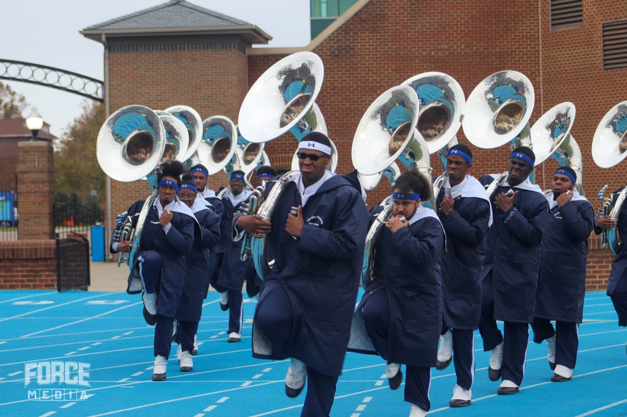
— WHY HAZING HAPPENS
THE HAMPTON UNIVERSITY MARCHING FORCE
The Hidden Scale
It is far more common—and far more invisible—than people think.
If almost no one names it and almost no one reports it, then silence—not cruelty—is what keeps hazing alive. Leaders are the ones who can break the silence.
Source: Allan and Madden, Hazing in View: College Students at Risk, National Study of Student Hazing, University of Maine (2008), n = 11,482 students across 53 campuses.
Pre-Drill Camp 2026 · Leadership Seminars
06
Notes:
SLIDE 6 — THE HIDDEN SCALE
The numbers. Let them be uncomfortable.
THE POINT: most students who are hazed don't label it hazing, and almost none report it. "That's why it stays invisible."

Slide 7

— WHY HAZING HAPPENS
THE HAMPTON UNIVERSITY MARCHING FORCE
It Starts With a Real Need
To understand hazing, start with something good: the human need to belong.
◆ fundamental human drivetal human drive—psychologists rank it alongside food and safety. Every new member walks in wanting to be part of something.
◆ love and belongingced love and belonging at the center of human motivation: once we are fed and safe, we reach for acceptance and connection.
◆ hijacks a healthy need problem. It is the fuel. Hazing works precisely because it hijacks a healthy need and charges a cruel price for it.
◆ Meet the need the right way, and no one ever pays the wrong price for it.
Sources: Baumeister and Leary, "The Need to Belong," Psychological Bulletin (1995); Maslow, "A Theory of Human Motivation," Psychological Review (1943).
Pre-Drill Camp 2026 · Leadership Seminars
07
Notes:
SLIDE 7 — IT STARTS WITH A REAL NEED
The pivot that makes this session work. "To understand hazing, start with something GOOD — the human need to belong."
"Nobody joins a band wanting to be humiliated. They join wanting to be part of something."

Slide 8

— WHY HAZING HAPPENS
THE HAMPTON UNIVERSITY MARCHING FORCE
Belonging, Turned Cruel
How a good need gets weaponized into a rite of suffering.
◆ sacrificestinctively want proof of commitment. The more someone sacrifices to get in, the more “serious” their membership feels to everyone watching.
◆ Researchers describe hazing as a way groups test loyalty—screening out the uncommitted and binding in those who endure. The logic feels ancient and automatic.
◆ suffering is a fatal confusion here: groups mistake suffering for commitment. Pain is easy to inflict and easy to measure—so it becomes the lazy shortcut for proving devotion.
◆ Real commitment is built through shared work and trust, not through who can take the most abuse.
Sources: Cimino, "The Evolution of Hazing," Journal of Cognition and Culture (2011); Keating et al., "Going to College and Unpacking Hazing," Group Dynamics (2005).
Pre-Drill Camp 2026 · Leadership Seminars
08
Notes:
SLIDE 8 — BELONGING, TURNED CRUEL
How the good need gets weaponized into a rite of suffering.
The promise is real — the method is the corruption.

Slide 9

— WHY HAZING HAPPENS
THE HAMPTON UNIVERSITY MARCHING FORCE
“I Suffered, So You Will”
The mind's oldest trap—and the engine that keeps hazing running.
◆ severe, embarrassing initiationwho endured a severe, embarrassing initiation to join a group rated that group as more valuable than those who joined easily.
◆ cognitive dissonanceive dissonance: “I went through all of that, so it must have been worth it.” The mind justifies the pain by inflating the prize.
◆ “I went through it, so you will too.”st line in hazing: “I went through it, so you will too.” Yesterday's victim becomes today's enforcer—not because they are evil, but because admitting it was pointless is too painful.
◆ Naming this out loud is how you break the chain: the suffering did not make it worth it. It never does.
Sources: Aronson and Mills, "The Effect of Severity of Initiation on Liking for a Group," Journal of Abnormal and Social Psychology (1959); Festinger, A Theory of Cognitive Dissonance (1957).
Pre-Drill Camp 2026 · Leadership Seminars
09
Notes:
SLIDE 9 — "I SUFFERED, SO YOU WILL"
The engine. Effort justification and cognitive dissonance in plain words:
"If I went through something painful to get here, my mind has to decide it was worth it. So I defend it. And then I do it to the next person to prove it meant something."
THE LINE: "That's not tradition. That's a mind protecting itself from admitting it was hurt for nothing."

Slide 10
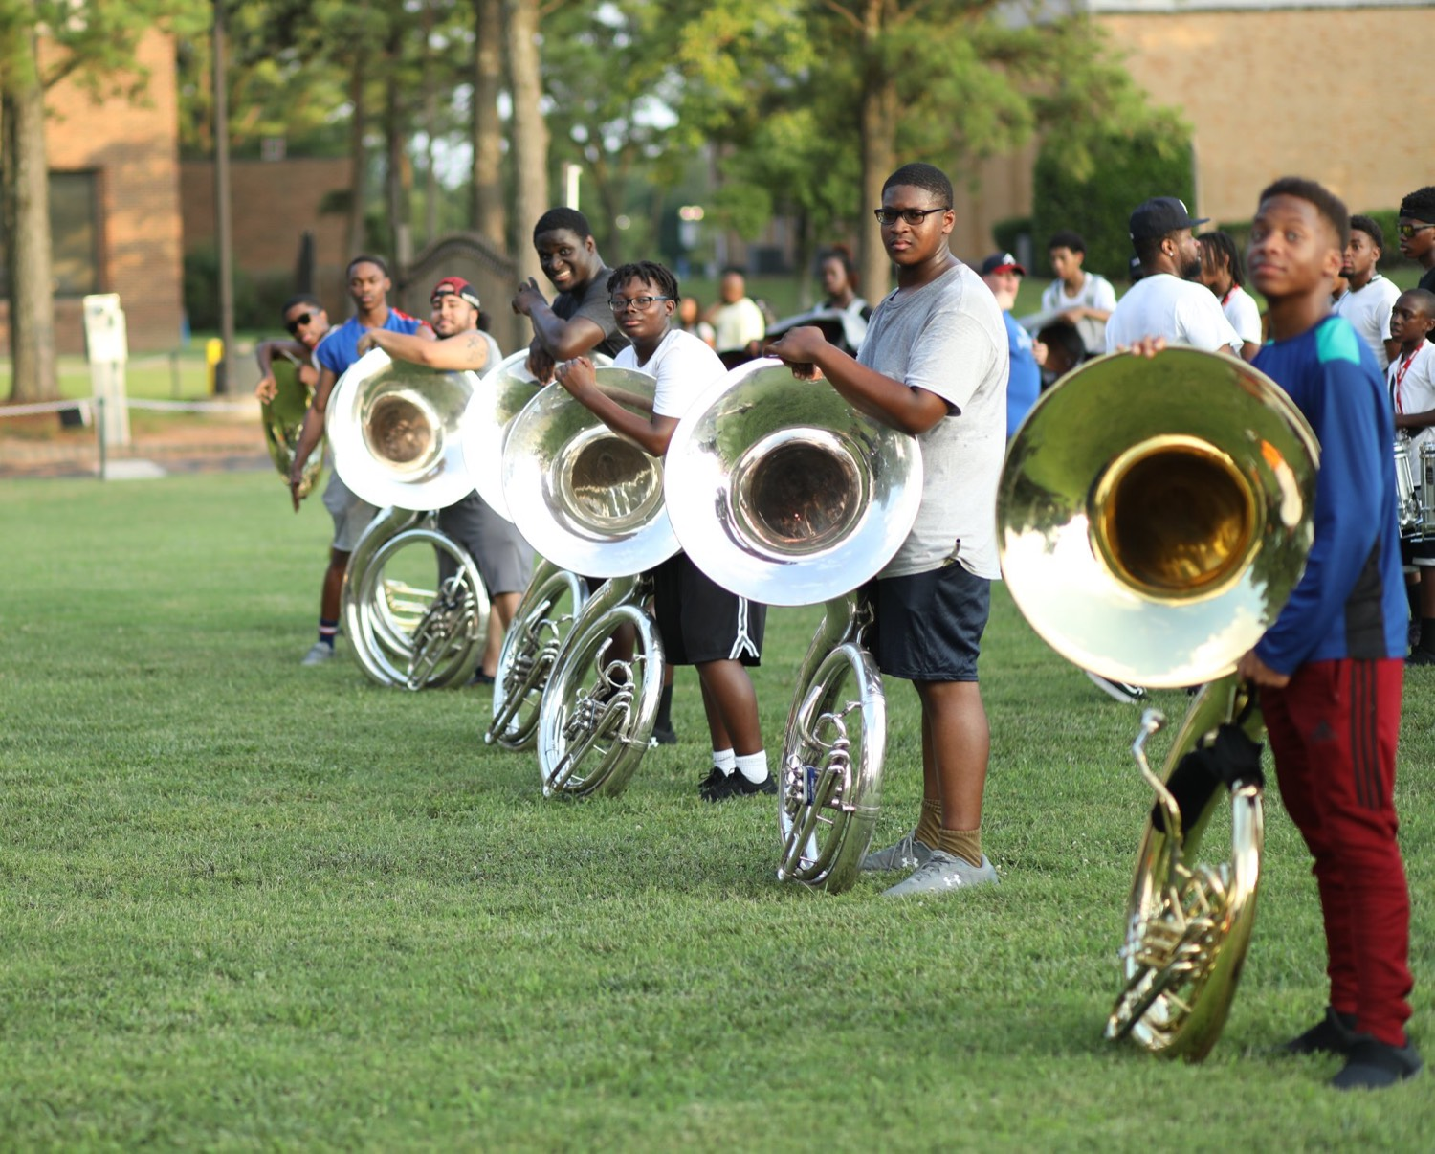
— WHY HAZING HAPPENS
THE HAMPTON UNIVERSITY MARCHING FORCE
The Bonding Myth
“It brings us closer together.” The evidence says the opposite.
◆ builds unityne excuse for hazing is that it builds unity. It is the myth that keeps good people participating.
◆ notn researchers actually measured it, hazing did not produce real cohesion. Groups bonded by shared positive experiences were closer than groups bonded by shared abuse.
◆ compliance and silencecompliance and silence—people who are quiet out of fear, not loyal out of love. It also breeds resentment that surfaces for years.
◆ If the “bonding” only works through fear and humiliation, it is not bonding. It is control wearing a team jersey.
Sources: Keating et al., Group Dynamics (2005); Van Raalte et al., "The Relationship Between Hazing and Team Cohesion," Journal of Sport Behavior (2007); Lodewijkx and Syroit, "Severity of Initiation Revisited," Journal of Social Behavior and Personality (1997).
Pre-Drill Camp 2026 · Leadership Seminars
10
Notes:
SLIDE 10 — THE BONDING MYTH
Head-on: "'It brings us closer.' The evidence says the opposite."
Hazing produces compliance and resentment, not cohesion. Shared hard WORK bonds people. Shared humiliation does not.

Slide 11

— WHY HAZING HAPPENS
THE HAMPTON UNIVERSITY MARCHING FORCE
The Power of the Group
Why smart, kind people go along with things they know are wrong.
◆ deny what is right in front of their eyes what is right in front of their eyes to agree with a group—even on something as obvious as the length of a line.
◆ We are wired to read the room and follow it. When “everybody's doing it,” the brain treats the behavior as normal, even when it is clearly harmful.
◆ peer leader influence is the most powerful driver of behavior there is peer leader influence is the most powerful driver of behavior there is. The line follows its leaders.
◆ one voicehe whole opportunity. Be the one voice that makes it safe for everyone else to say what they already know.
Sources: Asch, "Opinions and Social Pressure," Scientific American (1955); Jones, dissertation, North Carolina A&T State University (2014).
Pre-Drill Camp 2026 · Leadership Seminars
11
Notes:
SLIDE 11 — THE POWER OF THE GROUP
Why smart, kind people go along.
Conformity, obedience to authority, and the fear of being the one who breaks ranks.
"Nobody in that room individually wanted it. Collectively they allowed it."

Slide 12

— WHY HAZING HAPPENS
THE HAMPTON UNIVERSITY MARCHING FORCE
When No One Steps In
The bystander effect—the reason a whole room can watch and do nothing.
◆ more peopleLatané found that the more people who witness something wrong, the less likely any one of them is to act. Everyone assumes someone else will.
◆ Responsibility gets divided until it disappears. “It wasn't my place,” “I figured a leader would handle it,” “I didn't want to make it weird.”
◆ Hazing thrives in exactly that gap—a crowd of decent people, each waiting for another to be the first to say enough.
◆ if you see it, it is your place. You are the one.ee it, it is your place. You are the one.
Sources: Darley and Latané, "Bystander Intervention in Emergencies," Journal of Personality and Social Psychology (1968); Latané and Darley, The Unresponsive Bystander (1970).
Pre-Drill Camp 2026 · Leadership Seminars
12
Notes:
SLIDE 12 — WHEN NO ONE STEPS IN
The bystander effect. "The more people watching, the less likely any one of them acts. Everyone assumes somebody else will."
THE ANTIDOTE: "Diffusion of responsibility dies the moment one person is specifically responsible. Tonight, that's each of you."

Slide 13

— WHY HAZING HAPPENS
THE HAMPTON UNIVERSITY MARCHING FORCE
Losing Yourself in the Crowd
How groups do things no single member ever would alone.
◆ Deindividuation: inside a group, people feel anonymous and stop feeling personally responsible. “It was the line, not me.” The crowd becomes a place to hide.
◆ Groupthink: a tight group that prizes agreement will silence its own doubts, ignore consequences, and convince itself that obvious wrongs are fine.
◆ Give ordinary people a role, a uniform, and power over others with no accountability, and cruelty can drift in quietly—the warning the Stanford Prison study dramatized.
◆ counter-programmingis deliberate counter-programming: open dialogue and psychological safety, so doubt has somewhere to go besides silence.
Sources: Festinger, Pepitone, and Newcomb, "Some Consequences of De-Individuation," Journal of Abnormal and Social Psychology (1952); Janis, Victims of Groupthink (1972); Jones (2014).
Pre-Drill Camp 2026 · Leadership Seminars
13
Notes:
SLIDE 13 — LOSING YOURSELF IN THE CROWD
Deindividuation — anonymity in a group lowers personal accountability.
"Groups do things no single member would ever do alone."

Slide 14

— WHY HAZING HAPPENS
THE HAMPTON UNIVERSITY MARCHING FORCE
The Cycle That Feeds Itself
Put the pieces together and you see a machine—one that runs on its own.
◆ needs to belongeds to belong. The group demands suffering as the price. The member endures, and the mind decides it must have been worth it.
◆ A year later, that same member enforces the ritual—to protect the meaning of their own pain, and because the crowd expects it.
◆ Each cycle, the tradition feels more sacred and the silence grows deeper. No villain is required. The machine runs on ordinary needs and ordinary fear.
◆ broken on purpose broken on purpose. It will not stop on its own—and one leader, in one moment, is usually where it breaks.
Sources: Nuwer, Hazing: Destroying Young Lives (2018); Cimino, "The Evolution of Hazing," Journal of Cognition and Culture (2011).
Pre-Drill Camp 2026 · Leadership Seminars
14
Notes:
SLIDE 14 — THE CYCLE THAT FEEDS ITSELF
Put the pieces together: need to belong, suffering, justification, silence, repetition.
"It's a machine. It runs on its own once it starts — which is exactly why it has to be stopped before it starts."

Slide 15
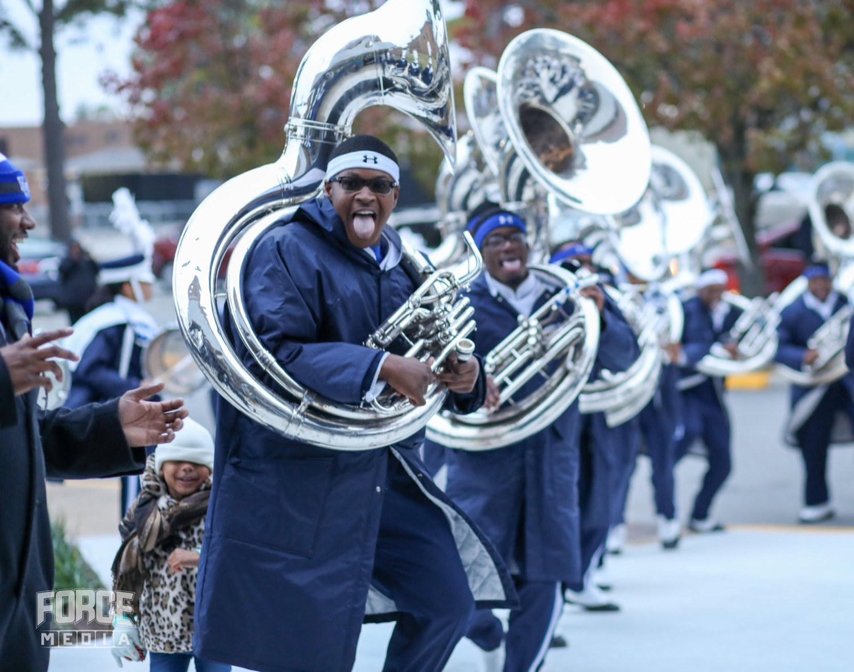
— WHY HAZING HAPPENS
THE HAMPTON UNIVERSITY MARCHING FORCE
A Hard Lesson: Robert Champion
Not a distant story. It happened to a marching band like ours—and it was a leadership failure.
◆ Robert Champion, a 26-year-old drum major26-year-old drum major in Florida A&M University's famed Marching 100, died after a hazing ritual aboard a band bus following a game in Orlando.
◆ homicidecal examiner ruled it a homicide—he died of internal bleeding from blunt-force trauma. By every account, Champion had opposed hazing.
◆ failure of culture and leadershipged, the celebrated band was suspended, and its director departed—studied afterward as a failure of culture and leadership, not merely a conduct violation.
Sources: Orange County (FL) Medical Examiner ruling (2011); State of Florida v. band members, Ninth Judicial Circuit (2012–2015); Nuwer, Hazing: Destroying Young Lives (2018).
Pre-Drill Camp 2026 · Leadership Seminars
15
Notes:
SLIDE 15 — A HARD LESSON: ROBERT CHAMPION
STOP. Change your tone completely. This slide has his photograph on it.
Tell it accurately and without sensationalism: a drum major, beaten to death on a band bus in 2011. Criminal convictions. A program shut down.
SAY IT CLEARLY: "That was a marching band like ours. It was a leadership failure — not a freak accident."
Do not rush. Let the room sit with it. Silence is appropriate here.

Slide 16

— WHY HAZING HAPPENS
THE HAMPTON UNIVERSITY MARCHING FORCE
The Real Cost
Hazing is not a prank that went too far. It is a crime with a body count.
◆ Human: death, lasting injury, trauma, and students who quit the thing they loved. There has been at least one reported hazing death nearly every year for decades.
◆ Legal: hazing is a crime. In Virginia it is prosecutable under Code § 18.2-56, and consent is not a defense. Nearly every state now has an anti-hazing law.
◆ Federal: the Stop Campus Hazing Act now requires colleges to publicly report hazing incidents. There is nowhere left for it to hide.
◆ Institutional: a single incident can suspend a program, end careers, trigger lawsuits, and stain a legacy built over decades. One night can undo a hundred years.
Sources: Virginia Code § 18.2-56; Stop Campus Hazing Act, Public Law 118-173 (2024); Nuwer hazing death record, StopHazing.org.
Pre-Drill Camp 2026 · Leadership Seminars
16
Notes:
SLIDE 16 — THE REAL COST
"Hazing is not a prank that went too far. It is a crime with a body count."
Deaths, felony charges, expulsions, lawsuits, programs shut down.
MAKE IT PERSONAL AND LEGAL: they are adults and will be charged as adults. So will bystanders.

Slide 17

— WHY HAZING HAPPENS
THE HAMPTON UNIVERSITY MARCHING FORCE
The Antidote Is Proven
This is not a theory. It was studied in a band like ours—and it worked.
◆ servant-leadershiptation examined how servant-leadership was built into an HBCU marching band (the Blue and Gold Marching Machine at North Carolina A&T). The result: hazing declined while excellence deepened.
◆ rigorous, respectful rites of passagerespectful rites of passage—hard because excellence is hard, never because harm was intended.
◆ peer leader influence, trained ethicallynfluence, trained ethically—the “linking pin” leaders who bridge the staff and the members and set the culture day to day.
◆ serve the growth and safetyocumented opposite of hazing: authority that exists to serve the growth and safety of members, never to control or initiate them.
Sources: Jones, doctoral dissertation, North Carolina A&T State University (2014); Greenleaf, The Servant as Leader (1970); see the Servant-Leadership seminar.
Pre-Drill Camp 2026 · Leadership Seminars
17
Notes:
SLIDE 17 — THE ANTIDOTE IS PROVEN
Turn the corner from fear to hope — this is the point of the whole session.
"This isn't theory. It was studied in a band like ours, and it worked."
Servant-leadership as a documented approach to preventing hazing — your own research.

Slide 18

— WHY HAZING HAPPENS
THE HAMPTON UNIVERSITY MARCHING FORCE
The “Is This Hazing?” Test
When you are unsure, run the activity through four questions.
◆ in front of a parent, a university administrator, or on public videodministrator, or on public video?
◆ veterans have not doneasked to do something veterans have not done or are unwilling to do?
◆ defend the merit of this activity in courtof this activity in court?
◆ affirm the dignity, growth, and safety growth, and safety of every participant?
The decision rule: if any one of these questions produces doubt—do not proceed.
Source: HUMF Anti-Hazing Decision Framework, adapted from Jones (2014).
Pre-Drill Camp 2026 · Leadership Seminars
18
Notes:
SLIDE 18 — THE "IS THIS HAZING?" TEST
The practical tool. Walk the four questions.
TELL THEM TO SCREENSHOT IT: "When you're unsure at eleven at night in a dorm hallway, run the activity through these four."

Slide 19

— WHY HAZING HAPPENS
THE HAMPTON UNIVERSITY MARCHING FORCE
The Non-Negotiables
Most of this seminar helps you think. These four do not require thought—they are bright lines.
◆ No physical contact and no excessive physical punishment. No hitting, no paddling, no “smoke sessions.” Conditioning is the staff's job, never a leader's weapon.
◆ No off-campus activities. Band business happens on campus, in approved spaces. Nothing that matters to the section happens at an apartment or across town.
◆ No drugs and no alcohol. Not at any band function, not tied to membership, and never as a price of belonging.
◆ No activities outside approved operational hours. If it is not on the staff-approved schedule, it does not happen. Unsanctioned late-night sectionals are where hazing lives.
Break one of these and you are risking your place in this band—and possibly a courtroom. There is no version of the story where crossing these lines ends well. Do not test them.
Source: Director's Non-Negotiables, HUMF Revised Anti-Hazing Policy (2026), retained prohibitions.
Pre-Drill Camp 2026 · Leadership Seminars
19
Notes:
SLIDE 19 — THE NON-NEGOTIABLES
Slow and flat. No discussion on this slide.
"Most of this seminar helps you think. These four don't require thought. They're bright lines."
Read each one and pause after it.

Slide 20

— WHY HAZING HAPPENS
THE HAMPTON UNIVERSITY MARCHING FORCE
Build Belonging the Right Way
Every rite of passage we keep must pass four tests.
1
Transparent
Every activity is disclosed to participants and staff in advance. Nothing about belonging here happens in the dark.
Source: HUMF Rites-of-Passage Redesign criteria; Jones (2014).
Pre-Drill Camp 2026 · Leadership Seminars
20
Notes:
SLIDE 20 — BUILD BELONGING THE RIGHT WAY
Give them the alternative — you can't just take something away.
Every rite of passage we keep has to pass four tests.
"Real belonging never requires cruelty. That's the whole promise of The Marching Force."

Slide 21
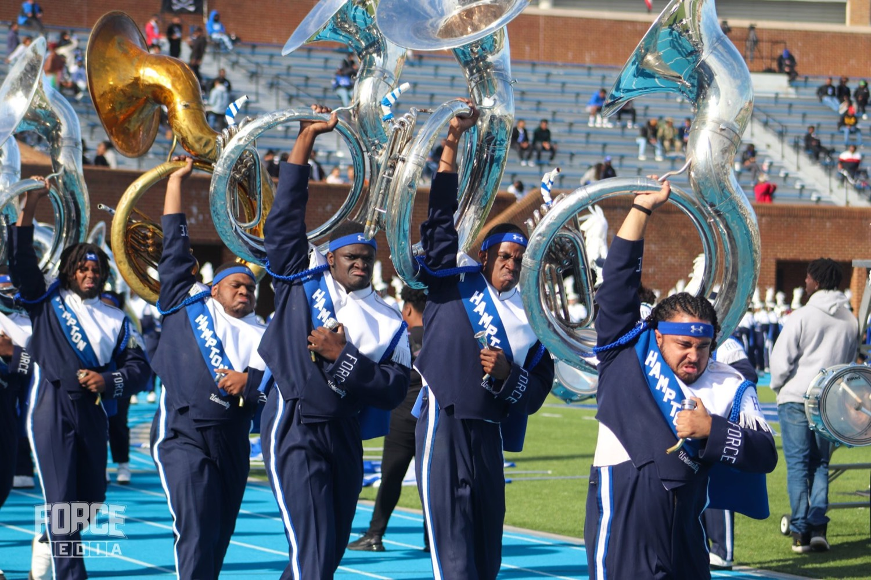
— WHY HAZING HAPPENS
THE HAMPTON UNIVERSITY MARCHING FORCE
Recognize. Refuse. Report.
When the machine starts up, one leader can stop it. That leader is you.
1
Recognize
Name it early, before it escalates. You now know the signs and the science. Trust that knowledge the moment something feels off.
Pre-Drill Camp 2026 · Leadership Seminars
21
Notes:
SLIDE 21 — RECOGNIZE. REFUSE. REPORT.
The action slide.
"When the machine starts up, one leader can stop it. That leader is you."
BE SPECIFIC ABOUT REPORTING: who to tell, how fast. Say your own name and how to reach you.
"Silence is complicity. There is no neutral."

Slide 22

02
OUR COVENANT
In The Marching Force, no one earns their place through humiliation, and no one proves their love through pain. We build belonging the honest way—through work, welcome, and service—and we protect every member who walks through our door as if the whole legacy depends on it. Because it does. Not on my watch, not in my section, not in this band.
NOT ON MY WATCH.
Notes:
SLIDE 22 — OUR COVENANT (statement slide)
Read it as an oath, not information.
Takeaway: "Not on my watch."
Consider having the room say it together. It's the one moment in the weekend where that's warranted.

Slide 23

YOUR CHARGE
Break the Cycle.
Guard the Family.
You understand it now—the need it hijacks, the mind's trap, the power of the crowd, and the cost when no one stops it. That understanding is a responsibility. Build belonging the right way, refuse the counterfeit in every form, and be the one voice that says enough. The cycle breaks where a leader decides it will. Let it break with you.
Serve First. Lead Always. — Drive the Legacy.
The Hampton University Marching Force
Hampton's Heartbeat
Notes:
SLIDE 23 — CLOSE: Break the Cycle. Guard the Family.
Deliver standing.
End on the sign-off — and then be available. Some members will want to talk to you privately after this session. Build in the time and do not leave immediately.

