Slide 1
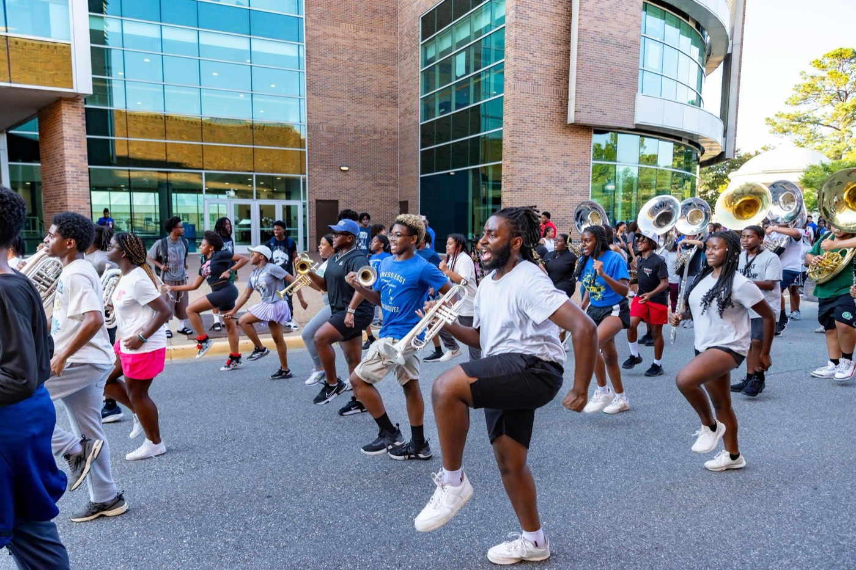
PRE-DRILL CAMP 2026 · LEADERSHIP SEMINARS · DAY 1
Bonds,
Not Fear
"Lead the Culture Without Intimidation"
Dr. Thomas L. Jones, Jr.
Director of University Bands · Saturday, August 1, 2026
The Hampton University Marching Force
Hampton's Heartbeat
Notes:
SLIDE 1 — TITLE: Bonds, Not Fear
SAY: "You can rule a section by fear or lead it by connection. Both work in the short run. Only one of them is still working in October."
CUE: This session sits right next to the hazing session. Signal that now.

Slide 2
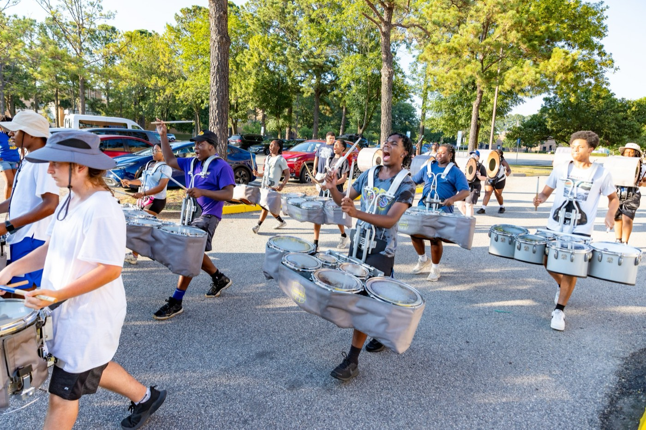
— BONDS, NOT FEAR
THE HAMPTON UNIVERSITY MARCHING FORCE
Icebreaker
This is what a section sounds like when it moves as one—built on brotherhood, not fear.
▶
Remember the Titans — “Left Side, Strong Side”
youtu.be/-AWtpFqKD-o
WATCH · 1:39
Pre-Drill Camp 2026 · Leadership Seminars
02
Notes:
SLIDE 2 — ICEBREAKER: Remember the Titans, "Left Side, Strong Side" (1:39)
SET UP: "Listen to what they built — and notice nobody made them do it."
Play it.
AFTER: "That's what a section sounds like when it moves as one. That came from brotherhood, not fear."

Slide 3

01
THE PREMISE
You can rule a section by fear or lead it by connection—but only one of them lasts. Fear buys you a quiet room today and an empty one tomorrow. Bonds build a section that trusts you, protects one another, and gives you everything they have—not because they are afraid of you, but because they belong to something with you.
BONDS OUTLAST FEAR.
Notes:
SLIDE 3 — THE PREMISE (statement slide)
Read it.
THE LINE: "Fear buys you a quiet room today and an empty one tomorrow."
Takeaway: "Bonds outlast fear."

Slide 4
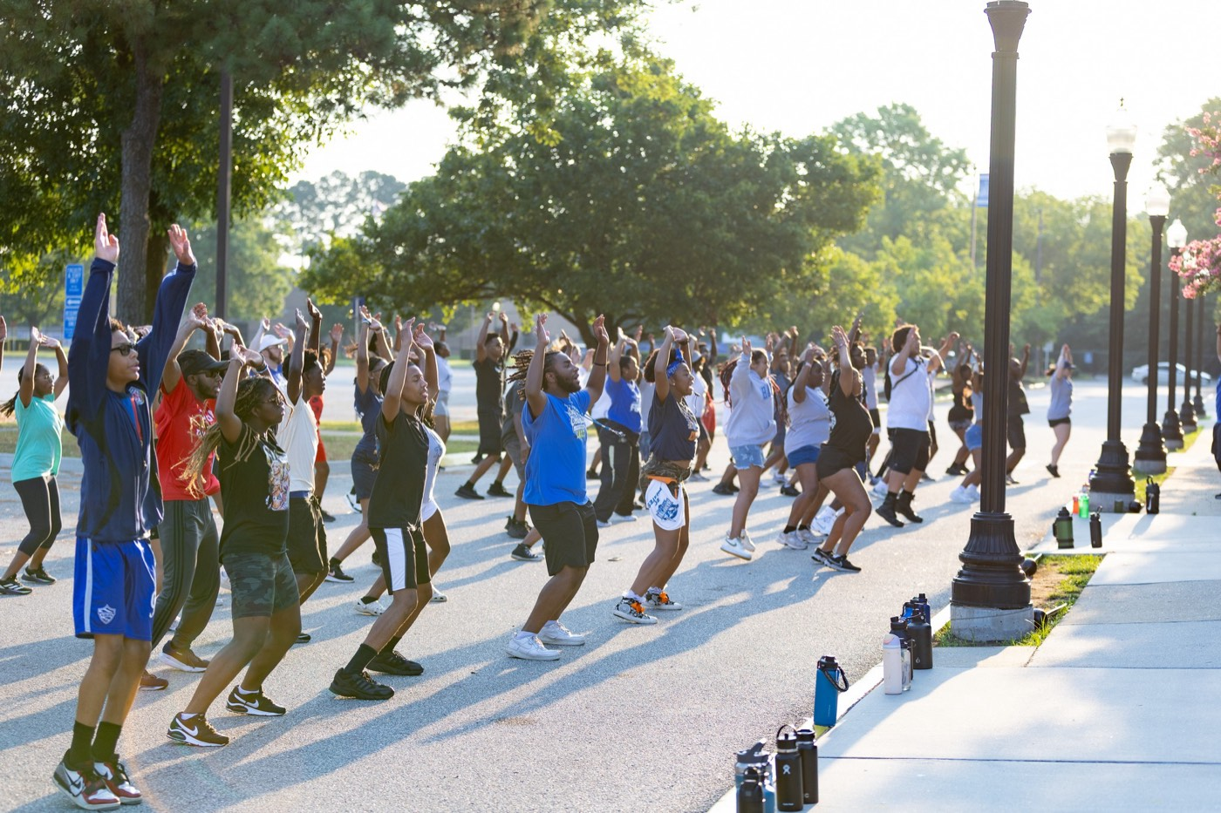
— BONDS, NOT FEAR
THE HAMPTON UNIVERSITY MARCHING FORCE
The Fear Trap
Fear is the easiest tool to reach for—and the weakest one you own.
◆ compliance, not commitmentnot commitment. People do the minimum to stay out of trouble, and nothing more.
◆ silenthtened section goes silent—members hide mistakes, stop asking questions, and stop bringing you problems.
◆ no creativity, no risk, no growtho survival mode: no creativity, no risk, no growth. Scared people shrink.
◆ hazingar is the seed of hazing—a culture that makes people suffer to belong will eventually make them leave.
Sources: Zak, "The Neuroscience of Trust" (Harvard Business Review, 2017); LeDoux, The Emotional Brain (1996).
Pre-Drill Camp 2026 · Leadership Seminars
04
Notes:
SLIDE 4 — THE FEAR TRAP
Walk the four costs of fear: compliance not commitment, silence, survival mode, and the seed of hazing.
HIT THE SECOND ONE: "A frightened section hides mistakes and stops bringing you problems." Ask: "How do you fix a problem you never hear about?"
Flag the fourth bullet — it's the bridge to the hazing session.

Slide 5

— BONDS, NOT FEAR
THE HAMPTON UNIVERSITY MARCHING FORCE
A Warning: How Good People Turn Cruel
The Stanford Prison Experiment—what a fear-and-power culture does to the ones in charge.
◆ In 1971, Stanford researchers randomly assigned students to be “guards” or “prisoners” in a mock prison. Within days, the ordinary students playing guards grew controlling and cruel, and the study was shut down early.
◆ power over othersthat the guards were bad people. It is that a system built on power over others and fear can bring out the worst in almost anyone—including you.
◆ Hand a leader authority with no accountability, and the same drift can start: small cruelties, excused by “the role,” that grow into hazing.
◆ culturedy has since been criticized as more staged than scientific—but the warning it dramatized is real, and the safeguard is culture: build bonds, never a license to demean.
Sources: Haney, Banks, and Zimbardo, "Interpersonal Dynamics in a Simulated Prison" (1973); Zimbardo, The Lucifer Effect (2007); Le Texier, "Debunking the Stanford Prison Experiment," American Psychologist (2019).
Pre-Drill Camp 2026 · Leadership Seminars
05
Notes:
SLIDE 5 — A WARNING: HOW GOOD PEOPLE TURN CRUEL
Tell the Stanford Prison Experiment briefly — students randomly assigned as guards and prisoners, ordinary people drifting into cruelty within days.
BE ACCURATE, and say the caveat on the slide out loud: the study has since been criticized as more staged than scientific. Don't oversell it.
THE POINT THAT SURVIVES THE CRITICISM: "Authority without accountability lets small cruelties get excused by the role. That drift is real, and culture is the safeguard."

Slide 6

— BONDS, NOT FEAR
THE HAMPTON UNIVERSITY MARCHING FORCE
Safe People Rise
The most effective teams are not the most feared—they are the safest.
◆ Amy Edmondson Edmondson named it psychological safety: the shared belief that you can speak up, fail, and be yourself without being punished for it.
◆ number-onee studied its best teams, psychological safety was the number-one factor—above talent, above resources.
◆ Safe people take smart risks, admit mistakes early, and give their real effort. Afraid people just hide.
◆ safe enough to be great your section comfortable. It is to make it safe enough to be great.
Sources: Edmondson, "Psychological Safety and Learning Behavior in Work Teams," Administrative Science Quarterly (1999); Edmondson, The Fearless Organization (2019); Rozovsky, "The Five Keys to a Successful Google Team" (Google re:Work, 2015).
Pre-Drill Camp 2026 · Leadership Seminars
06
Notes:
SLIDE 6 — SAFE PEOPLE RISE
Amy Edmondson's psychological safety, and Google's finding that it outranked talent and resources on their best teams.
GUARDRAIL — say it plainly: "Your job is not to make your section comfortable. It's to make it safe enough to be great." Some of them will hear 'safe' as 'soft.' Cut that off here.

Slide 7

— BONDS, NOT FEAR
THE HAMPTON UNIVERSITY MARCHING FORCE
Everyone Needs to Belong
Belonging is not a luxury. It is a human need.
◆ fundamental belong is fundamental—as real a driver as hunger. Every member walks in wanting to be part of something.
◆ right way need the right way, through genuine bonds, and you get loyalty, effort, and a section that stays.
◆ wrong way, and people find belonging the wrong way: cliques, division, or the false family that hazing pretends to offer.
◆ Give them the real thing, and no one goes looking for the counterfeit.
Sources: Baumeister and Leary, "The Need to Belong," Psychological Bulletin (1995); Deci and Ryan, self-determination theory, Psychological Inquiry (2000).
Pre-Drill Camp 2026 · Leadership Seminars
07
Notes:
SLIDE 7 — EVERYONE NEEDS TO BELONG
"The need to belong is fundamental. Every member walks in wanting to be part of something."
THE CRITICAL BULLET: "Ignore it and people find belonging the wrong way — cliques, division, or the false family hazing pretends to offer."
LAND: "Give them the real thing and nobody goes looking for the counterfeit."

Slide 8

— BONDS, NOT FEAR
THE HAMPTON UNIVERSITY MARCHING FORCE
Bonds vs. Fear
Two sections. One breaks under pressure. One bends and holds.
Pre-Drill Camp 2026 · Leadership Seminars
08
Notes:
SLIDE 8 — BONDS VS. FEAR
Two-column contrast. Read the fear column, then the bonds column.
PULL ONE OUT: "Hides mistakes until they become disasters." Ask if anybody has watched that happen. Usually somebody has.

Slide 9

— BONDS, NOT FEAR
THE HAMPTON UNIVERSITY MARCHING FORCE
How to Build Real Bonds
Connection is not an accident. You build it on purpose.
1
Know Them
Learn names, stories, and what each member is carrying. People bond with leaders who truly see them.
Pre-Drill Camp 2026 · Leadership Seminars
09
Notes:
SLIDE 9 — HOW TO BUILD REAL BONDS
Four: know them, sweat together, be human, protect them.
MAKE IT ACTIONABLE: "Learn names and what people are carrying." And on being human: "A leader who admits a mistake gives everyone else permission to be honest."
Emphasize Protect Them — defend, celebrate, never humiliate.

Slide 10
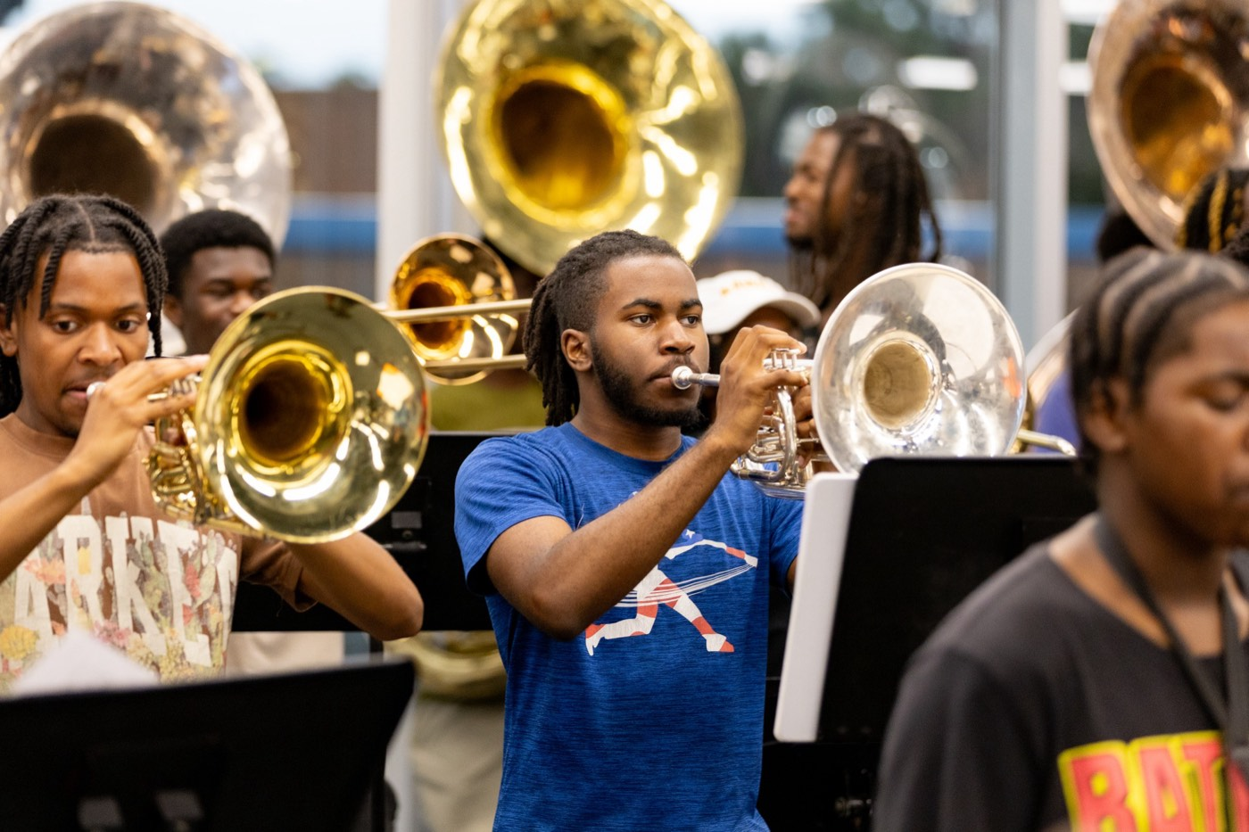
— BONDS, NOT FEAR
THE HAMPTON UNIVERSITY MARCHING FORCE
Bonding Is Not Hazing
They are opposites. Know the line, and hold it.
◆ Bonding builds up: it is voluntary, it includes everyone, it protects dignity, and it points the whole section at a shared goal.
◆ Hazing tears down: it is coerced, it singles people out, it humiliates, and it is about power over—not belonging.
◆ notan activity only "works" because someone is afraid or ashamed, it is not team-building. It is hazing.
◆ Real belonging never requires cruelty. That is the whole promise of The Marching Force.
Sources: Nuwer, Hazing: Destroying Young Lives (2018); Jones, doctoral dissertation, North Carolina A&T State University (2014); HU Bands Anti-Hazing Policy (2026).
Pre-Drill Camp 2026 · Leadership Seminars
10
Notes:
SLIDE 10 — BONDING IS NOT HAZING
Slow down. This is the line-drawing slide and it must be unambiguous.
Bonding: voluntary, includes everyone, protects dignity, shared goal.
Hazing: coerced, singles people out, humiliates, power over.
GIVE THEM THE TEST: "If an activity only works because somebody is afraid or ashamed, it is not team-building. It is hazing." Say that twice.

Slide 11

02
THE GOAL
Build it right, and your section becomes a family—a place where people are known, safe, and willing to run through a wall for one another. Not a family built on fear of the ones above them, but on trust in the ones beside them. That is a section that wins on the field because it first belongs to itself off of it.
KNOWN. SAFE. TOGETHER.
Notes:
SLIDE 11 — THE GOAL (statement slide)
Read it. The word to land on is family — but the right kind.
Takeaway: "Known. Safe. Together."

Slide 12

— BONDS, NOT FEAR
THE HAMPTON UNIVERSITY MARCHING FORCE
What It Looks Like Here
Bonds are built in the small, everyday moments.
◆ Learn every member's name in the first week—and use it.
◆ Check on the quiet ones. The member who says the least often needs you the most.
◆ Work them hard, then have their back completely. Demanding and caring are not opposites.
◆ Shut down humiliation the instant you see it—no matter who is doing it.
◆ Celebrate the wins out loud, and carry the losses together.
Pre-Drill Camp 2026 · Leadership Seminars
12
Notes:
SLIDE 12 — WHAT IT LOOKS LIKE HERE
The everyday behaviors. Keep it brisk.
HIT TWO: "Check on the quiet ones — the member who says the least often needs you the most." And: "Shut down humiliation the instant you see it, no matter who is doing it."
That last one is a direct instruction, not a suggestion. Say it that way.

Slide 13
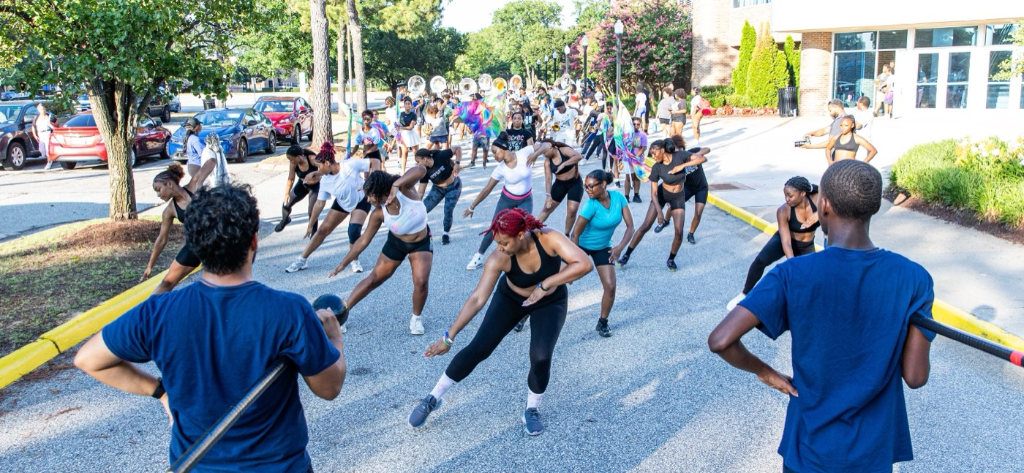
YOUR CHARGE
Build the Bond.
Lose the Fear.
Lead your section by connection, not intimidation. Know them, protect them, work them hard, and make them safe enough to be great. Do that, and they will give you everything—not out of fear, but because they belong to something with you, and they will never want to let it down.
Serve First. Lead Always. — Drive the Legacy.
The Hampton University Marching Force
Hampton's Heartbeat
Notes:
SLIDE 13 — CLOSE: Build the Bond. Lose the Fear.
"Know them, protect them, work them hard, and make them safe enough to be great."
End on the sign-off.

