Slide 1
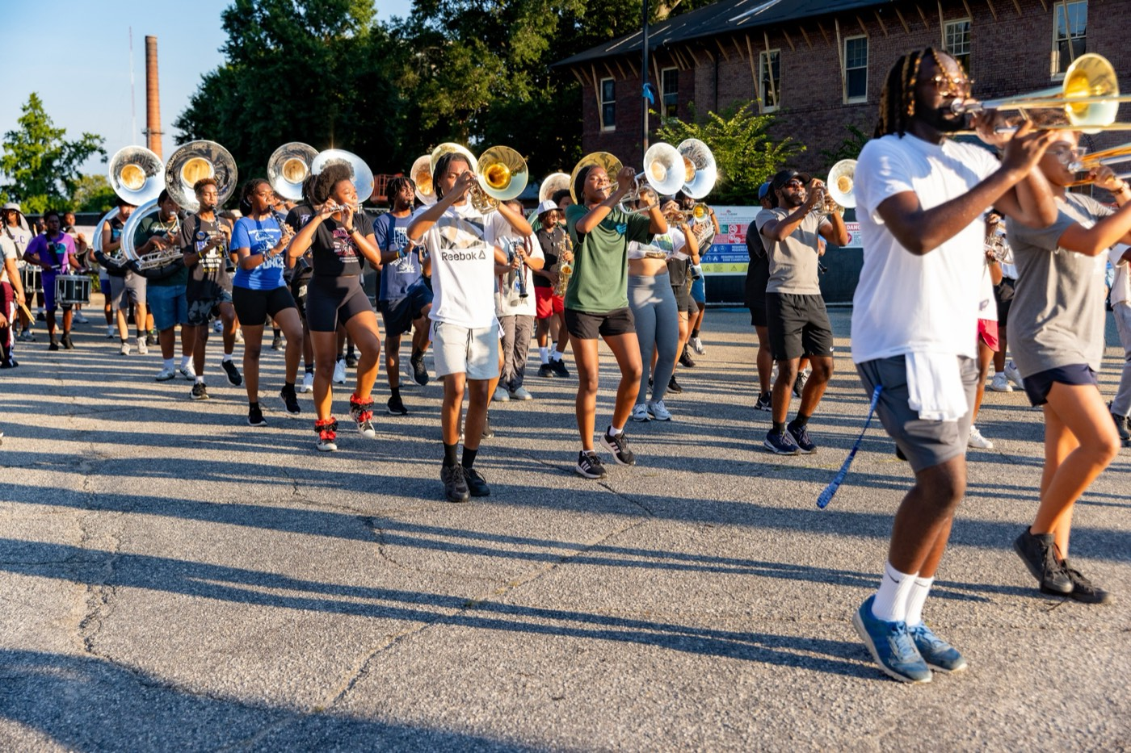
PRE-DRILL CAMP 2026 · LEADERSHIP SEMINARS · DAY 1
Command
Respect
"Respect Is Earned Through Conduct, Not Title"
Dr. Thomas L. Jones, Jr.
Director of University Bands · Saturday, August 1, 2026
The Hampton University Marching Force
Hampton's Heartbeat
Notes:
SLIDE 1 — TITLE: Command Respect
SAY: "Your title put you in charge of a section. It did not make one person in it respect you. That has to be earned, and this hour is about how."
CUE: Name the distinction early — command versus demand. It's the spine of the whole session.

Slide 2

— COMMAND RESPECT
THE HAMPTON UNIVERSITY MARCHING FORCE
Icebreaker
The general this seminar is built on—in his own words, on where respect really comes from.
▶
Colin Powell on Leadership and Trust
youtu.be/PbfBUrh4QWM
WATCH · 2:43
Pre-Drill Camp 2026 · Leadership Seminars
02
Notes:
SLIDE 2 — ICEBREAKER: Colin Powell on Leadership and Trust (2:43)
SET UP: "This whole seminar is built on this man. Four-star general, Chairman of the Joint Chiefs, Secretary of State. Listen for the one word he lands on."
Play it.
AFTER: "What was the word?" You want them to say trust. If nobody does, say it yourself and move.

Slide 3
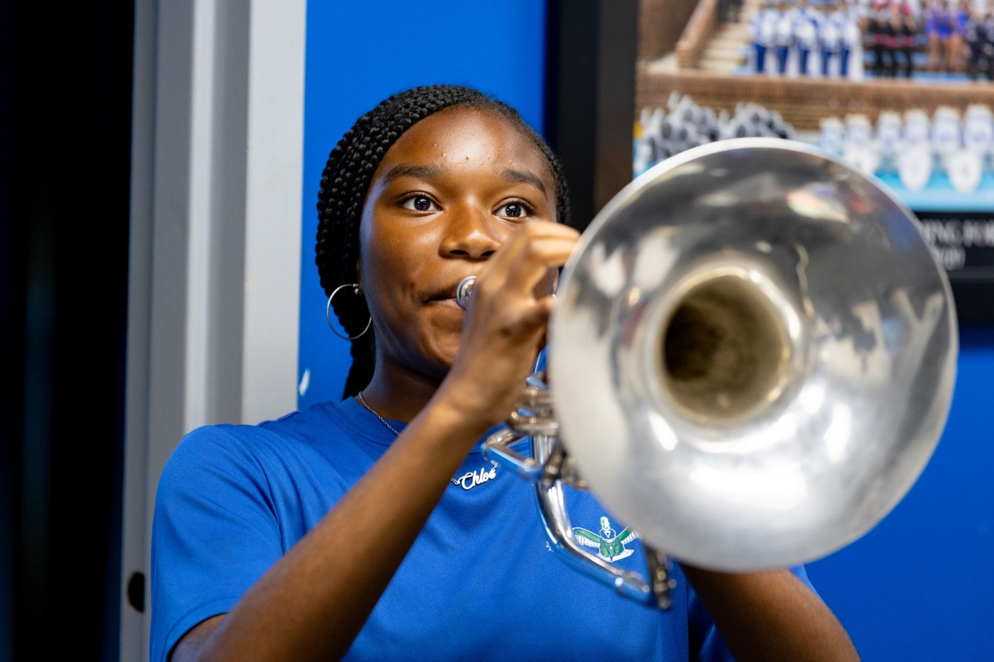
01
THE PREMISE
Your title puts you in charge. It does not make anyone respect you. Respect is not issued with a position—it is earned by how you carry yourself, how you treat people, and whether they can trust you when it counts. Your section will follow your conduct, not the rank on your collar.
EARN IT. NEVER DEMAND IT.
Notes:
SLIDE 3 — THE PREMISE (statement slide)
Read it as written.
KEY: "Respect is not issued with a position."
Takeaway: "Earn it. Never demand it." Say it, then pause before advancing.

Slide 4
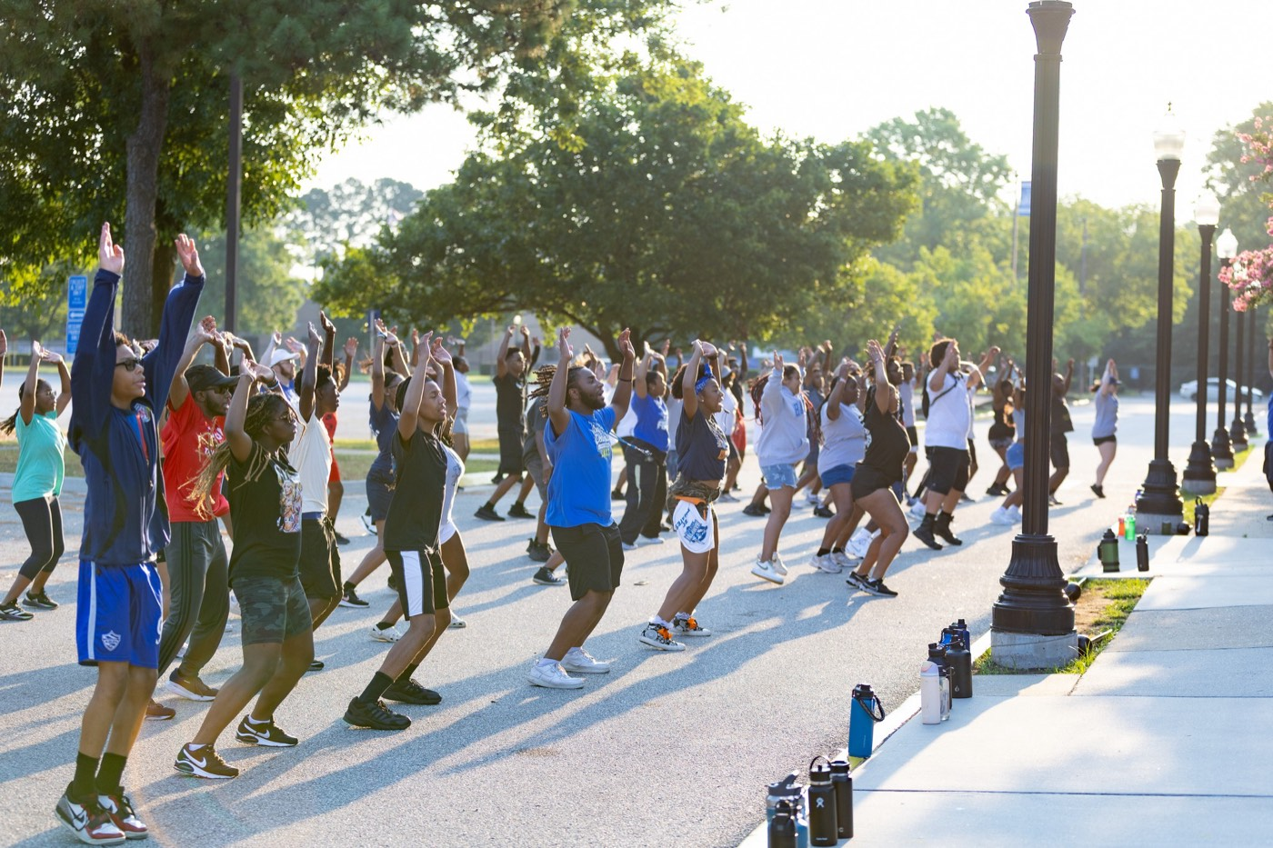
— COMMAND RESPECT
THE HAMPTON UNIVERSITY MARCHING FORCE
Command Respect. Don't Demand It.
The loudest leader in the room is rarely the most respected.
◆ Demanding respect—through your title, your volume, or fear—buys you compliance, and only while you are watching.
◆ Commanding respect—through competence, character, and consistency—earns you people who follow when you are not.
◆ Rank can make people obey. Only conduct makes them believe.
◆ trustedl is not to be feared, or even liked. It is to be trusted.
The tell: a demanded respect disappears the moment you turn your back. An earned respect follows you into the dark.
Pre-Drill Camp 2026 · Leadership Seminars
04
Notes:
SLIDE 4 — COMMAND RESPECT. DON'T DEMAND IT.
Walk the contrast. Demanded respect buys compliance while you're watching. Commanded respect earns people who follow when you're not.
BEST LINE ON THE SLIDE — read the callout verbatim: "A demanded respect disappears the moment you turn your back. An earned respect follows you into the dark."
Land: "The goal isn't to be feared. It isn't even to be liked. It's to be trusted."

Slide 5
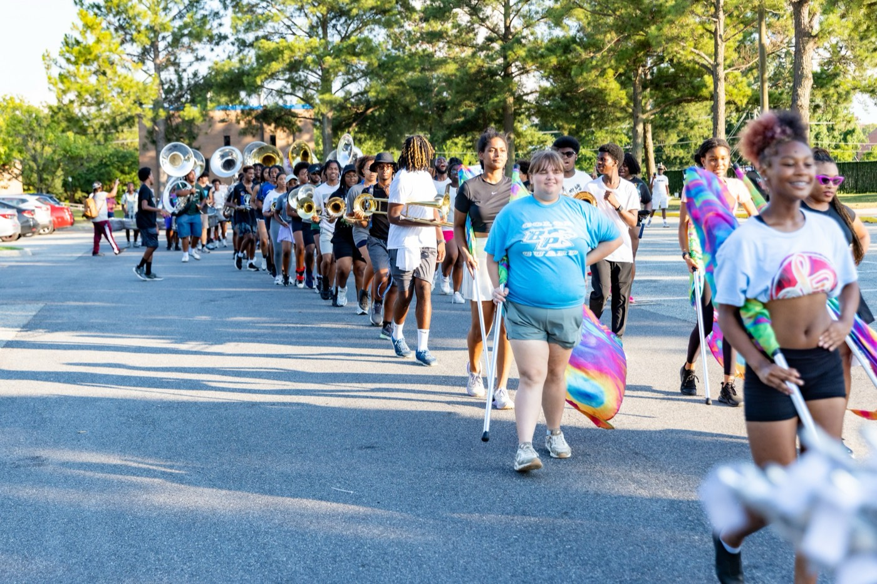
— COMMAND RESPECT
THE HAMPTON UNIVERSITY MARCHING FORCE
A Word From a General
Few earned more respect than Colin Powell—here is how he explained it.
◆ Colin Powell rose from a rifle platoon to four-star general, Chairman of the Joint Chiefs, and Secretary of State.
◆ trust to define effective leadership, his answer came down to one word: trust.
◆ trustership ultimately comes down to creating conditions of trust within an organization.” Good leaders are the ones followers trust.
◆ Trust and respect are the same currency—and you cannot order either one. You earn both.
Sources: Colin Powell, remarks to White House Fellows on leadership and trust; Powell, My American Journey (1995); Powell, It Worked for Me: In Life and Leadership (2012).
Pre-Drill Camp 2026 · Leadership Seminars
05
Notes:
SLIDE 5 — A WORD FROM A GENERAL
Give Powell's résumé briefly — rifle platoon to four stars. It buys the quote credibility with this room.
QUOTE IT DIRECTLY: "Leadership ultimately comes down to creating conditions of trust within an organization."
Then: "Trust and respect are the same currency. You can't order either one."

Slide 6
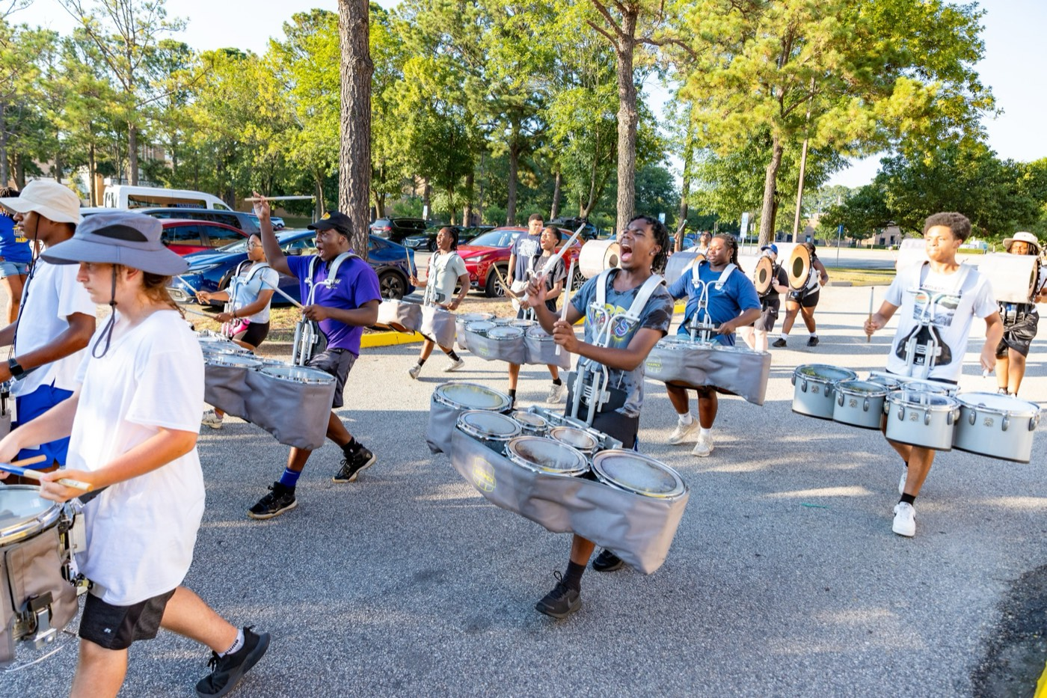
— COMMAND RESPECT
THE HAMPTON UNIVERSITY MARCHING FORCE
Follow You Out of Curiosity
Powell's favorite definition—from an old infantry sergeant.
◆ “if only out of curiosity.” Benning, a sergeant told a young Lieutenant Powell he would know he was a good leader when his people would follow him “if only out of curiosity.”
◆ trustl called it the best definition he ever heard. They follow into the unknown for one reason: they trust you.
◆ That trust is earned—they have seen you serve them, prepare them, and share their risks.
◆ Build it, and they will follow you through the hardest nights and the steepest climbs, on your word alone.
Sources: Colin Powell, remarks to White House Fellows on leadership and trust; Powell, My American Journey (1995).
Pre-Drill Camp 2026 · Leadership Seminars
06
Notes:
SLIDE 6 — FOLLOW YOU OUT OF CURIOSITY
Tell the story properly — a sergeant at Fort Benning telling a young Lieutenant Powell he'd know he was a good leader when his people would follow him, if only out of curiosity.
Powell called it the best definition he ever heard.
ASK: "Would your section follow you around a corner they can't see around? Be honest with yourself."

Slide 7
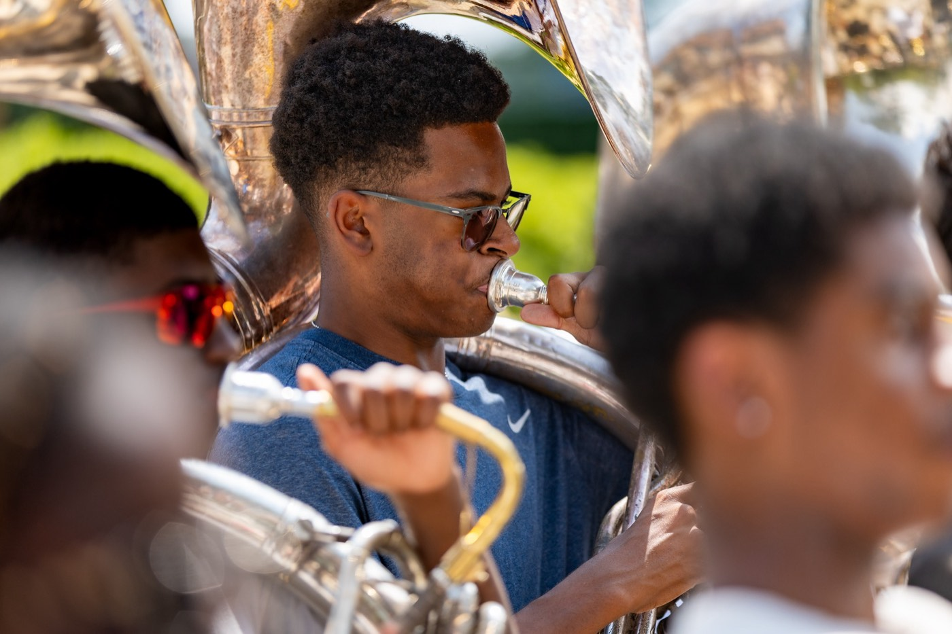
— COMMAND RESPECT
THE HAMPTON UNIVERSITY MARCHING FORCE
How Respect Is Earned
Powell named the currency. Here is how you bank it.
1
Clear Mission
Give your people a clear purpose and direction. They trust a leader who knows where they are going.
Sources: Colin Powell, remarks to White House Fellows on leadership and trust; Powell, It Worked for Me: In Life and Leadership (2012).
Pre-Drill Camp 2026 · Leadership Seminars
07
Notes:
SLIDE 7 — HOW RESPECT IS EARNED
Four ways to bank it: clear mission, selfless service, prepare your people, share the risk.
SPEND YOUR TIME ON THE LAST TWO. "Never hand out a job without the resources to do it." And: "Respect follows the leader who carries the load, not the one who assigns it."

Slide 8
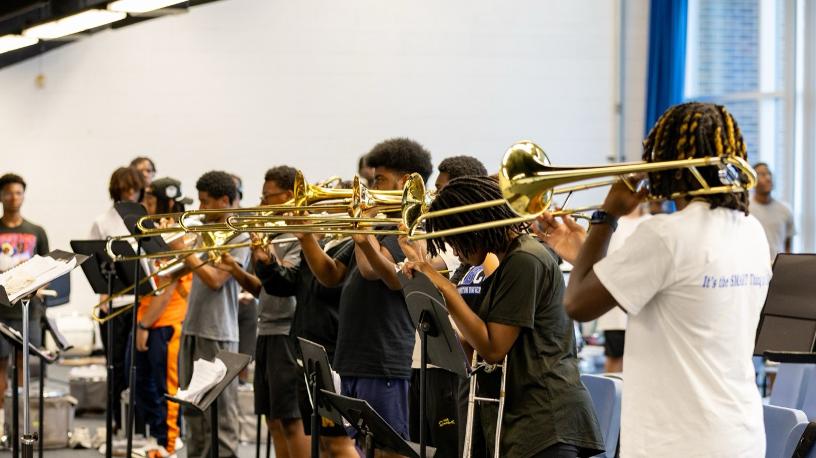
— COMMAND RESPECT
THE HAMPTON UNIVERSITY MARCHING FORCE
Never Let Them See You Shaken
The infantry lesson Powell never forgot.
◆ never lets it showe infantry school: no matter how cold, hungry, or terrified you are, the leader never lets it show.
◆ Because whatever you show, your people will feel—your fear becomes their fear, and your calm becomes their calm.
◆ Powell admitted he was often scared and exhausted, and still said, “Let's go around this corner.”
◆ Your composure under pressure is one of the fastest ways to earn a section's respect.
Sources: Colin Powell, remarks to White House Fellows on leadership and trust; Powell, My American Journey (1995).
Pre-Drill Camp 2026 · Leadership Seminars
08
Notes:
SLIDE 8 — NEVER LET THEM SEE YOU SHAKEN
The infantry rule: however cold, hungry, or scared you are, the leader doesn't show it.
BE HONEST HERE: "Powell admitted he was often scared and exhausted — and still said, let's go around this corner." That's not fakery, that's the job.
Tie forward: "We'll come back to this Sunday in Leading Under Pressure."

Slide 9
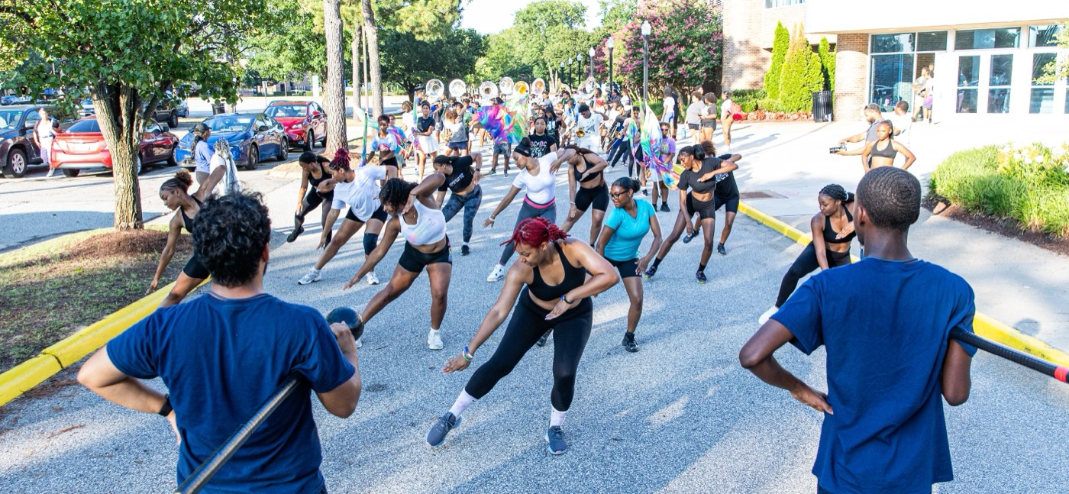
— COMMAND RESPECT
THE HAMPTON UNIVERSITY MARCHING FORCE
Powell's Rules to Lead By
A few of the general's thirteen rules—made for earning respect.
◆ “Remain calm. Be kind.” Pressure is exactly when your people are watching how you treat them.
◆ “Get mad, then get over it.” Feel it, then lead past it—grudges cost you respect.
◆ “Share credit.” Take the blame, give the credit, every single time.
◆ “Have a vision. Be demanding.” High standards, held with care, are a form of respect.
◆ “Perpetual optimism is a force multiplier.” Your belief lifts the whole section.
Sources: Powell, My American Journey (1995); Powell, It Worked for Me: In Life and Leadership (2012).
Pre-Drill Camp 2026 · Leadership Seminars
09
Notes:
SLIDE 9 — POWELL'S RULES TO LEAD BY
Don't read all five flat. Pick two and actually talk about them.
Recommend: "Get mad, then get over it" — because grudges inside a section are what kill it. And "Share credit" — take the blame, give the credit, every time.
Optional: ask which rule they find hardest.

Slide 10
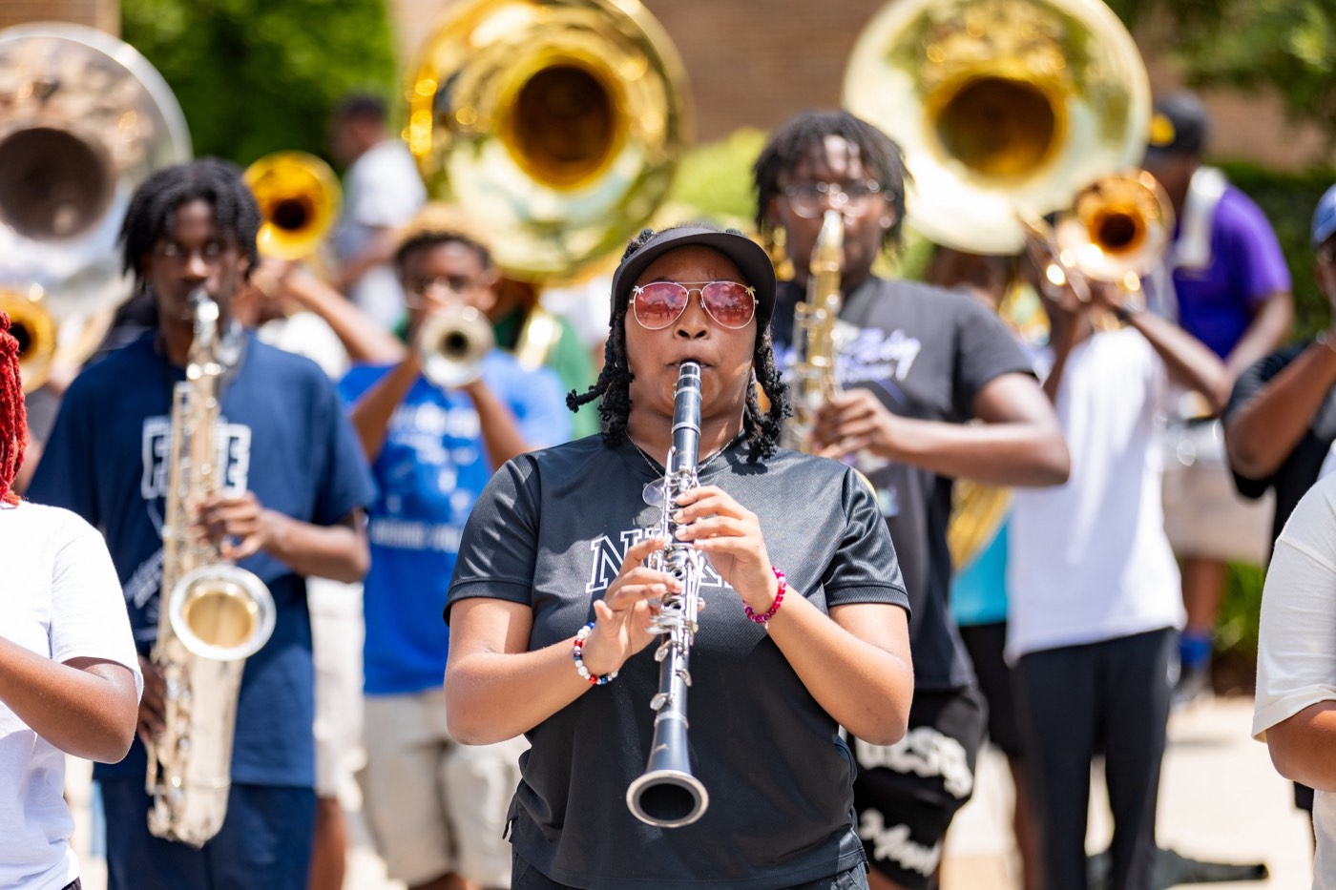
— COMMAND RESPECT
THE HAMPTON UNIVERSITY MARCHING FORCE
Command vs. Demand
Two leaders, same rank. Only one is respected.
Pre-Drill Camp 2026 · Leadership Seminars
10
Notes:
SLIDE 10 — COMMAND VS. DEMAND
A two-column contrast. Read the demanding column in that leader's voice, then reset for the commanding column.
ASK: "Which column did you live in last season?" Let it be quiet — this is a self-check, not a discussion.

Slide 11
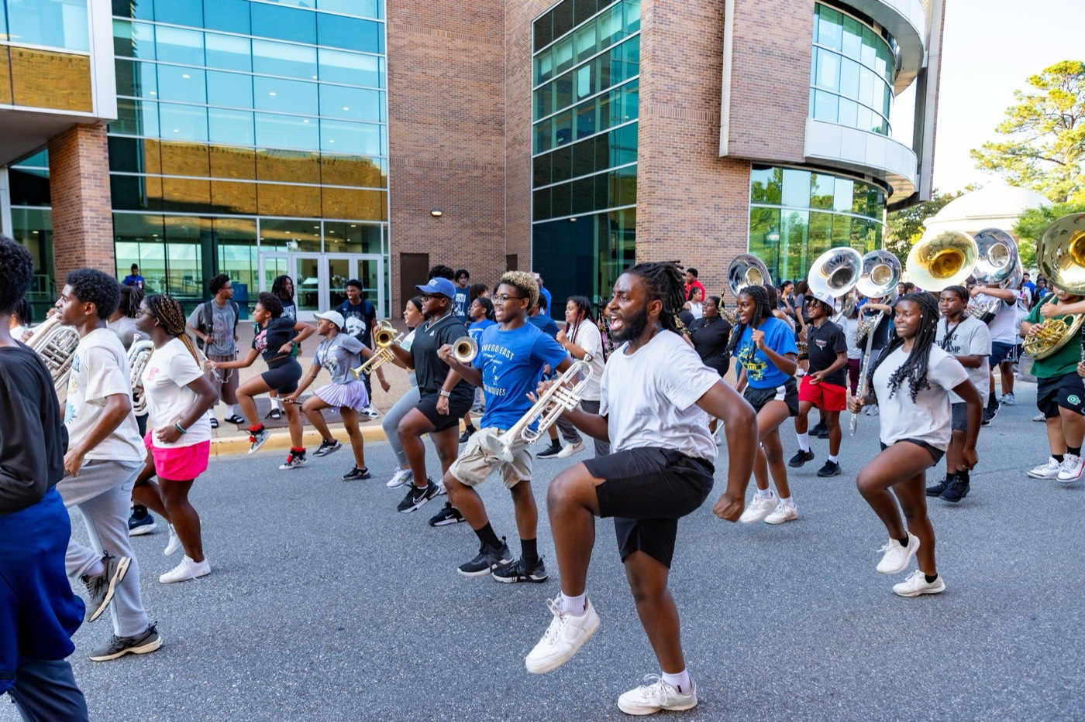
— COMMAND RESPECT
THE HAMPTON UNIVERSITY MARCHING FORCE
What It Looks Like Here
Earn your section's respect the way Powell earned his.
◆ Be the standard before you set it—on time, in uniform, and prepared, every time.
◆ Know your craft cold. Competence earns respect faster than any speech.
◆ Serve first: carry the water, remove the obstacles, and take the hardest job yourself.
◆ Stay calm when it goes wrong. Your composure is contagious.
◆ Keep your word, and do the small things right. Trust is built in the details.
Pre-Drill Camp 2026 · Leadership Seminars
11
Notes:
SLIDE 11 — WHAT IT LOOKS LIKE HERE
Bring it home to the Marching Force. These are the concrete behaviors.
HIT: "Be the standard before you set it." And: "Know your craft cold — competence earns respect faster than any speech."
CUE: This is the slide they should photograph. Tell them so.

Slide 12
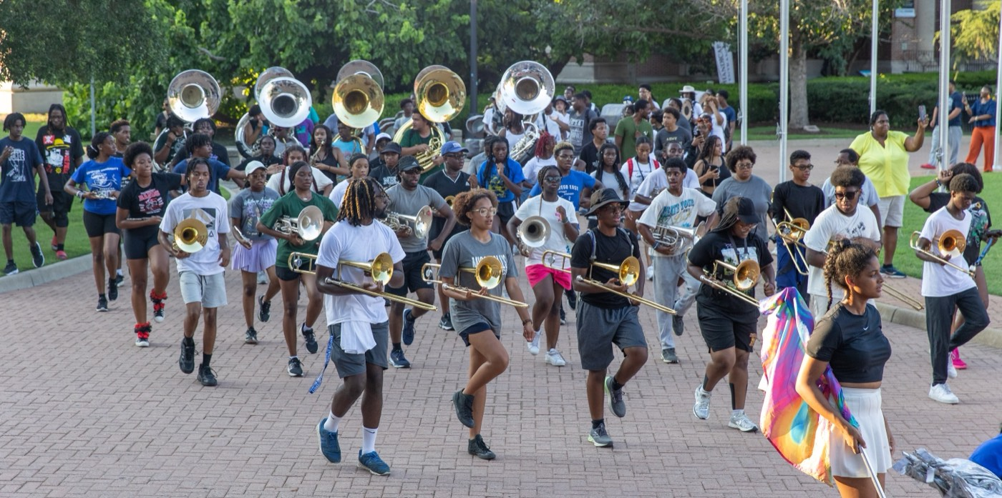
YOUR CHARGE
Earn the Room.
Then Keep It.
You will not command respect by demanding it. Earn it the way the best leaders always have—serve your people, prepare them, share their risks, and never let them see you shaken. Do that, and they will follow you around any corner, into the darkest night, if only out of curiosity.
Serve First. Lead Always. — Drive the Legacy.
The Hampton University Marching Force
Hampton's Heartbeat
Notes:
SLIDE 12 — CLOSE: Earn the Room. Then Keep It.
"Serve your people, prepare them, share their risks, and never let them see you shaken."
End on the sign-off and stop.

