Slide 1
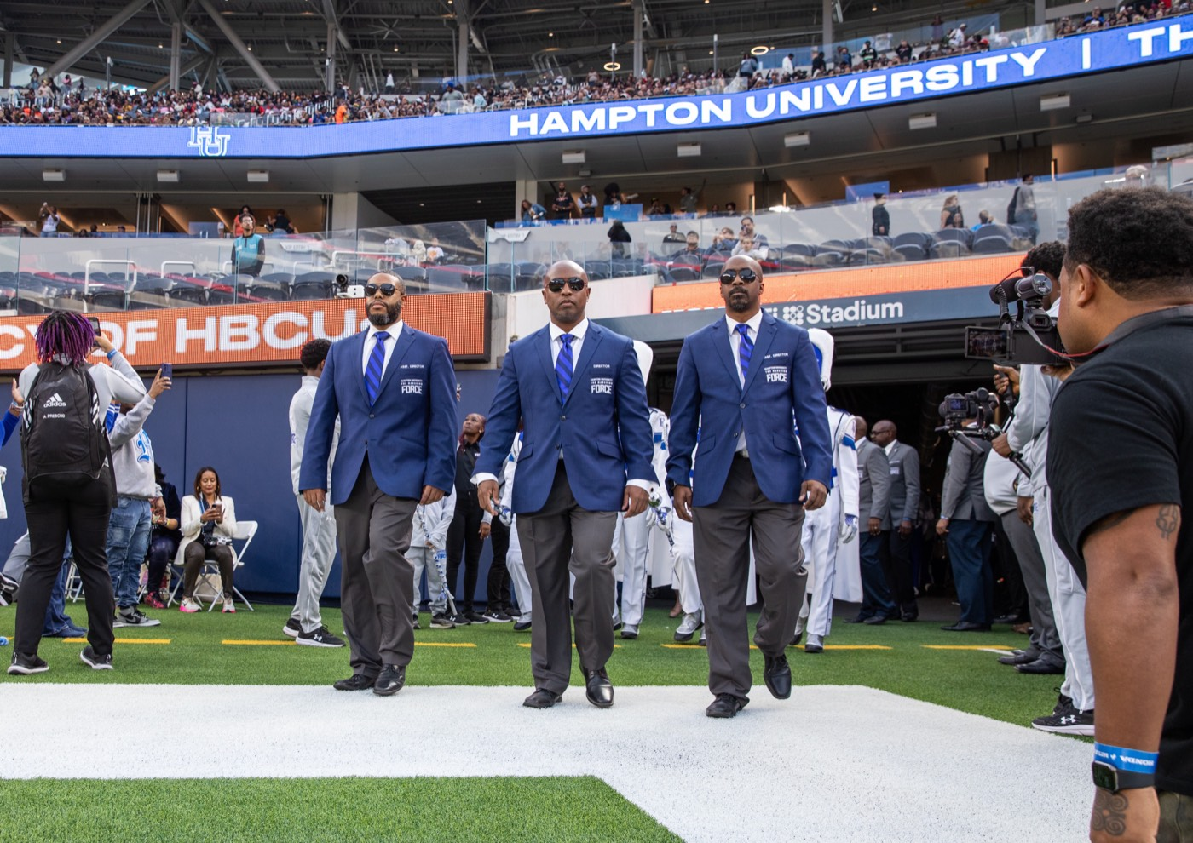
PRE-DRILL CAMP 2026 · LEADERSHIP SEMINARS · DAY 1
Servant-
Leadership
"The Model for The Marching Force"
Dr. Thomas L. Jones, Jr.
Director of University Bands · Saturday, August 1, 2026
The Hampton University Marching Force
Hampton's Heartbeat
Notes:
SLIDE 1 — TITLE: Servant-Leadership
THE FLAGSHIP SESSION. This is the program's leadership model — everything else in the weekend hangs off it.
OPEN: "Every program decides what kind of leaders it builds. We've already decided."

Slide 2
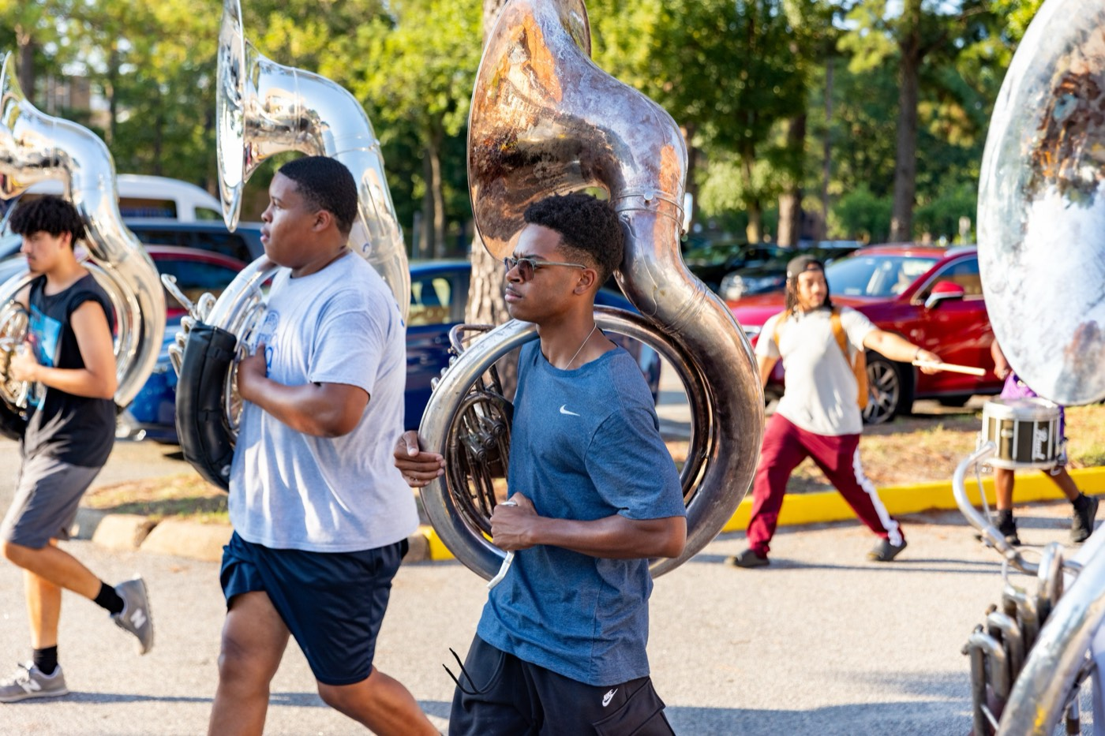
— SERVANT-LEADERSHIP
THE HAMPTON UNIVERSITY MARCHING FORCE
Icebreaker
One clip, one question: what makes someone a leader worth following?
▶
“That's a Leader”
youtu.be/0fpK9591u6M
WATCH · 1:06
Pre-Drill Camp 2026 · Leadership Seminars
02
Notes:
SLIDE 2 — ICEBREAKER: "That's a Leader" (1:06)
SET UP: "One clip, one question: what makes somebody a leader worth following?"
Play it.
AFTER: take two or three answers. Write the words they use where everyone can see them — you'll come back to them at the close.

Slide 3
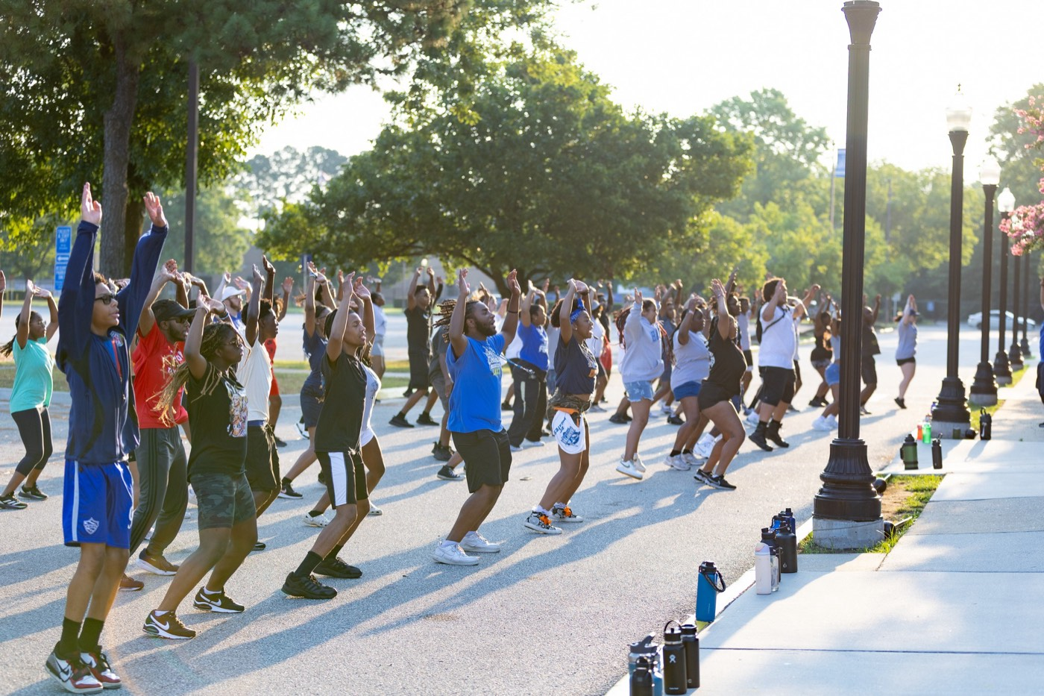
01
THE MODEL
Every program decides what kind of leaders it builds. The Marching Force has already decided. We do not lead in order to be served—we serve in order to lead. Servant-leadership is not one option among many here. It is the model this band, this mission, and your director are built on, and it is the standard every leader in this room is held to.
SERVE FIRST. LEAD ALWAYS.
Notes:
SLIDE 3 — THE MODEL (statement slide)
Read it.
THE SENTENCE: "We do not lead in order to be served. We serve in order to lead."
Takeaway: "Serve first. Lead always." That's our sign-off on every deck this weekend — point that out.

Slide 4
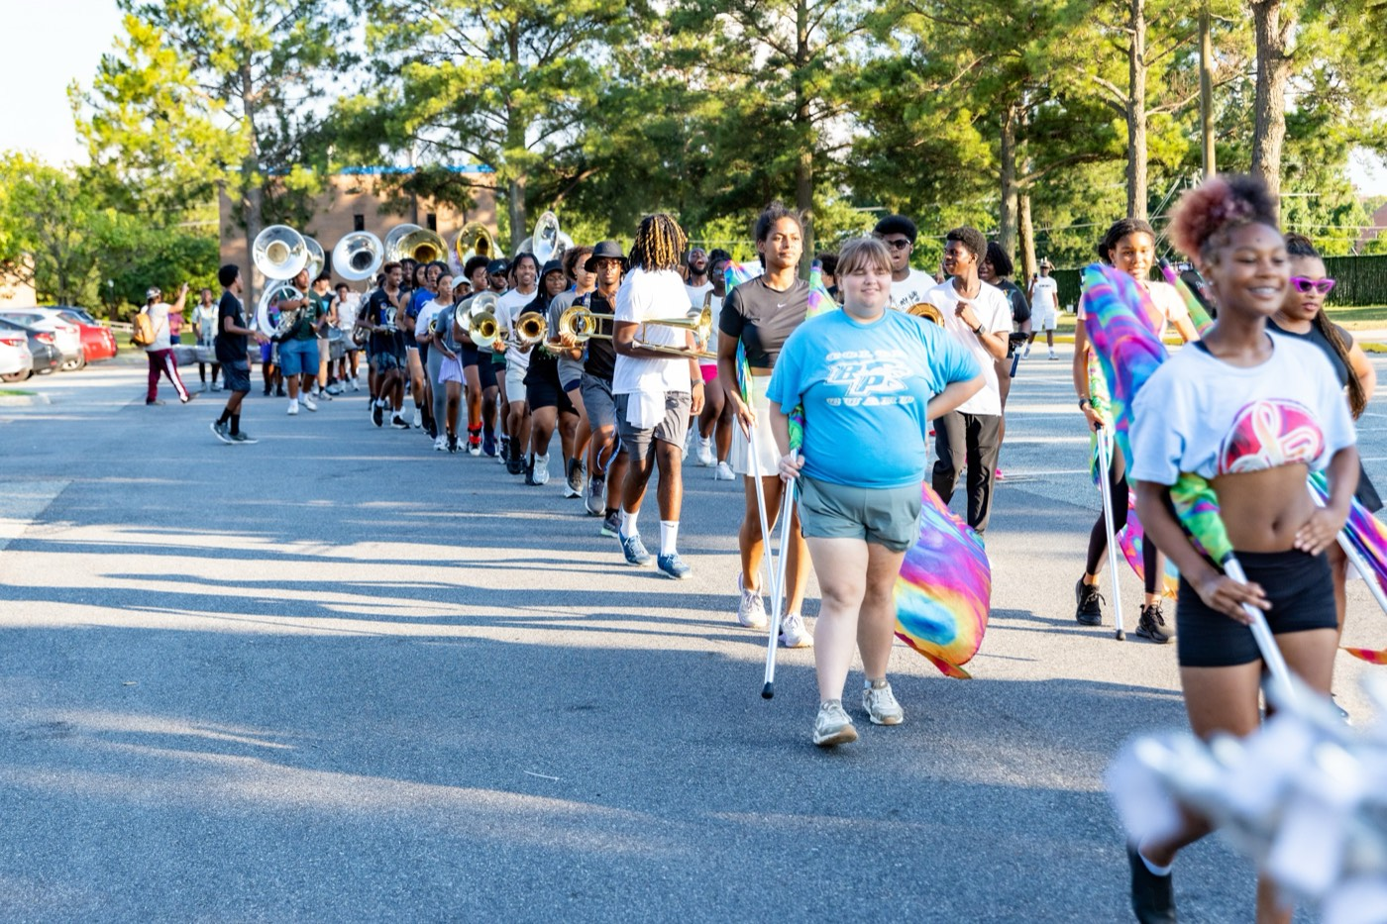
— SERVANT-LEADERSHIP
THE HAMPTON UNIVERSITY MARCHING FORCE
Where It Comes From
A leadership idea with a name and an origin.
◆ Robert K. Greenleaf by Robert K. Greenleaf in his 1970 essay The Servant as Leader, drawn from a lifetime studying how institutions and leaders actually work.
◆ servants firsts simple and radical: the best leaders are servants first—the desire to serve comes before the desire to lead.
◆ stewardship leadership as stewardship, not privilege—responsibility, not rank.
◆ Fifty years on, it is one of the most studied and adopted leadership models in the world—in business, the military, education, and the arts.
Sources: Greenleaf, The Servant as Leader (1970) and Servant Leadership: A Journey into the Nature of Legitimate Power and Greatness (1977); Spears, "Character and Servant Leadership" (2010).
Pre-Drill Camp 2026 · Leadership Seminars
04
Notes:
SLIDE 4 — WHERE IT COMES FROM
Robert K. Greenleaf, 1970, The Servant as Leader.
"His premise was simple and radical: the best leaders are servants first."
"It reframes leadership as stewardship, not privilege. Responsibility, not rank."
Note it's now one of the most studied models in the world — business, military, education, church.

Slide 5
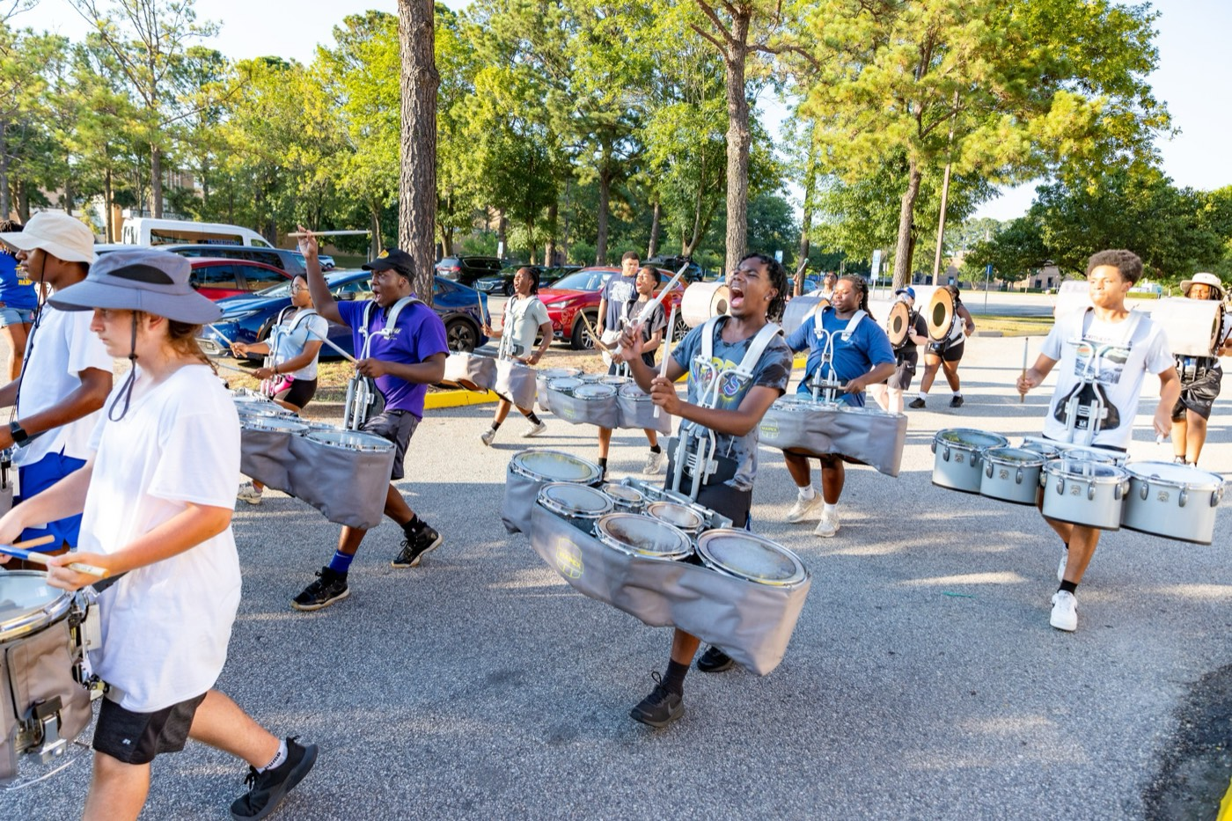
— SERVANT-LEADERSHIP
THE HAMPTON UNIVERSITY MARCHING FORCE
Servant First, Leader Second
The order is the whole idea.
◆ servegins with a genuine desire to serve—then a conscious choice to lead, so you can serve more people, better.
◆ Contrast the "leader first," who leads for position, power, or applause—and serves only enough to protect it.
◆ growdifference always shows up in the people: do they grow, or do they just obey?
◆ "What do they need from me?"from "What do I want from them?" to "What do they need from me?"
The flip: you were not handed a title to be served. You were handed a section to serve—and to hold to the standard while you do.
Pre-Drill Camp 2026 · Leadership Seminars
05
Notes:
SLIDE 5 — SERVANT FIRST, LEADER SECOND
"The order is the whole idea."
CONTRAST: the leader-first serves only enough to protect the position.
THE TEST: "Do the people grow, or do they just obey?"
READ THE CALLOUT: "You weren't handed a title to be served. You were handed a section to serve — and to hold to the standard while you do."
GIVE THEM THE DAILY QUESTION: not 'what do I want from them' but 'what do they need from me.'

Slide 6

— SERVANT-LEADERSHIP
THE HAMPTON UNIVERSITY MARCHING FORCE
Why It Is Our Model
Not a trend we adopted—the identity we were built on.
◆ Missionsion and Vision name it by word: we develop members through servant-leadership and a commitment to excellence.
◆ doctoral dissertationof your director's scholarship—a doctoral dissertation on a servant-leadership approach in the HBCU marching band, and years of research on band culture.
◆ It is the through-line from the classroom to the field: the same model that earned the degrees now runs the block.
◆ Lead this way and you are not following a fad—you are carrying the identity of The Marching Force.
Sources: The Marching Force Mission and Vision (HU Bands Handbook, 2026); Jones, doctoral dissertation, North Carolina A&T State University (2014); Jones, master's thesis, Gonzaga University (2012).
Pre-Drill Camp 2026 · Leadership Seminars
06
Notes:
SLIDE 6 — WHY IT IS OUR MODEL
"Not a trend we adopted. The identity we were built on."
It's named by word in our Mission and Vision — point back to this morning.
And it's the foundation of the director's scholarship: a dissertation on servant-leadership in the HBCU marching band.
"The same model that earned the degrees now runs the block."

Slide 7
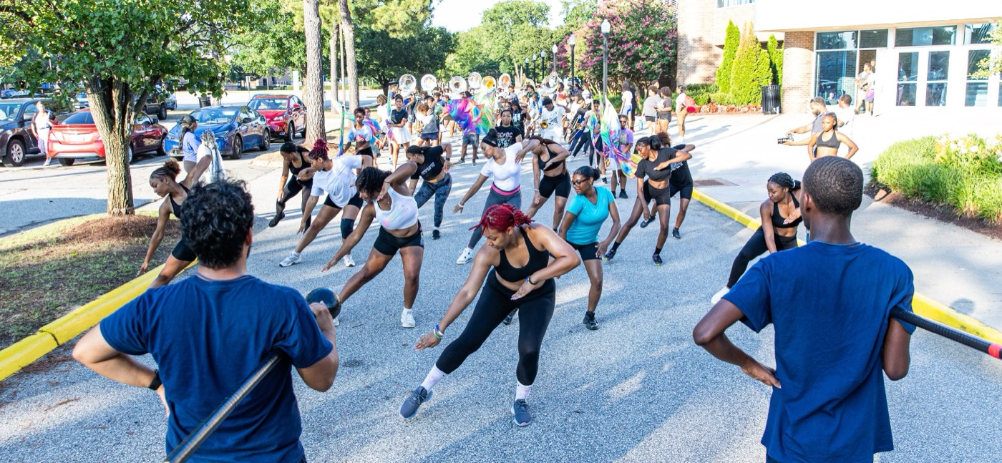
— SERVANT-LEADERSHIP
THE HAMPTON UNIVERSITY MARCHING FORCE
The Ten Characteristics
Larry Spears drew ten traits from Greenleaf's writing.
Sources: Spears, "Character and Servant Leadership: Ten Characteristics of Effective, Caring Leaders" (2010); Greenleaf, The Servant as Leader (1970).
Pre-Drill Camp 2026 · Leadership Seminars
07
Notes:
SLIDE 7 — THE TEN CHARACTERISTICS
Larry Spears drew ten traits from Greenleaf's writing.
Don't read all ten here — the next three slides group them. Just orient them: person, mission, community.

Slide 8
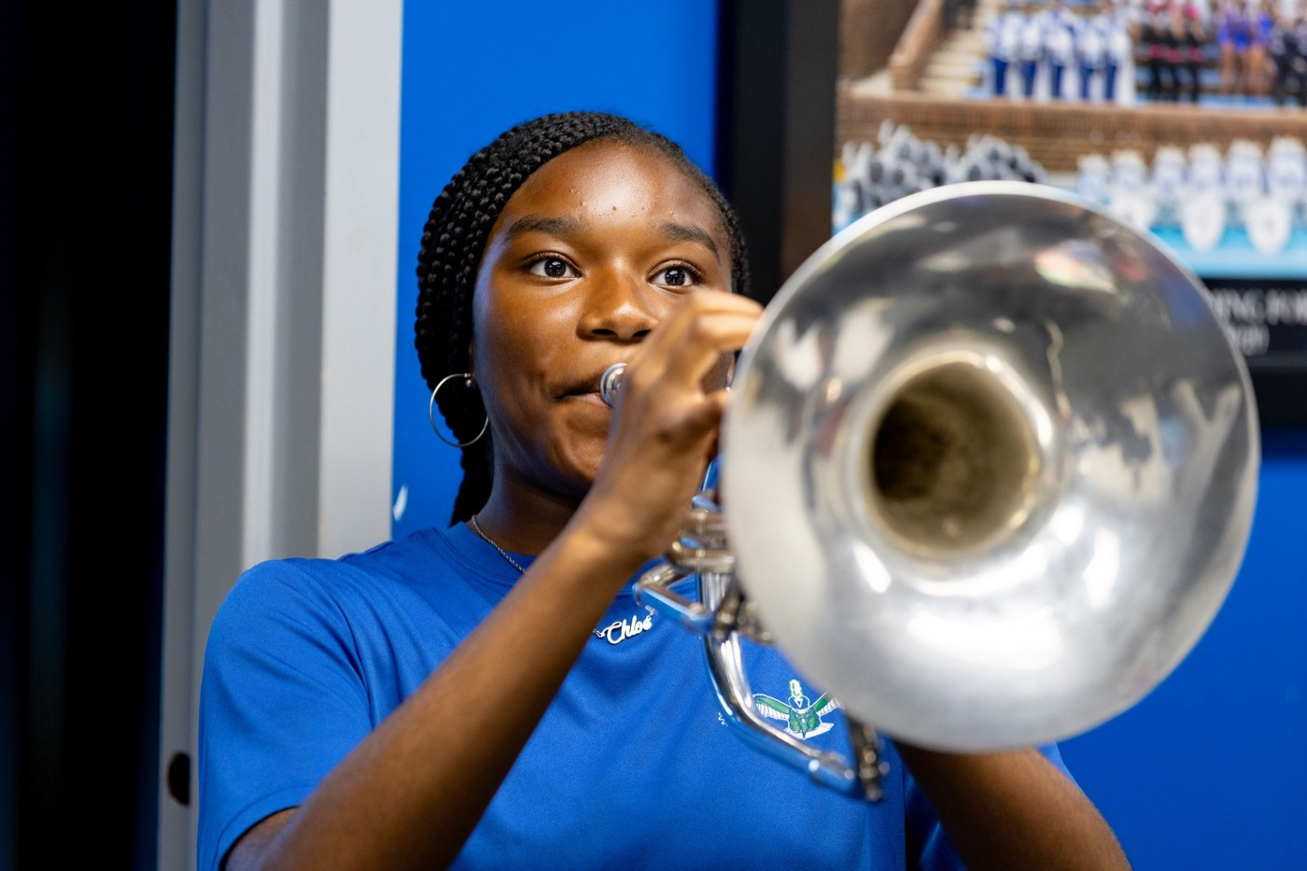
— SERVANT-LEADERSHIP
THE HAMPTON UNIVERSITY MARCHING FORCE
Serve the Person
The first four traits are how you treat the member in front of you.
1
Listening
Hear the whole member before you correct. Most “attitude” is an unheard need.
Pre-Drill Camp 2026 · Leadership Seminars
08
Notes:
SLIDE 8 — SERVE THE PERSON
Listening, Empathy, Healing, Awareness.
BEST LINE ON THE SLIDE: "Most 'attitude' is an unheard need." Say it twice — it will change how they handle their hardest member.
On Healing: sections carry homesickness, failure, conflict. Name that it's real.

Slide 9
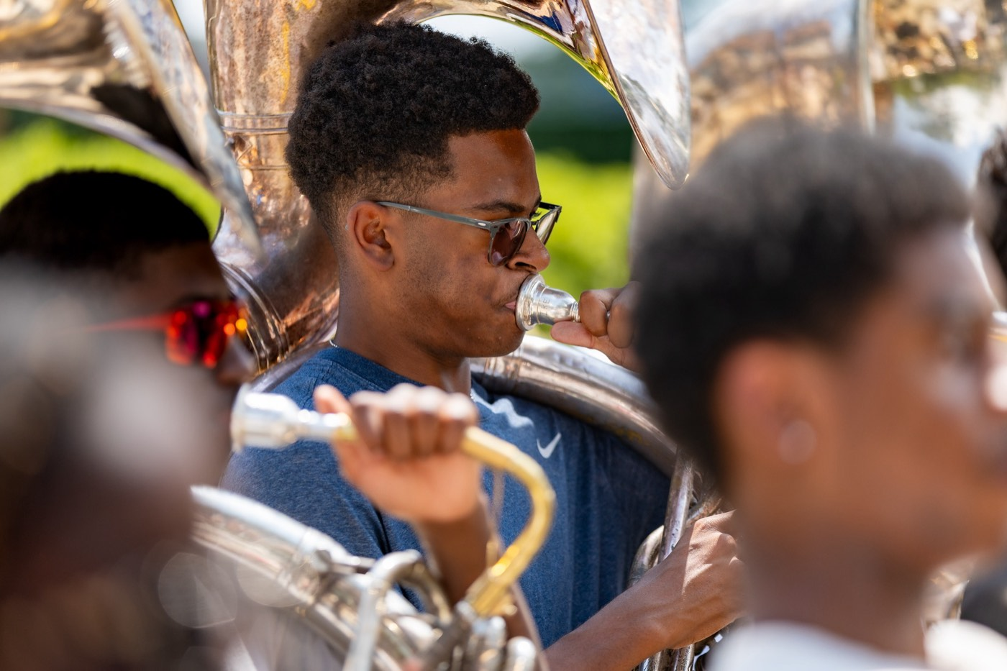
— SERVANT-LEADERSHIP
THE HAMPTON UNIVERSITY MARCHING FORCE
Serve the Mission
The next four are how you move the section toward the standard.
5
Persuasion
Win buy-in with reasons and respect, not rank and volume.
Pre-Drill Camp 2026 · Leadership Seminars
09
Notes:
SLIDE 9 — SERVE THE MISSION
Persuasion, Conceptualization, Foresight, Stewardship.
EMPHASIZE: "Win buy-in with reasons and respect, not rank and volume."
And Stewardship: "Your section, its instruments, and its name are held in trust. Return them better."

Slide 10

— SERVANT-LEADERSHIP
THE HAMPTON UNIVERSITY MARCHING FORCE
Serve the Community
The last two are how you build something that outlasts you.
9
Commitment to Growth
Measure your leadership by who your people become, not only how they perform.
Belonging is the point. A section that truly belongs to one another does not need to haze to prove it—and will not tolerate anyone who tries.
Pre-Drill Camp 2026 · Leadership Seminars
10
Notes:
SLIDE 10 — SERVE THE COMMUNITY
Commitment to Growth, Building Community.
"Measure your leadership by who your people BECOME, not only how they perform."
READ THE CALLOUT — it's the hinge to the hazing session: "A section that truly belongs to one another does not need to haze to prove it, and will not tolerate anyone who tries."

Slide 11
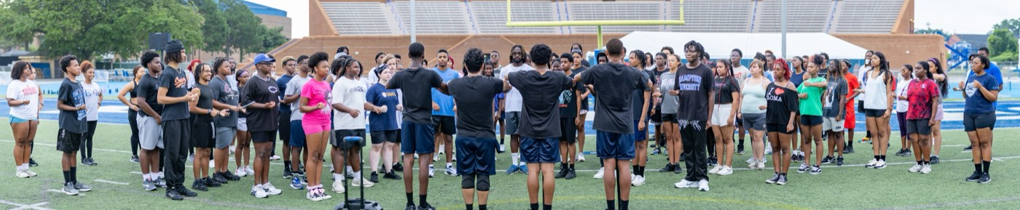
— SERVANT-LEADERSHIP
THE HAMPTON UNIVERSITY MARCHING FORCE
Know What They Need
You cannot lead a hungry, tired, unsafe, or excluded section to greatness.
Sources: Maslow, "A Theory of Human Motivation," Psychological Review (1943); Maslow, Motivation and Personality (1954).
Pre-Drill Camp 2026 · Leadership Seminars
11
Notes:
SLIDE 11 — KNOW WHAT THEY NEED
"You cannot lead a hungry, tired, unsafe, or excluded section to greatness."
Walk the needs hierarchy quickly and make it literal: water, rest, safety, belonging — then performance.
PRACTICAL: "If your people are dehydrated, your leadership problem is a water problem."

Slide 12
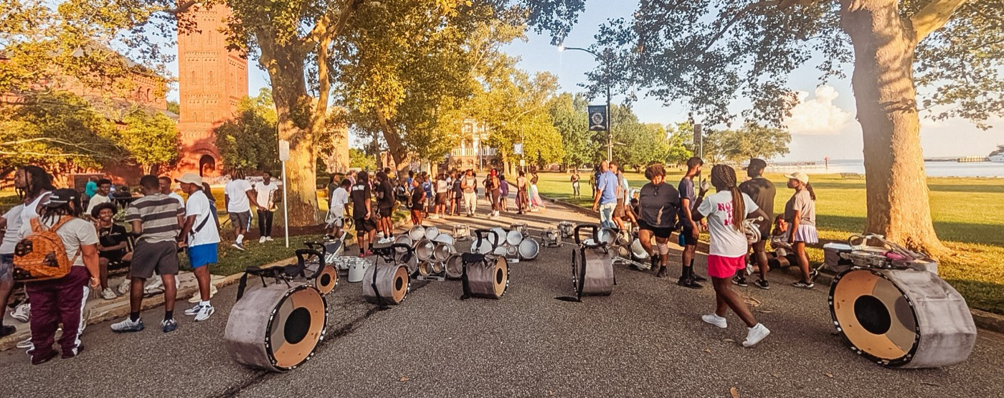
02
THE BEST TEST
Greenleaf offered one test for whether you are truly leading as a servant. Look at the people you lead and ask: are they growing because of you? Are they becoming healthier, wiser, stronger, freer, and more able to lead themselves—and are they, in turn, beginning to serve others? If yes, you are a servant-leader. If your people only grow smaller in your presence, the title means nothing.
JUDGE YOURSELF BY HOW THEY GROW.
Notes:
SLIDE 12 — THE BEST TEST (statement slide)
Greenleaf's own test. Read it as written.
"Are they growing because of you? Healthier, wiser, stronger, freer — and more likely to serve others themselves?"
Takeaway: "Judge yourself by how they grow."
Let this sit. It's the most demanding sentence in the session.

Slide 13
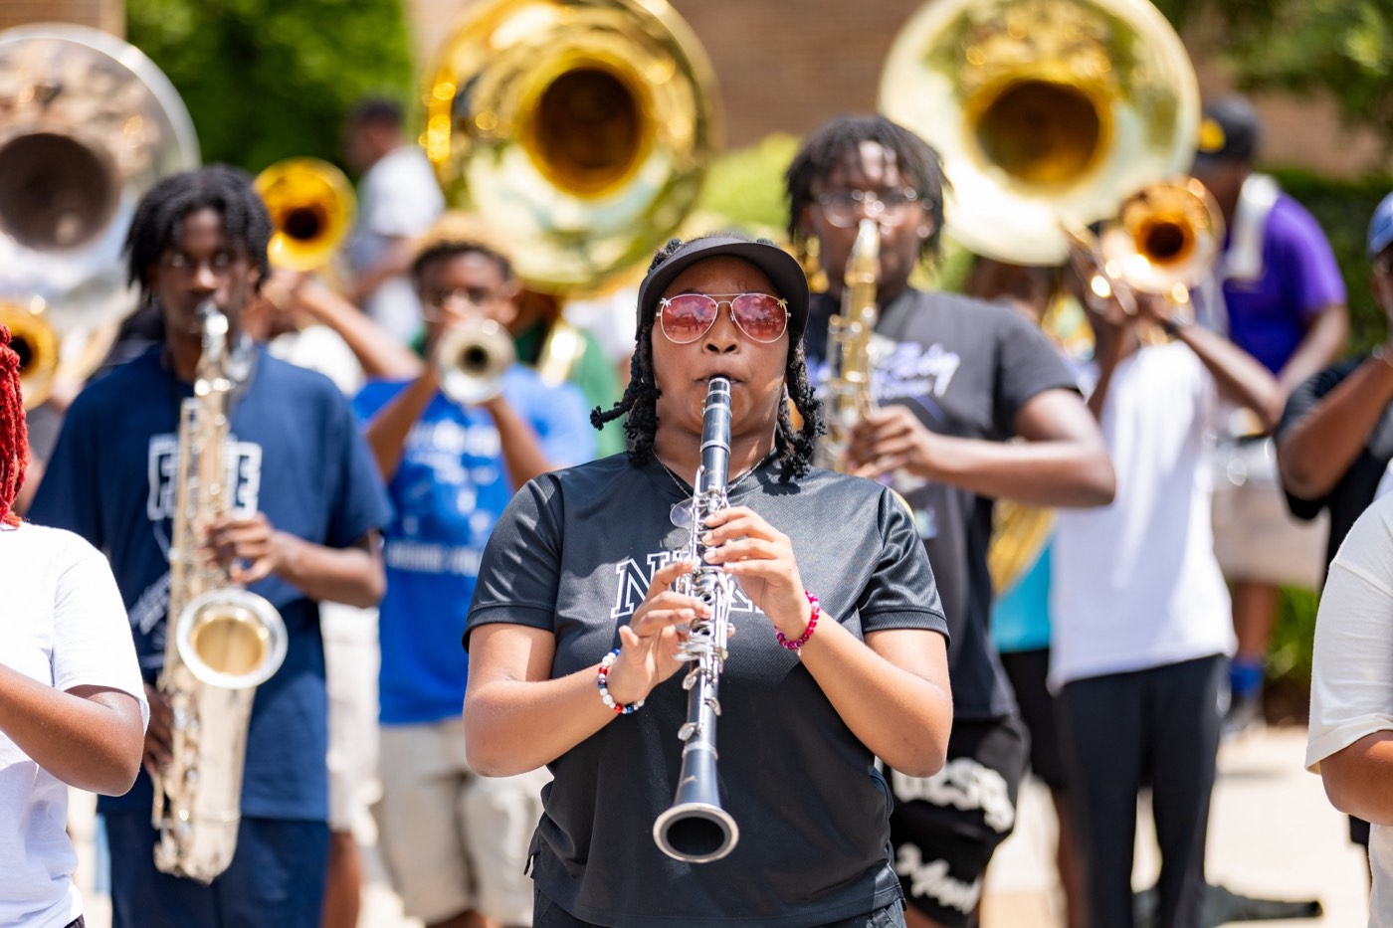
— SERVANT-LEADERSHIP
THE HAMPTON UNIVERSITY MARCHING FORCE
Servant vs. the Old Way
Two ways to run a section. Only one builds people.
Pre-Drill Camp 2026 · Leadership Seminars
13
Notes:
SLIDE 13 — SERVANT VS. THE OLD WAY
Two columns. Read the old way in that voice, then reset.
ASK QUIETLY: "Which column did the leader you remember most fall into?"

Slide 14
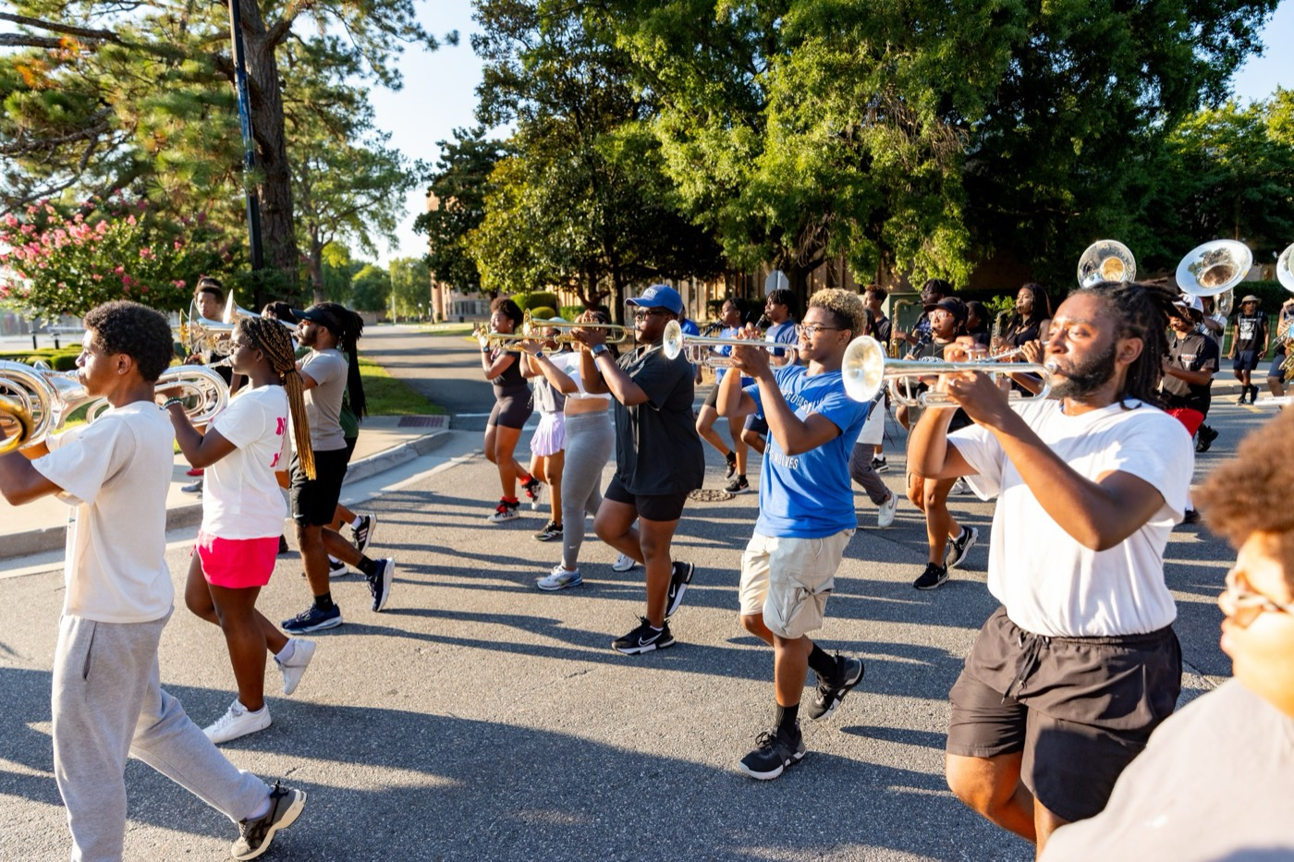
— SERVANT-LEADERSHIP
THE HAMPTON UNIVERSITY MARCHING FORCE
The Five Sources of Power
French and Raven named five. Servant-leaders build the two that last.
Sources: French and Raven, "The Bases of Social Power," in Studies in Social Power (1959); Raven, "The Bases of Power: Origins and Recent Developments," Journal of Social Issues (1993).
Pre-Drill Camp 2026 · Leadership Seminars
14
Notes:
SLIDE 14 — THE FIVE SOURCES OF POWER
French and Raven: coercive, reward, legitimate, expert, referent.
THE POINT: "The first three come with the title and disappear with it. Expert and referent — competence and respect — are the two you build, and the two that last."

Slide 15
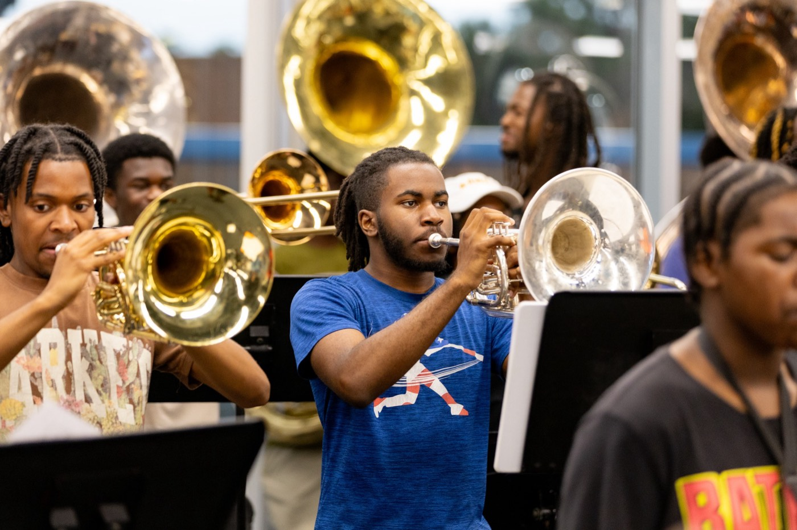
— SERVANT-LEADERSHIP
THE HAMPTON UNIVERSITY MARCHING FORCE
The Antidote to Hazing
Belonging, built the right way, leaves no room for cruelty.
◆ belonging a broken answer to a real need—belonging. Servant-leadership meets that need without cruelty.
◆ developed, not testedew members are developed, not tested; welcomed, not weeded out.
◆ preventing hazing of your director's research—servant-leadership as a documented approach to preventing hazing in the HBCU marching band.
◆ A served section polices itself: people protect what protects them.
Sources: Jones, doctoral dissertation, North Carolina A&T State University (2014); Jones, master's thesis, Gonzaga University (2012); Nuwer, Hazing: Destroying Young Lives (2018); HU Bands Anti-Hazing Policy (2026).
Pre-Drill Camp 2026 · Leadership Seminars
15
Notes:
SLIDE 15 — THE ANTIDOTE TO HAZING
This is the bridge to the hazing session. Slow down.
"Hazing is a broken answer to a real need — belonging. Servant-leadership meets that need without cruelty."
"New members get developed, not tested. Welcomed, not weeded out."
LAND: "A served section polices itself. People protect what protects them."

Slide 16
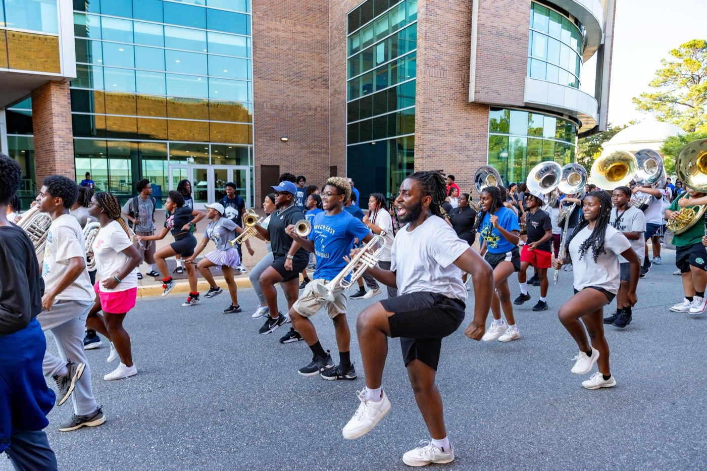
— SERVANT-LEADERSHIP
THE HAMPTON UNIVERSITY MARCHING FORCE
What It Is Not
Serving is not softness. Read this twice.
◆ notis not permissive. Servant-leaders hold the highest standards—they just hold them with people, not over them.
◆ notis not doing their work for them. You develop your people; you do not carry them.
◆ notis not being liked. It is being trusted—which will sometimes cost you being liked.
◆ notis not weakness. It takes more strength to serve and stay demanding than to bark and walk away.
High support, high standards. Servant-leaders are often the most demanding people in the room—because they can push hard and still keep the room.
Pre-Drill Camp 2026 · Leadership Seminars
16
Notes:
SLIDE 16 — WHAT IT IS NOT
CRITICAL SLIDE — some of them have been quietly hearing 'soft' for twenty minutes. Kill it here.
Not permissive. Not doing their work. Not being liked. Not weakness.
READ THE CALLOUT: "High support, high standards. Servant-leaders are often the most demanding people in the room — because they can push hard and still keep the room."

Slide 17

— SERVANT-LEADERSHIP
THE HAMPTON UNIVERSITY MARCHING FORCE
What It Looks Like Here
Servant-leadership, translated into your section's day.
◆ First in, last out—you set up before them and break down after them.
◆ Remove obstacles: the missing reed, the lost freshman, the water break nobody called.
◆ Develop, don't just direct—teach the why, not only the what.
◆ Take the blame, give the credit—always, and out loud.
◆ Serve the standard: the kindest thing you can do is refuse to let them be less than they can be.
Pre-Drill Camp 2026 · Leadership Seminars
17
Notes:
SLIDE 17 — WHAT IT LOOKS LIKE HERE
Translate it into their actual day.
FIRST IN, LAST OUT appears here — flag it: "That's the creed, and it closes both days of this camp."
BEST LINE: "The kindest thing you can do is refuse to let them be less than they can be."

Slide 18
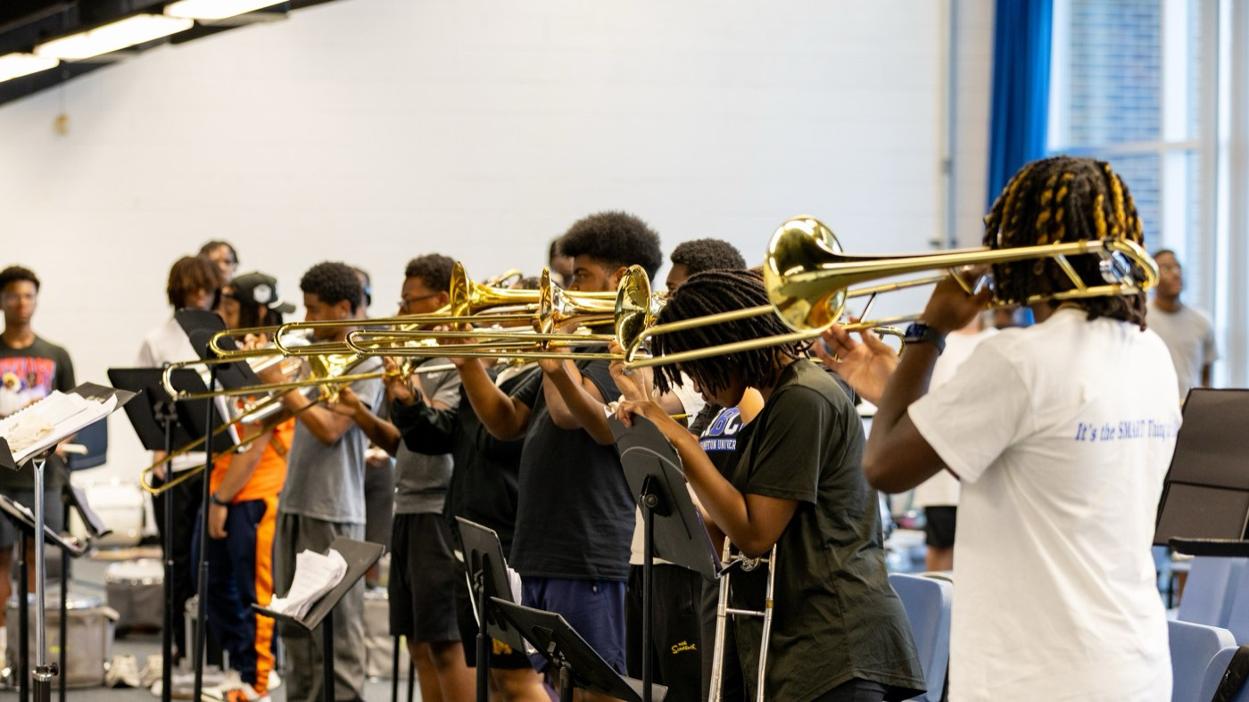
— SERVANT-LEADERSHIP
THE HAMPTON UNIVERSITY MARCHING FORCE
Does It Actually Work?
The research says yes—decisively.
◆ trust, engagement, and team performancehip to higher trust, engagement, and team performance.
◆ citizenship stronger citizenship—people helping people—and lower turnover.
◆ serving cultureving culture that reproduces itself: served people become serving leaders.
◆ winsther words, the model that is right is also the model that wins.
Sources: van Dierendonck, "Servant Leadership: A Review and Synthesis," Journal of Management (2011); Liden, Wayne, Liao, and Meuser, Academy of Management Journal (2014); Eva, Robin, Sendjaya, van Dierendonck, and Liden, The Leadership Quarterly (2019).
Pre-Drill Camp 2026 · Leadership Seminars
18
Notes:
SLIDE 18 — DOES IT ACTUALLY WORK?
For the skeptics in the room. Keep it brisk.
Higher trust, engagement, and performance. Stronger citizenship, lower turnover. A serving culture that reproduces itself.
LAND: "The model that's right is also the model that wins."

Slide 19
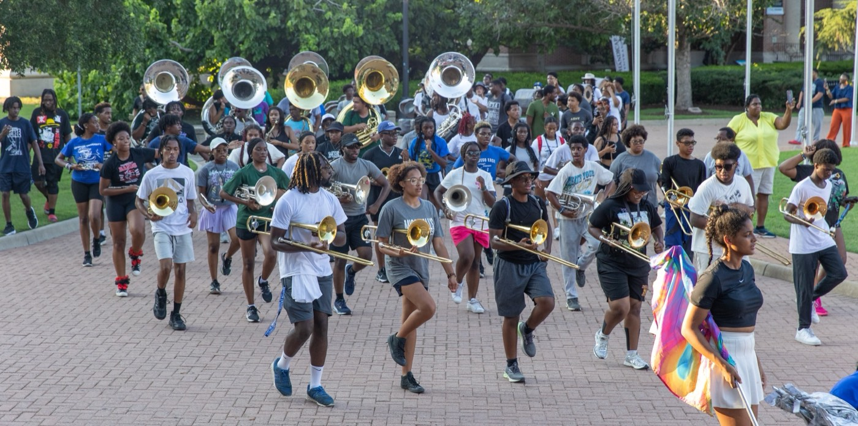
— SERVANT-LEADERSHIP
THE HAMPTON UNIVERSITY MARCHING FORCE
Before You Lead Them
Sit with these before the members arrive.
◆ hardest to serveion will be hardest to serve—and what do they actually need from you?
◆ removes one obstacle you can remove for your people this week?
◆ Where are you tempted to lead "first"—for credit, control, or comfort?
◆ becomeill your people become because you led them this year?
Pre-Drill Camp 2026 · Leadership Seminars
19
Notes:
SLIDE 19 — BEFORE YOU LEAD THEM
Four reflection questions. Don't answer them for the room — give real silence.
THE ONE TO SIT ON: "Where are you tempted to lead first — for credit, control, or comfort?"
Have them write one answer down.

Slide 20

03
OUR COVENANT
This is the standard of leadership we hold one another to—not because it is soft, but because it is the hardest and highest way to lead, and because it is who The Marching Force is. We serve our people, we serve the mission, and we serve the ones who come after us. Lead any other way, and you are leading someone else's band.
WE SERVE TO LEAD.
Notes:
SLIDE 20 — OUR COVENANT (statement slide)
Read it as a commitment, not information. Slower and lower than the rest of the session.
Takeaway: "We serve to lead."

Slide 21
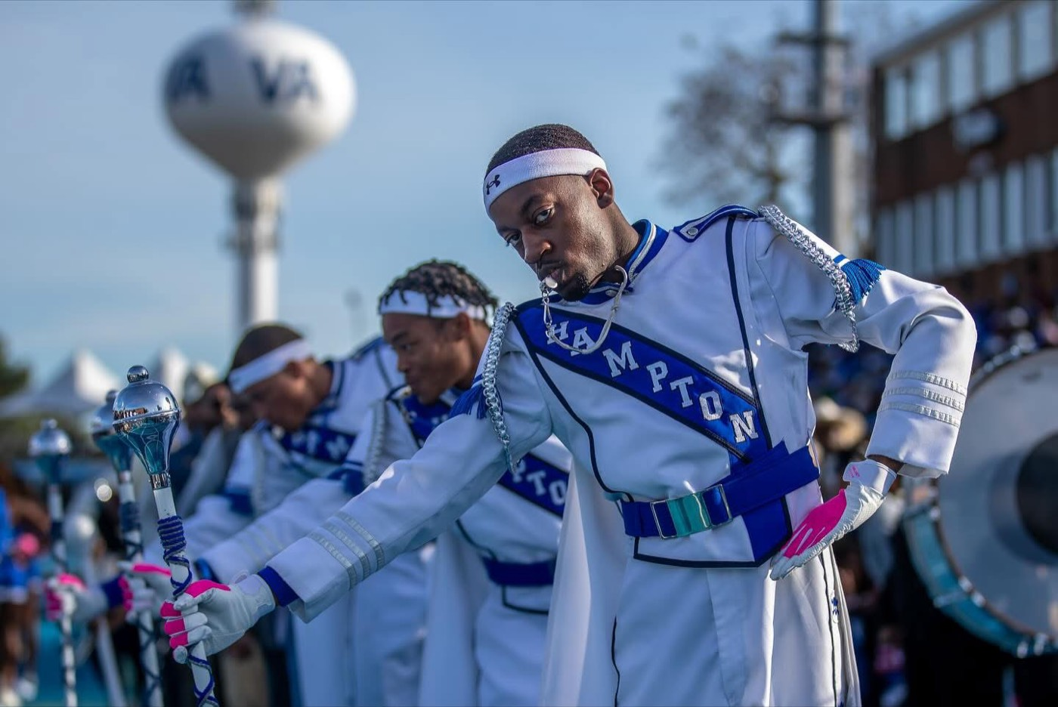
YOUR CHARGE
Serve First.
Lead Always.
Put your people before your position, the mission before your moods, and the section before yourself. Do that, and they will follow you anywhere—and become servant-leaders themselves. That is how a legacy is built, and how it is handed down.
Serve First. Lead Always. — Drive the Legacy.
The Hampton University Marching Force
Hampton's Heartbeat
Notes:
SLIDE 21 — CLOSE: Serve First. Lead Always.
Come back to the words they gave you after the icebreaker — point at them.
"Put your people before your position, the mission before your moods, and the section before yourself."
End on the sign-off.

