Slide 1
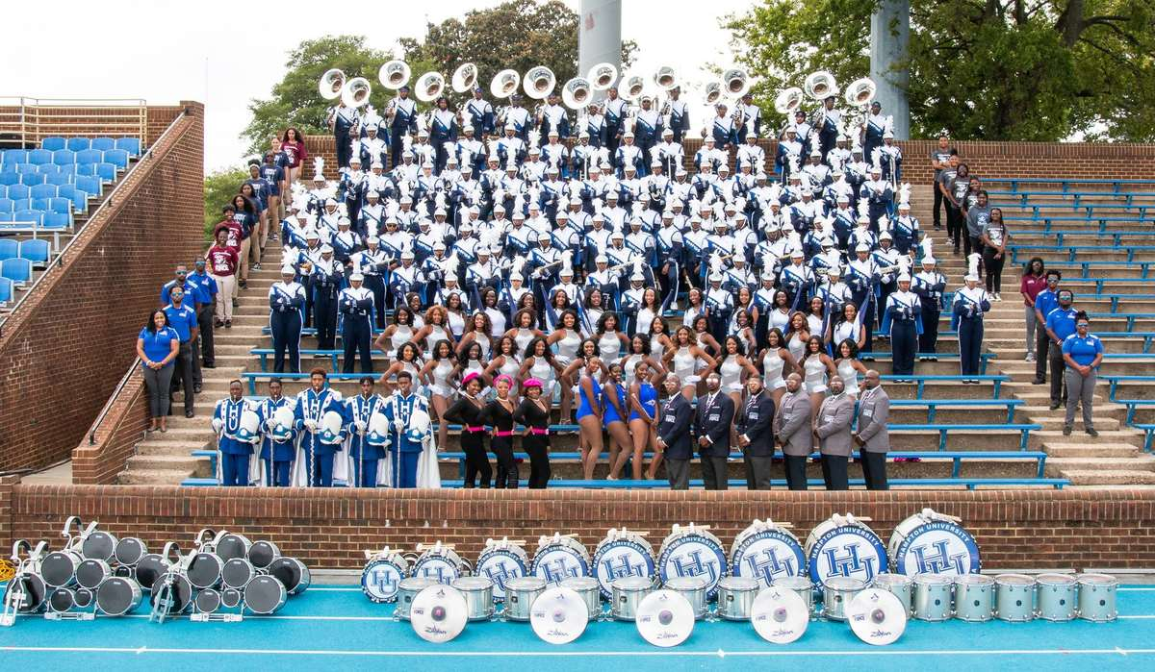
PRE-DRILL CAMP 2026 · LEADERSHIP SEMINARS · DAY 1
Emotional
Intelligence
"Manage Yourself. Read the Room."
Dr. Thomas L. Jones, Jr.
Director of University Bands · Saturday, August 1, 2026
The Hampton University Marching Force
Hampton's Heartbeat
Notes:
SLIDE 1 — TITLE: Emotional Intelligence
SAY: "Your musicianship got you the position. This is the part that makes people actually want to follow you."
CUE: Connect it back — "Know Yourself First told you who you are. This is how you run that person when the pressure is on."

Slide 2

— EMOTIONAL INTELLIGENCE
THE HAMPTON UNIVERSITY MARCHING FORCE
Icebreaker
Watch how a father manages his own emotions—and his son's—when everything is on the line.
▶
The Pursuit of Happyness — “Basketball and Dreams”
youtu.be/UZb2NOHPA2A
WATCH · 2:16
Pre-Drill Camp 2026 · Leadership Seminars
02
Notes:
SLIDE 2 — ICEBREAKER: The Pursuit of Happyness, "Basketball and Dreams" (2:16)
SET UP: "Watch him manage two sets of emotions at once — his son's, and his own."
Play it clean.
AFTER: "He catches himself. He'd already said the wrong thing, and he came back and fixed it." Ask: "How many of you have said the right thing the wrong way, and had to go back?"

Slide 3
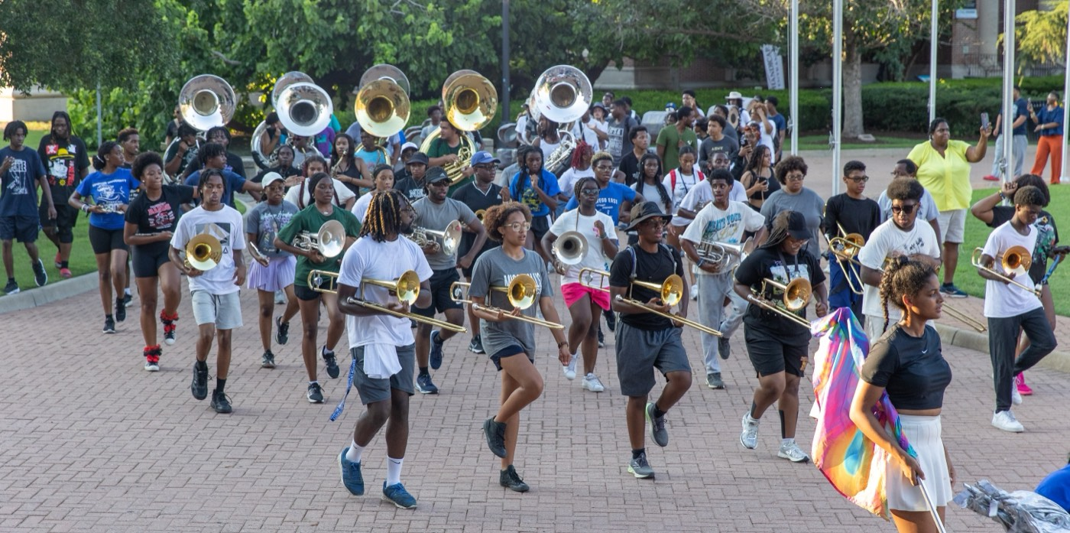
01
THE PREMISE
Your musicianship earned you the position. Your emotional intelligence is what makes people want to follow you. Talent fills a chair; composure, awareness, and empathy fill a leader. You will be judged less by what you know than by how you carry yourself—and how you handle your people when it is hard.
COMPOSURE IS A SKILL.
Notes:
SLIDE 3 — THE PREMISE (statement slide)
Read it as written.
The line to lean on: "Talent fills a chair. Composure, awareness, and empathy fill a leader."
Takeaway: "Composure is a skill." Say it twice — it reframes EI from personality to something trainable.

Slide 4

— EMOTIONAL INTELLIGENCE
THE HAMPTON UNIVERSITY MARCHING FORCE
Why It Runs the Room
Emotions are contagious—and yours set the temperature.
◆ mood section catches your mood before they catch your instructions—calm spreads, and so does panic.
◆ emotional temperaturemotional temperature of the block. Set it on purpose, not by accident.
◆ how you made them feelsure, people remember how you made them feel, not the words you used.
◆ Managing yourself first is what earns you the right to lead anyone else.
The through-line: Know Yourself First names who you are—Emotional Intelligence is how you run that person when the pressure is on.
Pre-Drill Camp 2026 · Leadership Seminars
04
Notes:
SLIDE 4 — WHY IT RUNS THE ROOM
SAY: "Your section catches your mood before they catch your instructions."
Walk the bullets. Land: "They remember how you made them feel, not the words you used."
CALLOUT ties the two sessions together — read it out loud, don't skip it.

Slide 5

— EMOTIONAL INTELLIGENCE
THE HAMPTON UNIVERSITY MARCHING FORCE
The Five Parts of EI
Daniel Goleman's model—built for exactly this work.
Sources: Goleman, Emotional Intelligence (1995) and "What Makes a Leader?" (Harvard Business Review, 1998); Salovey and Mayer, "Emotional Intelligence" (1990); Mayer, Salovey, and Caruso, American Psychologist (2008).
Pre-Drill Camp 2026 · Leadership Seminars
05
Notes:
SLIDE 5 — THE FIVE PARTS OF EI
Goleman's five. Name them, don't explain them yet — the next five slides do that.
CUE: "Five parts. We're going one at a time, and each one has something you can practice tomorrow."

Slide 6

— EMOTIONAL INTELLIGENCE
THE HAMPTON UNIVERSITY MARCHING FORCE
1 · Self-Awareness
You cannot manage what you cannot name.
◆ in the momenttion in the moment—name it before it starts driving you.
◆ Know your triggers: the rep that won't clean, the member who tests you, the moment everyone is exhausted.
◆ Know Yourself FirstYourself First pays off—your wiring shows up loudest under stress.
◆ Ask a trusted peer how you come across when you're heated—then believe them.
Pre-Drill Camp 2026 · Leadership Seminars
06
Notes:
SLIDE 6 — 1 · SELF-AWARENESS
"You cannot manage what you cannot name."
Make the triggers concrete: the rep that won't clean, the member who tests you, the moment everyone's exhausted.
THE ASK: "Go to a peer this week and ask how you come across when you're heated. Then believe them." That last part is the hard part — say it.

Slide 7

— EMOTIONAL INTELLIGENCE
THE HAMPTON UNIVERSITY MARCHING FORCE
2 · Self-Regulation
The pause between feeling and doing is where leaders live.
◆ amygdala hijackjack: strong emotion fires before thought. A few seconds of pause lets your judgment catch up.
◆ angry coach, correct, or text angry. Take the rep back when you are level.
◆ Your control gives your section permission to stay controlled.
Pre-Drill Camp 2026 · Leadership Seminars
07
Notes:
SLIDE 7 — 2 · SELF-REGULATION
Teach the amygdala hijack simply: "Strong emotion fires before thought. A few seconds of pause lets your judgment catch up."
THE RULE, say it flat: "Never coach, correct, or text angry."
Give them the out: "Take the rep back when you're level. Nobody loses respect for a leader who says 'give me a second.'"

Slide 8

— EMOTIONAL INTELLIGENCE
THE HAMPTON UNIVERSITY MARCHING FORCE
3 · Motivation
Drive that doesn't need applause to keep going.
◆ deep into the grindt. Your energy is the section's thermostat deep into the grind, not just at the start.
◆ purpose, not mood, not mood—connect the grind to the goal, out loud and often.
◆ Model resilience: lose a rep, reset, and go again without sulking or blaming.
◆ Optimism is a discipline, not a personality. Choose it where they can see you.
Pre-Drill Camp 2026 · Leadership Seminars
08
Notes:
SLIDE 8 — 3 · MOTIVATION
SAY: "Camp is long and it is hot. Your energy is the section's thermostat deep in the grind, not just at the start."
KEY LINE: "Optimism is a discipline, not a personality. Choose it where they can see you."
Model resilience out loud: lose a rep, reset, go again — no sulking, no blaming.

Slide 9

— EMOTIONAL INTELLIGENCE
THE HAMPTON UNIVERSITY MARCHING FORCE
4 · Empathy
Read the room—and the person right in front of you.
◆ changefor the change: the quiet member who goes quieter, the tears behind the sunglasses, the sudden attitude.
◆ "You good?"you assume. "You good?" is leadership.
◆ reachhy is not lowering the standard—it is understanding what a person needs to reach it.
◆ Some of your people are carrying things you cannot see. Lead like it's true, because it is.
Pre-Drill Camp 2026 · Leadership Seminars
09
Notes:
SLIDE 9 — 4 · EMPATHY
Slow down here. This is the one they'll need most during camp.
"Watch for the change — the quiet member who goes quieter, the tears behind the sunglasses, the sudden attitude."
GIVE THEM THE TOOL: "'You good?' is leadership. Ask before you assume."
GUARDRAIL: "Empathy is not lowering the standard. It's understanding what a person needs to reach it." Say that clearly — some of them will hear empathy as softness.

Slide 10
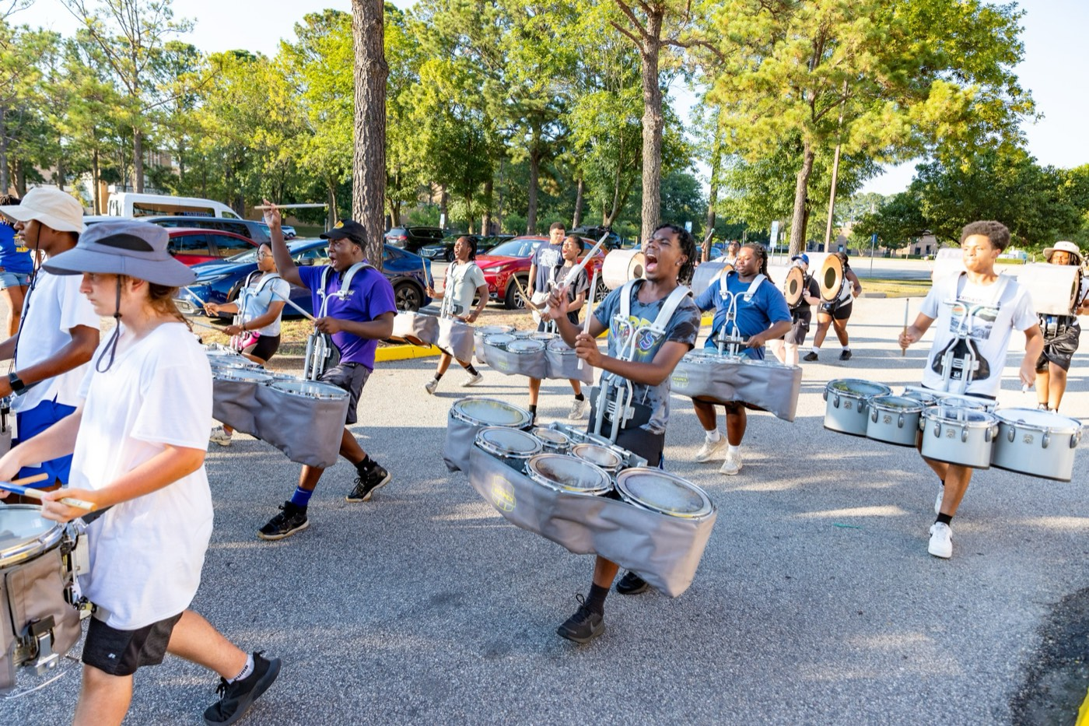
— EMOTIONAL INTELLIGENCE
THE HAMPTON UNIVERSITY MARCHING FORCE
5 · Social Skill
Move people without heat, without force.
◆ Influence beats authority—people follow respect a lot further than they follow rank.
◆ De-escalate: lower your voice, name the tension, and solve the problem instead of the ego.
◆ cleaner the hard message clean—direct, private, and never in front of an audience.
◆ Repair fast. A leader who apologizes well keeps the section's trust for years.
Pre-Drill Camp 2026 · Leadership Seminars
10
Notes:
SLIDE 10 — 5 · SOCIAL SKILL
"Influence beats authority. People follow respect a lot further than they follow rank."
De-escalation: lower your voice, name the tension, solve the problem instead of the ego.
Hard message: direct, private, never in front of an audience.
LAND IT: "Repair fast. A leader who apologizes well keeps the section's trust for years."

Slide 11

— EMOTIONAL INTELLIGENCE
THE HAMPTON UNIVERSITY MARCHING FORCE
React or Respond
Same moment on the field. Two very different leaders.
Pre-Drill Camp 2026 · Leadership Seminars
11
Notes:
SLIDE 11 — REACT OR RESPOND
This slide is a contrast — walk the reacting column first, then the responding column.
CUE: Read the reacting bullets in the tone of a leader losing it, then reset your voice for the responding ones. The tonal shift teaches more than the words.
ASK: "Which column were you in the last time a rep went bad?" Let it be quiet. Nobody has to answer out loud.

Slide 12

02
MAKE NO MISTAKE
Emotional intelligence is not softness—it is control. It does not lower the bar; it is how you hold the bar without losing yourself or your people. The most emotionally intelligent leader in the room is often the most demanding one, because they can push hard and stay respected. Composure is not the opposite of intensity. It is what makes intensity safe to follow.
EI IS STRENGTH, NOT SOFTNESS.
Notes:
SLIDE 12 — MAKE NO MISTAKE (statement slide)
The guardrail slide. Deliver it firmly.
"Emotional intelligence is not softness. It is control. It doesn't lower the bar — it's how you hold the bar without losing yourself or your people."
Takeaway: "EI is strength, not softness."

Slide 13
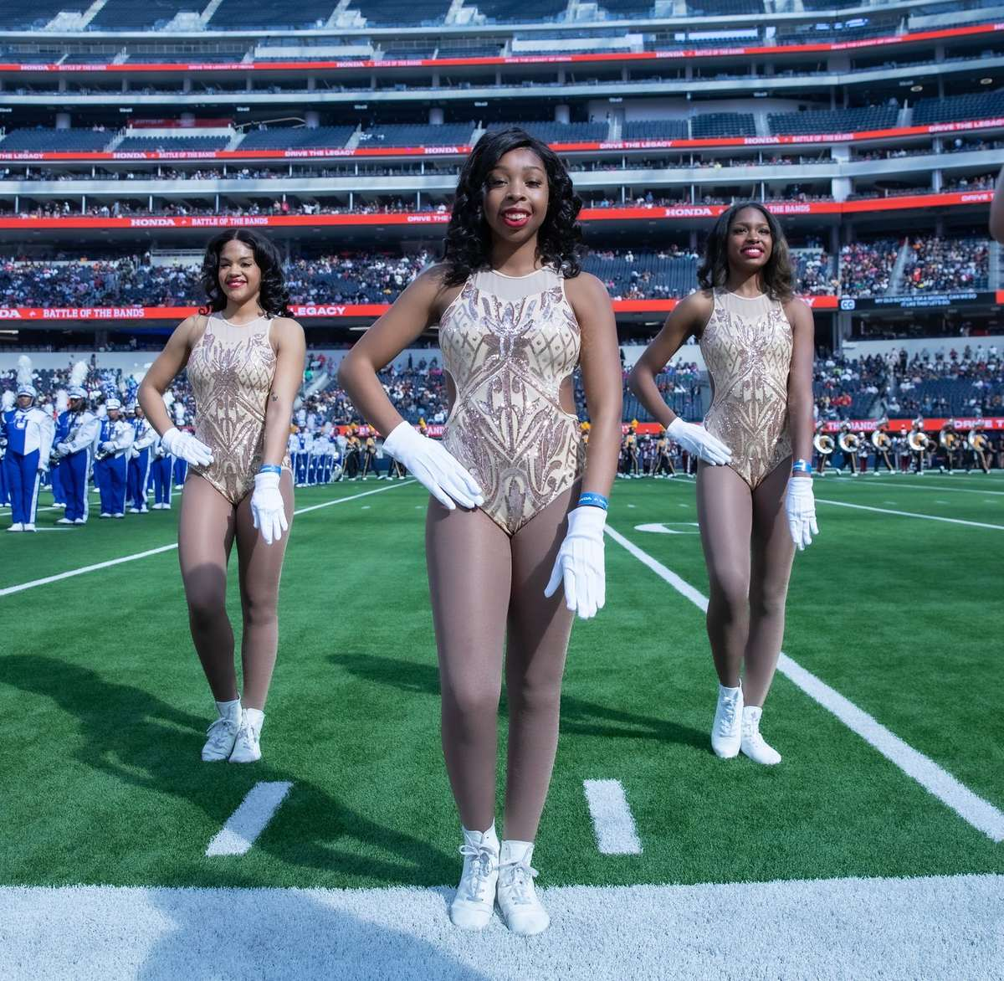
YOUR CHARGE
Master Yourself.
Move the Room.
Manage your own emotions before you manage anyone else's. Read your people, meet them where they are, and lead them to the standard with a steady hand. The section will rise to the temperature you set—so set it high, and set it calm.
Serve First. Lead Always. — Drive the Legacy.
The Hampton University Marching Force
Hampton's Heartbeat
Notes:
SLIDE 13 — CLOSE: Master Yourself. Move the Room.
"Manage your own emotions before you manage anyone else's. The section will rise to the temperature you set."
End on the sign-off. Don't add to it.

