Slide 1
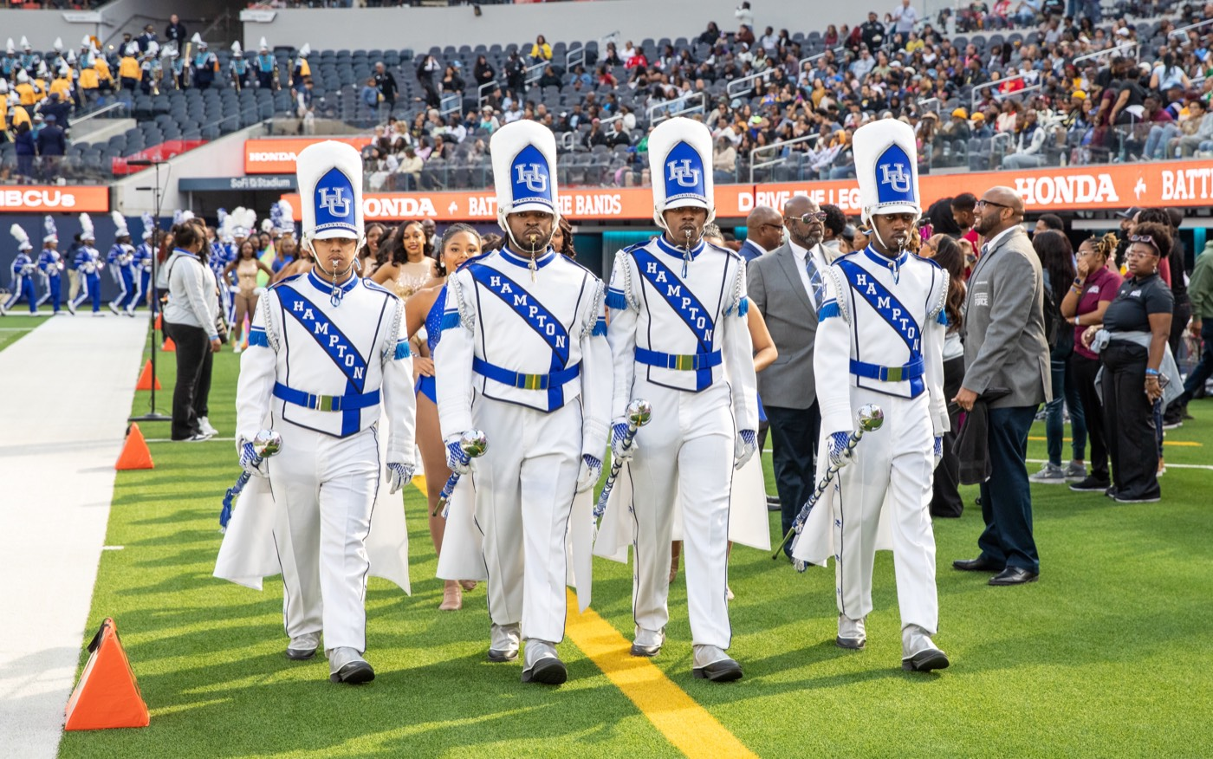
PRE-DRILL CAMP 2026 · LEADERSHIP SEMINARS · DAY 1
Know Yourself
First
"Self-Awareness as the Starting Point of Leadership"
Dr. Thomas L. Jones, Jr.
Director of University Bands · Saturday, August 1, 2026
The Hampton University Marching Force
Hampton's Heartbeat
Notes:
SLIDE 1 — TITLE: Know Yourself First
SAY: "Every leadership book starts somewhere else. We start in the mirror. You cannot lead people you don't understand, and that begins with you."
CUE: Tell them up front they'll take a test in about fifteen minutes and need their phone. That stops the phones-out problem before it starts.

Slide 2

— KNOW YOURSELF FIRST
THE HAMPTON UNIVERSITY MARCHING FORCE
Icebreaker
We all wear a different face for a different room. This seminar is about knowing the one underneath.
▶
Key and Peele — “Phone Call”
youtu.be/qXH5CD3O7Oc
WATCH · 0:48
Pre-Drill Camp 2026 · Leadership Seminars
02
Notes:
SLIDE 2 — ICEBREAKER: Key and Peele, "Phone Call" (0:48)
SET UP: "Watch how fast he changes."
Play it. It's short — let the laugh happen.
AFTER: "We all do that. Different face for a different room. That's not fake — that's human. The question is whether you know which one is actually you."
Don't over-discuss. One or two reactions, then move.

Slide 3
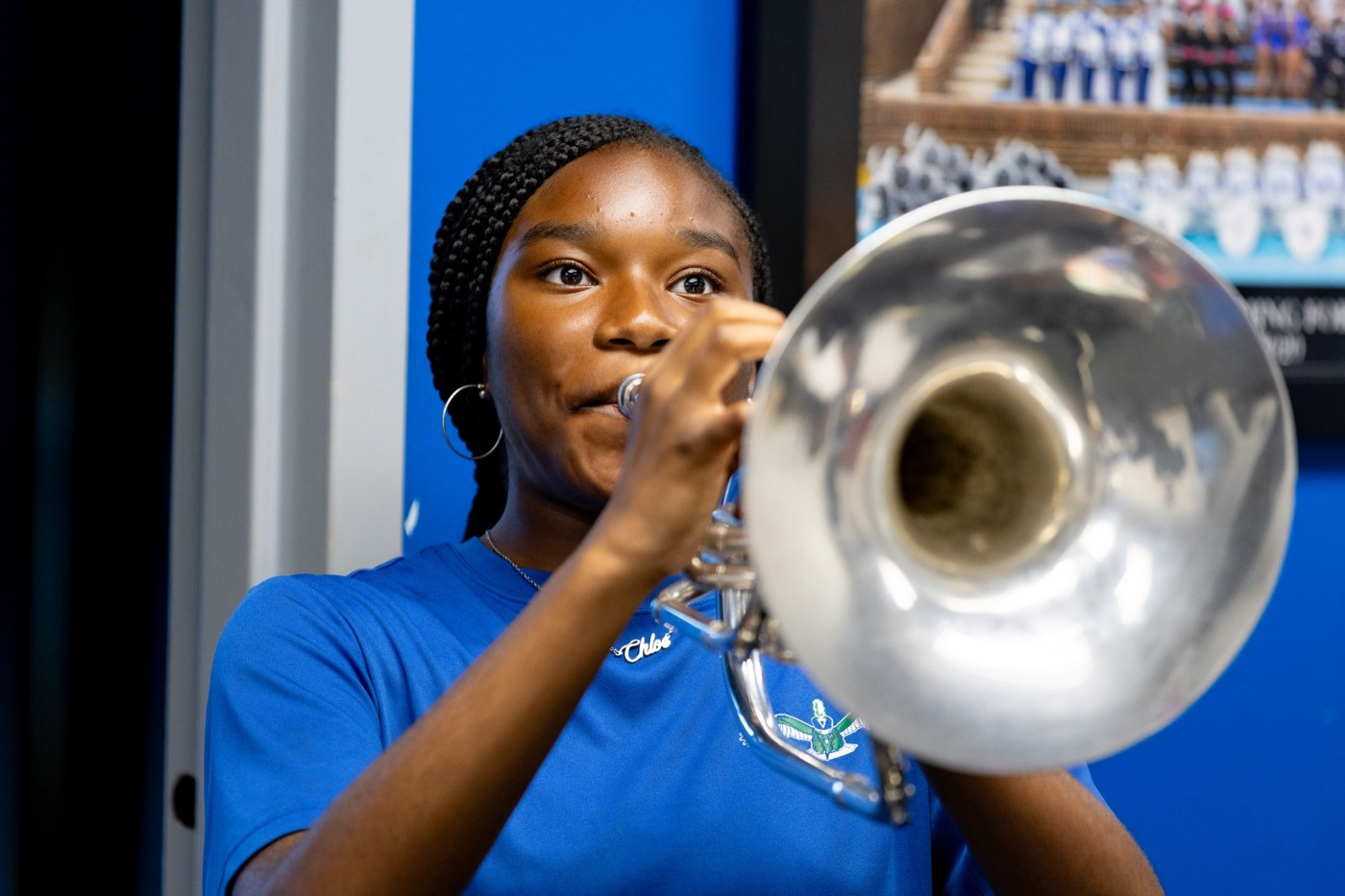
01
THE PREMISE
You cannot lead people you do not understand—and that begins with understanding yourself. Before you can read your section, you have to read your own wiring: your defaults, your strengths, and your blind spots. Self-awareness is not soft. It is the first skill of a leader.
LEAD YOURSELF FIRST.
Notes:
SLIDE 3 — THE PREMISE (statement slide)
Read it, don't paraphrase.
Then: "Before you can read your section, you have to read your own wiring — your defaults, your strengths, your blind spots."
Land the takeaway: "Lead yourself first."

Slide 4

— KNOW YOURSELF FIRST
THE HAMPTON UNIVERSITY MARCHING FORCE
Why Self-Awareness Comes First
Your section reads you before they ever follow you.
◆ how you show upct to how you show up—your tone, your defaults, your moods—long before they hear your words.
◆ your section's problemt see becomes your section's problem to manage.
◆ on purposeown wiring and you lead on purpose, not by accident or by mood.
◆ once you know your own starting pointhave once you know your own starting point.
Your move here: put language to how you are built—then use it to lead better, not to excuse yourself.
Pre-Drill Camp 2026 · Leadership Seminars
04
Notes:
SLIDE 4 — WHY SELF-AWARENESS COMES FIRST
Walk the four bullets briskly.
HIT HARDEST: "A blind spot you can't see becomes your section's problem to manage." Let that sit — most of them have been on the receiving end of somebody else's blind spot.
CALLOUT: "Put language to how you're built — then use it to lead better, not to excuse yourself." Flag that you'll come back to the excuse part at the end.

Slide 5

— KNOW YOURSELF FIRST
THE HAMPTON UNIVERSITY MARCHING FORCE
The Tool: Personality Type
The Myers-Briggs framework—a mirror, not a verdict.
◆ preferencesur preferences across four dichotomies into one of 16 types—a shorthand for how you naturally operate.
◆ free test at 16Personalities 16Personalities—quick, plain-language, and easy to discuss as a group.
◆ leadership strengths and blind spotsy type has leadership strengths and blind spots.
◆ starting point for the conversationnt for the conversation—a mirror to look into, never a box to hide in.
Sources: Jung, Psychological Types (1921); Myers and Myers, Gifts Differing (1980); Myers, McCaulley, Quenk, and Hammer, MBTI Manual, 3rd ed. (1998); NERIS Analytics, 16Personalities (2011–present).
Pre-Drill Camp 2026 · Leadership Seminars
05
Notes:
SLIDE 5 — THE TOOL: PERSONALITY TYPE
Frame it honestly: "This is a mirror, not a verdict. Sixteen types, four letters each."
SAY PLAINLY: "No type is better than another. Every one has leadership strengths and blind spots."
Head off the eye-roll: some of them have taken this before or think it's a horoscope. Acknowledge it — "Use it as a starting point for conversation, not a box."

Slide 6
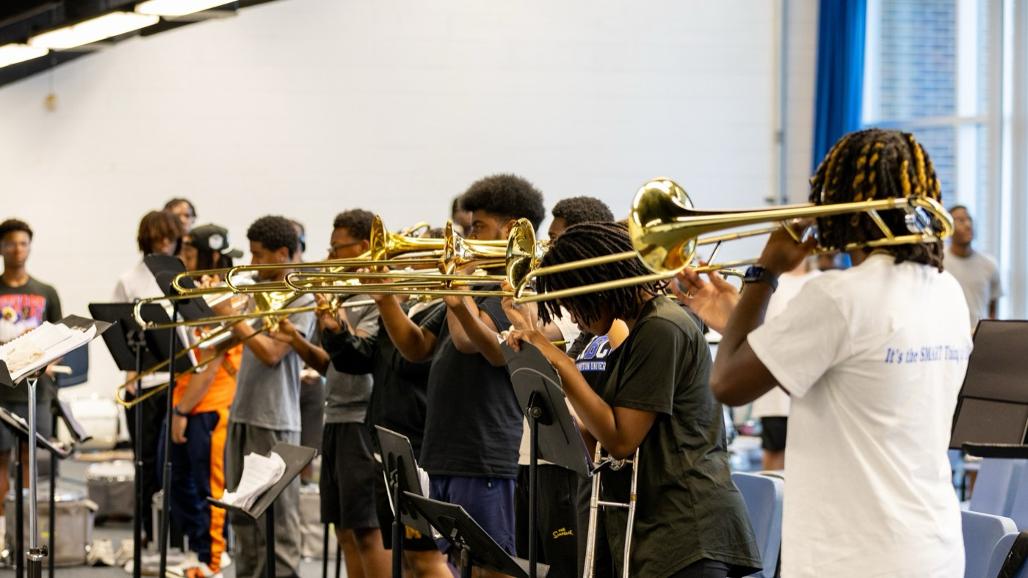
— KNOW YOURSELF FIRST
THE HAMPTON UNIVERSITY MARCHING FORCE
The Four Preferences
Your type is four letters—one from each pair.
Pre-Drill Camp 2026 · Leadership Seminars
06
Notes:
SLIDE 6 — THE FOUR PREFERENCES
Walk the four pairs quickly — where you get energy, how you take in information, how you decide, how you organize.
CUE: Keep this fast. They'll understand it better after they have their own result than they will from your explanation now.

Slide 7

— KNOW YOURSELF FIRST
THE HAMPTON UNIVERSITY MARCHING FORCE
Take the Test—Right Now
Ten honest minutes. Bring your four letters back to the room.
Pre-Drill Camp 2026 · Leadership Seminars
07
Notes:
SLIDE 7 — TAKE THE TEST, RIGHT NOW (activity)
LOGISTICS — say all of it clearly:
"Phones out. 16personalities.com. Ten minutes. Answer fast and honestly — first instinct, not the answer that makes you look like a good leader."
Write the URL where everyone can see it.
Set a visible timer. Circulate. At eight minutes give a two-minute warning.
Bring them back with: "Everybody has four letters? Say yours to the person next to you."

Slide 8
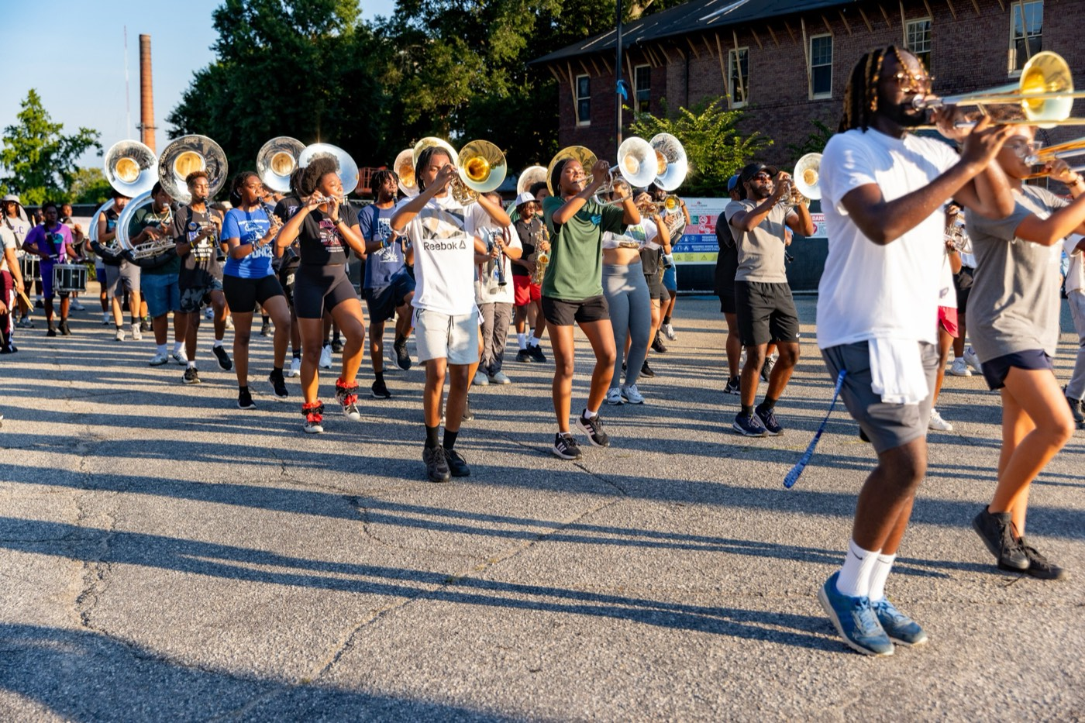
— KNOW YOURSELF FIRST
THE HAMPTON UNIVERSITY MARCHING FORCE
The 16 Types
Four families, grouped by what drives each one.
Pre-Drill Camp 2026 · Leadership Seminars
08
Notes:
SLIDE 8 — THE 16 TYPES
Let them find themselves on the board. Give it a beat — there will be noise and comparing. That's fine, it's the point.
Then: "Four families. Let's talk about what each one brings to a section."

Slide 9
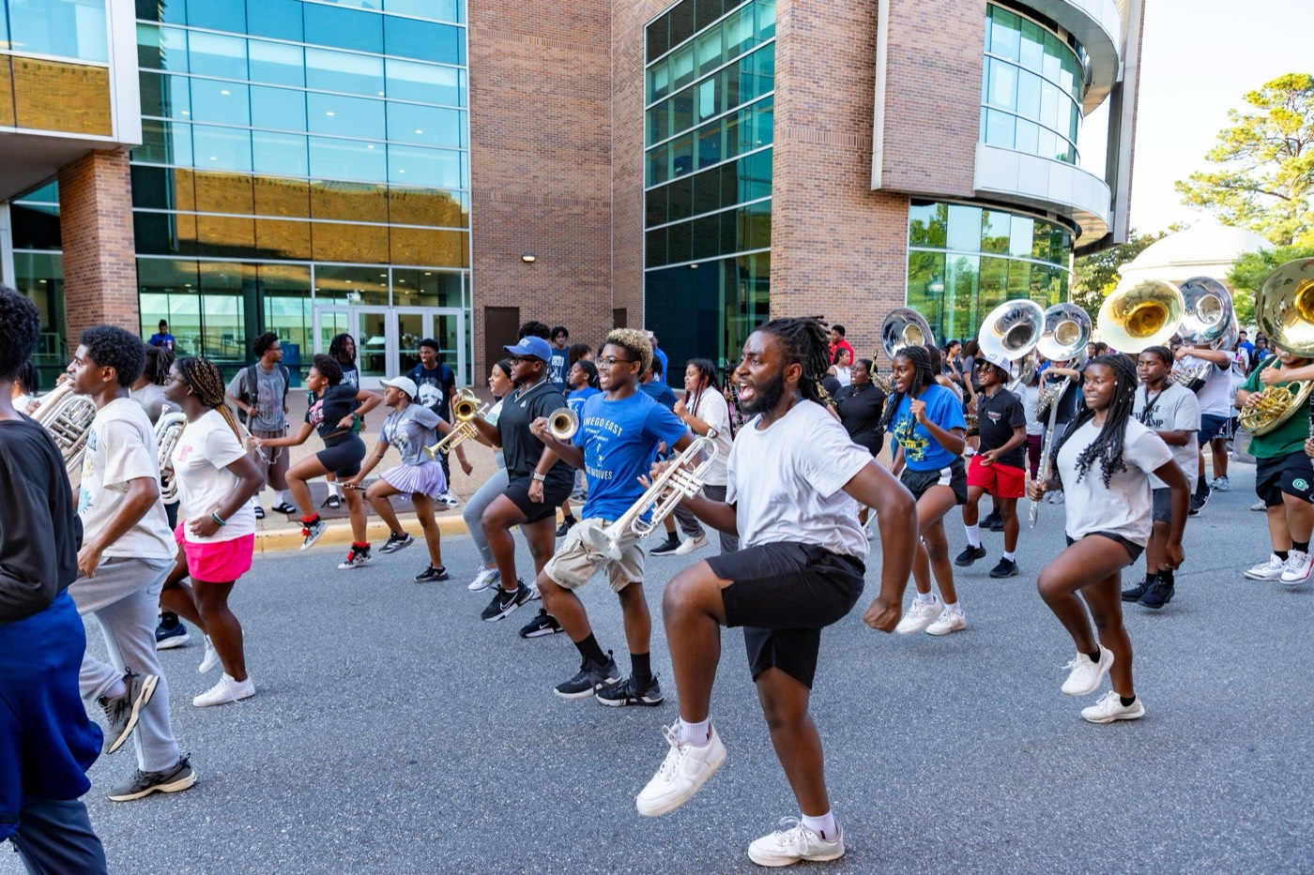
— KNOW YOURSELF FIRST
THE HAMPTON UNIVERSITY MARCHING FORCE
What Your Family Brings
Every family leads—each with a strength and a watch-out.
NT
Analysts — the Strategists
Strength: vision and systems. Watch-out: can run past people's feelings. Slow down and bring the section with you.
Pre-Drill Camp 2026 · Leadership Seminars
09
Notes:
SLIDE 9 — WHAT YOUR FAMILY BRINGS
Go family by family. As you name each, ask that group to raise hands so the room sees the mix.
Analysts (NT) — vision and systems, can run past feelings.
Diplomats (NF) — inspiration and empathy, can avoid hard calls.
Sentinels (SJ) — reliability and order, can resist change.
Explorers (SP) — energy and adaptability, can skip details.
KEY POINT: "Every family has a watch-out. Yours is written right there. That's the part to own."

Slide 10

— KNOW YOURSELF FIRST
THE HAMPTON UNIVERSITY MARCHING FORCE
Lead Yourself, Then Flex
Know your default—then meet your people where they are.
◆ Thinking (T)by Thinking (T), remember a Feeling (F) member needs the why and the care, not just the logic.
◆ Judging (J)Judging (J) and structured, give a Perceiving (P) member room to get there their own way.
◆ Extraverted (E)averted (E), make space for the Introverted (I) members who lead quietly and think before they speak.
◆ stretch past it to change your type—it is to stretch past it for the good of the section.
Pre-Drill Camp 2026 · Leadership Seminars
10
Notes:
SLIDE 10 — LEAD YOURSELF, THEN FLEX
This is the whole payoff of the session.
SAY: "Your job isn't to change your type. It's to stretch past it for the good of the section."
Walk the T/F, J/P, E/I examples. Make it concrete: "Who on your line is your opposite?" Let them think of a real name.

Slide 11
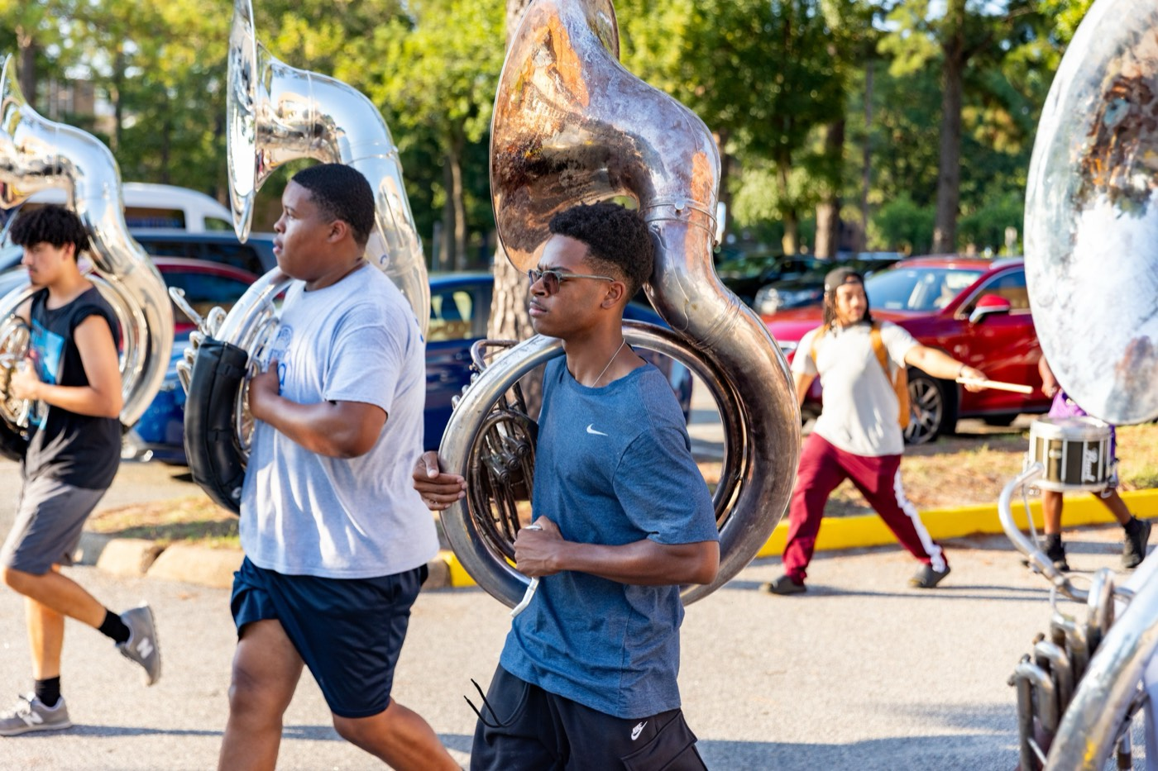
— KNOW YOURSELF FIRST
THE HAMPTON UNIVERSITY MARCHING FORCE
Open Discussion
Now that you have your four letters—let's talk.
◆ does it feel true, and does it feel true? Where is it off?
◆ how you lead your section up in how you lead your section—for better and for worse?
◆ blind spotlind spot your type warns you about. How will you cover it?
◆ your oppositeine is your opposite—and how will you adjust to lead them well?
Pre-Drill Camp 2026 · Leadership Seminars
11
Notes:
SLIDE 11 — OPEN DISCUSSION (facilitated)
This is the heart of the session — protect the time for it.
Work the four questions on screen. Don't rush to fill silence; let them think.
FACILITATION CUES:
· Pull in the quiet ones by type — "Any Introverts want to speak to this?" gets a laugh and a real answer.
· If someone says "this is so me," push: "Where is it off?"
· Watch the clock — you can spend the whole session here if you let it.

Slide 12

02
A WORD OF CAUTION
Your type is a mirror, not a box—and never an excuse. "That's just my personality" is not a reason to skip the standard or dodge the hard conversation. People are more than four letters, and they grow. Use what you learn here to understand yourself and your people—then lead them all to the same bar.
A MIRROR, NOT A BOX.
Notes:
SLIDE 12 — A WORD OF CAUTION (statement slide)
This is the guardrail. Say it firmly.
"Your type is a mirror, not a box — and never an excuse. 'That's just my personality' is not a reason to skip the standard or dodge a hard conversation."
CUE: Expect somebody to try this on you within the week. Tell them now that you'll call it.

Slide 13
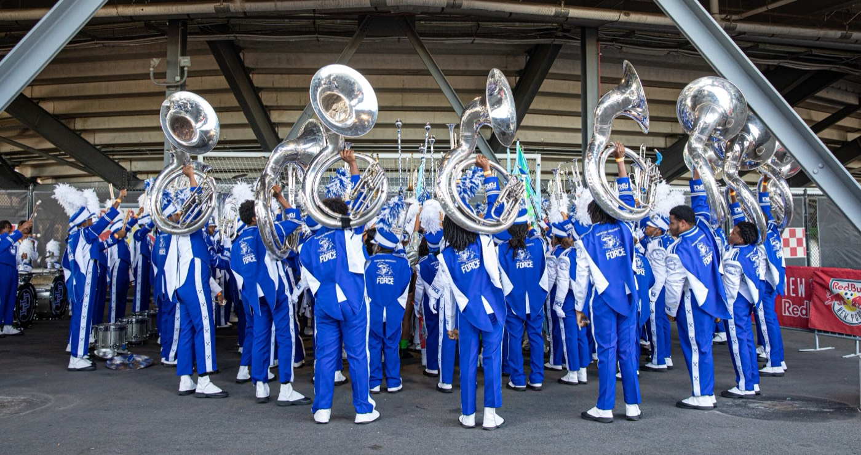
YOUR CHARGE
Know Yourself.
Then Lead.
You cannot give your section what you have not found in yourself first. Know your wiring, own your blind spots, and stretch past your defaults—so you can lead every type of person on your line to the standard.
Serve First. Lead Always. — Drive the Legacy.
The Hampton University Marching Force
Hampton's Heartbeat
Notes:
SLIDE 13 — CLOSE: Know Yourself. Then Lead.
Deliver the charge, then end.
"You can't give your section what you haven't found in yourself first. Know your wiring, own your blind spots, and stretch past your defaults."
Tell them to keep their four letters — Emotional Intelligence picks up right here.

