Slide 1
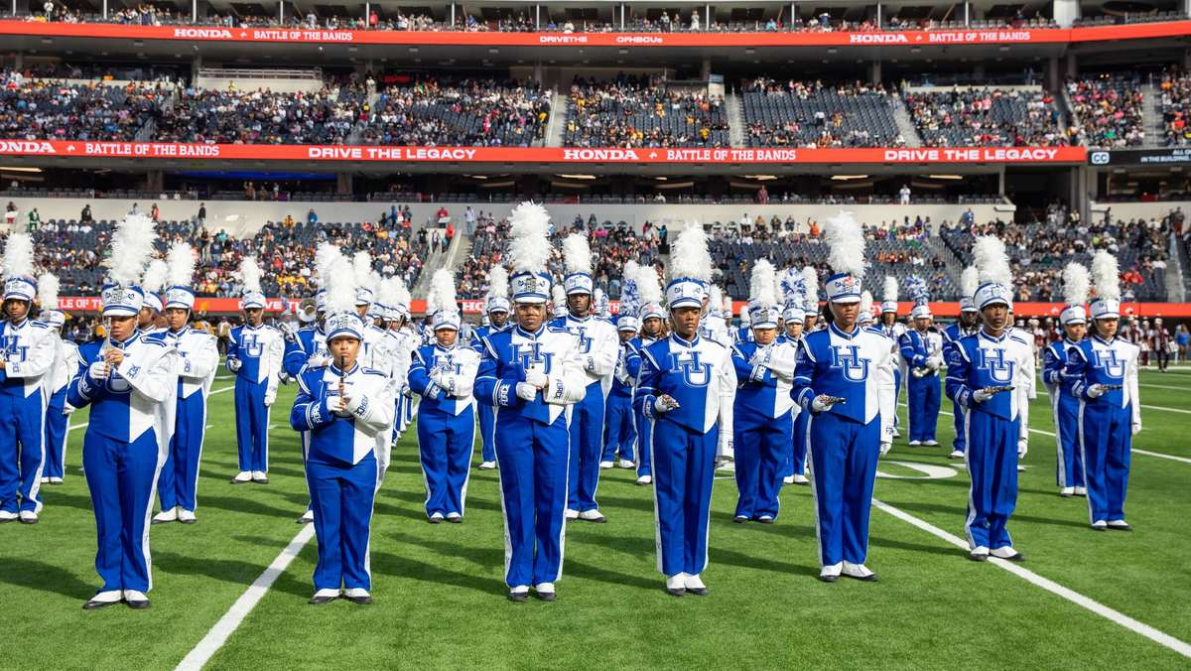
PRE-DRILL CAMP 2026 · LEADERSHIP SEMINARS · DAY 1
Welcome
and Vision
"The Standard and The Why"
Dr. Thomas L. Jones, Jr.
Director of University Bands · Saturday, August 1, 2026
The Hampton University Marching Force
Hampton's Heartbeat
Notes:
SLIDE 1 — TITLE: Welcome and Vision
THE OPENING SESSION OF THE ENTIRE CAMP. Set the tone for two days here.
SAY: "Before the membership arrives, the twenty-some people in this room decide what kind of band this is going to be."
CUE: Start on time, to the second. You're about to spend two days teaching First In — model it now.

Slide 2
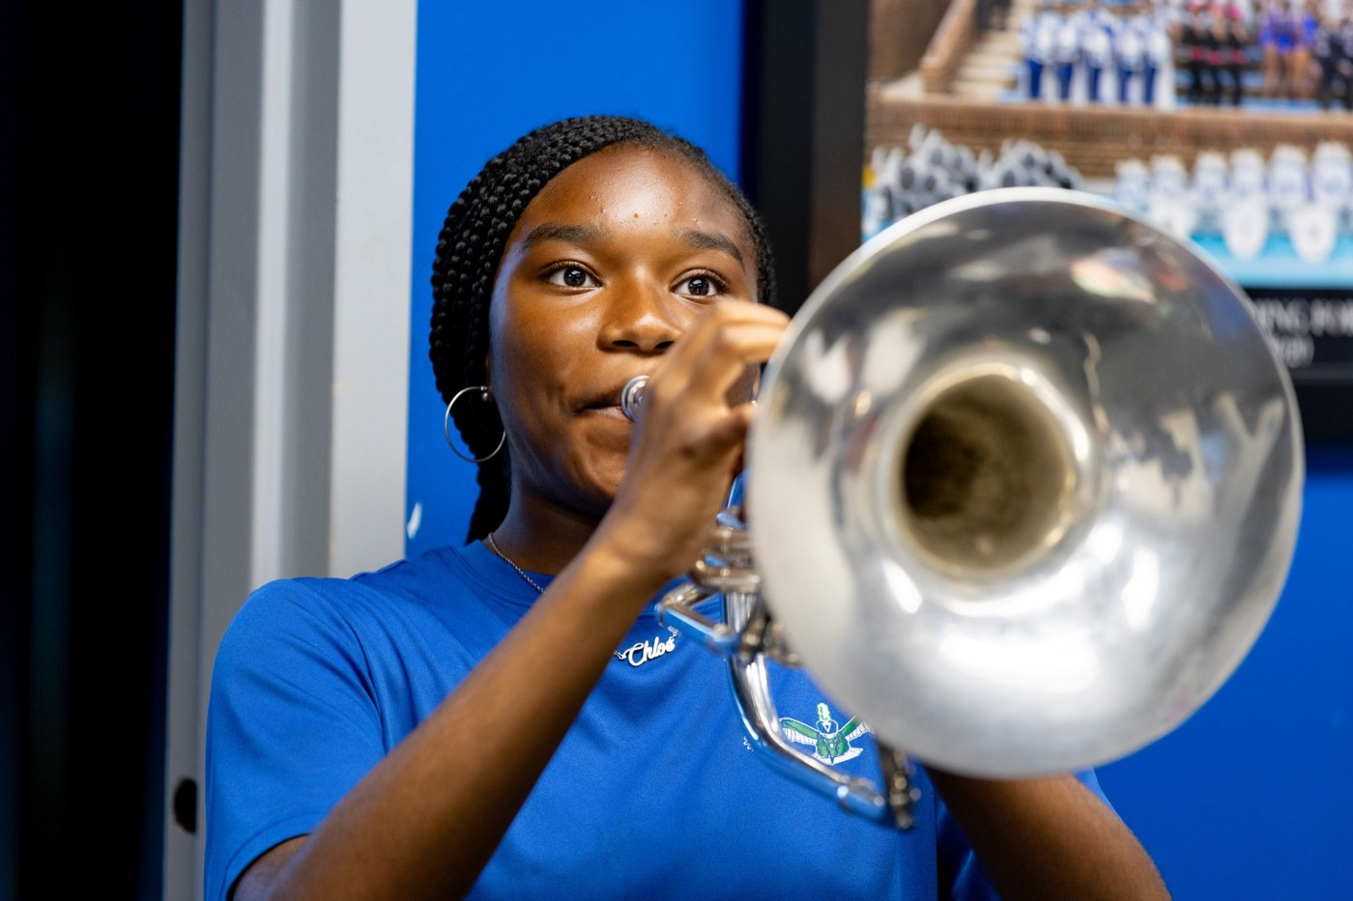
— WELCOME AND VISION
THE HAMPTON UNIVERSITY MARCHING FORCE
Icebreaker
Before we talk about who we are and where we are going, take a minute and remember what this band can do.
▶
Hampton at the Macy's Thanksgiving Day Parade
youtu.be/ZC7VVKsBfyQ
WATCH · 1:12
Pre-Drill Camp 2026 · Leadership Seminars
02
Notes:
SLIDE 2 — ICEBREAKER: Hampton at the Macy's Parade (1:12)
SET UP: "Before we talk about where we're going, remember what this band can already do."
Play it. Let them react — cheering is fine and good.
AFTER: "That's us. That's the bar."

Slide 3
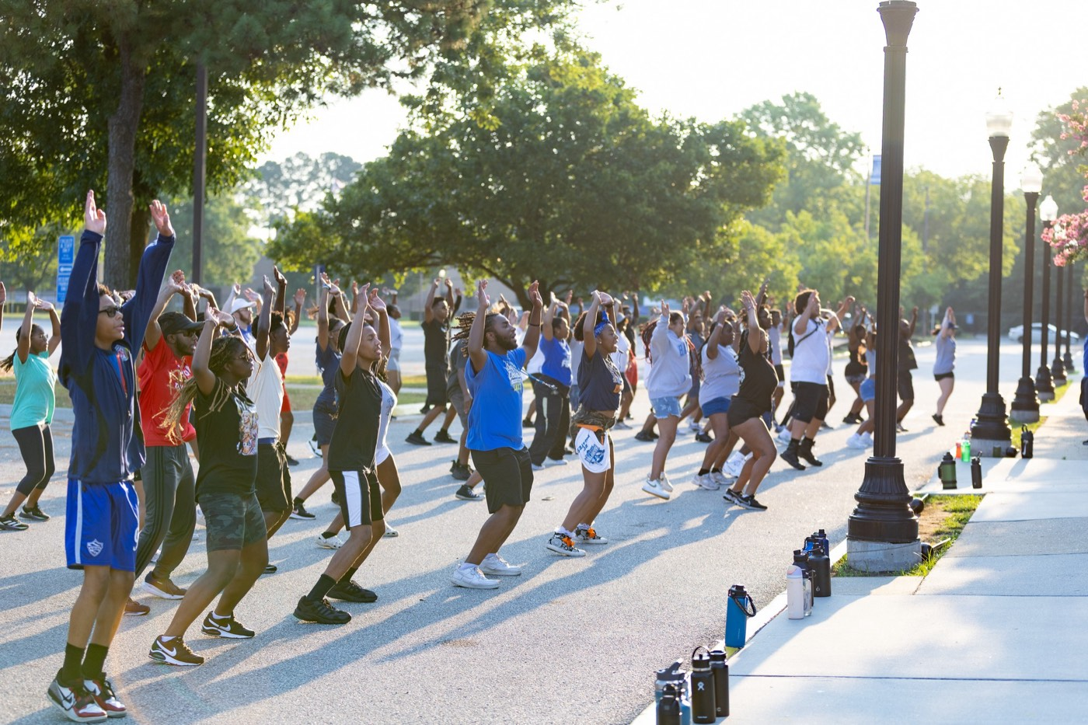
— WELCOME AND VISION
THE HAMPTON UNIVERSITY MARCHING FORCE
Welcome, Leaders.
You set the standard before the membership arrives.
◆ who we arend we align on who we are, where we are going, and how we will operate this year.
◆ Every session is short and direct—come ready to think, take notes, and buy in.
◆ modelnday, the members will follow what you model this weekend, not what we say.
Our charge for the next two days: leave here aligned, accountable, and ready to lead The Marching Force.
Pre-Drill Camp 2026 · Leadership Seminars
03
Notes:
SLIDE 3 — WELCOME, LEADERS
"This weekend we align on who we are, where we're going, and how we operate this year."
SET EXPECTATIONS: sessions are short and direct — think, take notes, buy in.
THE LINE THAT MATTERS: "By Monday the members will follow what you MODEL this weekend, not what we say."

Slide 4
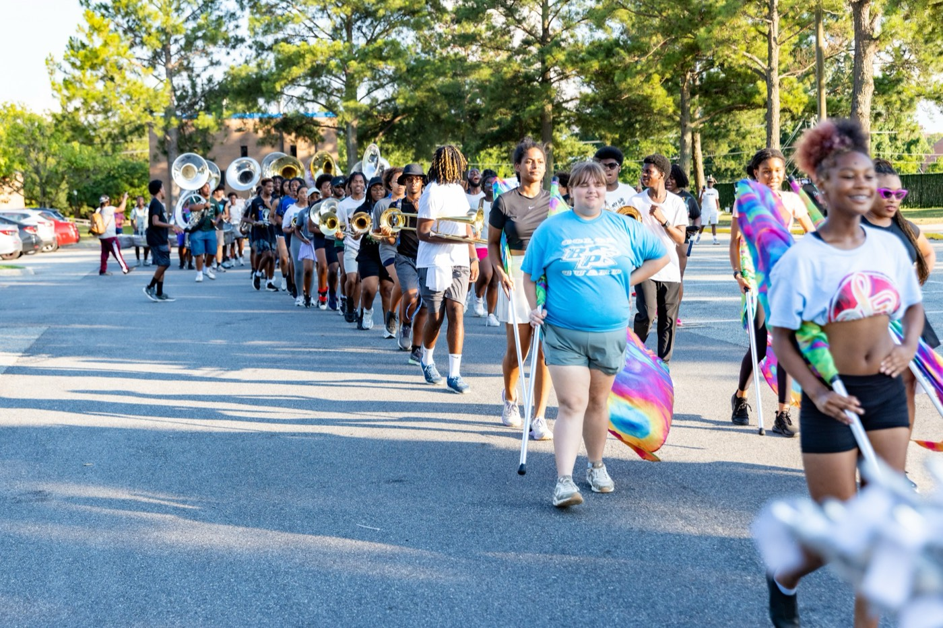
— WELCOME AND VISION
THE HAMPTON UNIVERSITY MARCHING FORCE
The Band by the Numbers
Every section that makes The Marching Force.
Pre-Drill Camp 2026 · Leadership Seminars
04
Notes:
SLIDE 4 — THE BAND BY THE NUMBERS
Walk the roster: Winds, Drumline, Auxiliary, Drum Majors, Support.
CUE: let each section find their number. It makes the scale of the program real.
NOTE: if the roster has shifted since this was built, say the current figure rather than reading the slide.

Slide 5
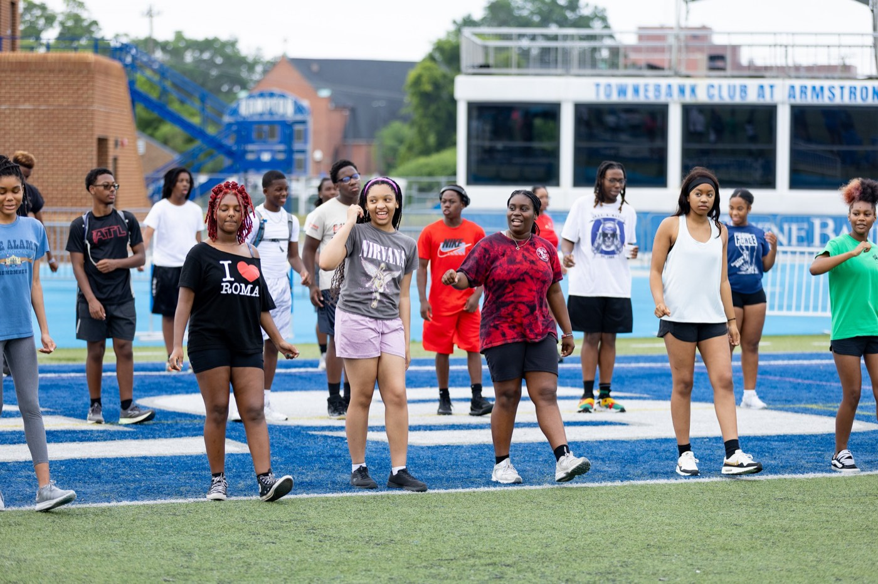
— WELCOME AND VISION
THE HAMPTON UNIVERSITY MARCHING FORCE
Where We're Headed
Our growth target for next season—section by section.
Pre-Drill Camp 2026 · Leadership Seminars
05
Notes:
SLIDE 5 — WHERE WE'RE HEADED
The growth target, section by section.
FRAME IT AS THEIR JOB: "Growth isn't a recruiting-office project. It's retention — and retention is culture, which is you."

Slide 6
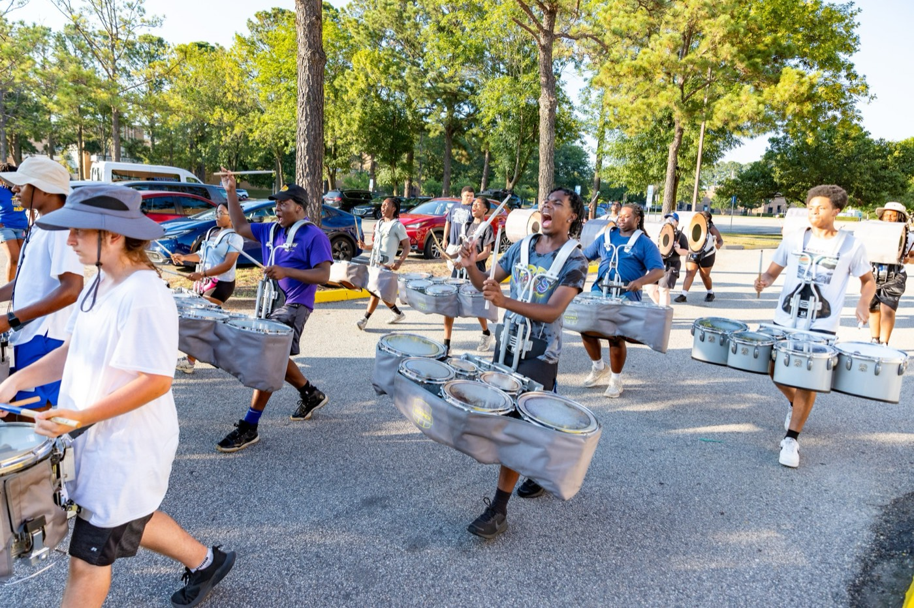
— WELCOME AND VISION
THE HAMPTON UNIVERSITY MARCHING FORCE
The Road to Hampton
What I ask of you, I have lived — at every stop along the way.
Pre-Drill Camp 2026 · Leadership Seminars
06
Notes:
SLIDE 6 — THE ROAD TO HAMPTON
Your own record. Deliver it plainly, not boastfully — the point is credibility, not applause.
LAND: "What I ask of you, I've lived at every stop."
End on the full circle — leading the band you marched in.

Slide 7
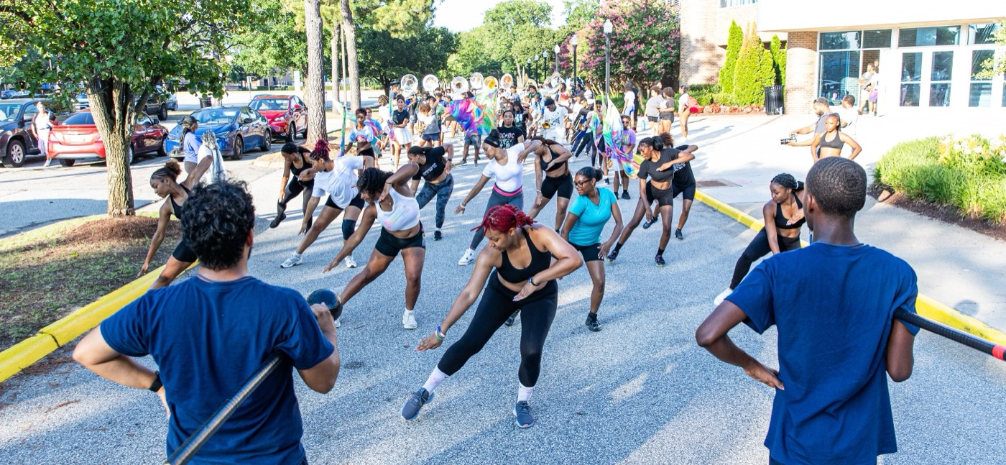
— WELCOME AND VISION
THE HAMPTON UNIVERSITY MARCHING FORCE
The Marching Force Record
Since 2017, under Dr. Jones — the national stages you now carry forward.
Pre-Drill Camp 2026 · Leadership Seminars
07
Notes:
SLIDE 7 — THE MARCHING FORCE RECORD
The national stages since 2017.
"That record is already on the books. You're writing the next chapter."

Slide 8
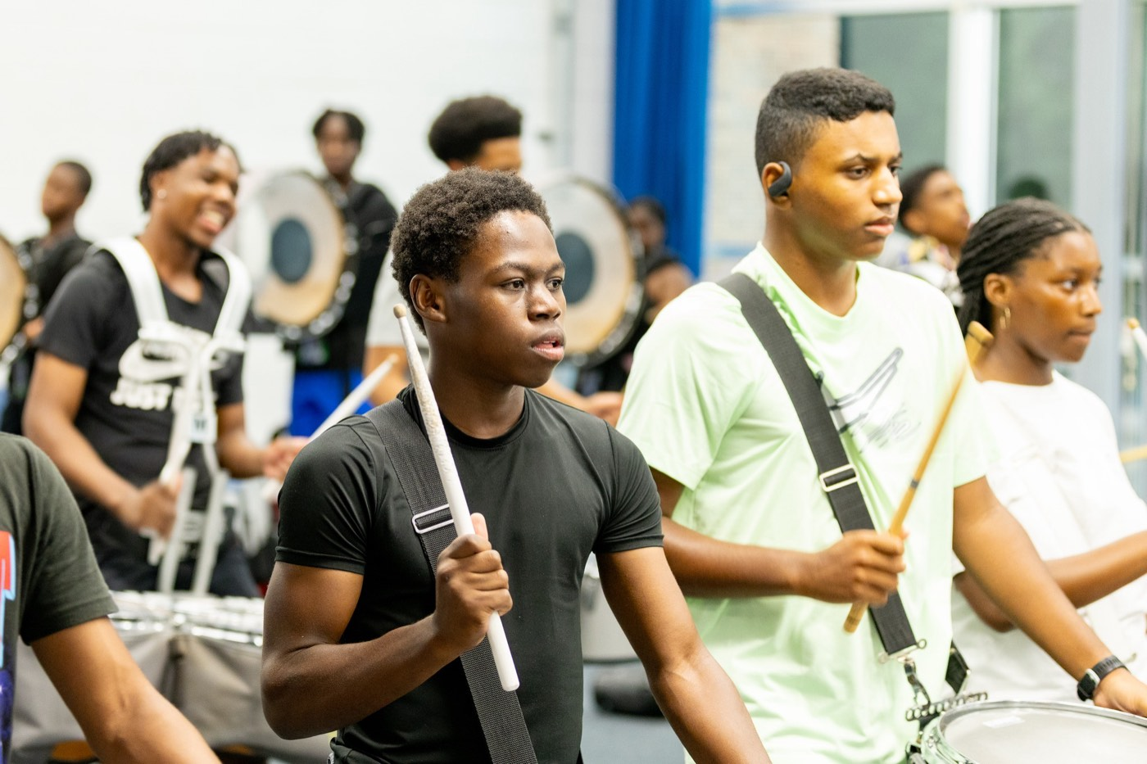
— WELCOME AND VISION
THE HAMPTON UNIVERSITY MARCHING FORCE
A Scholar of His Own Field
Why our vision centers on servant-leadership and anti-hazing.
The through-line: my doctoral dissertation, my Gonzaga thesis, and my 2026 publication all study servant-leadership and preventing hazing in HBCU marching bands—the very program you now help lead. This is not theory to me. It is the standard we will live.
Pre-Drill Camp 2026 · Leadership Seminars
08
Notes:
SLIDE 8 — A SCHOLAR OF HIS OWN FIELD
Why the vision centers on servant-leadership and anti-hazing.
READ THE CALLOUT: the dissertation, the Gonzaga thesis, and the 2026 publication all study servant-leadership and preventing hazing in HBCU marching bands.
THE POINT: "This isn't borrowed philosophy. It's the research, and it's about programs exactly like this one."

Slide 9
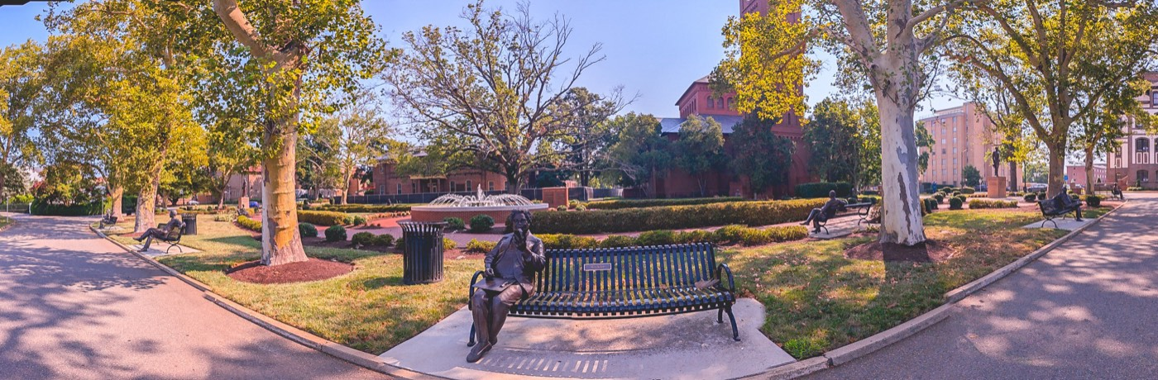
— WELCOME AND VISION
THE HAMPTON UNIVERSITY MARCHING FORCE
A Few Fun Facts
The person behind the podium.
Pre-Drill Camp 2026 · Leadership Seminars
09
Notes:
SLIDE 9 — A FEW FUN FACTS
Lighten it deliberately. The last three slides were heavy on credentials.
CUE: this humanizes you before you ask them for buy-in on purpose, mission, and vision. Don't skip it to save time.

Slide 10
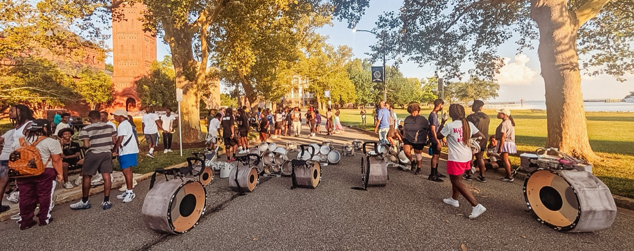
01
OUR PURPOSE
The purpose of The Hampton University Marching Force is to create an enriching musical environment that empowers students to excel as performers, scholars, and leaders. We exist to cultivate discipline, creativity, and character through music while providing experiences that uplift our community, preserve our legacy, and inspire excellence in all areas of life.
WHY WE EXIST.
Notes:
SLIDE 10 — OUR PURPOSE (statement slide)
READ IT VERBATIM. Do not paraphrase, do not shorten. This is the official statement.
Takeaway: "Why we exist."

Slide 11
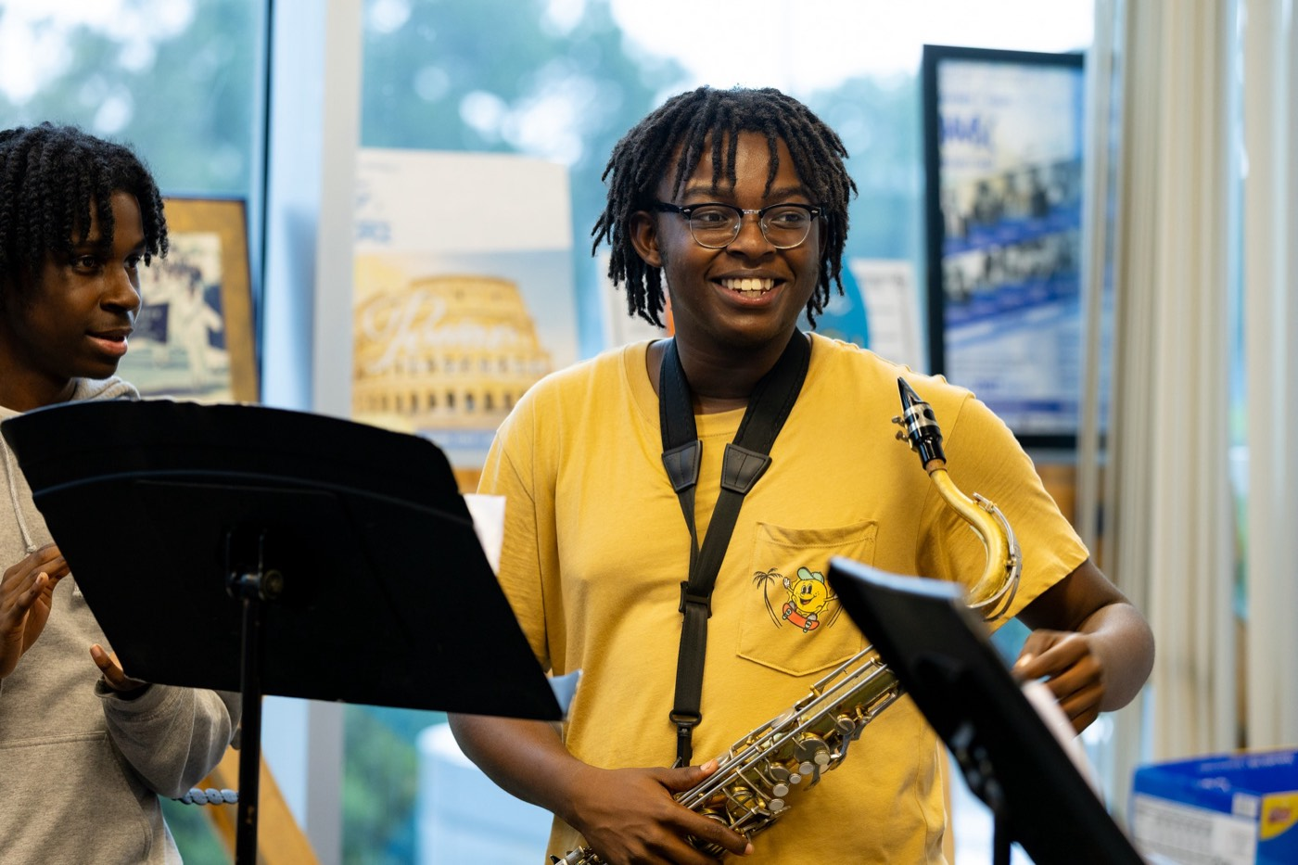
02
OUR MISSION
The mission of The Hampton University Marching Force is to deliver world-class performances that reflect the heritage and pride of Hampton University, foster academic and personal growth among our members, and develop students into leaders of integrity and high moral character. Through rigorous musicianship, servant-leadership, and a commitment to excellence, we prepare our students to succeed on the field, in the classroom, and in their future endeavors.
WHAT WE DO.
Notes:
SLIDE 11 — OUR MISSION (statement slide)
READ IT VERBATIM.
Takeaway: "What we do."

Slide 12
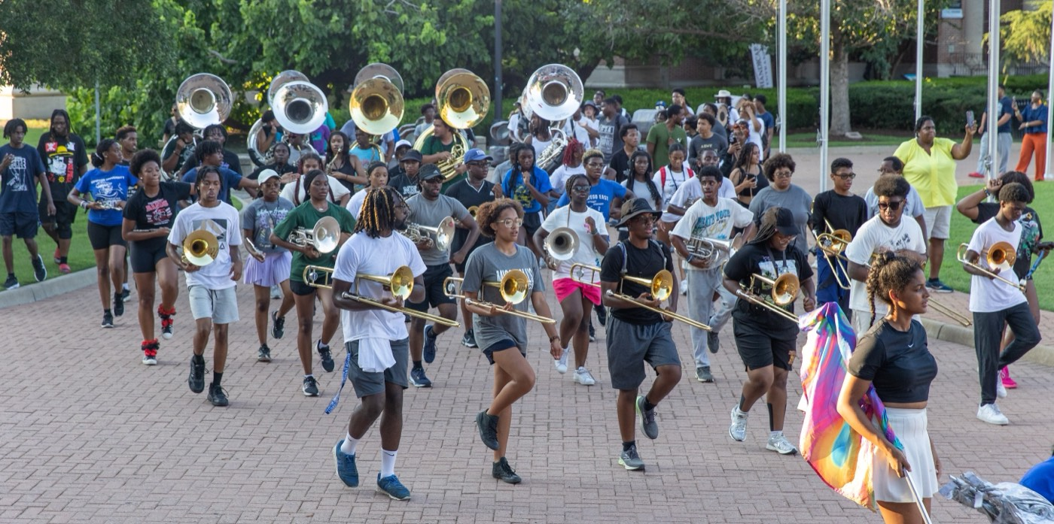
03
OUR VISION
The Hampton University Marching Force envisions a dynamic, inclusive, and inspiring musical community that balances excellence in musical performance with academic achievement and personal growth. We strive to deliver captivating performances that celebrate our legacy and uplift our audiences, all while fostering a culture of discipline, creativity, and joy. Through music, servant-leadership, and meaningful experiences, we develop students of strong moral character who lead with integrity, perform with passion, and succeed with purpose—on the field, in the classroom, and beyond.
WHERE WE ARE GOING.
Notes:
SLIDE 12 — OUR VISION (statement slide)
READ IT VERBATIM.
Takeaway: "Where we are going."
CUE: after all three, pause and ask if anything in them is unclear. These three statements govern every decision this year — it's worth the minute.

Slide 13
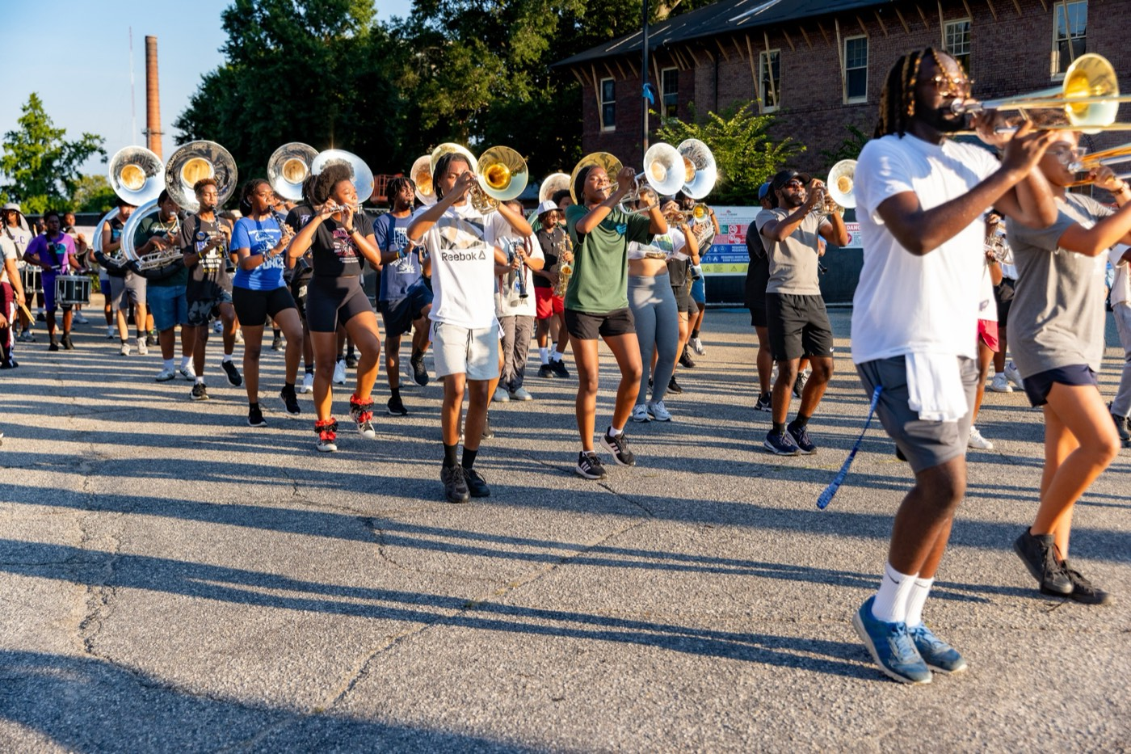
—
Pre-Drill Camp 2026 · Leadership Seminars
13
Notes:
SLIDE 13 — OPTIMIZE (the reveal)
Dark full-bleed word slide. Let it land before you say anything.
SAY: "This year's watchword. One word: OPTIMIZE."
Don't explain it yet — the next slide does.

Slide 14
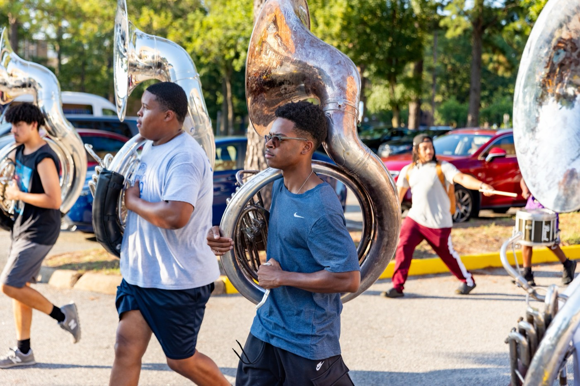
— WELCOME AND VISION
THE HAMPTON UNIVERSITY MARCHING FORCE
What OPTIMIZE Means
Run the program like a tighter ship—top to bottom.
01
Processes
Tighten how we operate. Clear steps, clear standards, repeatable results—so nothing runs on guesswork.
Pre-Drill Camp 2026 · Leadership Seminars
14
Notes:
SLIDE 14 — WHAT OPTIMIZE MEANS
Four: Processes, Accountability, Efficiency, A Tighter Ship.
MAKE IT CONCRETE: "Waste nothing — not a rep, not a minute, not a member's talent."
ASK: "Name one thing in your section that is not optimized right now." Take three answers. Write them down — they're your fix list.

Slide 15
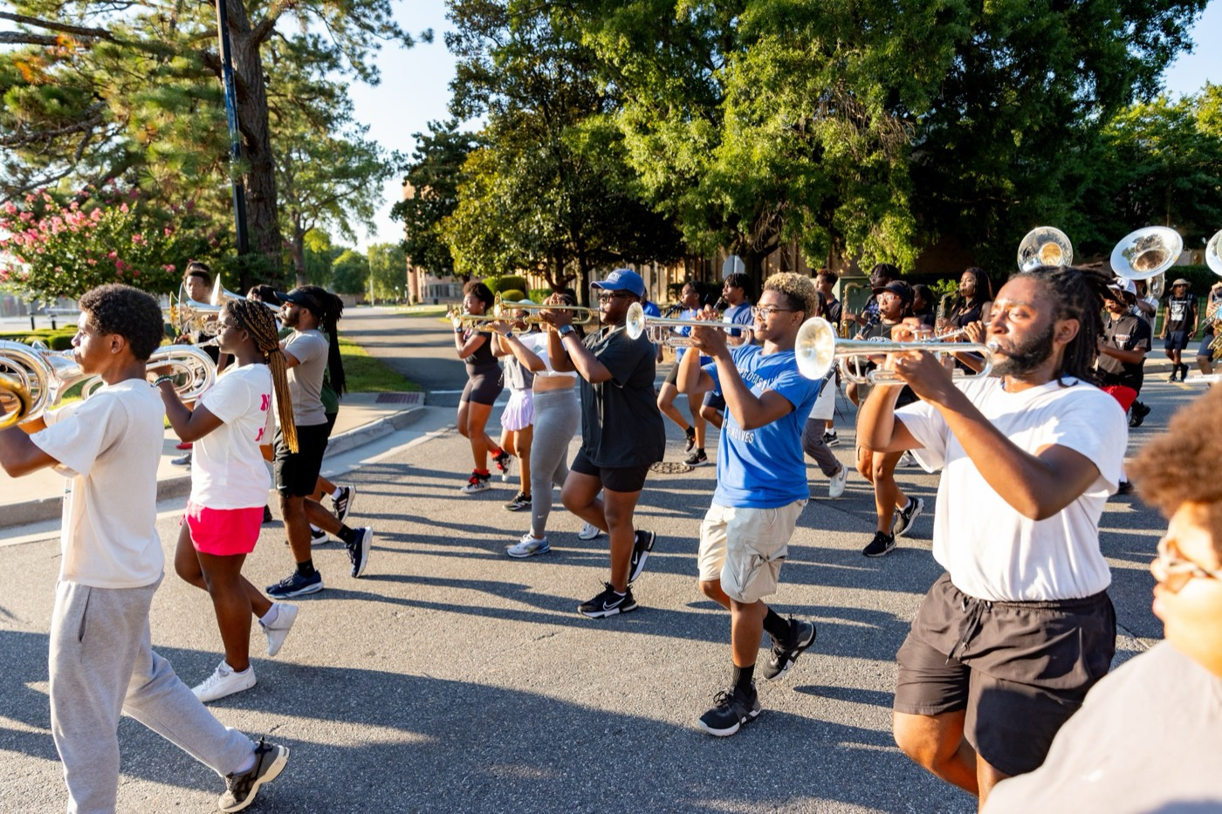
— WELCOME AND VISION
THE HAMPTON UNIVERSITY MARCHING FORCE
From the Handbook — The Standard
The Hampton University Code of Conduct we all model.
◆ Respect yourself—carry maturity, self-respect, and pride in the legacy.
◆ Respect the dignity, feelings, worth, and values of others.
◆ Foster a personal, professional work ethic—strive for efficiency and a spirit to serve.
◆ Foster an open, fair, and caring environment where ideas are shared and everyone is treated fairly.
◆ Respect the rights and property of others—no member shall lie, cheat, or steal.
Servant-leadership: the leader serves first; authority is earned through care, not title.
Pre-Drill Camp 2026 · Leadership Seminars
15
Notes:
SLIDE 15 — FROM THE HANDBOOK: THE STANDARD
The Hampton Code of Conduct. Read the five.
READ THE CALLOUT: "Servant-leadership — the leader serves first; authority is earned through care, not title."
FLAG IT: "That's a whole session tomorrow. Hold it."

Slide 16
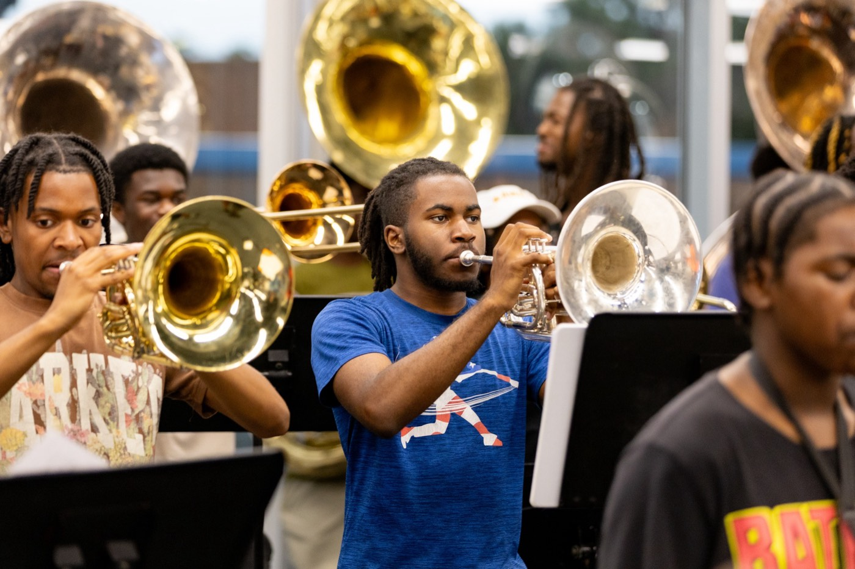
— WELCOME AND VISION
THE HAMPTON UNIVERSITY MARCHING FORCE
From the Handbook — Our Culture
How we treat each other is the program.
◆ Anti-hazing: belonging without cruelty. We build bonds on respect, not fear.
◆ The battle-buddy system: we monitor, help, and account for one another—no one moves alone.
◆ Academics = eligibility: the GPA is a condition to lead. We protect study time.
◆ Chain of command: know it, use it, and model it—on the field and on social media.
Pre-Drill Camp 2026 · Leadership Seminars
16
Notes:
SLIDE 16 — FROM THE HANDBOOK: OUR CULTURE
Anti-hazing: belonging without cruelty.
The battle-buddy system: we monitor, help, and account for one another — nobody moves alone.
CUE: this connects straight to Last Out on Sunday. Plant it now.

Slide 17
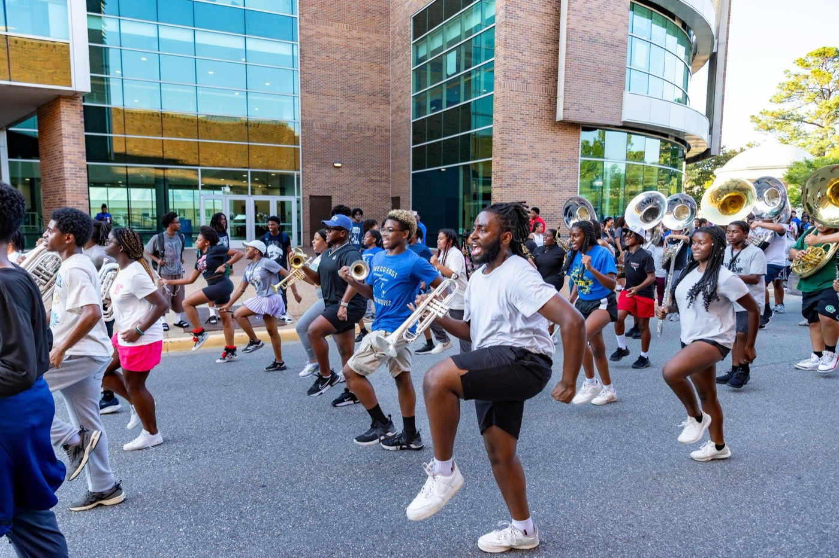
— WELCOME AND VISION
THE HAMPTON UNIVERSITY MARCHING FORCE
The 2026 Season
Where the standard shows up—every Saturday.
Pre-Drill Camp 2026 · Leadership Seminars
17
Notes:
SLIDE 17 — THE 2026 SEASON
Walk the schedule. Note the Norfolk State gym battle on October 17.
"This is where the standard shows up — every Saturday."

Slide 18
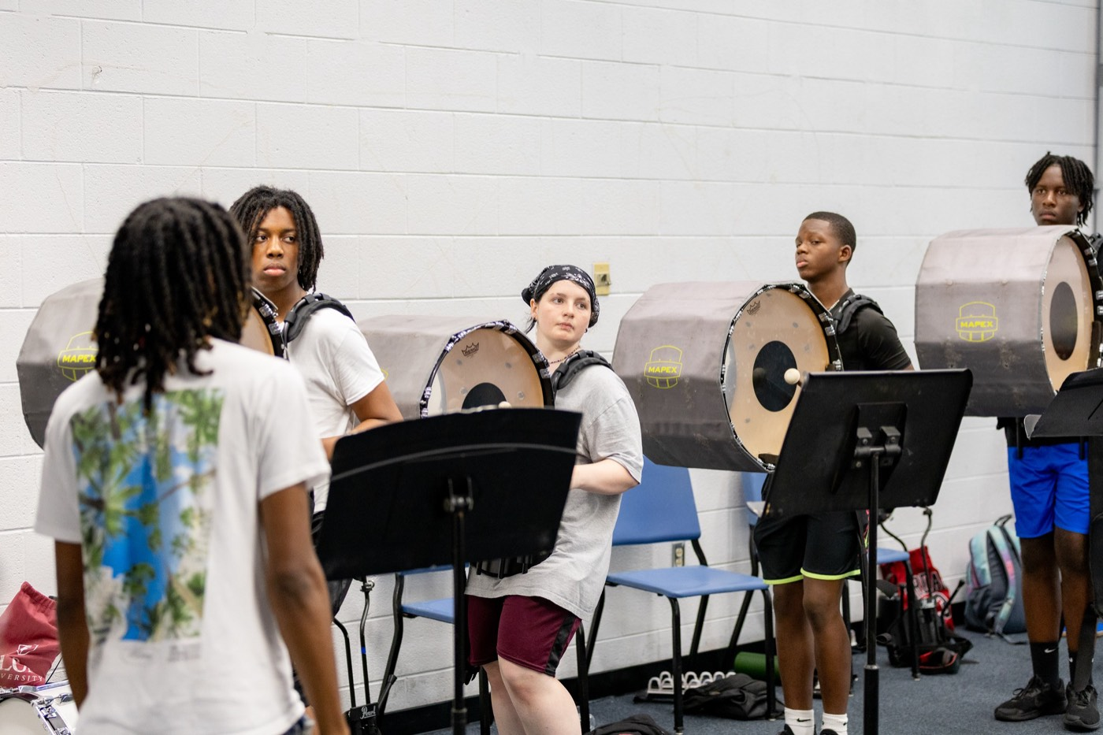
— WELCOME AND VISION
THE HAMPTON UNIVERSITY MARCHING FORCE
The Weekend Ahead — Day 1
Saturday, August 1 · "The Standard and The Why"
Pre-Drill Camp 2026 · Leadership Seminars
18
Notes:
SLIDE 18 — THE WEEKEND AHEAD, DAY 1
Preview today's sessions so they can pace themselves.
Name the presenters where they aren't you.

Slide 19
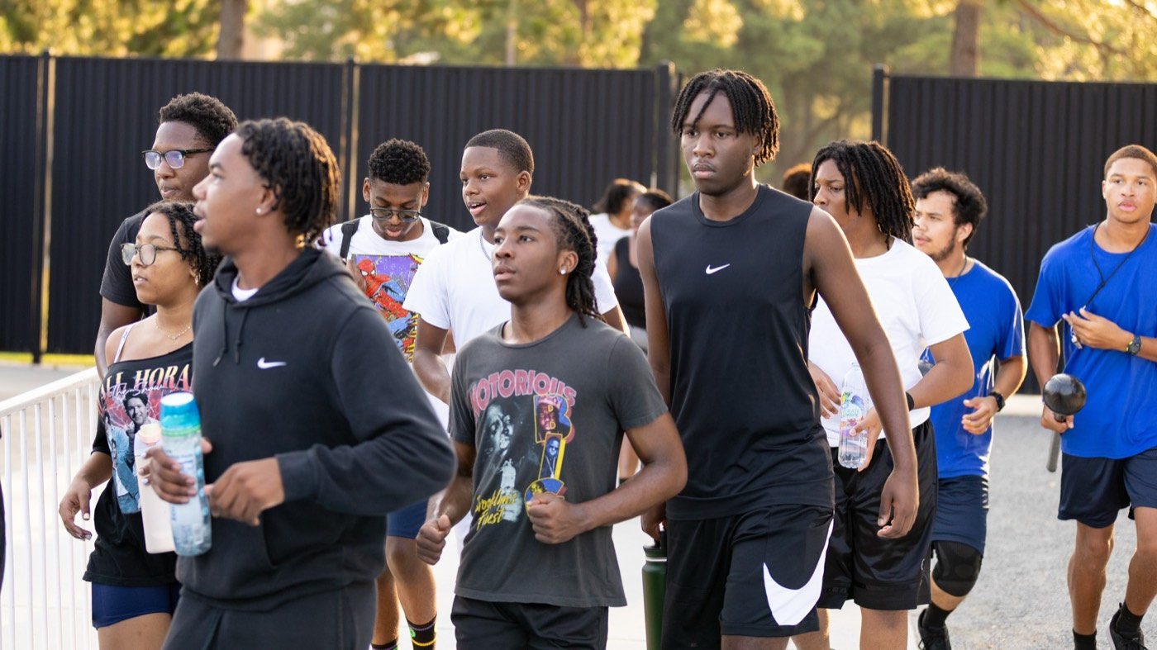
— WELCOME AND VISION
THE HAMPTON UNIVERSITY MARCHING FORCE
The Weekend Ahead — Day 2
Sunday, August 2 · "Applied Leadership and Camp Readiness"
Pre-Drill Camp 2026 · Leadership Seminars
19
Notes:
SLIDE 19 — THE WEEKEND AHEAD, DAY 2
Preview Sunday, including the breakouts and the guest presenters — Mr. Jae Brown, Coach Megan and Coach Brint, and the student-led sessions.
Give report time and location for tomorrow.

Slide 20
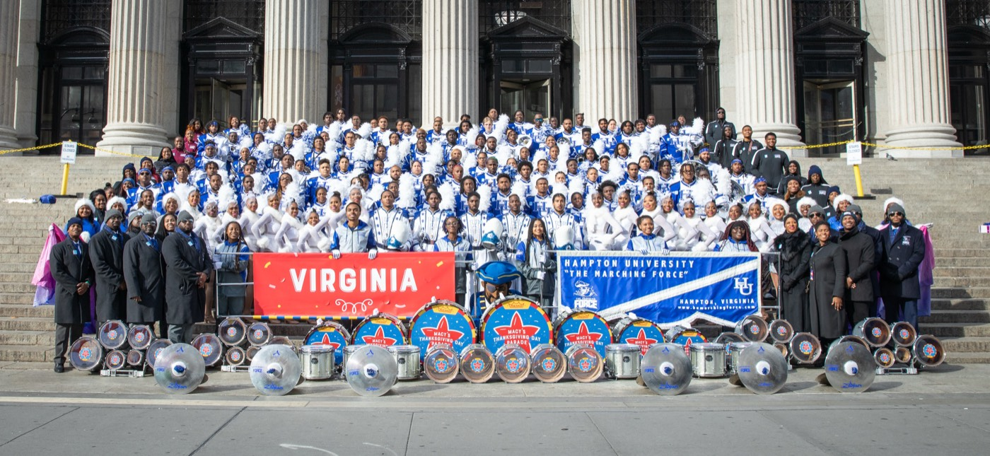
YOUR CHARGE
Set the Standard.
Lead the Week.
Optimize your section—your processes, your accountability, your efficiency. Live the mission, model the standard, and give the membership a team worth following.
Serve First. Lead Always. — Drive the Legacy.
The Hampton University Marching Force
Hampton's Heartbeat
Notes:
SLIDE 20 — CLOSE: Set the Standard. Lead the Week.
"Optimize your section — your processes, your accountability, your efficiency."
End on the sign-off, then go straight into Know Yourself First.

